Slide 1
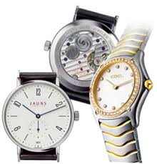
What time is it?

Slide 2
What time is it?
It is six o‘clock.
b. It is sixteen o‘clock.

Slide 3
What time is it?
It is one o‘clock.

Slide 4
What time is it?
It is twelve o‘clock.

Slide 5
What time is it?
It is five o‘clock.

Slide 6
What time is it?
It is twelve o‘clock.

Slide 7
What time is it?
It is eight o‘clock.

Slide 8
What time is it?
It is nine o‘clock.

Slide 9
What time is it?
It is four o‘clock.

Slide 10
Great!

