Slide 1
JOBS

Slide 2


farmer

Slide 3
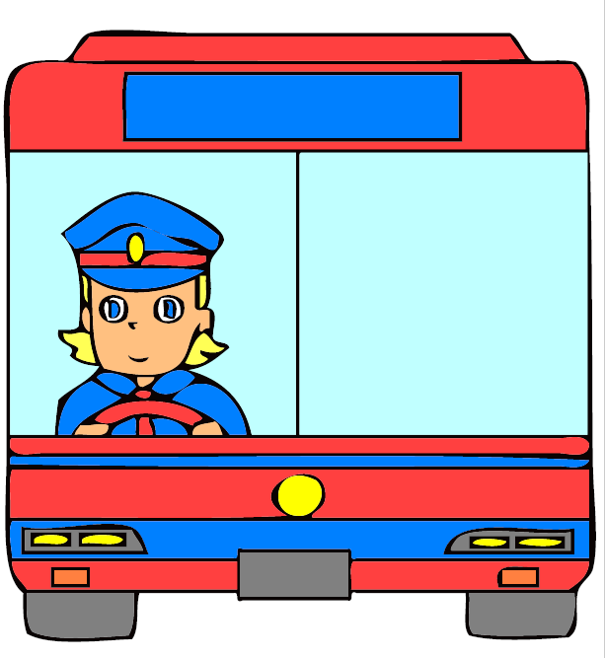
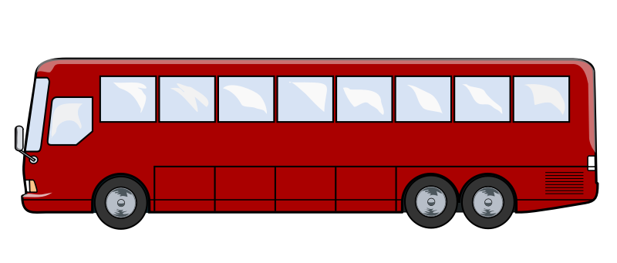
bus driver

Slide 4


dentist

Slide 5


police officer

Slide 6
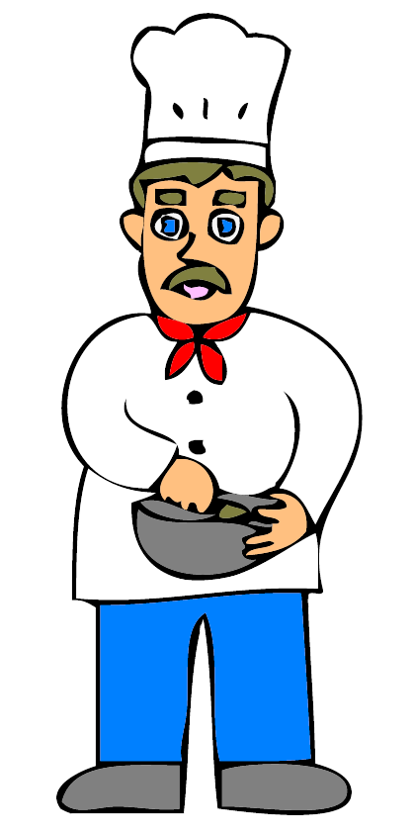

cook

Slide 7

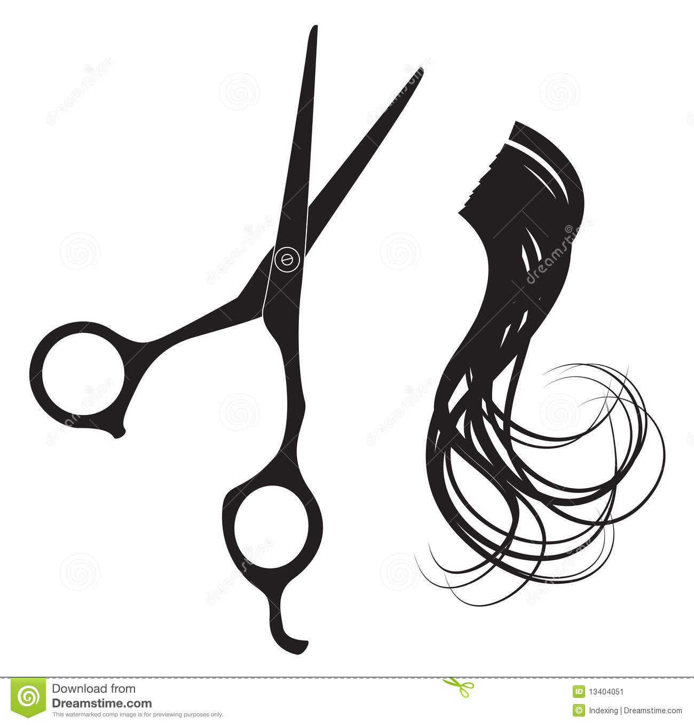
hairdresser

Slide 8


doctor

Slide 9


teacher

Slide 10
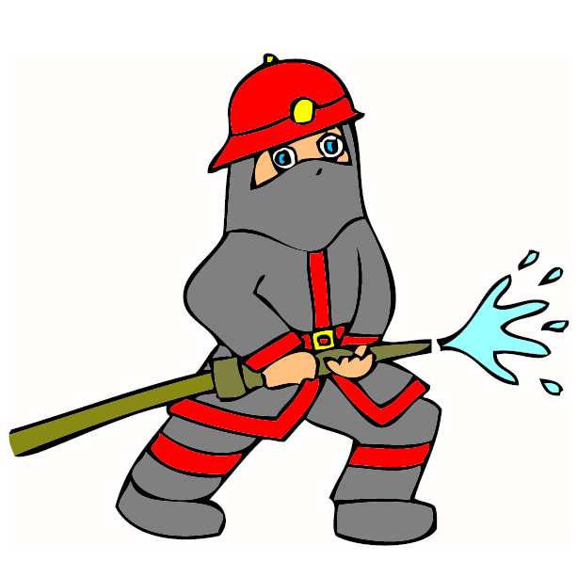

firefighter

Slide 11


nurse

