Slide 1
Števni in neštevni samostalniki
How many?/How much?
manjše količine

Slide 2
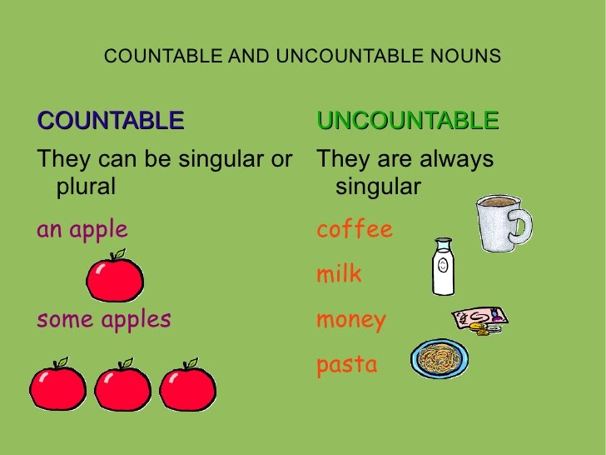
some

Slide 3
Countable/Uncounable nouns
(števni/neštevni samostalniki)
?
+
-
singular (ednina) plural (množina)
a/an some
How many? (Koliko? po številu)
Are there any?
nekaj (po številu)
Yes, there are some.
Yes, there are a lot of.
No, there aren’t any.
There are no oranges.
some (milk)
How much? (Koliko? po količini)
Is there any (milk)?
nekaj (po količini)
Yes, there is some.
No, there isn’t any.
There is no milk.

Slide 4
Can I have a tomato?
Can I have some milk, please?
Would you like some apples?
Would you like some apple juice?
Če ponujamo, prosimo, ostane tudi v vprašalnicah SOME.

Slide 5
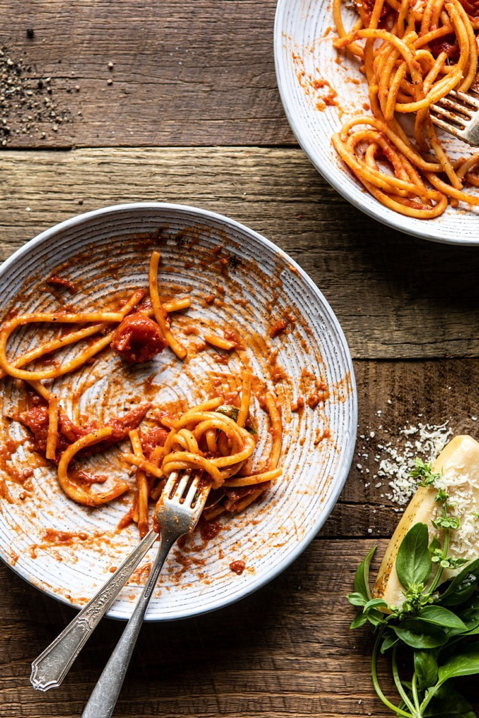
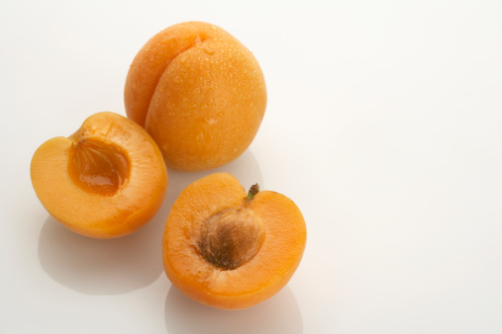
How many? How much?

Slide 6
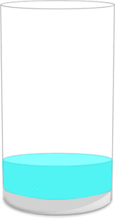
How much?
not much
only a little
uncountable

Slide 7
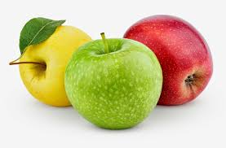
How many?
not many
only a few
countable

