Slide 1

ANIMALS COUNT
COUNT THE ANIMALS

Slide 2
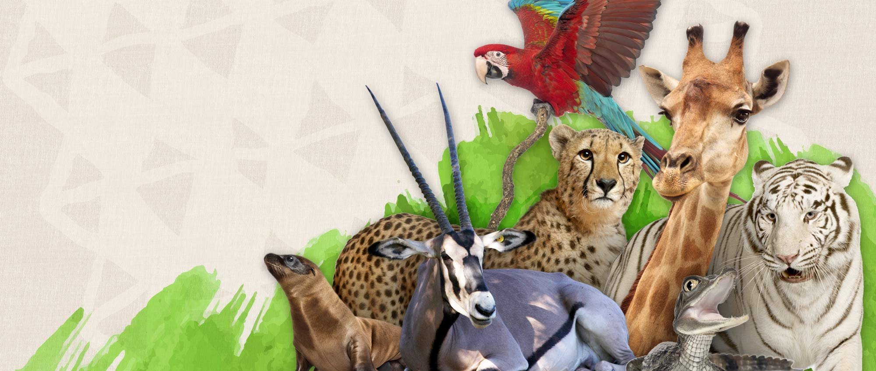

Slide 3
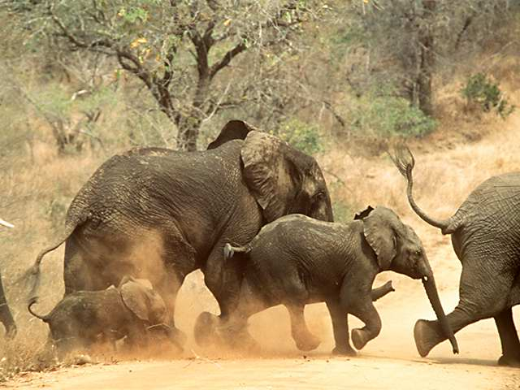

Slide 4
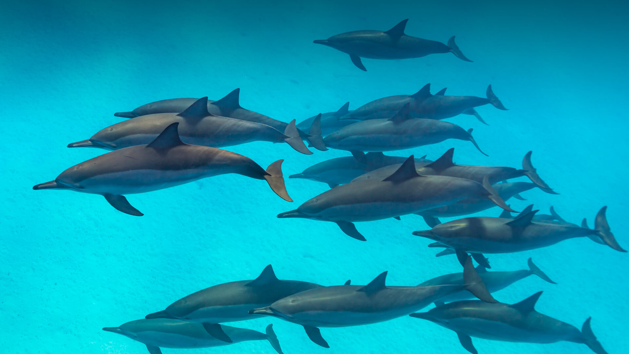

Slide 5
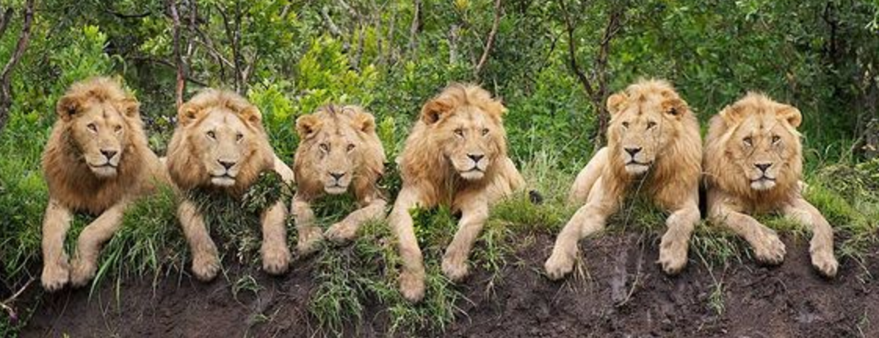

Slide 6
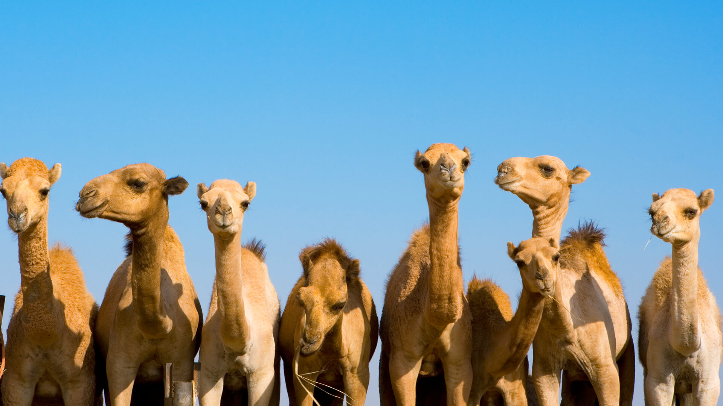

Slide 7
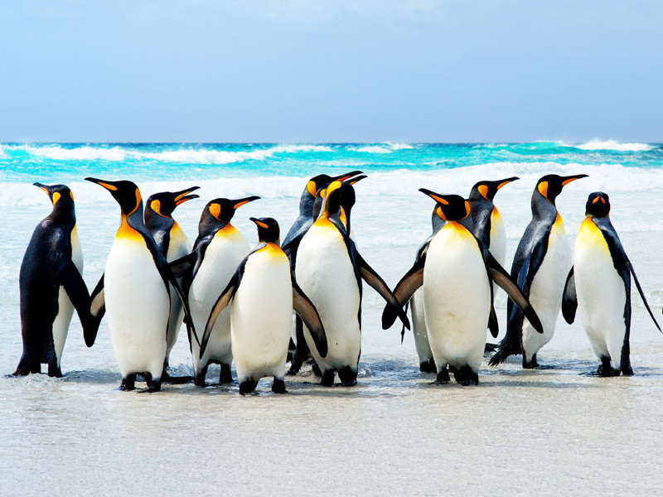

Slide 8
HOW MANY ANIMALS?
7 4 17 6 8 11
53

