Slide 1

Vehicles
(vozila)

Slide 2


VEHICLES (VOZILA)
POIZKUSI POIMENOVATI VOZILA NA SLIKI.
ČE IMAŠ TEŽAVE, SI POMAGAJ Z ZVOČNIKOM IN SLIŠAL BOŠ PRAVILNO BESEDO ZA VOZILO NA SLIKI.
HAVE FUN ☺!!!

Slide 3
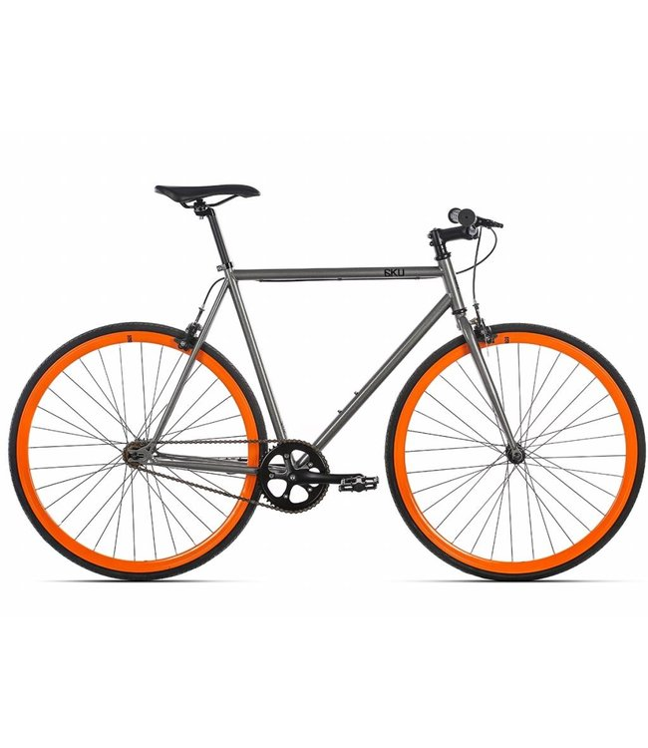

WHAT CAN YOU SEE ON THE PICTURE?

Slide 4
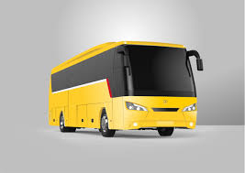
WHAT CAN YOU SEE ON THE PICTURE?

Slide 5
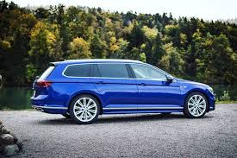
WHAT CAN YOU SEE ON THE PICTURE?

Slide 6
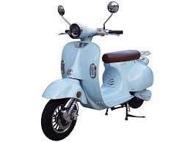
WHAT CAN YOU SEE ON THE PICTURE?

Slide 7
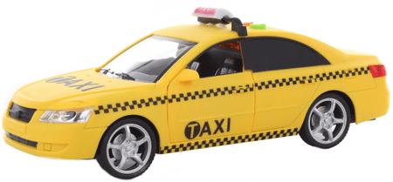
WHAT CAN YOU SEE ON THE PICTURE?

Slide 8
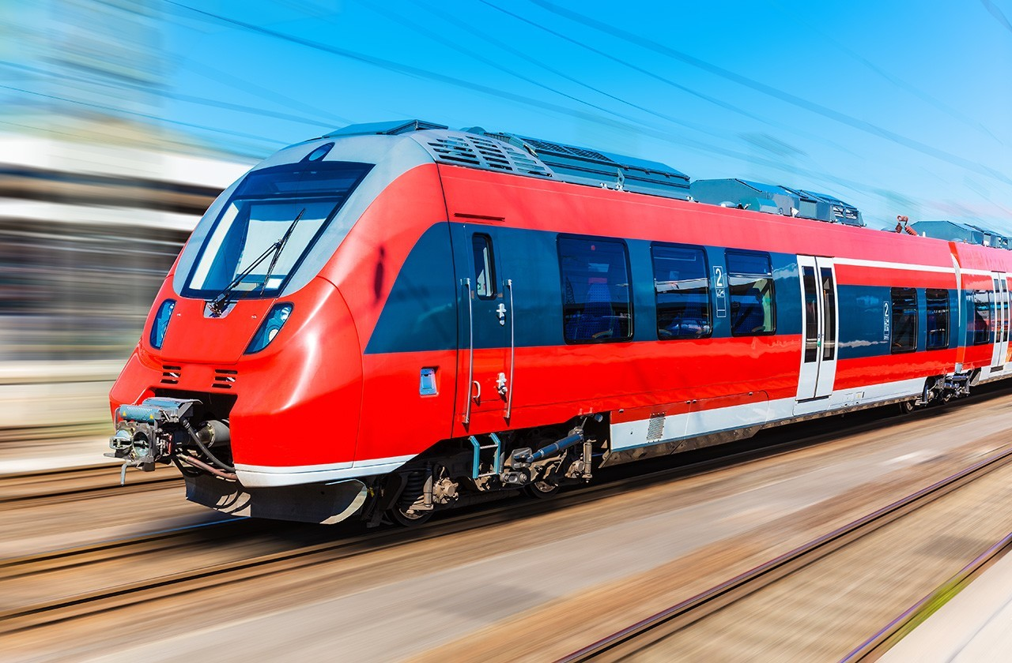
WHAT CAN YOU SEE ON THE PICTURE?

Slide 9
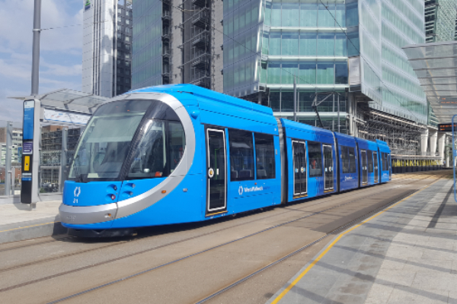
WHAT CAN YOU SEE ON THE PICTURE?

Slide 10
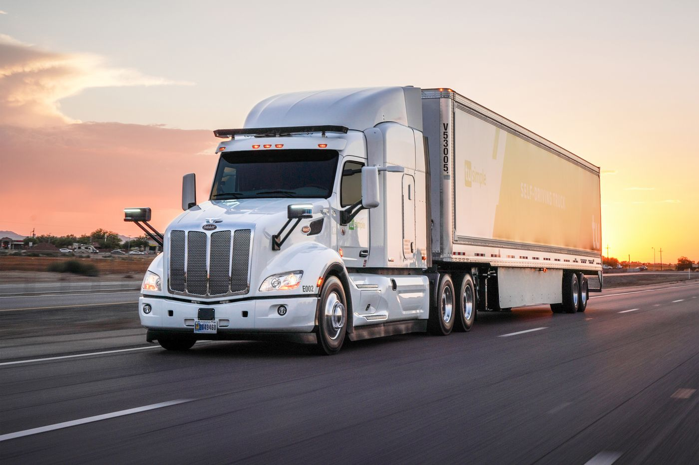
WHAT CAN YOU SEE ON THE PICTURE?

Slide 11
DODATNA NALOGA!!!
PREDSTAVITEV POGLEJ ŠE ENKRAT IN POVEJ ŠE KAKŠNE BARVE JE VOZILO!

Slide 12
WHAT CAN YOU SEE ON THE PICTURE?

Slide 13
WHAT CAN YOU SEE ON THE PICTURE?

Slide 14
WHAT CAN YOU SEE ON THE PICTURE?

Slide 15
WHAT CAN YOU SEE ON THE PICTURE?

Slide 16
WHAT CAN YOU SEE ON THE PICTURE?

Slide 17
WHAT CAN YOU SEE ON THE PICTURE?

Slide 18
WHAT CAN YOU SEE ON THE PICTURE?

Slide 19
WHAT CAN YOU SEE ON THE PICTURE?

Slide 20

GOOD JOB!!!!

