Slide 1

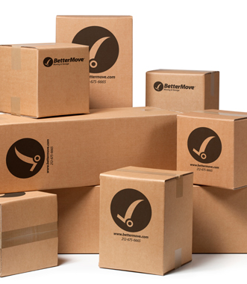
PREPOSITIONS OF PLACE
NAHAJANJE PREDMETOV

Slide 2
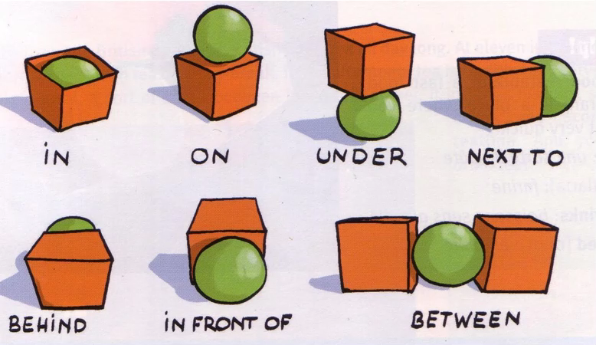


Slide 3

The ball is in the box.

Slide 4
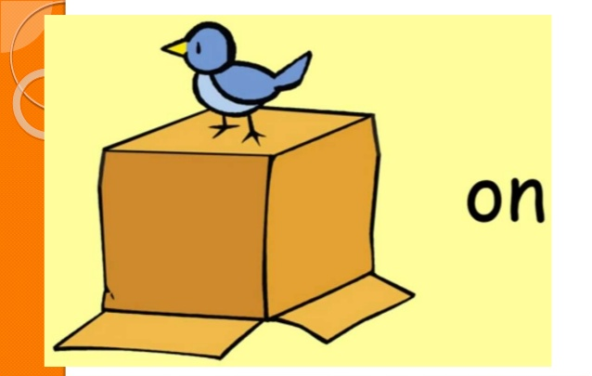
The bird is on the box.

Slide 5
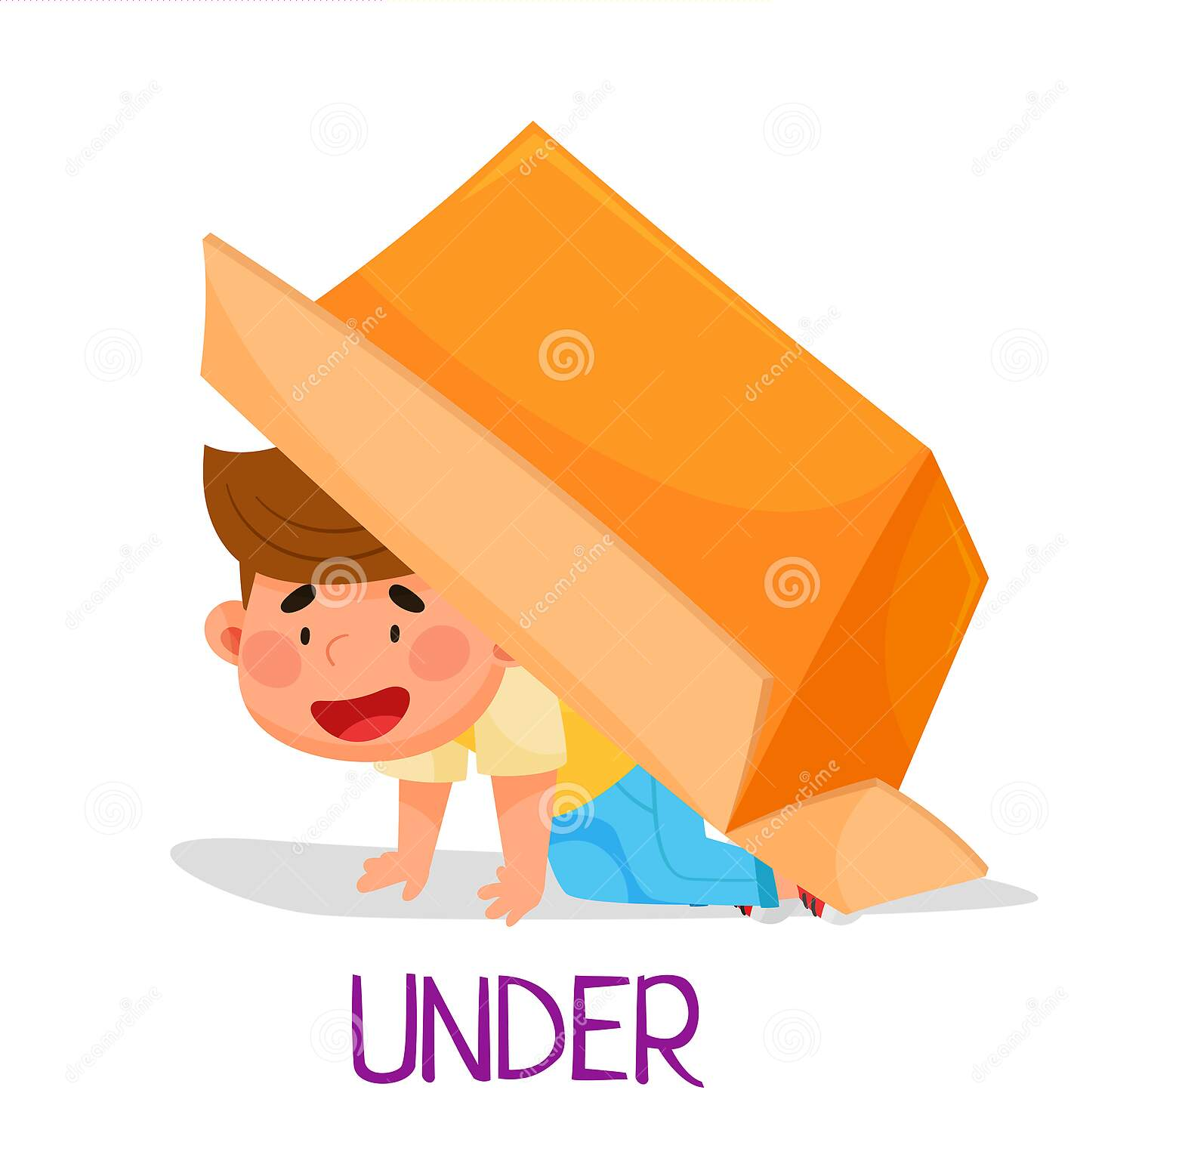
The boy is under the box.

Slide 6
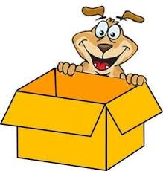
The dog is behind the box.

Slide 7
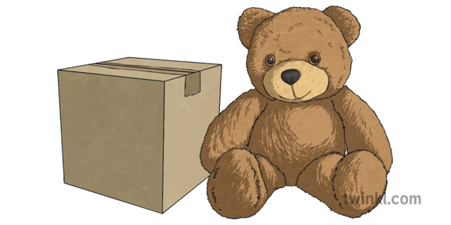
The bear is next to the box.

Slide 8

The girl is in front of the box.

Slide 9

The mouse is between the boxes.

