Slide 1
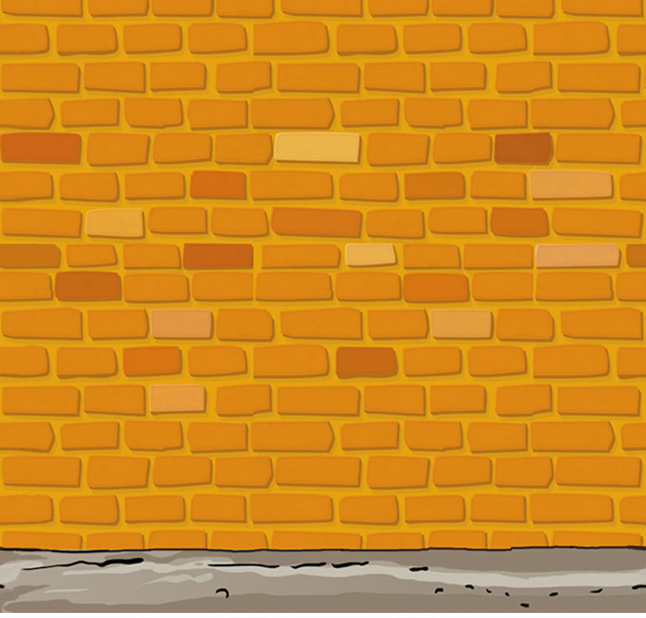


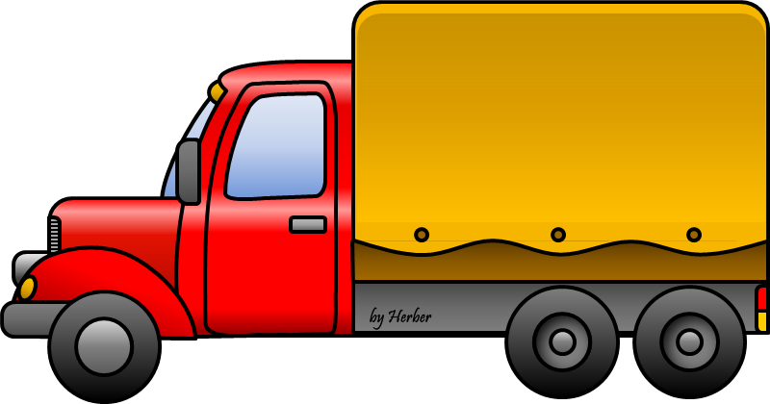
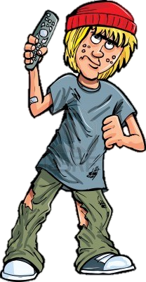
MEANS
OF
TRANSPORT
PLAY

Slide 2
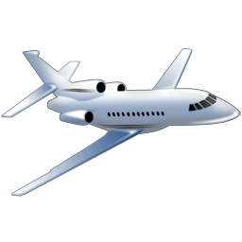


OH YEAH!
CLICK ON THE SPEAKER AND GUESS THE MEAN OF TRANSPORT CORRESPONDING TO THE SOUND
plane
helicopter
train

Slide 3
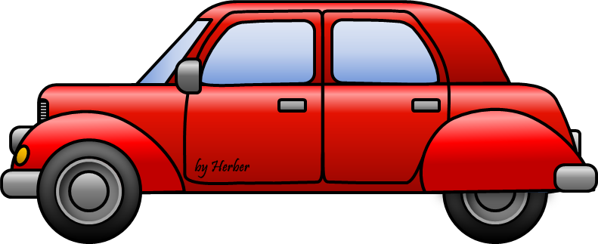
OH YEAH!
train
motorbike
car

Slide 4
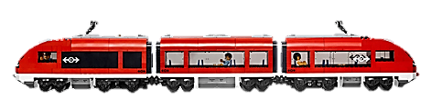

OH YEAH!
bus
motorbike
train

Slide 5
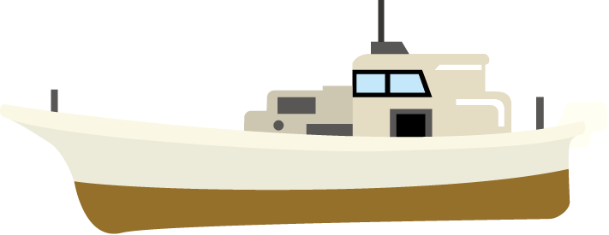

OH YEAH!
rocket
boat
bus

Slide 6
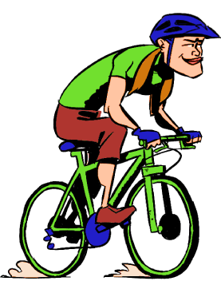

OH YEAH!
boat
bike
motorbike
EXIT

