Slide 1
Nature in the autumn
Narava jeseni

Slide 2

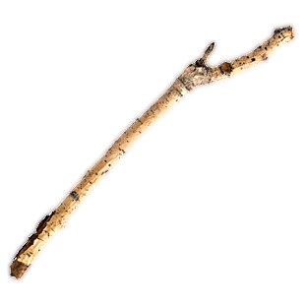
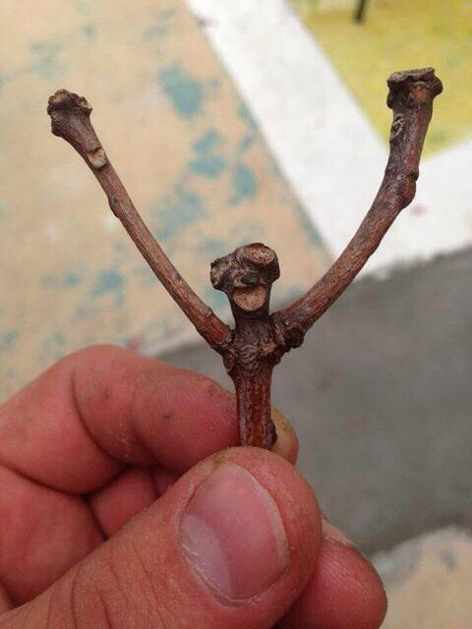
THIS IS A TWIG OR A STICK. – WELL, I SEE TWO STICKS!
This is a twig or a stick. (vejica) – Well, I see two (2) sticks!

Slide 3
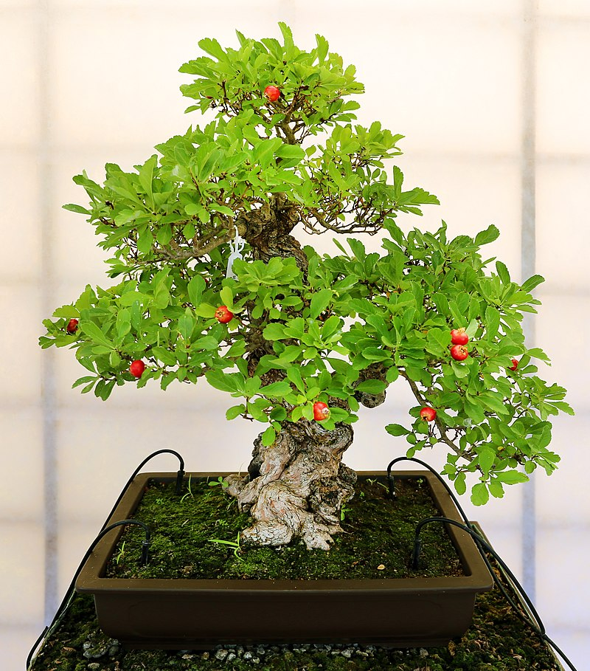
THIS IS A VERY SMALL TREE. – A BONSAI TREE.
This is a very small tree. – A bonsai tree.

Slide 4
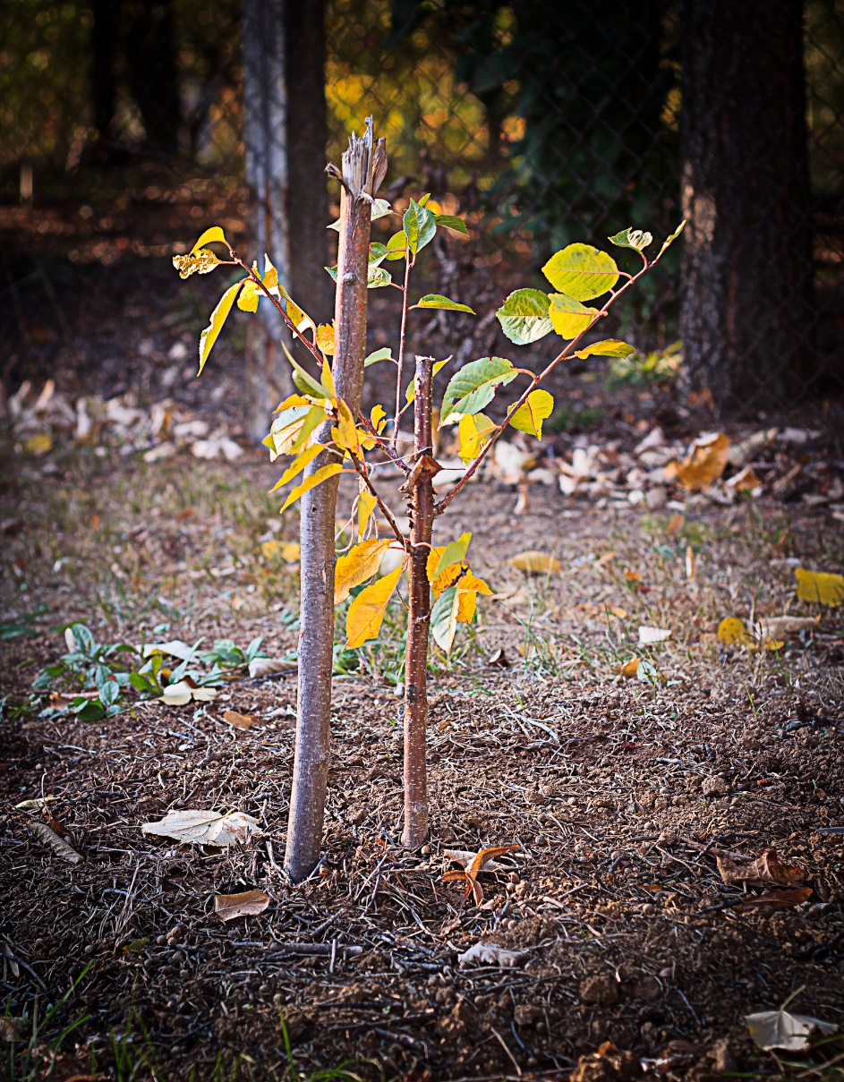
THIS IS A SMALL TREE, A YOUNG TREE.
This is a small tree, a young tree. (Majhno, mlado drevo.)

Slide 5
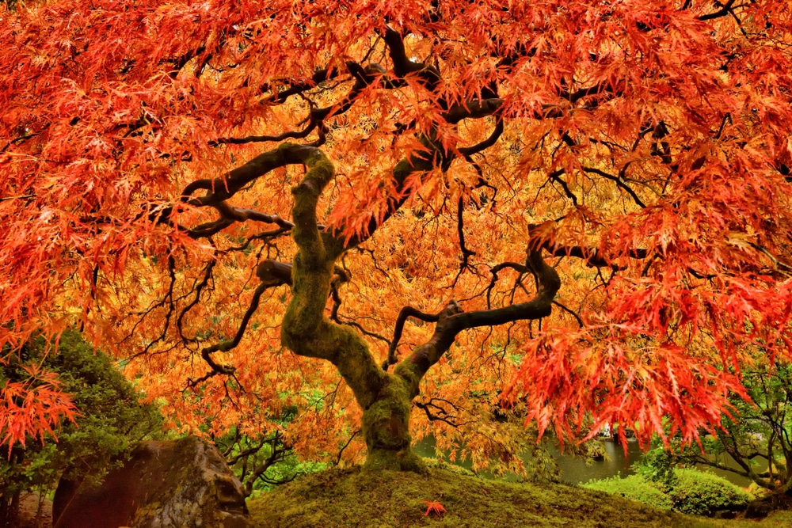
THIS IS A BIG TREE!
This is a big tree!

Slide 6
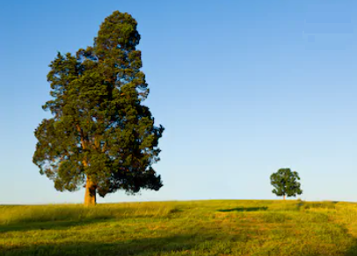
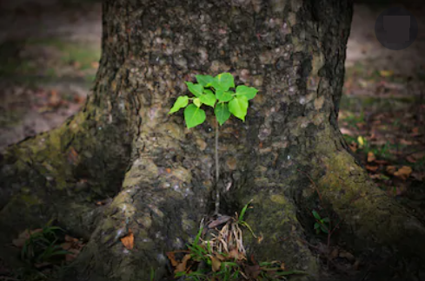
TREES GROW FROM SMALL TO BIG.
Trees grow from small to big.
Drevesa rastejo od majhnega do velikega.
Drevesa rastnejo od mladega do starega.
TREES GROW FROM YOUNG TO OLD.
Trees grow from young to old.

Slide 7
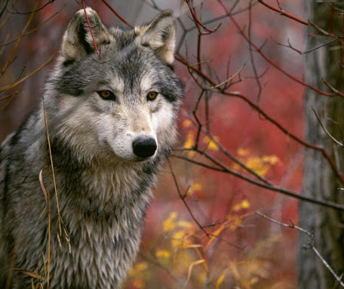
ONE WOLF

Slide 8
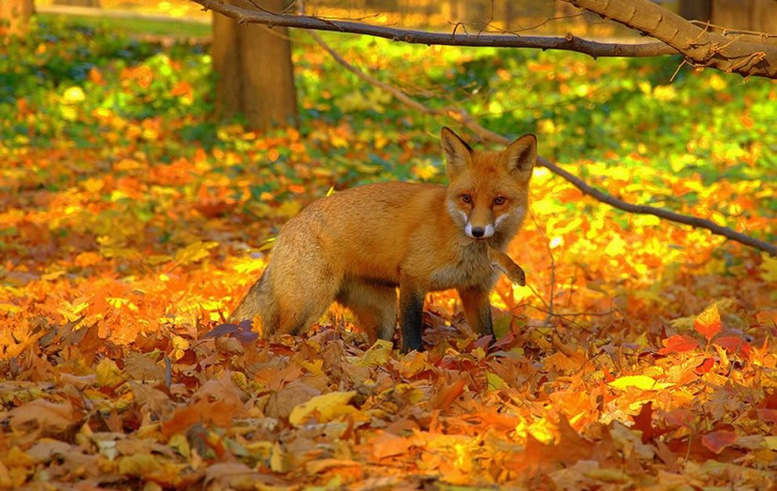
A MOLE
A FOX
AND A MOUSE

Slide 9
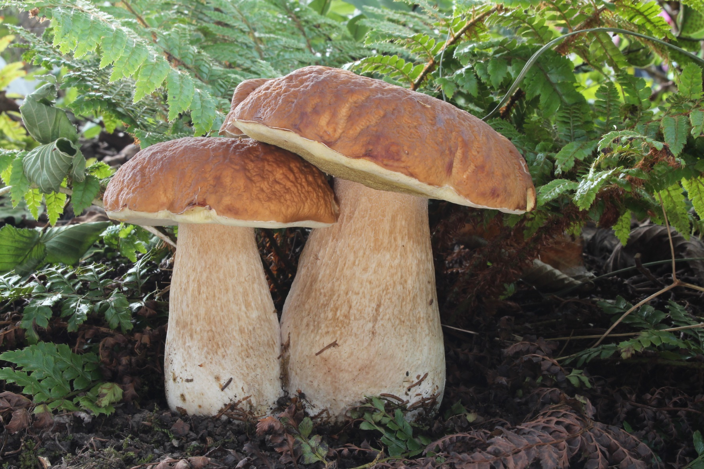
TWO MUSHROOMS

Slide 10
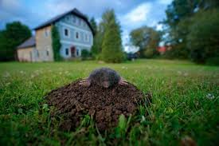
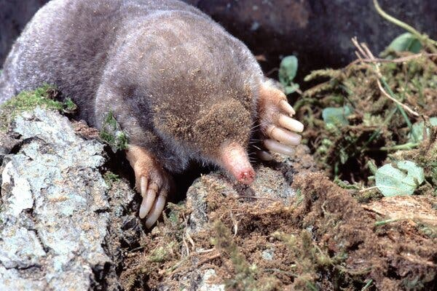
A MOLE - TWO MOLES

Slide 11
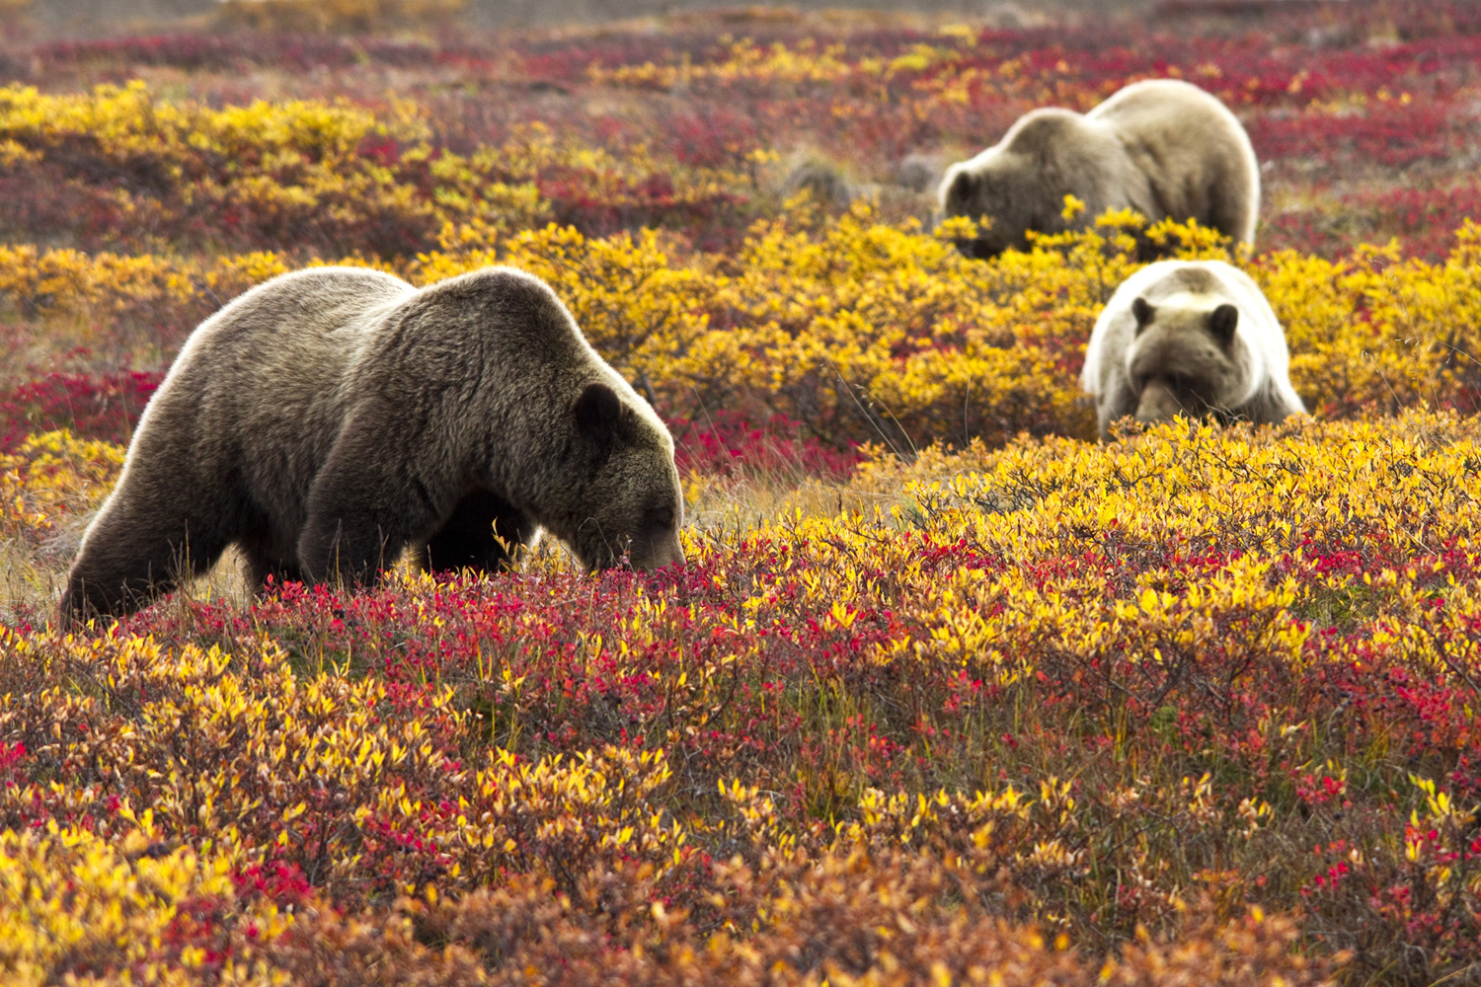
A BEAR - THREE BEARS

Slide 12
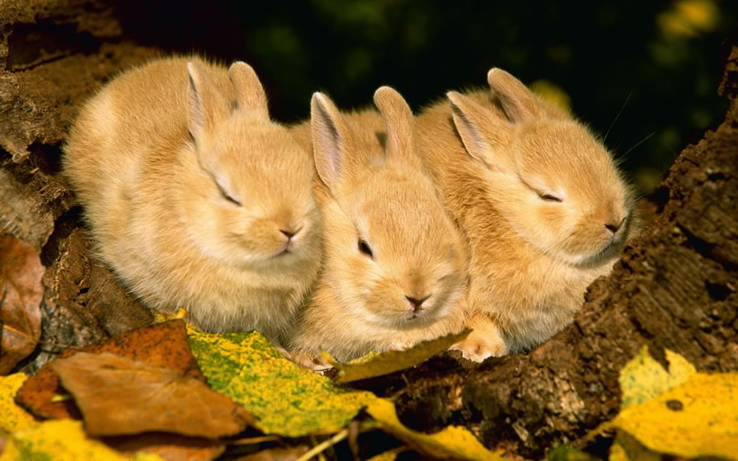
A RABBIT - THREE RABBITS

Slide 13
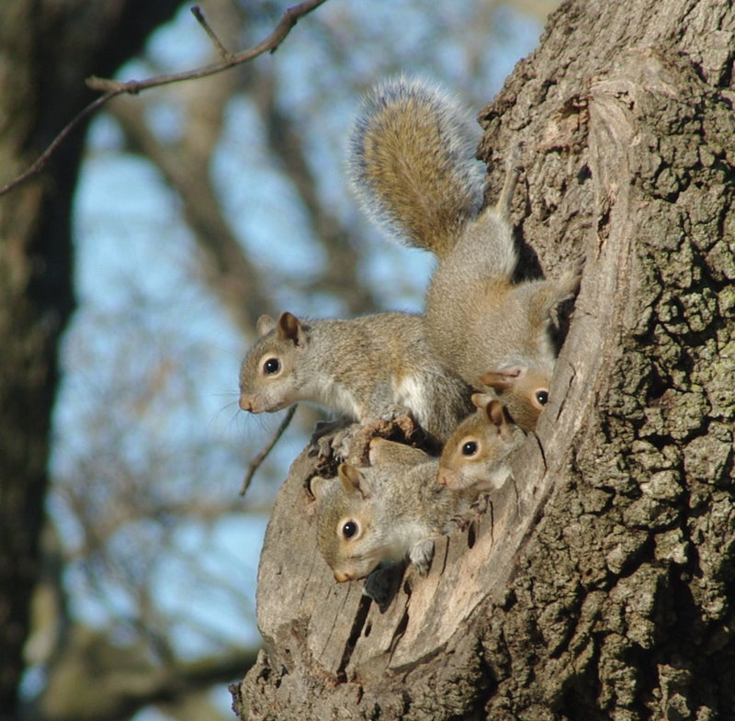
A SQUIRREL -
ARE THERE THREEE SQUIRRELS OR FOUR SQUIRRELS?
THE ANSWER
ODGOVOR:

Slide 14
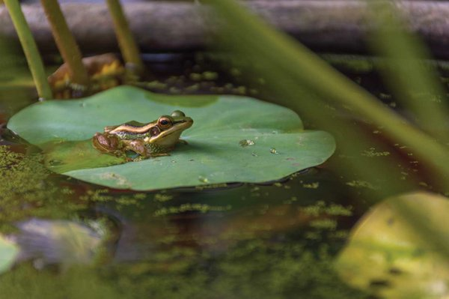
A FROG

Slide 15
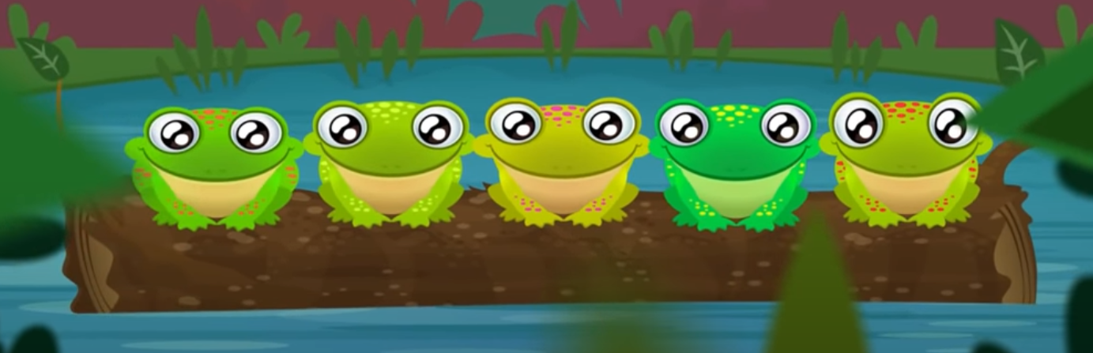
5 GREEN AND SPECKLED FROGS
5 ZELENIH IN PEGASTIH ŽABIC
SAT ON A SPECKLED LOG …
JE SEDELO NA PEGASTEM HLODU ...
KLIKNITE NA POVEZAVO, SI OGLEJTE IN POSLUŠAJTE, NATO PA SI POJTE ZRAVEN,
ČE VAS JE VEČ, SE LAHKO IGRATE ŽAB, KI SKAČEJO V RIBNIK!
https://www.youtube.com/watch?v=ziGG_L9C12o

