Slide 1

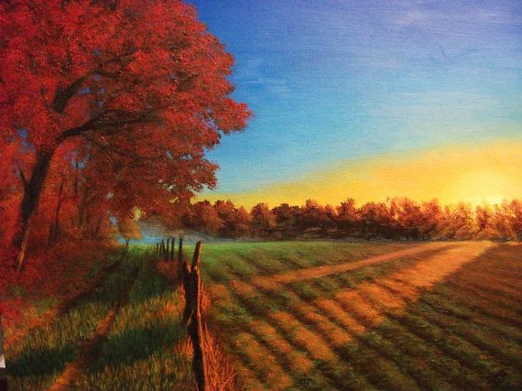


AUTUMN
FALL
JESEN
THIS IS A FIELD IN THE AUTUMN.

Slide 2
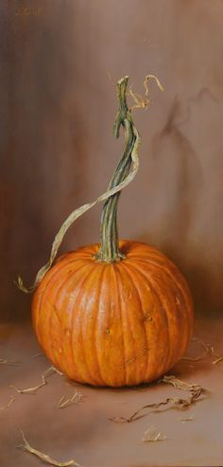
A PUMPKIN

Slide 3
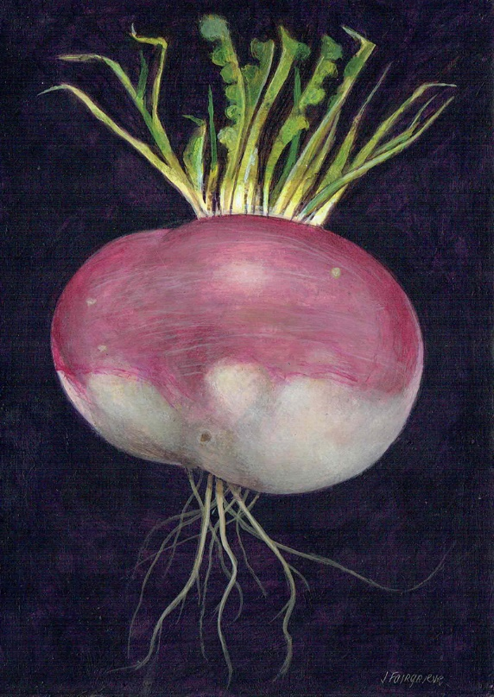
A TURNIP

Slide 4
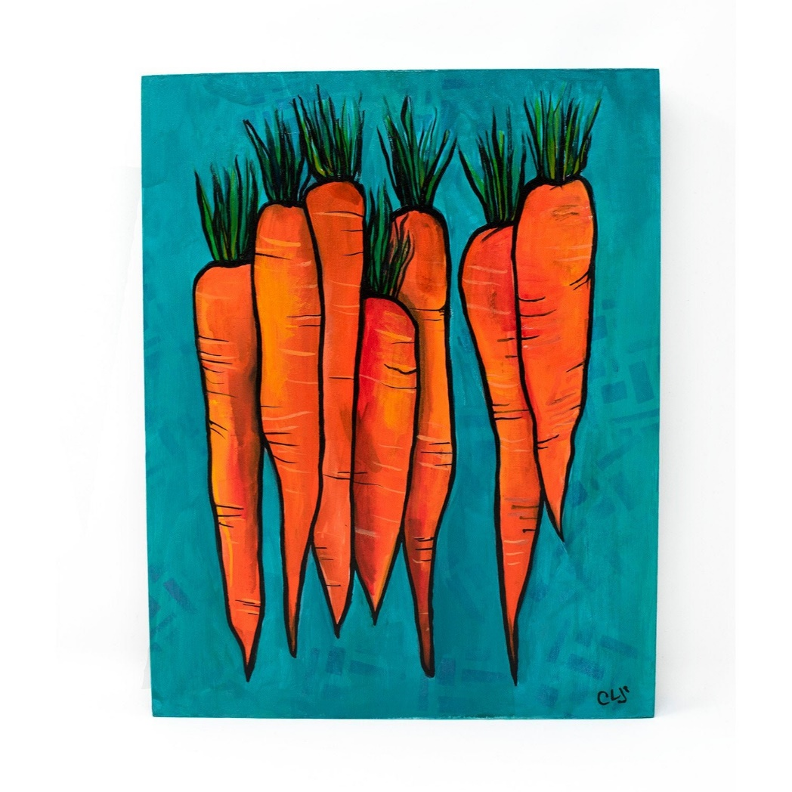
A CARROT
SEVEN.
THERE ARE
SEVEN
CARROTS.

Slide 5
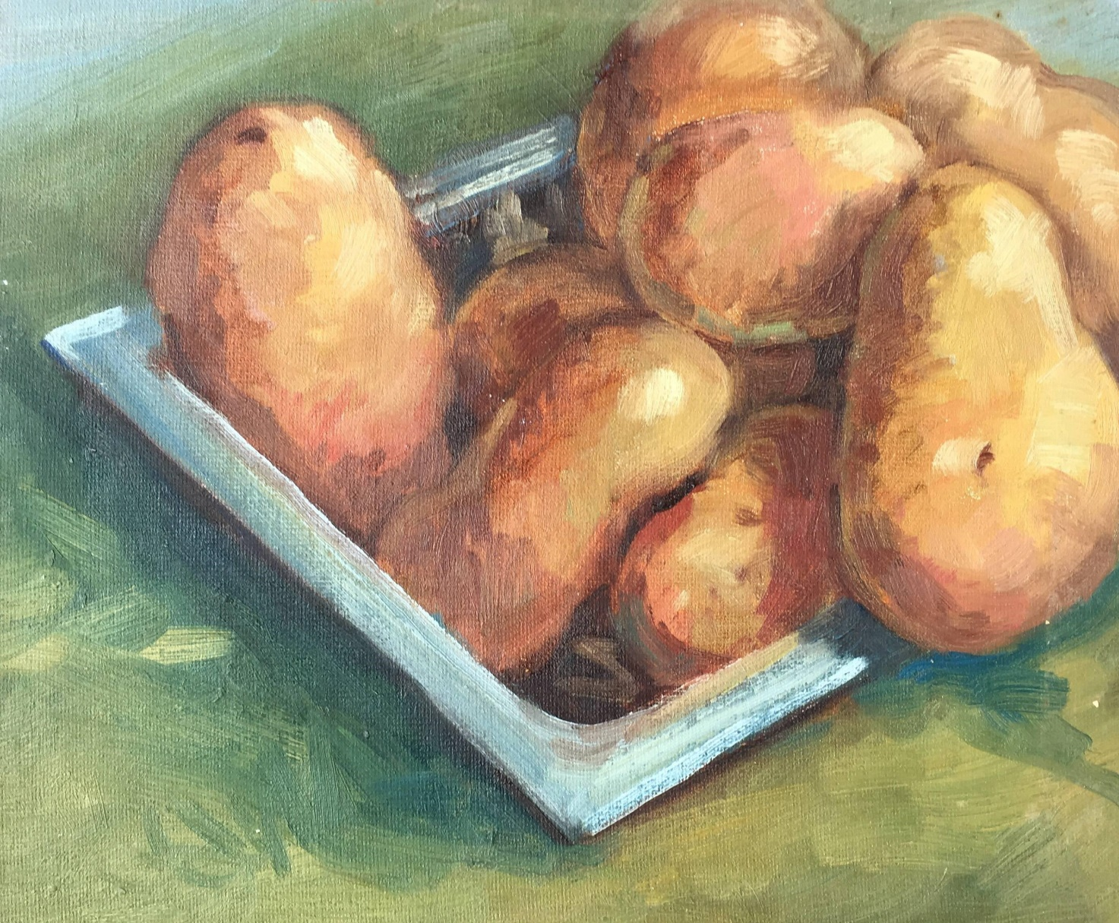
A POTATO - POTATOES
EIGHT.
THERE ARE
EIGHT POTATOES.

Slide 6

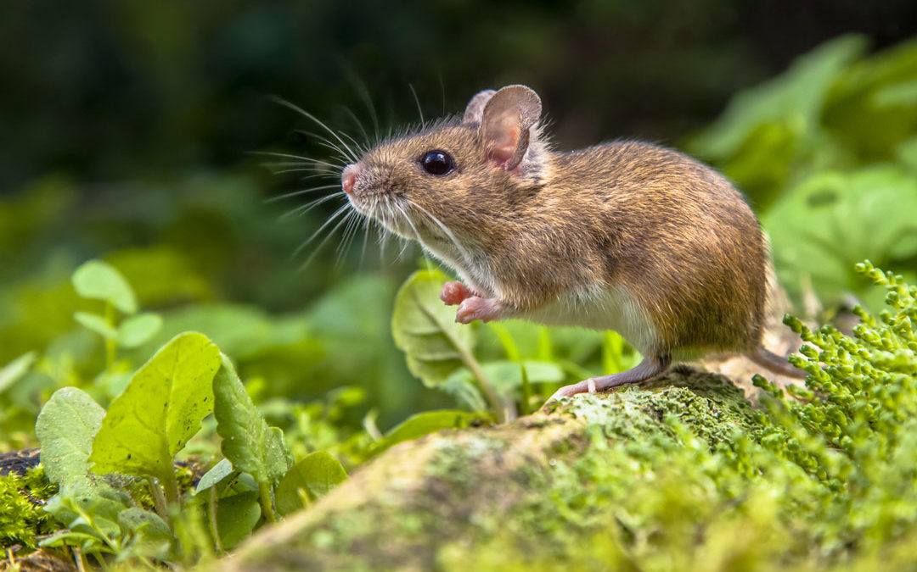
A MOUSE
THE MOUSE IS IN THE FIELD.

Slide 7
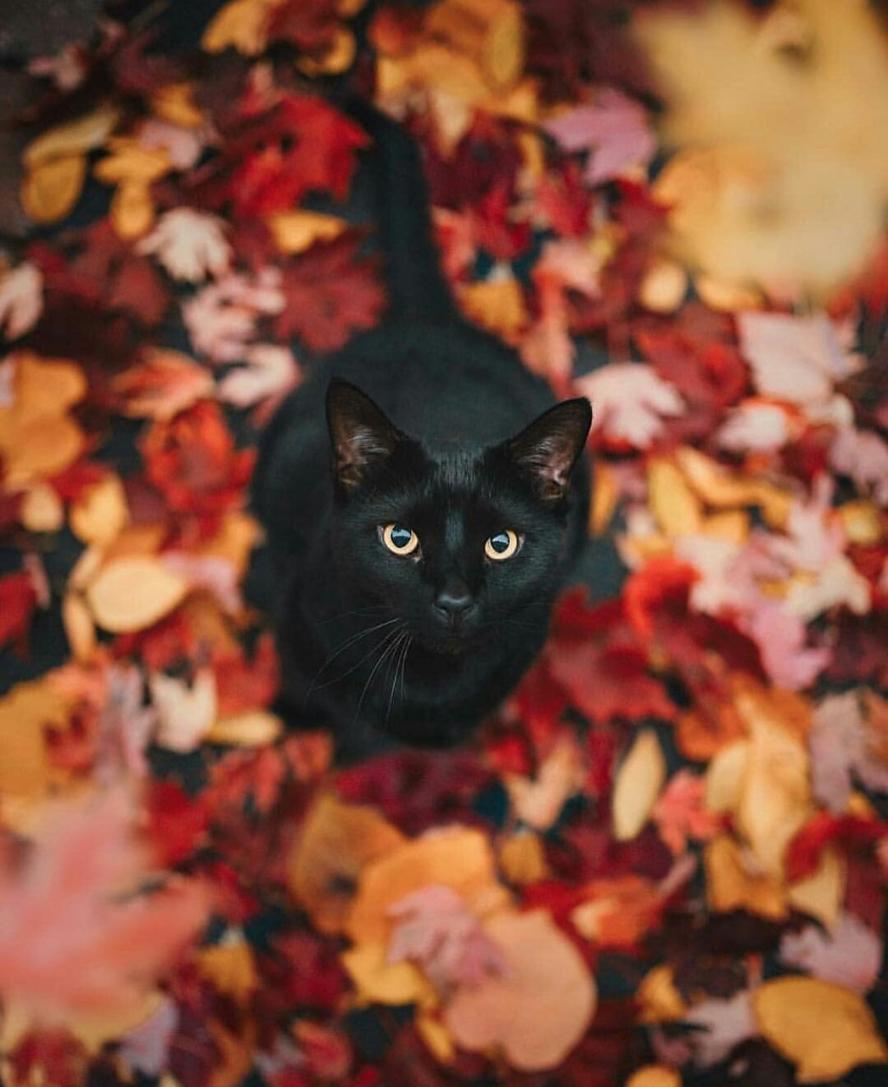
A BLACK CAT

Slide 8

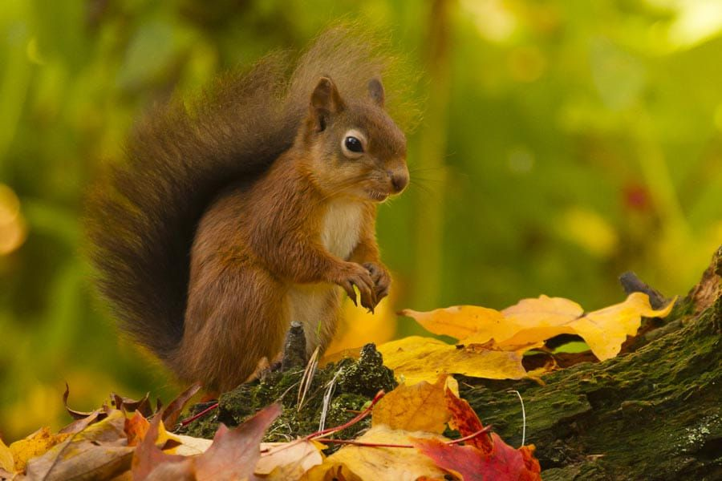
A SQUIRREL

Slide 9
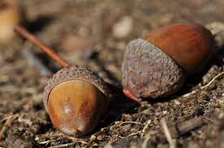
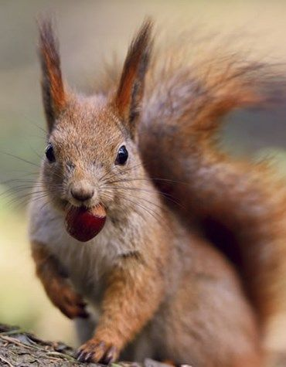
AN ACORN
SQUIRRELS LIKE TO EAT ACORN.

Slide 10
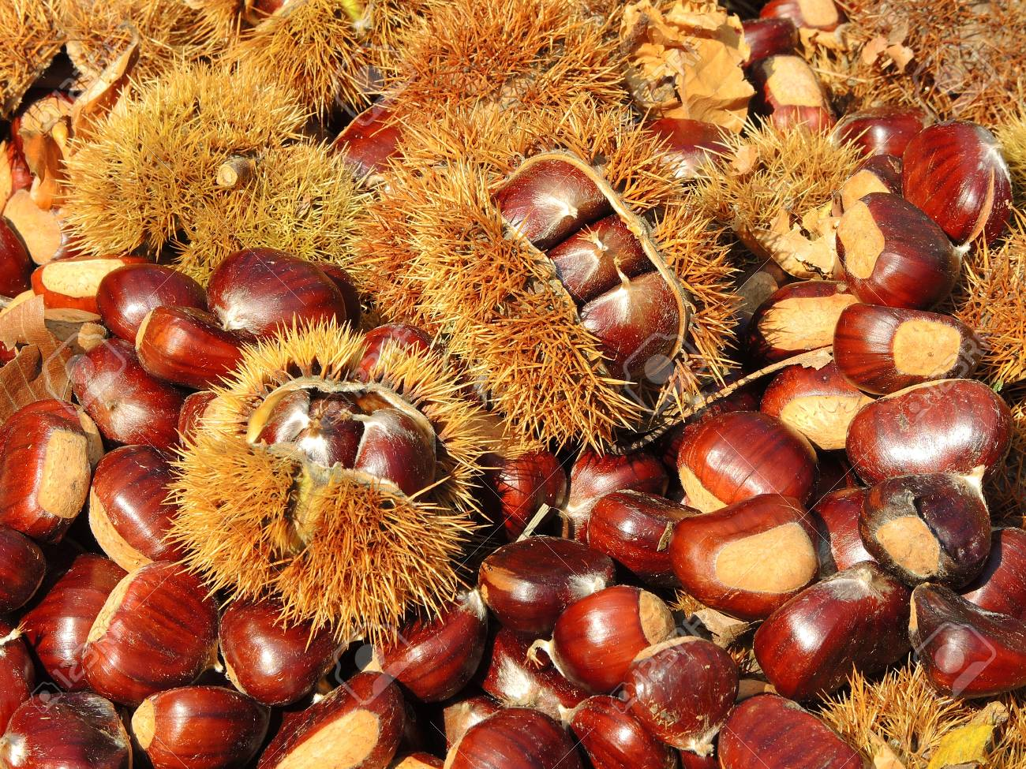
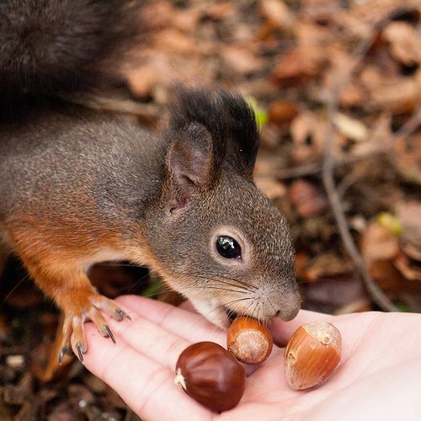
CHESTNUT
SQUIRRELS LIKE TO EAT CHESTNUT.

Slide 11
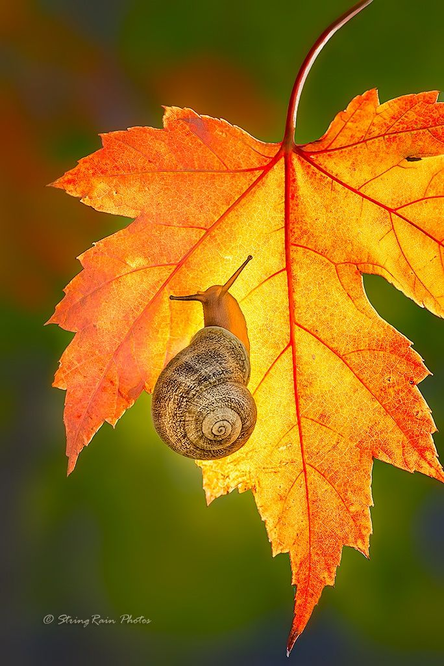
A SNAIL
A SNAIL
IS SLOW.

Slide 12
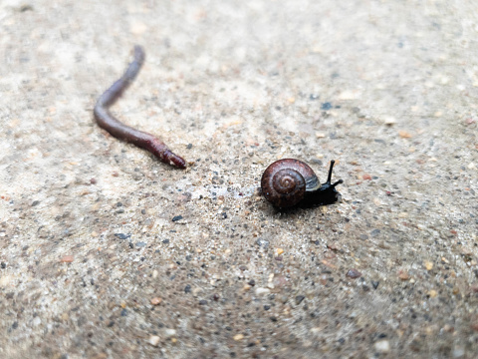
AN EARTHWORM
AN EARTHWORM AND A SNAIL ARE FRIENDS.

Slide 13
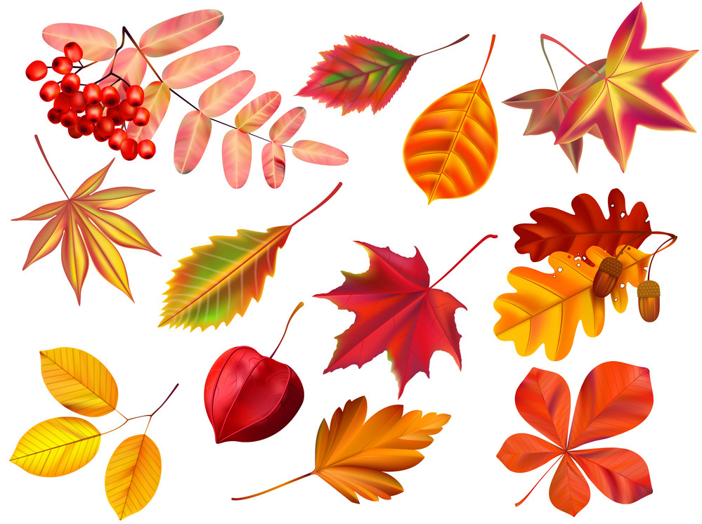
LEAVES
NAVODILO:
NAJPREJ IZRECI PO ANGLEŠKO BARVO LISTA IN NATO RECI LEAF, NATO PREVERI S KLIKOM NA ZVOČNIK.

