Slide 1

ROLL A TASK:
BRAIN BREAK

Slide 2

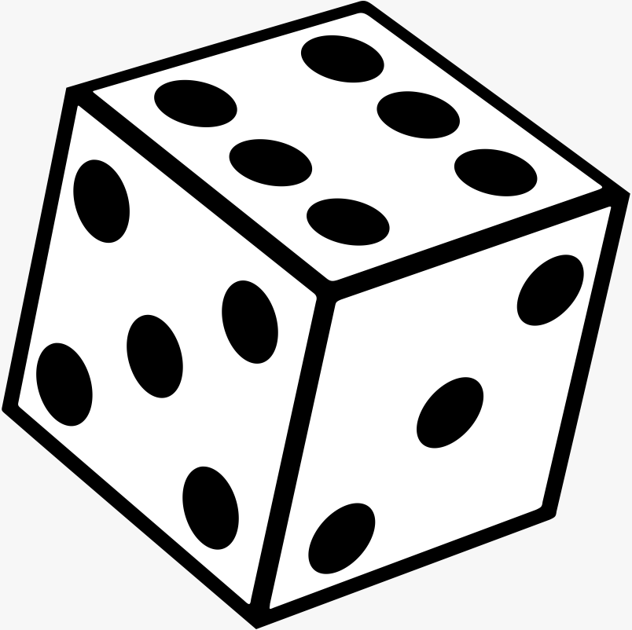
YOU NEED A DICE.

Slide 3


IF YOU ROLL
20
JUMPING
JACKS

Slide 4
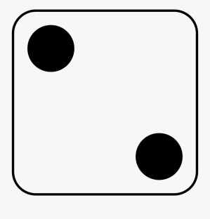
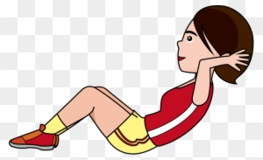
IF YOU ROLL
15
SIT-UPS

Slide 5
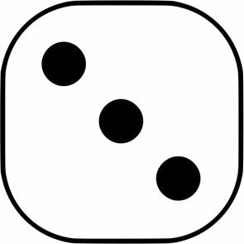
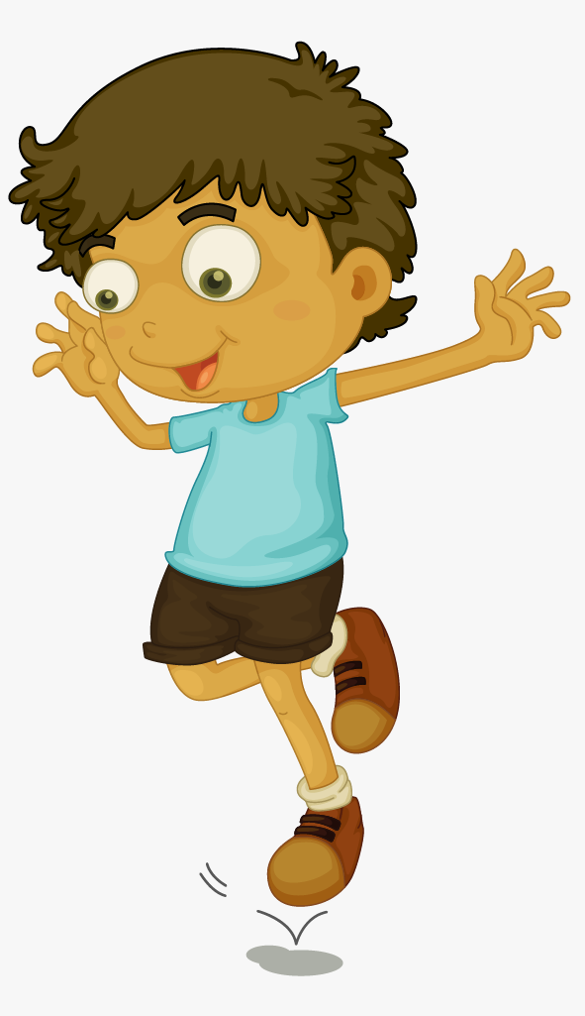
IF YOU ROLL
HOP ON ONE FOOT

Slide 6
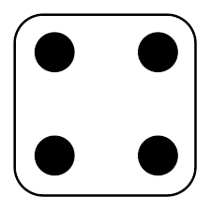
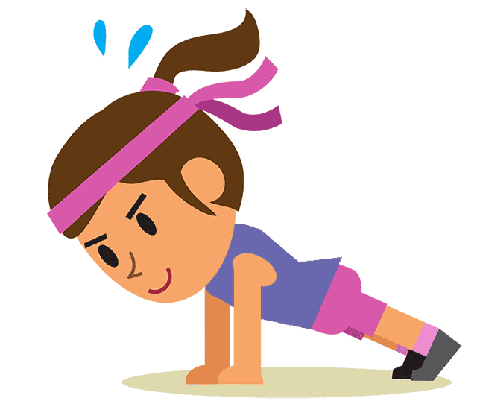
IF YOU ROLL
10
PUSH-UPS

Slide 7

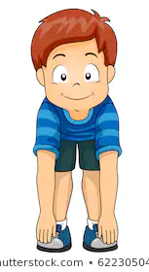
IF YOU ROLL
TOUCH YOUR TOES
(HOLD 15 SECONDS)

Slide 8

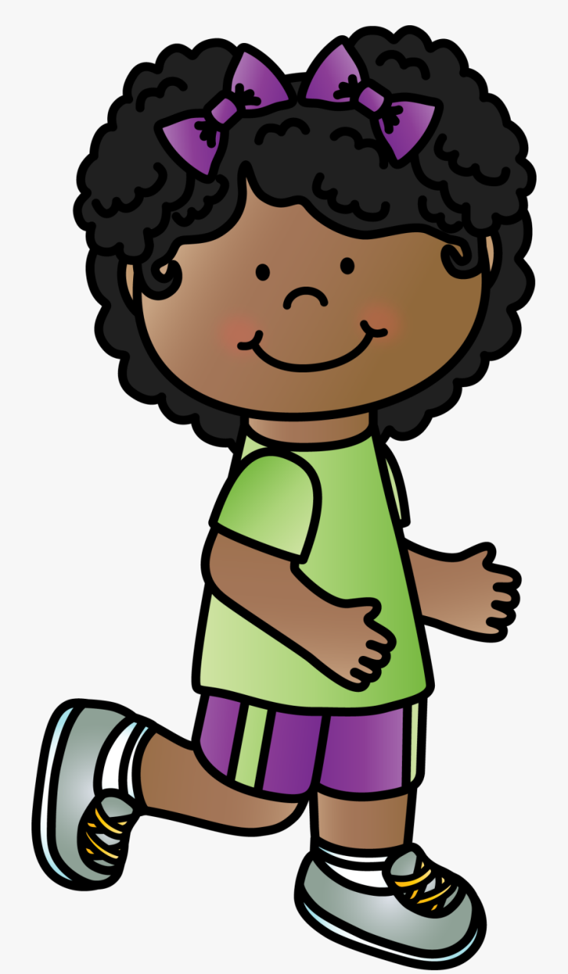
IF YOU ROLL
RUN IN PLACE

Slide 9

GREAT
JOB!

