Slide 1

Numbers from 10 to 20
Do you know the numbers from 10 to 20?
No?
Let’s go!

Slide 2
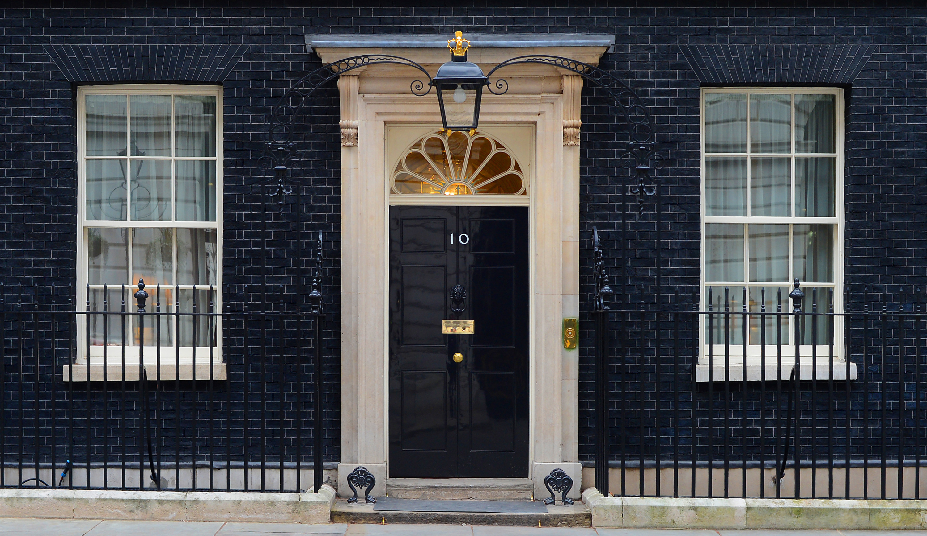
This is the number
10

Slide 3
1
1

Slide 4
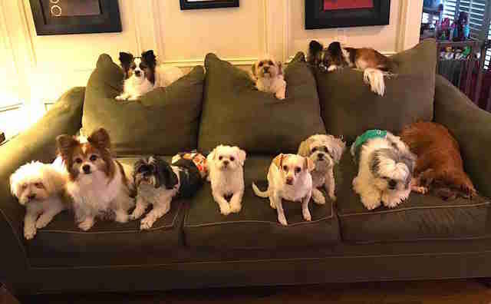
ELEVEN 11
How many dogs are there?
There are eleven dogs.

Slide 5
1
This is number
twelve.
2

Slide 6

How many angry pigs are there?

Slide 7
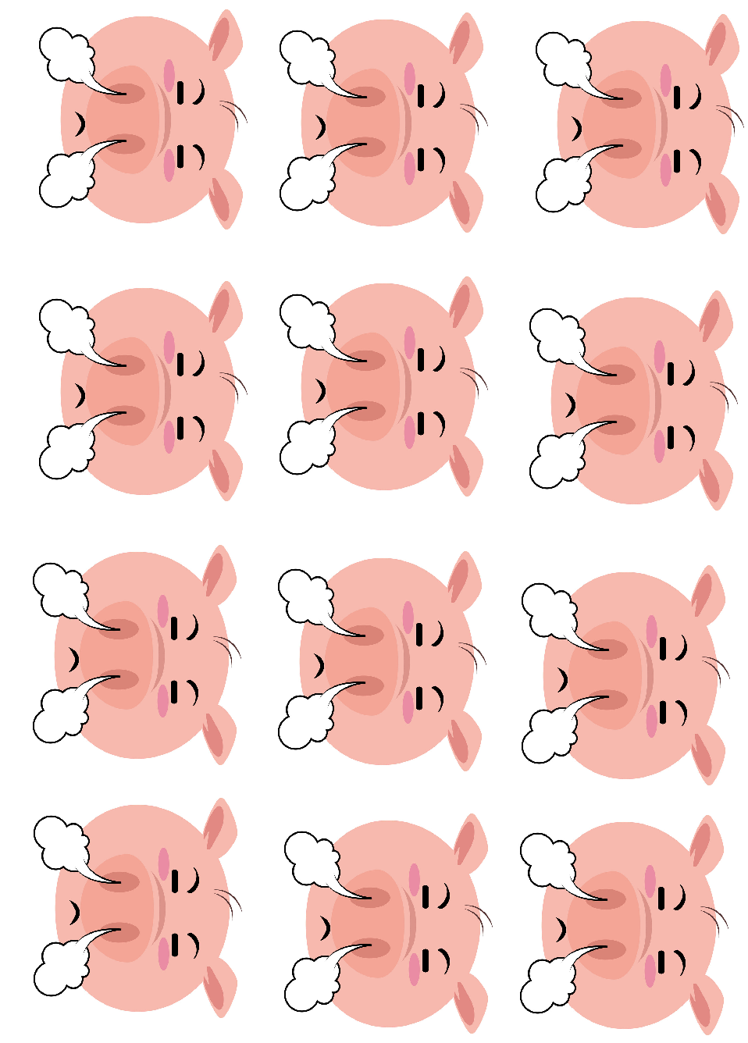
There are twelve angry pigs.

Slide 8
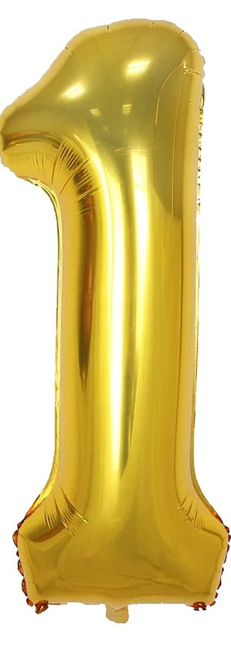
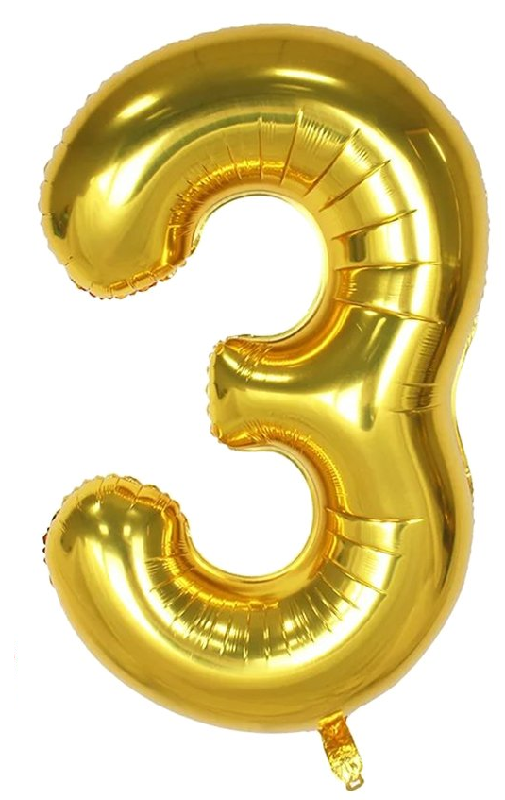
Number thirteen

Slide 9
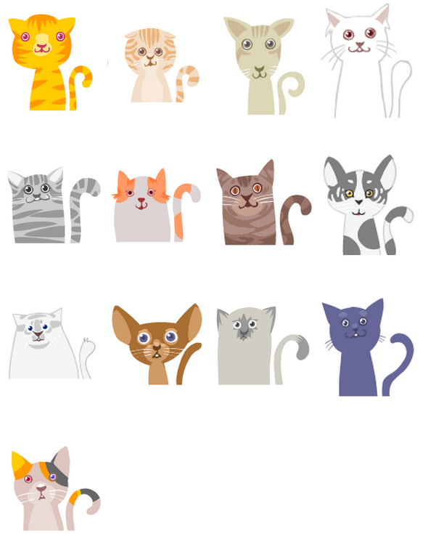

How many cats do you see?
Koliko mačk vidiš?
1 2 3 4
5 6 7 8
9 10 11 12
13

Slide 10


fourteen

Slide 11
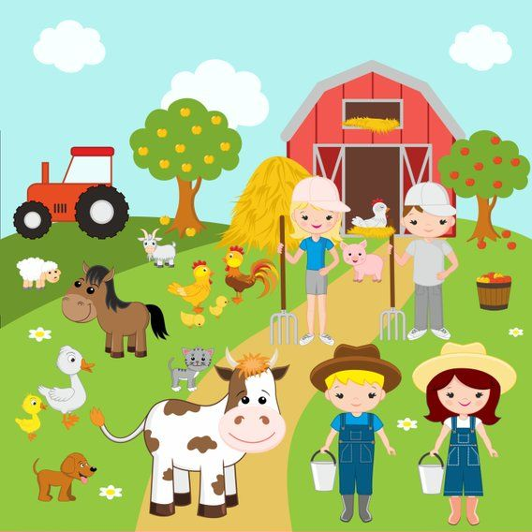
How many animals are on the farm?
14
7
11
13
12
10
6
9
8
4
5
THE ANSWER
ODGOVOR:
3
1
2

Slide 12
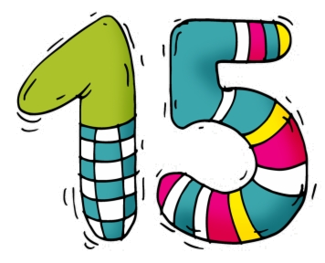
Number fifteen

Slide 13
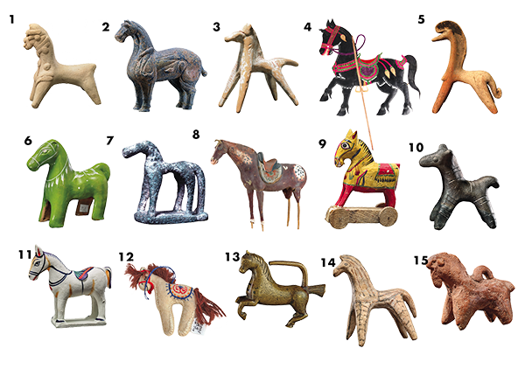
How many horses do you see?

Slide 14

Number sixteen

Slide 15
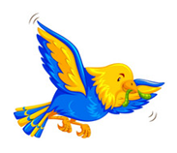
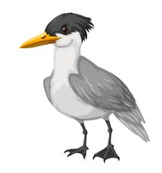




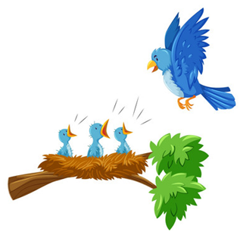
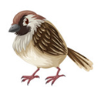
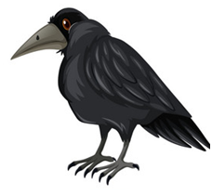
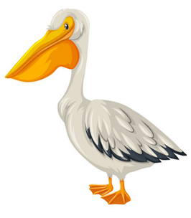
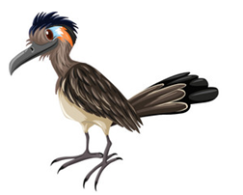
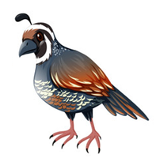
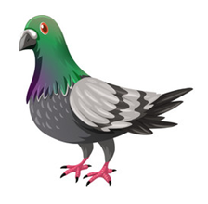
How many birds are there? Klick!
1
There are sixteen 16 birds.
5
3
4
2
6
7
8
10
13
11
15
9
14
16
12

Slide 16

Number seventeen

Slide 17
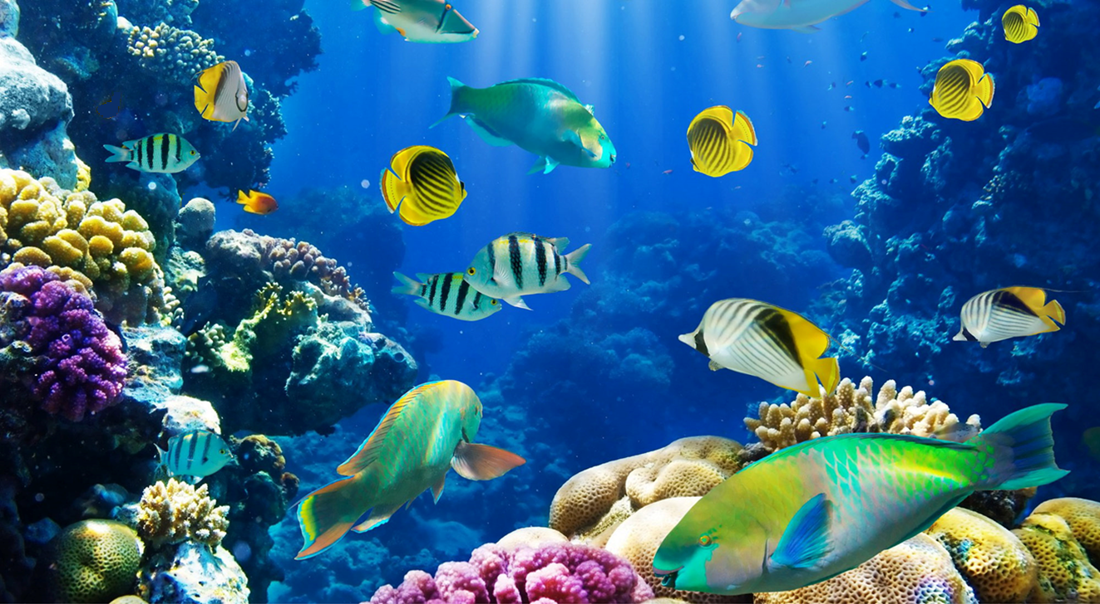
How many fish are there?
How many fish are there?
17

Slide 18

eighteen

Slide 19
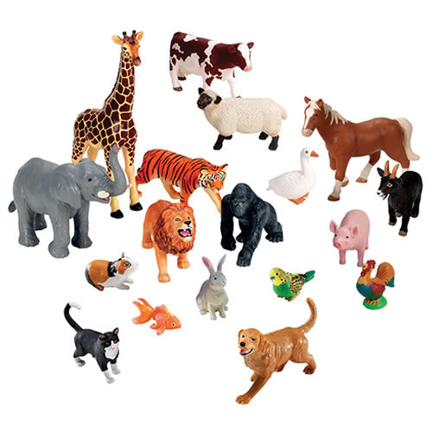
How many toy animals do you see?

Slide 20
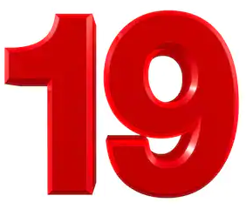
nineteen

Slide 21
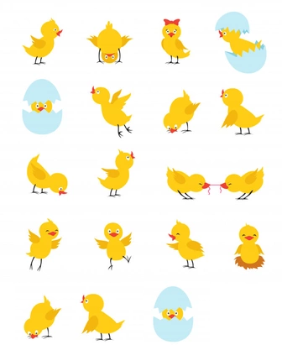
How many chicks do you see?

Slide 22

twenty

Slide 23
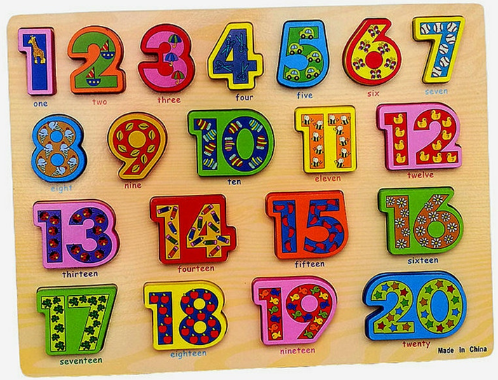
How many numbers are there?

