Slide 1



HOW ARE YOU?

Slide 2
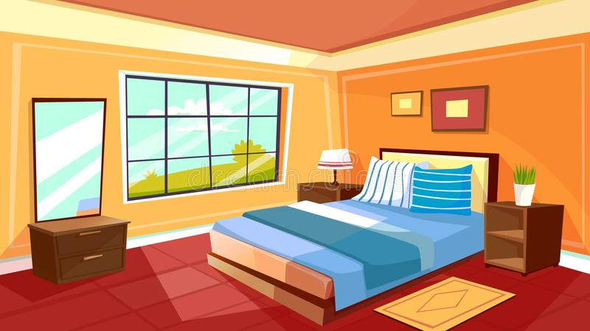
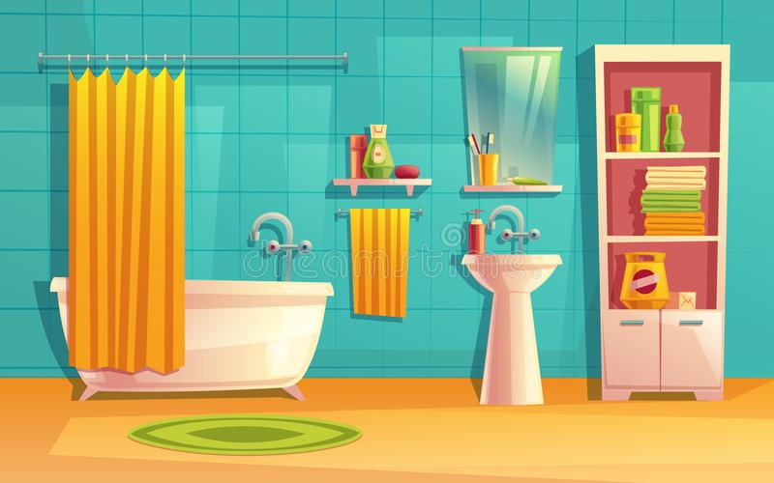
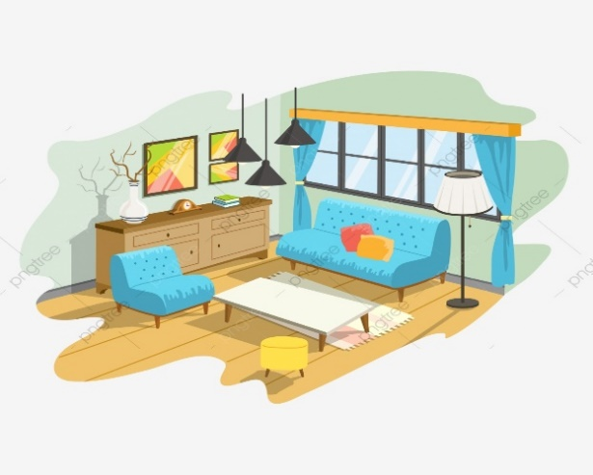
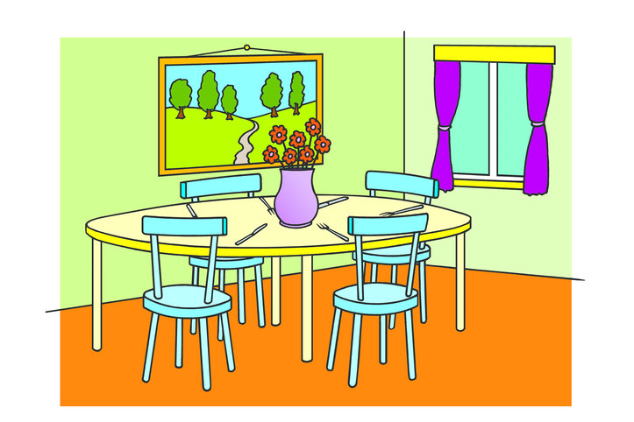
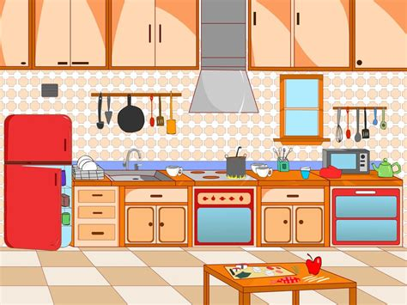

LISTEN AND REPEAT! Poslušaj in ponovi!

Slide 3
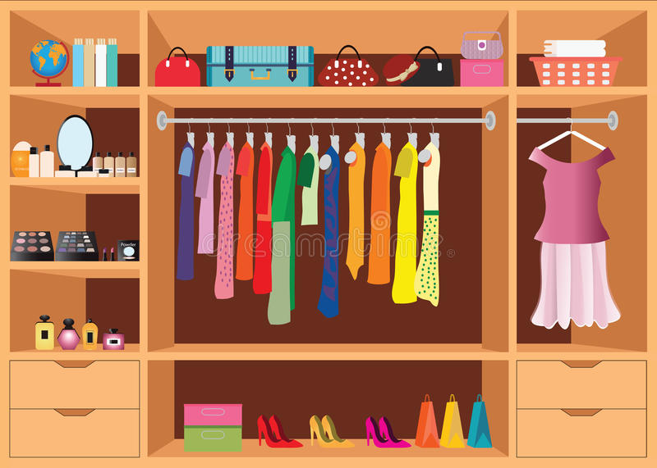

WHAT IS THERE IN THE BEDROOM?

Slide 4



WHAT IS THERE IN THE LIVING ROOM?

Slide 5



WHAT IS THERE IN THE BATHROOM?

Slide 6
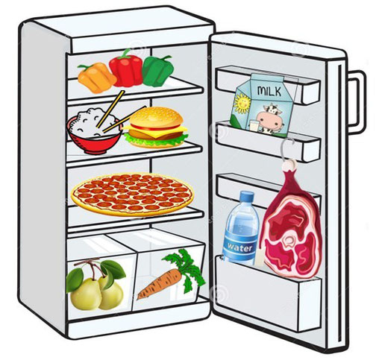

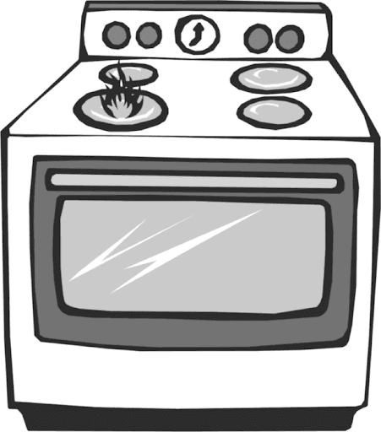
WHAT IS THERE IN THE KITCHEN?

Slide 7
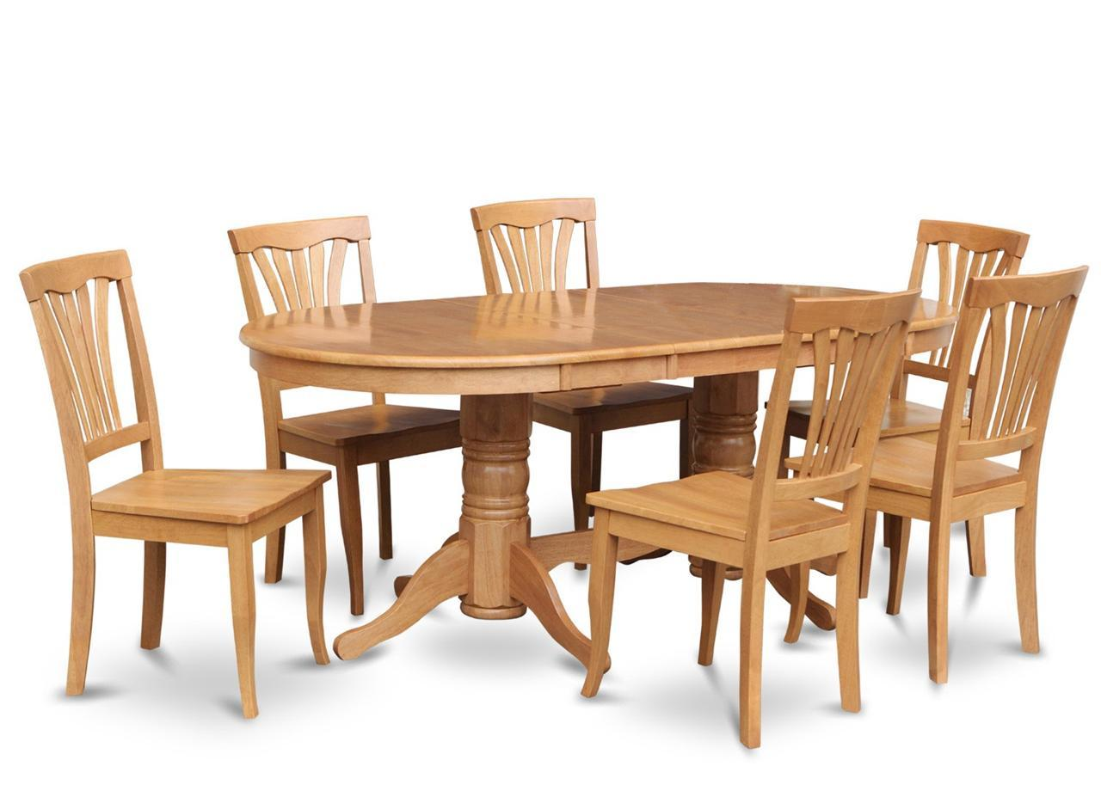
WHAT IS THERE IN THE DINING ROOM?

Slide 8

WHAT IS THERE IN THE HALLWAY?

Slide 9
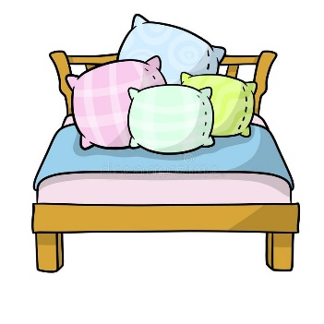
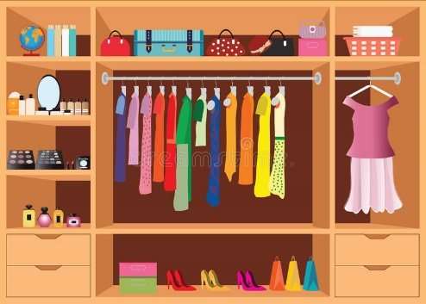

POSLUŠAJ IN PONOVI ZA MENOJ! LISTEN AND REPEAT!

Slide 10



Slide 11
TVOJA NALOGA JE, DA V HIŠKO DORIŠEŠ POHIŠTVO. ČE SI HIŠKO V CELOTI POBARVAL, LAHKO RIŠEŠ S ČRNIM FLOMASTROM. ČE NIMAŠ DOVOLJ PROSTORA, NARIŠI ZA VSAKO SOBO EN KOS POHIŠTVA OZIROMA APARATA. TVOJA HIŠKA JE SEDAJ KONČANA.

