Slide 1


NIČ
0
0 1 2 3 4 5

Slide 2

0

Slide 3
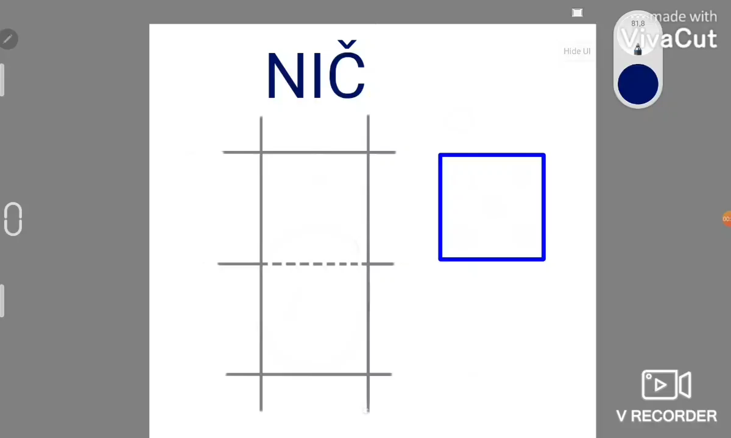

Slide 4
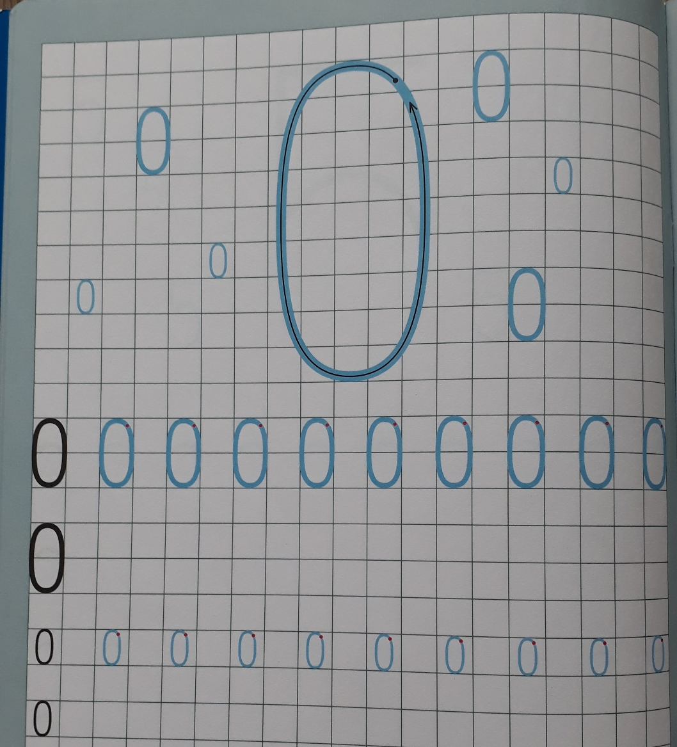


Slide 5
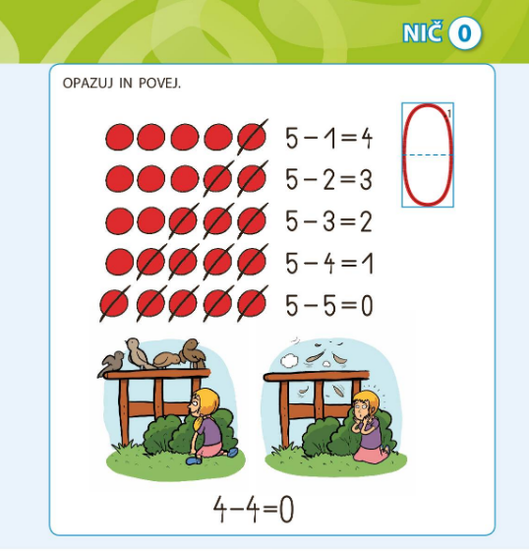

Slide 6
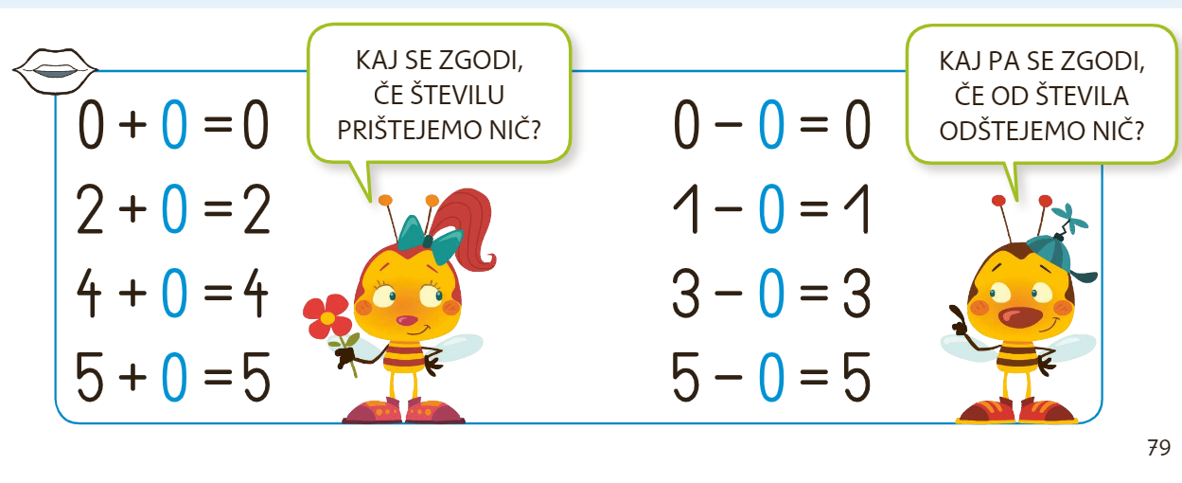
+
-

Slide 7
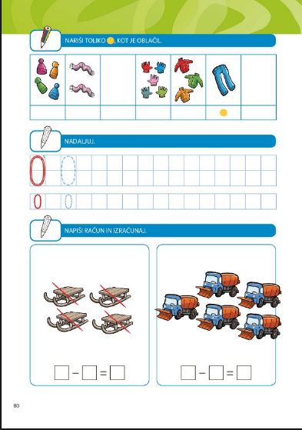

4 – 4 = 0
5 – 0 = 5

