Slide 1
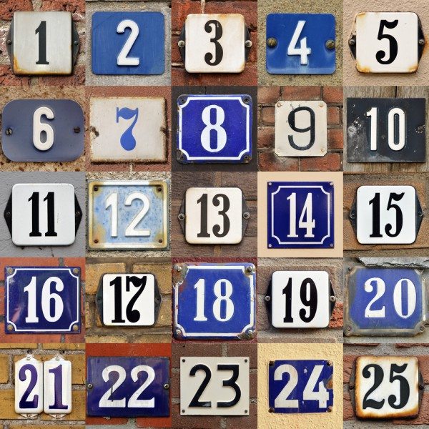
HOUSE NUMBERS

Slide 2



house number

Slide 3


house number

Slide 4
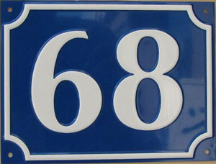
My house number is…
sixty-eight

Slide 5
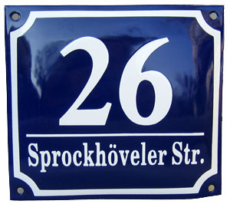
My house numbers is…
twenty-six

Slide 6

My house number is…
forty-two

Slide 7
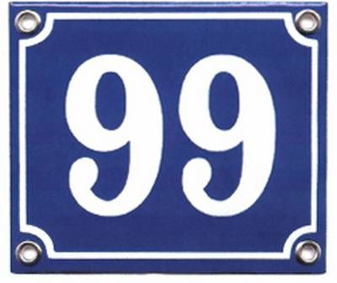
My house number is…
ninety-nine

Slide 8

My house number is…
twelve

Slide 9
My house number is…
seventeen

Slide 10
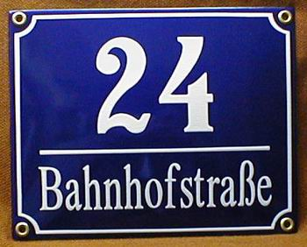
My house number is…
twenty-four

Slide 11
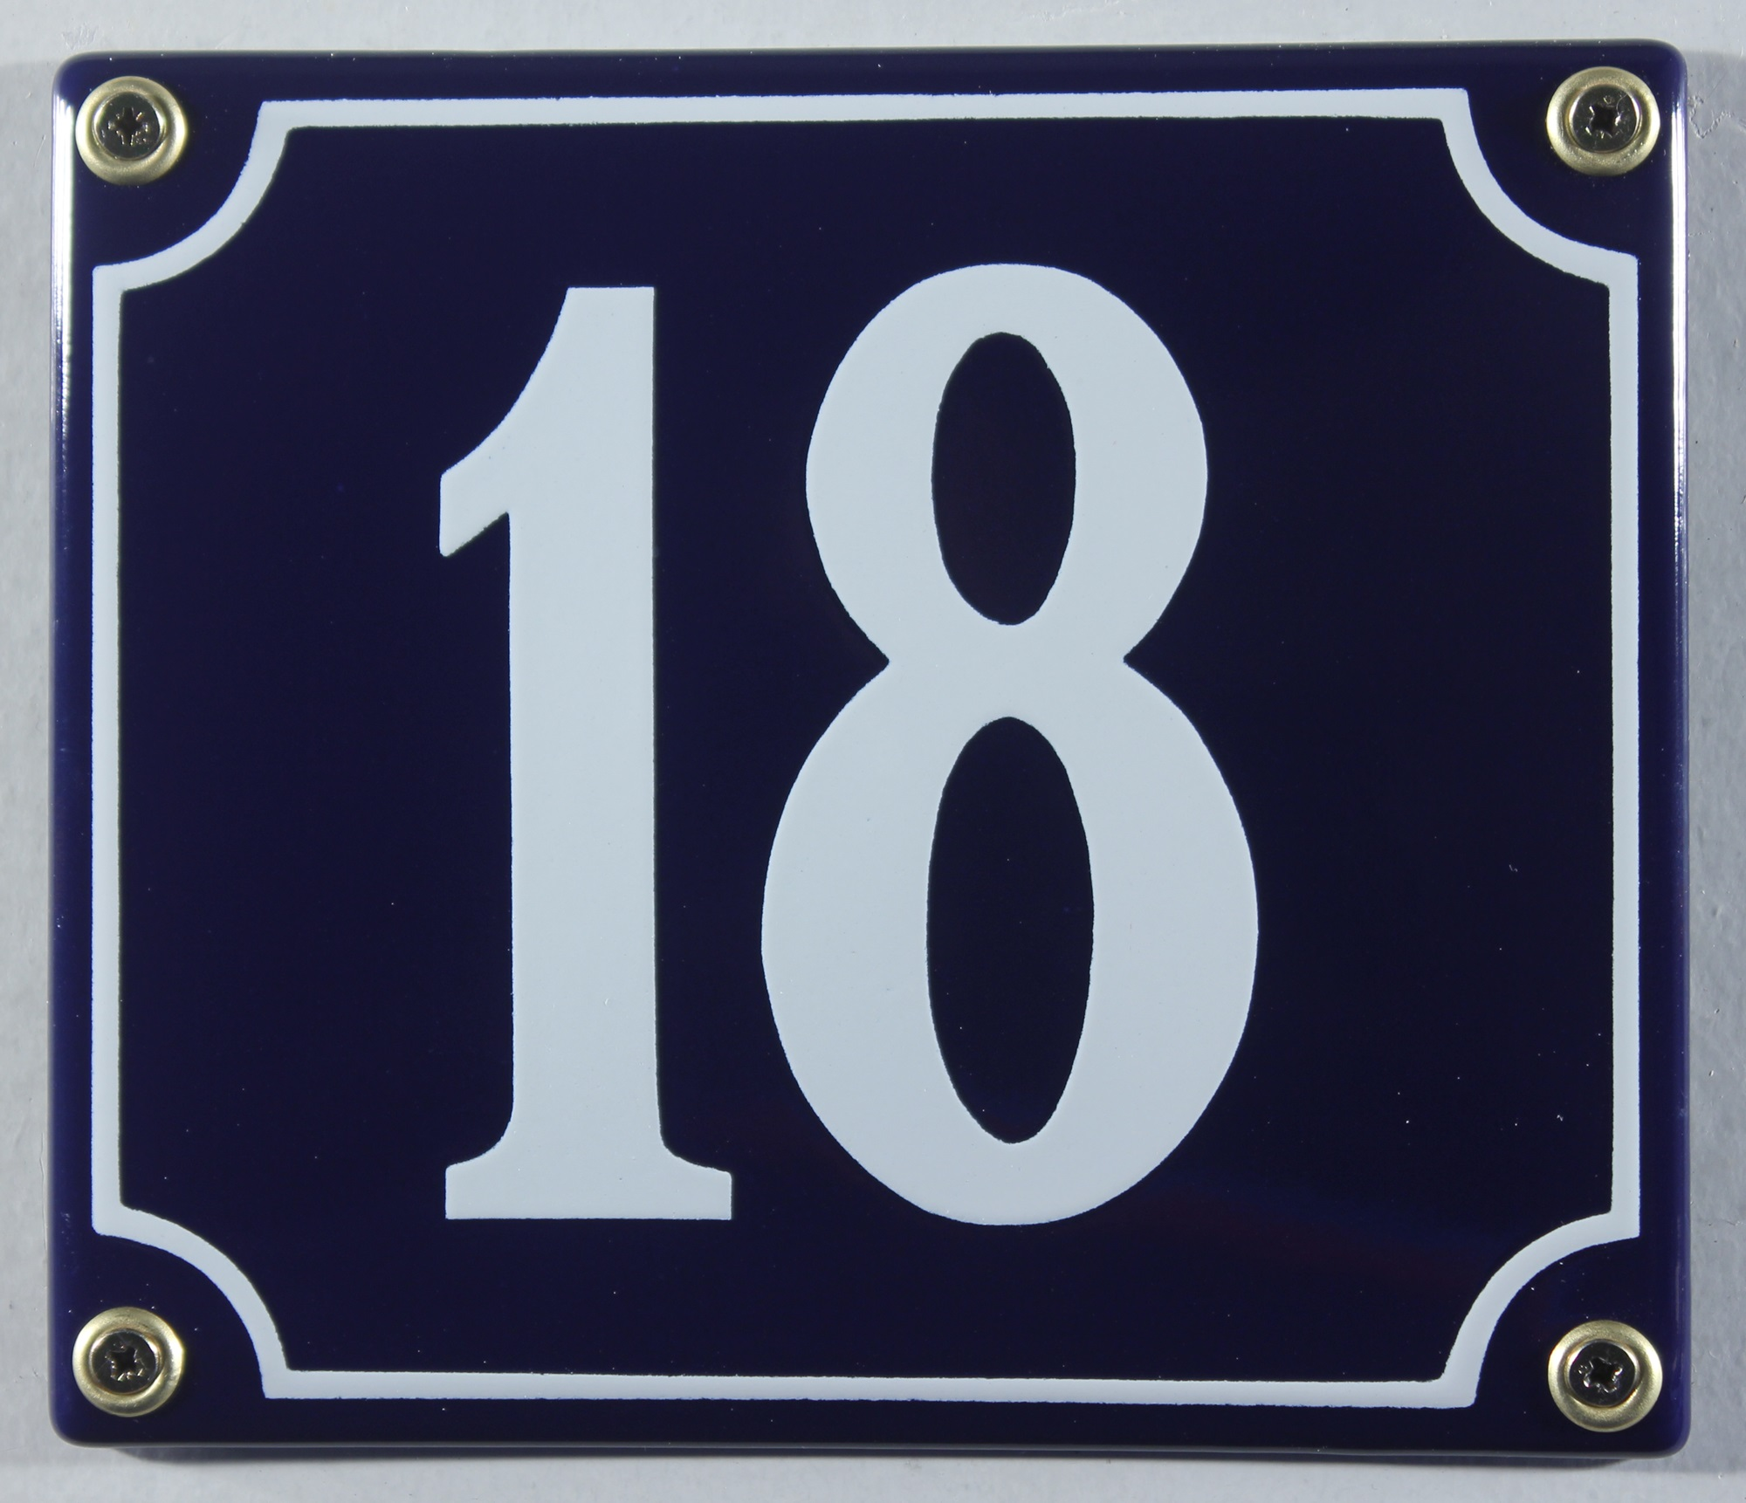
My house number is…
eighteen

Slide 12
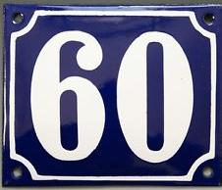
My house number is…
sixty

Slide 13

My house number is…
five

