Slide 1





CHRISTMAS
AND WINTER

Slide 2
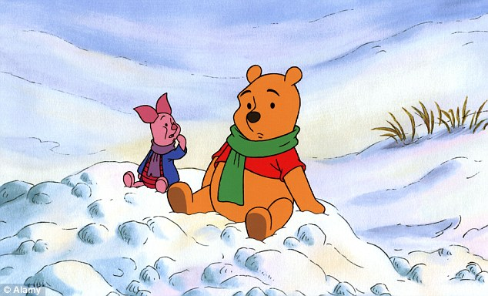
SNOW
snow

Slide 3

snowflakes
SNOWFLAKES

Slide 4






Slide 5
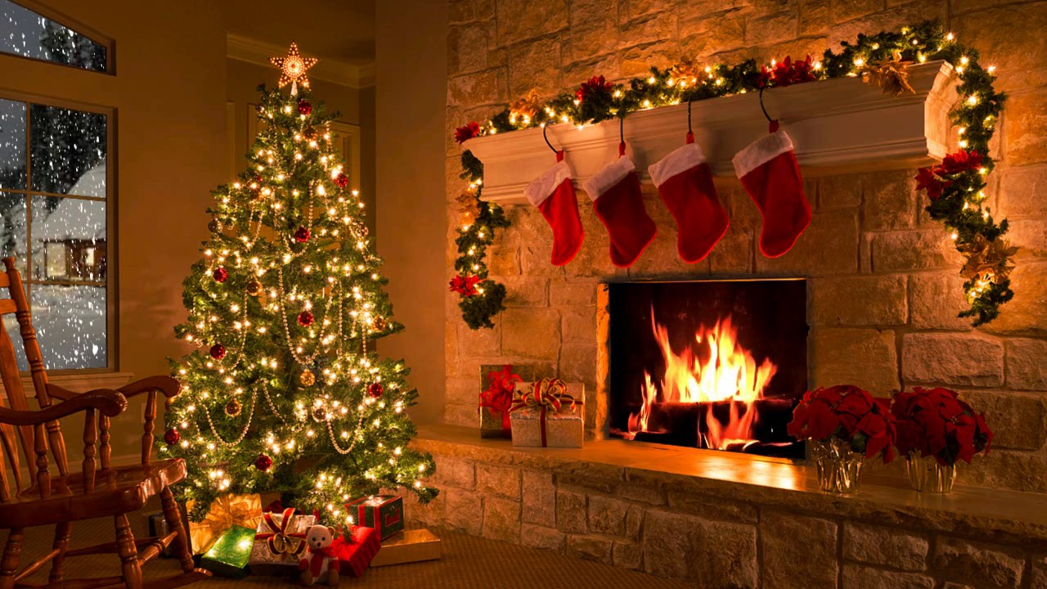
a Christmas tree
a star
Christmas stockings
window
It’s snowing.
pointsettia
presents
a fireplace
a teddy bear

Slide 6
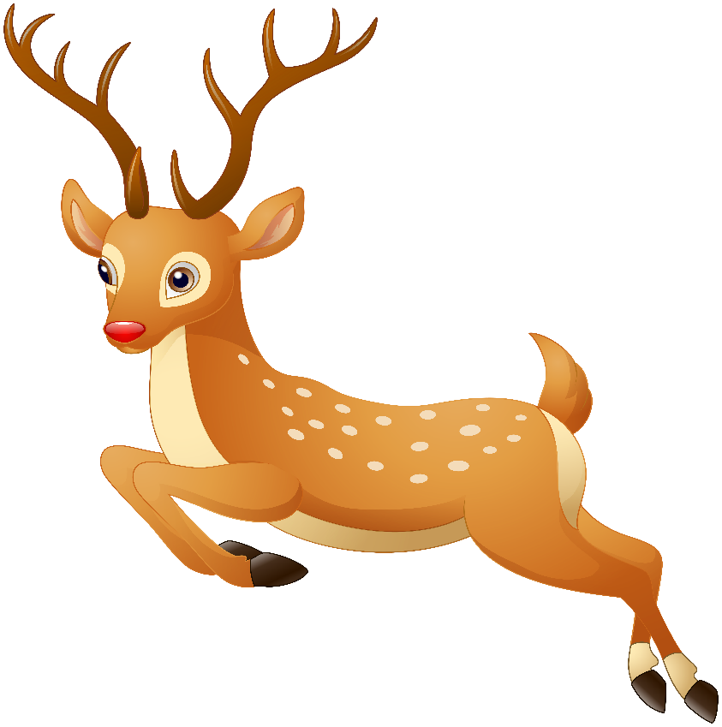

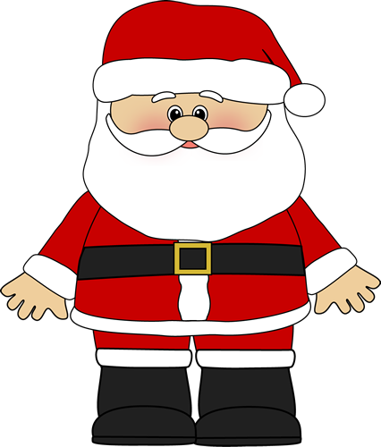
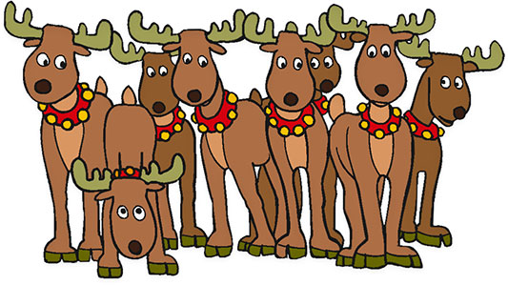
WHO IS THIS?
THIS IS SANTA CLAUS.
SANTA’S SLEIGH

