Slide 1


DAYS OF THE WEEK

Slide 2
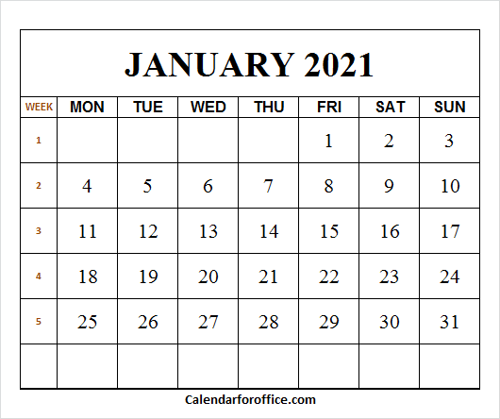

Slide 3


Slide 4


Slide 5


Slide 6


Slide 7


Slide 8


Slide 9


Slide 10


Slide 11
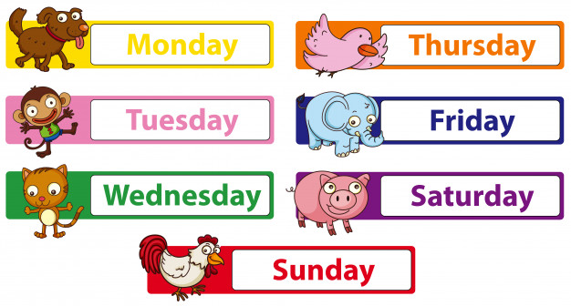

Slide 12
YESTERDAY (was) | TODAY (is) | TOMORROW (will be)
SUNDAY
MONDAY
TUESDAY
MONDAY
TUESDAY
WEDNESDAY
TUESDAY
WEDNESDAY
THURSDAY
WEDNESDAY
THURSDAY
FRIDAY
THURSDAY
FRIDAY
SATURDAY
FRIDAY
SATURDAY
SUNDAY
SATURDAY
SUNDAY
MONDAY

Slide 13
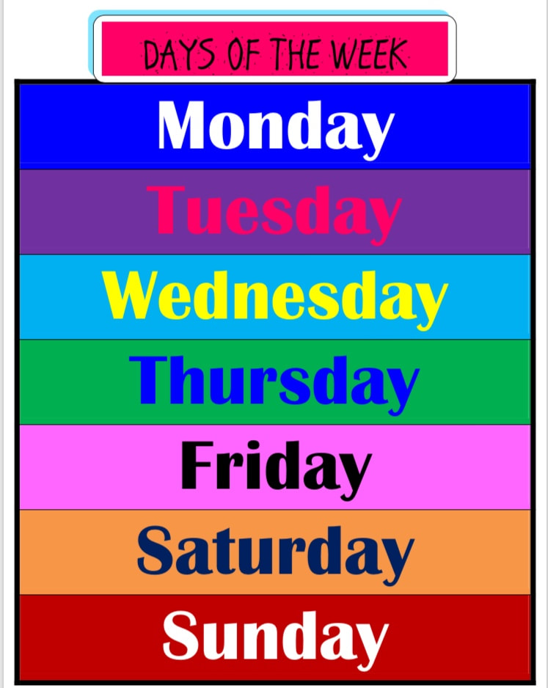
WRITE IN YOUR NOTEBOOK – PREPIŠI V ZVEZEK

