Slide 1

I LIKE/ I DON‘T LIKE
KAKO POVEDATI KAJ NAM JE VŠEČ IN KAJ NAM NI?

Slide 2
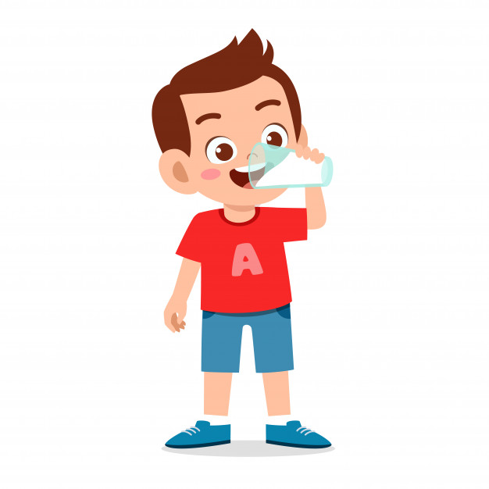
MY NAME IS ALEX.
I LIKE MILK.
I LIKE JUICE.
I LIKE SANDWICHES.
I LIKE BANANAS.
I LIKE APPLES.
I LIKE SALADS.
I DON‘T LIKE SOUP.
I DON‘T LIKE CHEESE.
I DON‘T LIKE BREAD.
I DON‘T LIKE BUTTER.

Slide 3

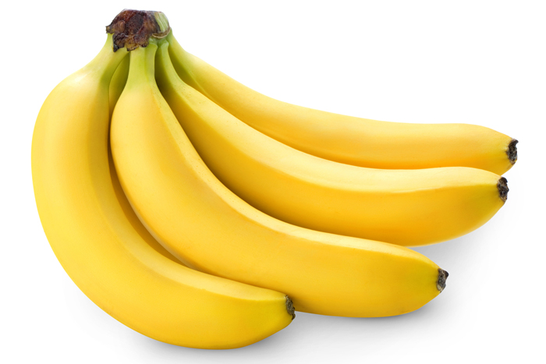
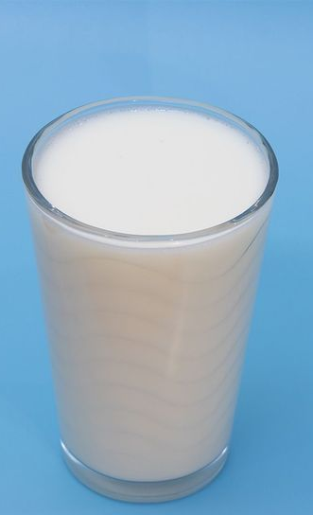
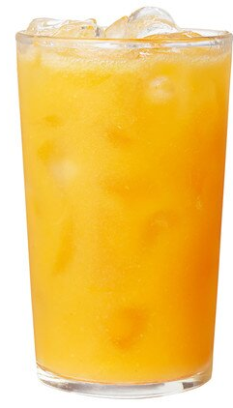
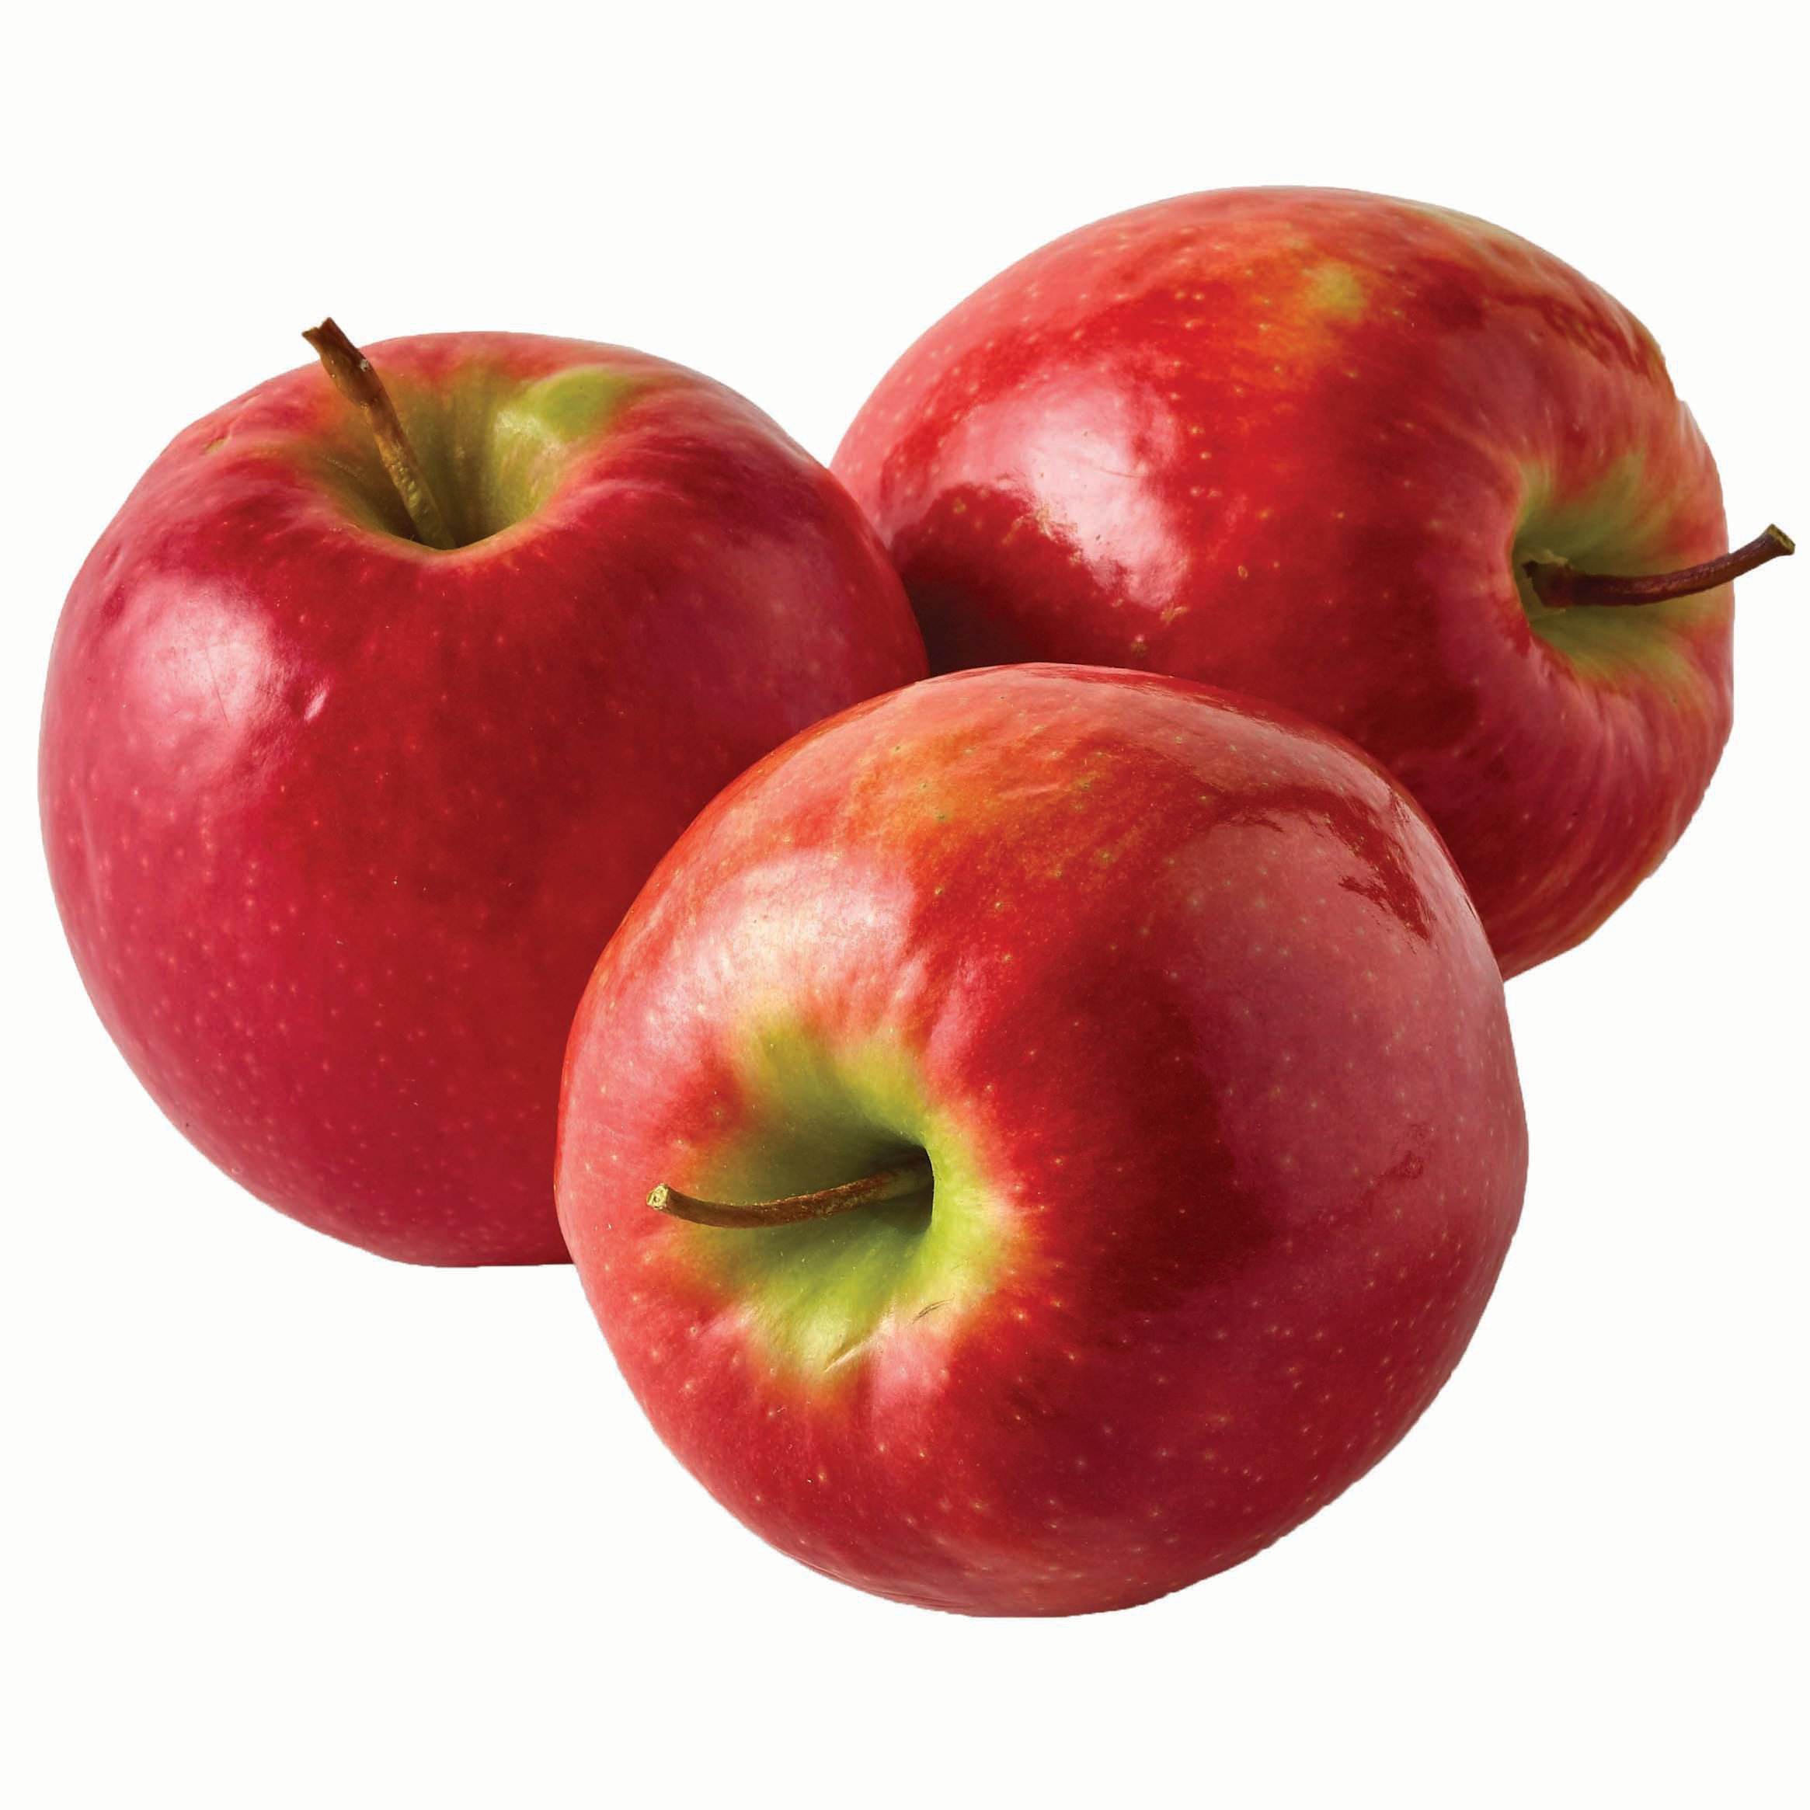
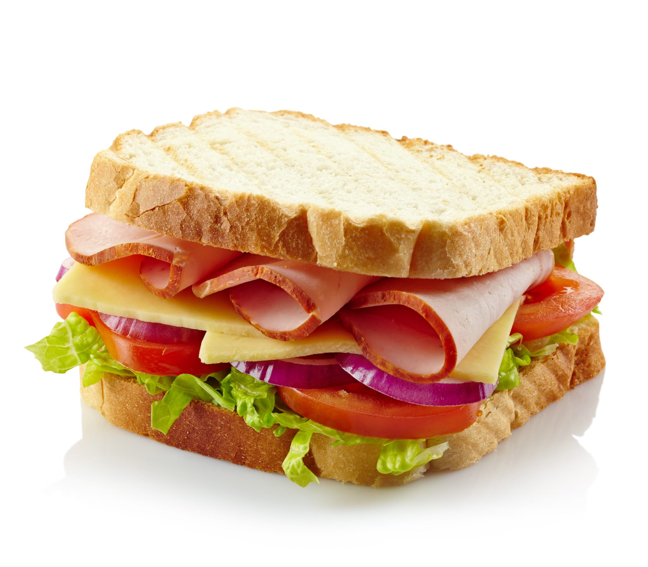
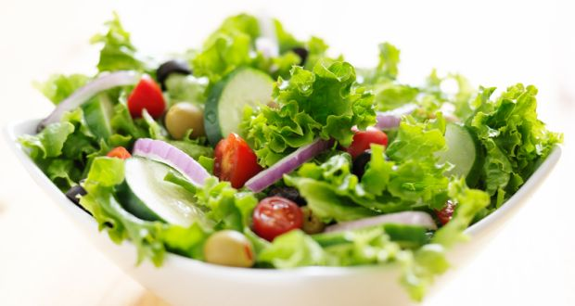
I LIKE

Slide 4
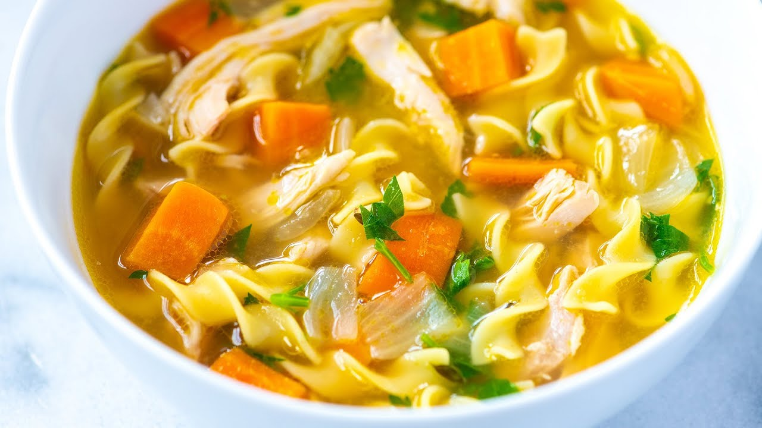

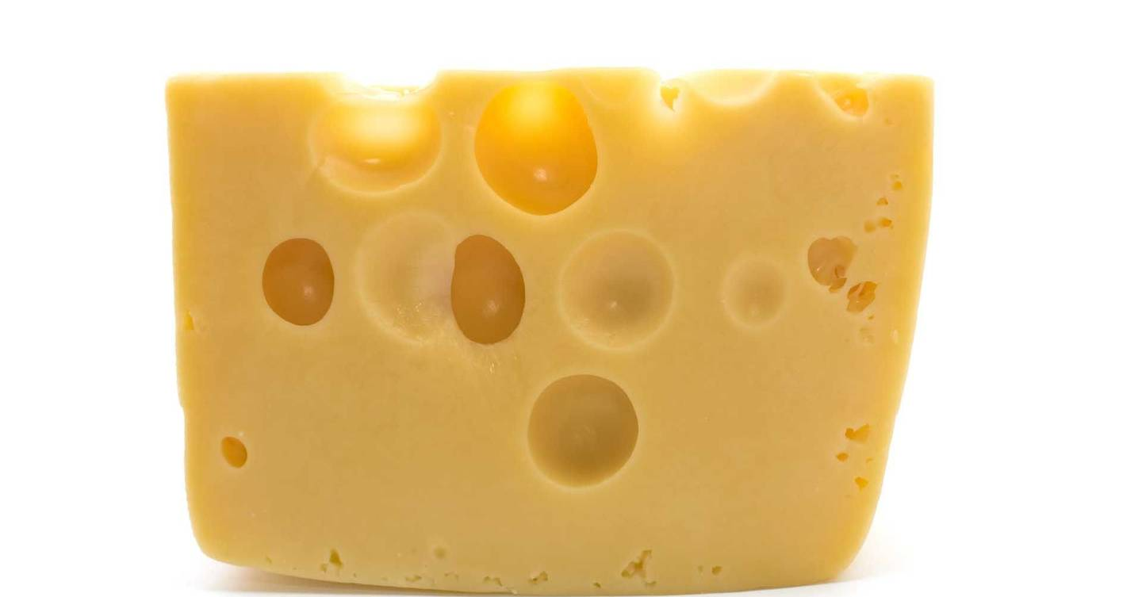
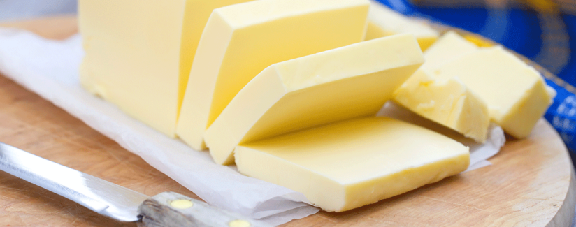
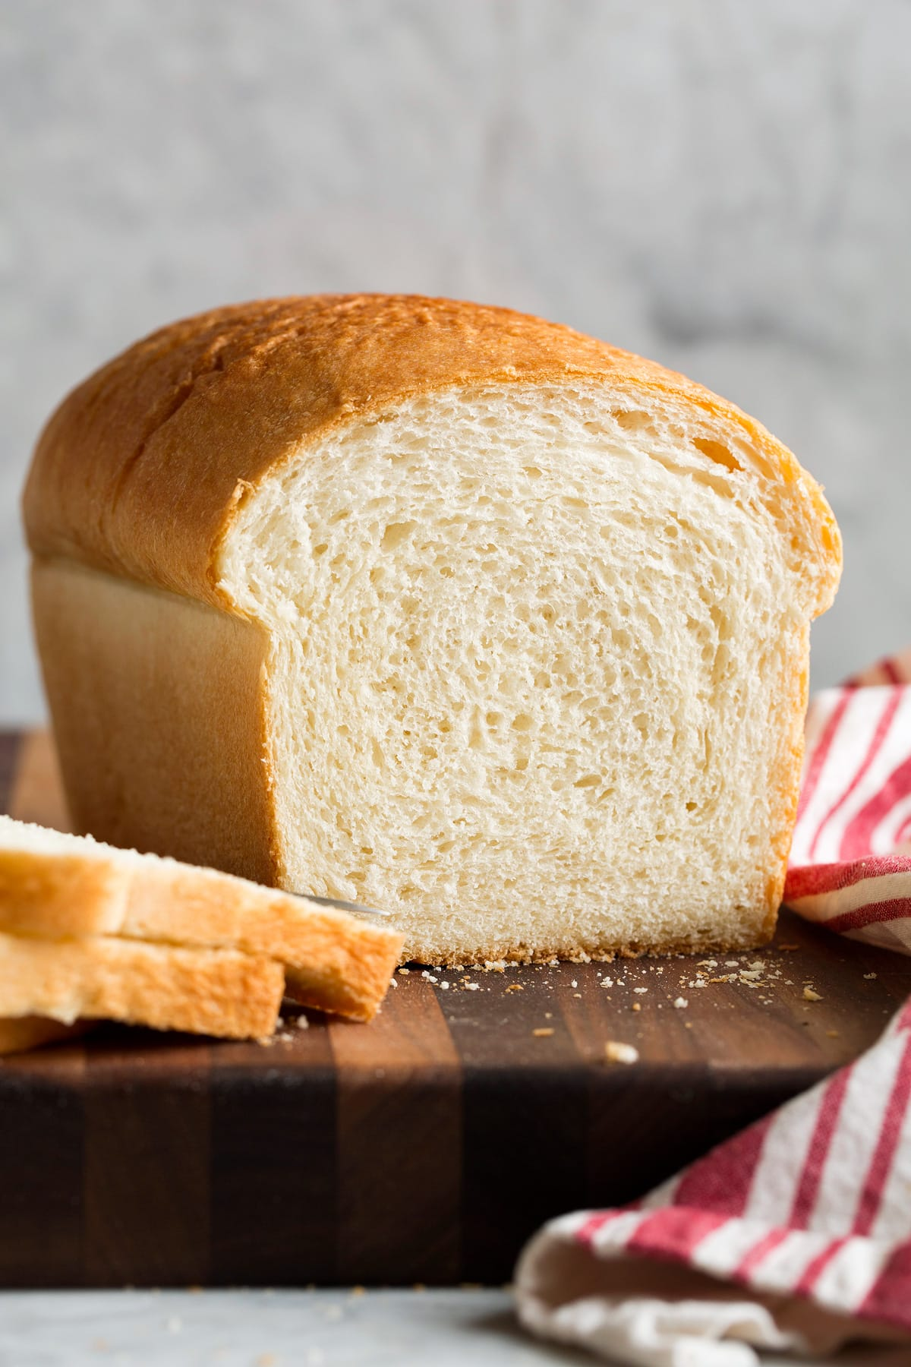
I DON‘T LIKE

Slide 5
WHAT ABOUT YOU?
V ZVEZEK NAPIŠI I LIKE IN NARIŠI KAJ RAD JEŠ.
NA DRUGI STRANI NAPIŠI I DON‘T LIKE IN NARIŠI ČESA NE JEŠ RAD.
I LIKE
I DON‘T LIKE

