Slide 1

MY FAMILY

Slide 2


Slide 3




MOTHER
MOM
FATHER
DAD
PARENTS

Slide 4
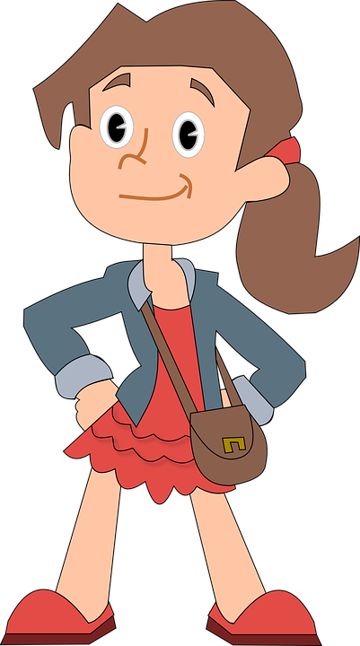

SISTER
DAUGHTER
BROTHER
SON
CHILDREN

Slide 5
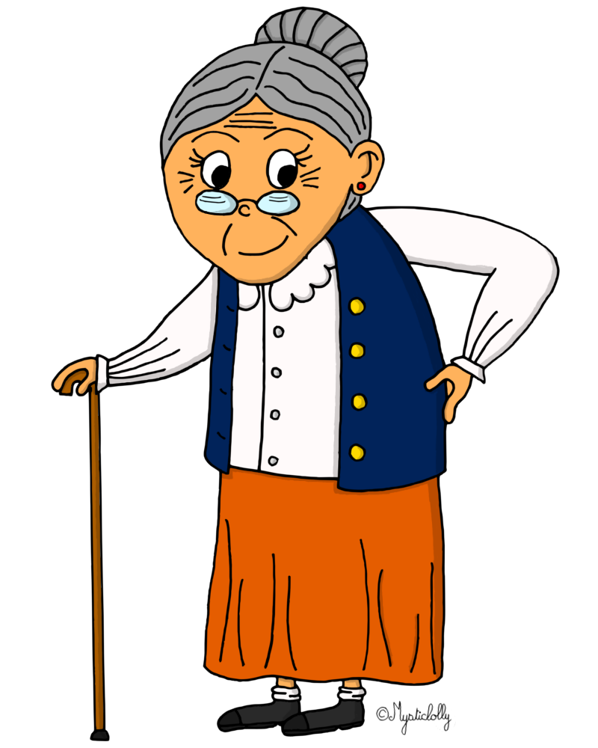
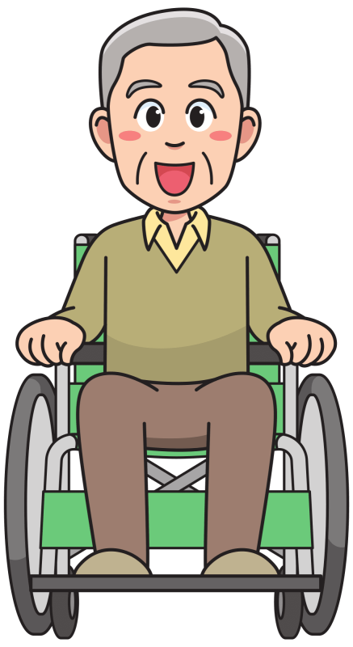

GRANDMOTHER
GRANDMA
GRANNY
GRANDFATHER
GRANDPA
GRANDPARENTS

Slide 6
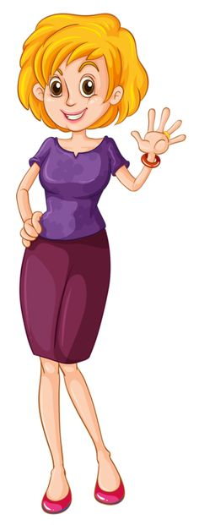


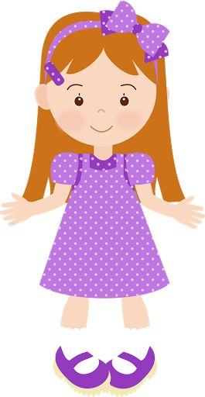
AUNT
UNCLE
COUSIN
COUSIN

Slide 7
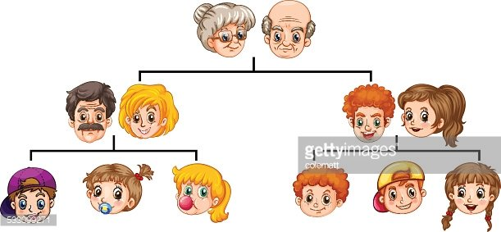


Slide 8
GRANDPA
MY FAMILY
TREE
GRANDMA
FATHER
MOTHER
UNCLE/AUNT
UNCLE/AUNT
ME
BROTHER/SISTER
COUSIN
COUSIN

Slide 9
