Slide 1


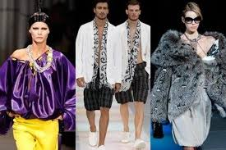
MODNI KREATOR, MODNA KREATORKA
Jesenice

Slide 2
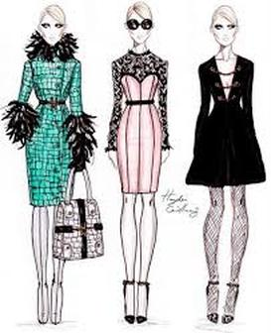
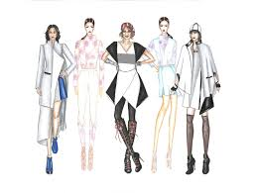

Slide 3
