Slide 1



SEASONS

Slide 2


Slide 3


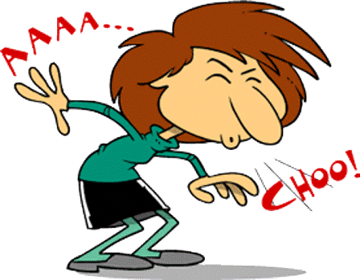


Slide 4




Slide 5



Slide 6


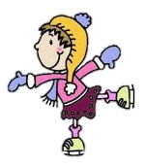

Slide 7


Slide 8
What is the weather
usually like in the SPRING?
snowy and cold
sunny and warm
windy and freezing
sunny and cold

Slide 9
SPRING MONTHS
MARCH
APRIL
MAY

Slide 10
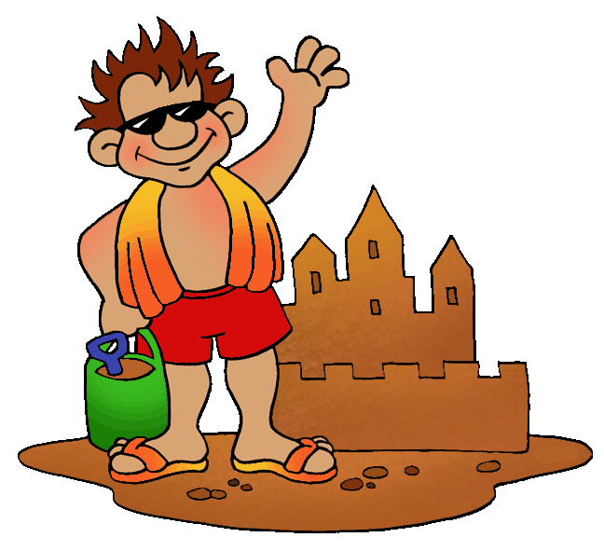


Slide 11
What is the weather
usually like in the SUMMER?
snowy and cold
windy and freezing
sunny and hot
sunny and cold

Slide 12

SUMMER MONTHS
JUNE
JULY
AUGUST

Slide 13
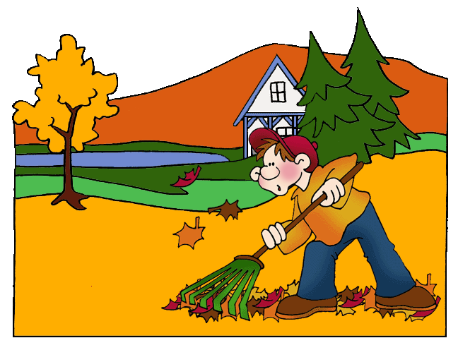

Slide 14

What is the weather
usually like in the AUTUMN?
cool and rainy
windy and freezing
snowy and cold
sunny and hot

Slide 15
AUTUMN MONTHS
SEPTEMBER
OCTOBER
NOVEMBER

Slide 16
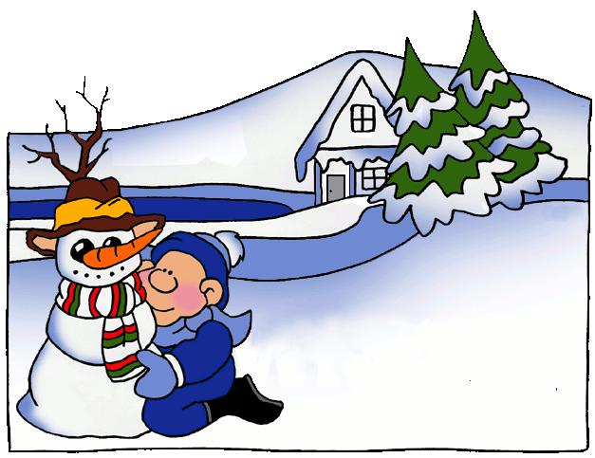

Slide 17
What is the weather
usually like in the WINTER ?
sunny and cool
snowy and freezing
windy and warm
cloudy and hot

Slide 18
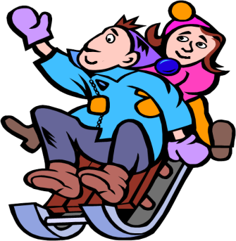
WINTER MONTHS
DECEMBER
JANUARY
FEBRUARY

Slide 19
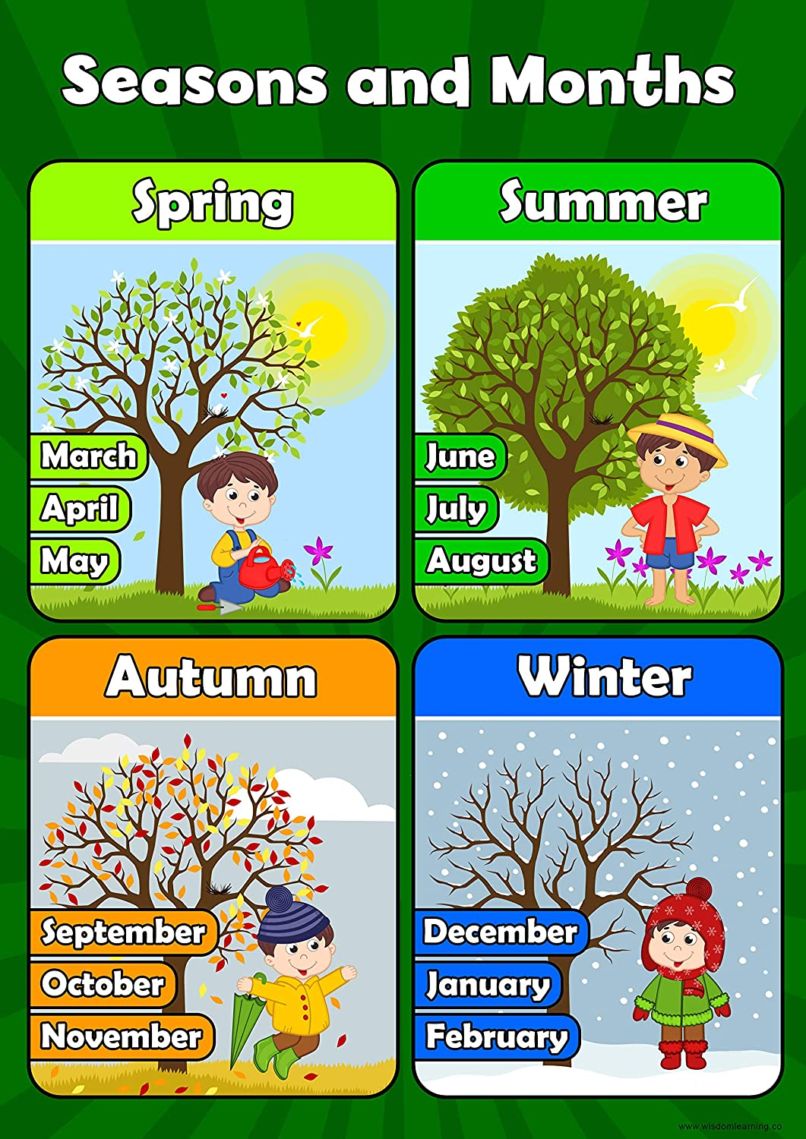

NARIŠI IN NAPIŠI V ZVEZEK

