Slide 1

FOOD
POGLEJ SI PREDSTAVITEV HRANE.
POIMENUJ HRANO, ČE BESEDE ŠE NE ZNAŠ, KLIKNI NA SLIČICO IN SLIŠAL BOŠ POIMENOVANJE HRANE

Slide 2
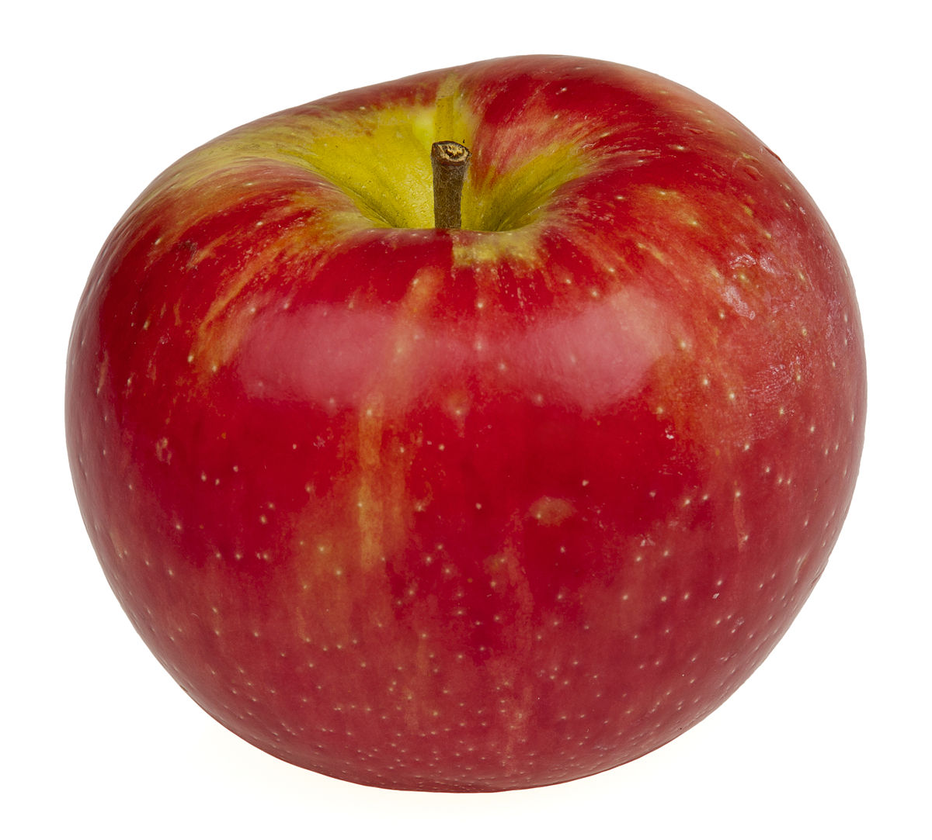
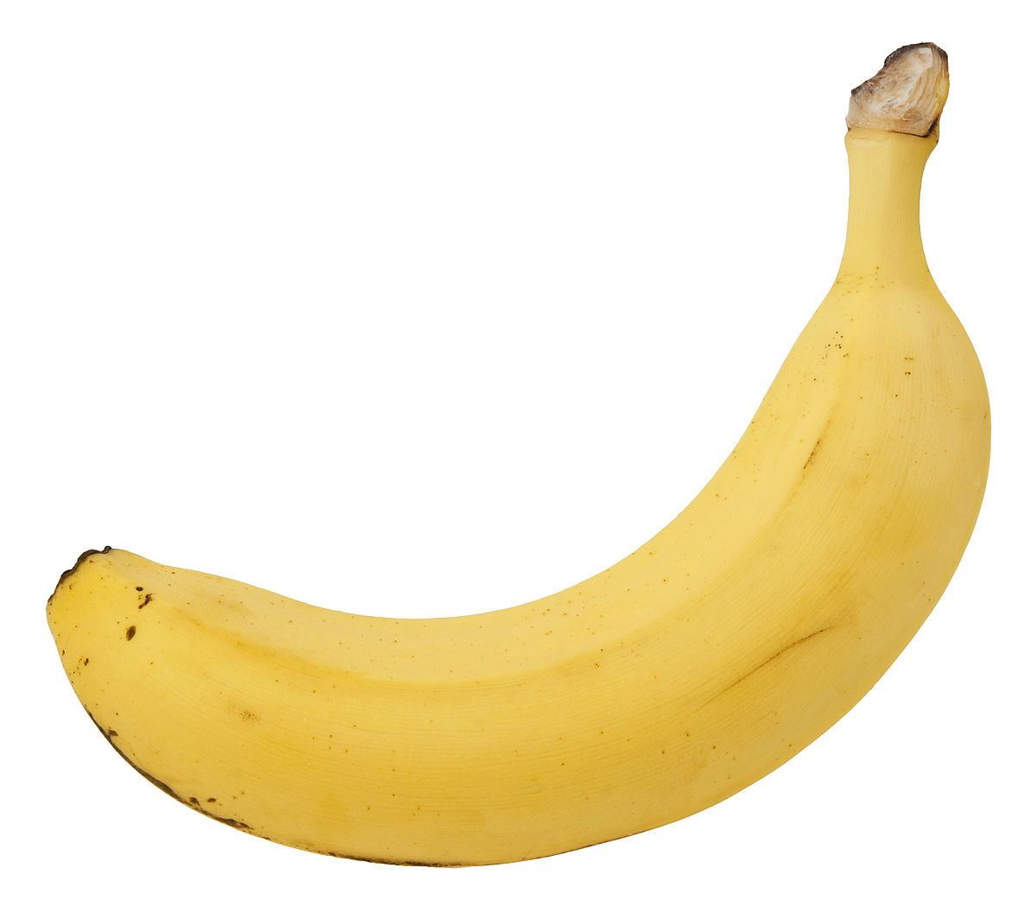
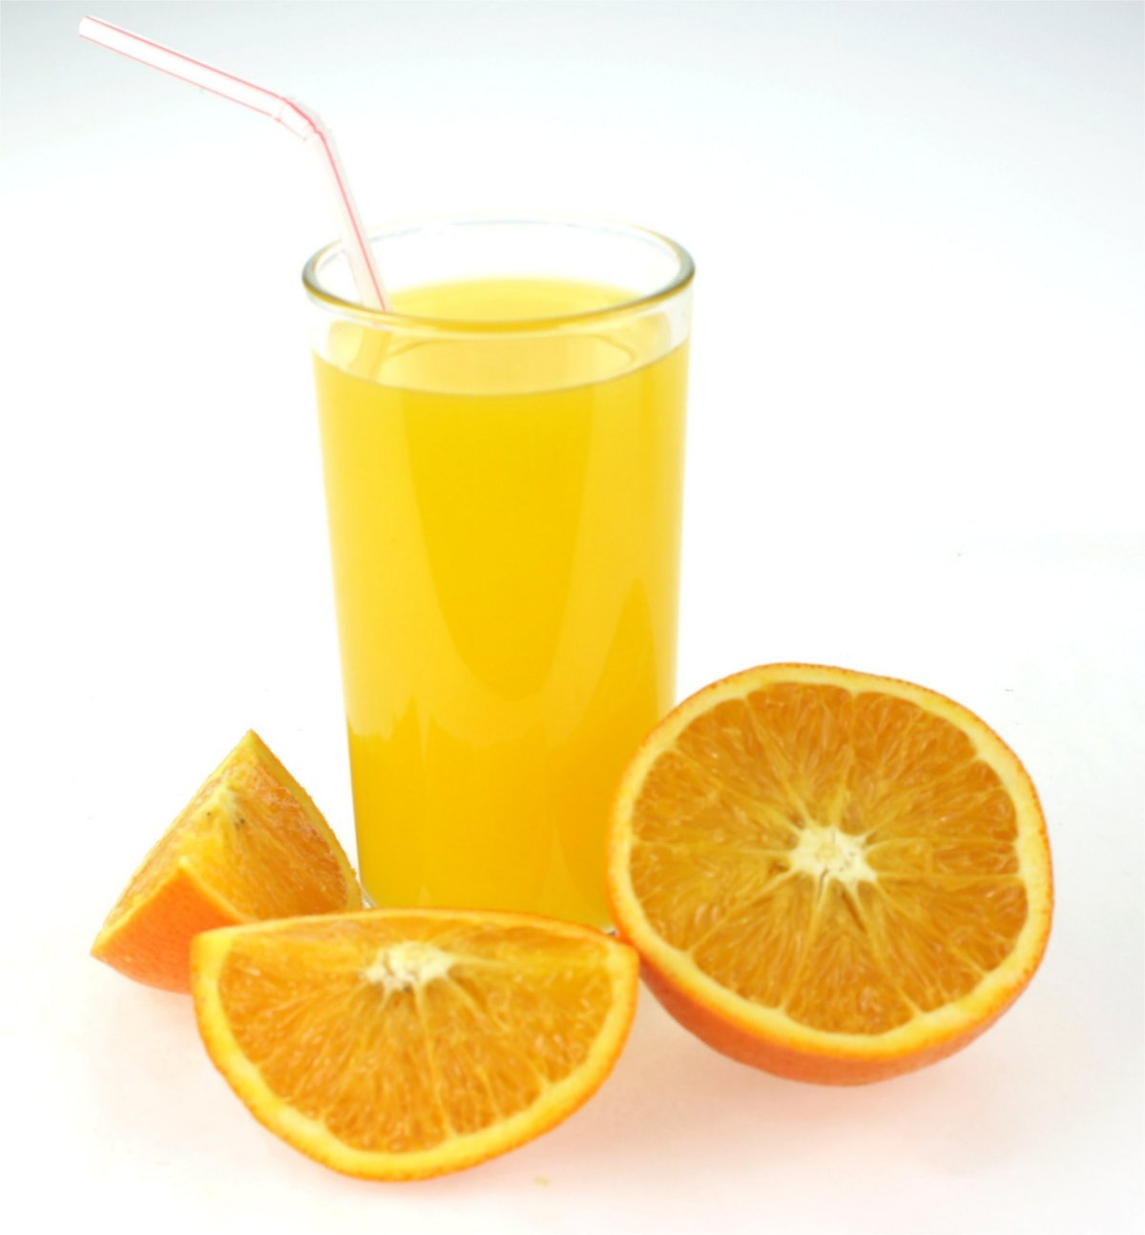
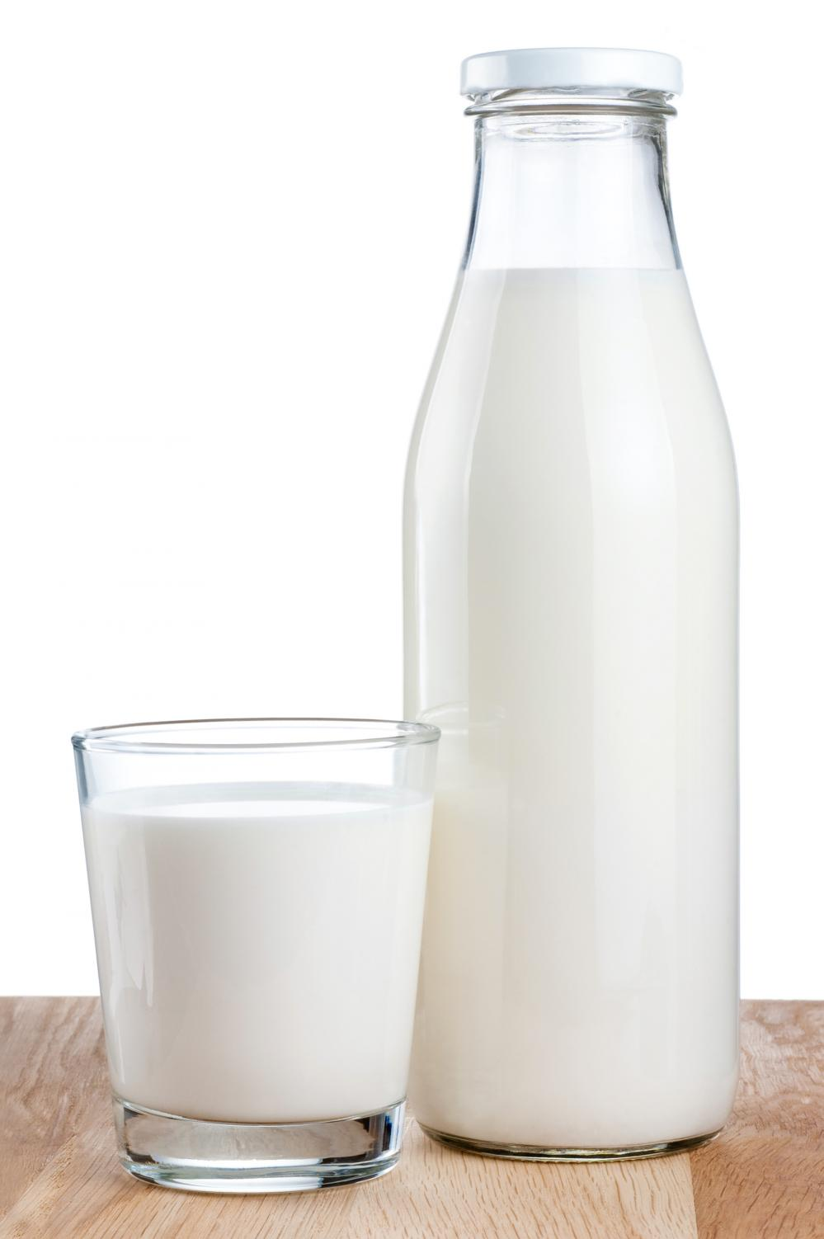

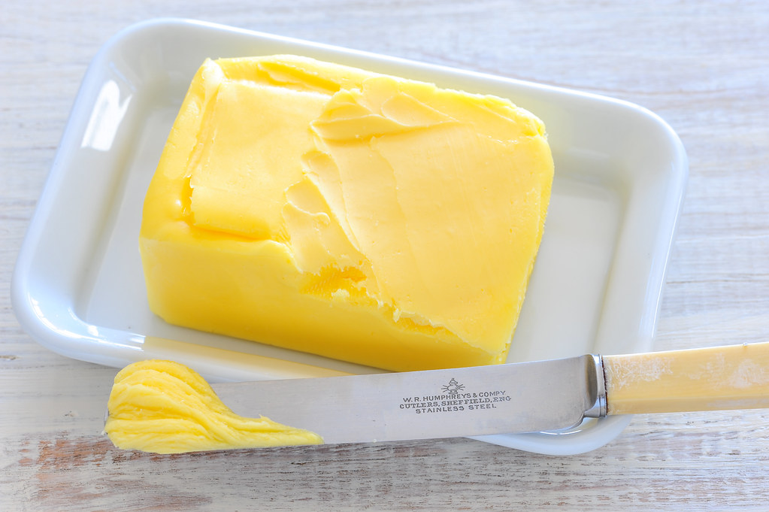
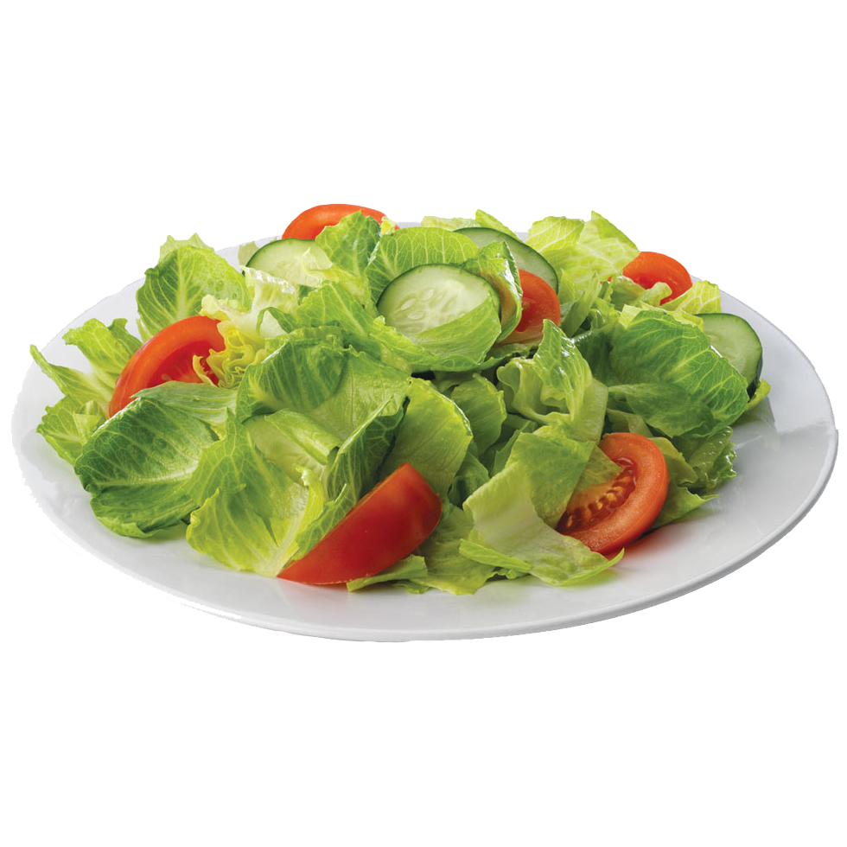
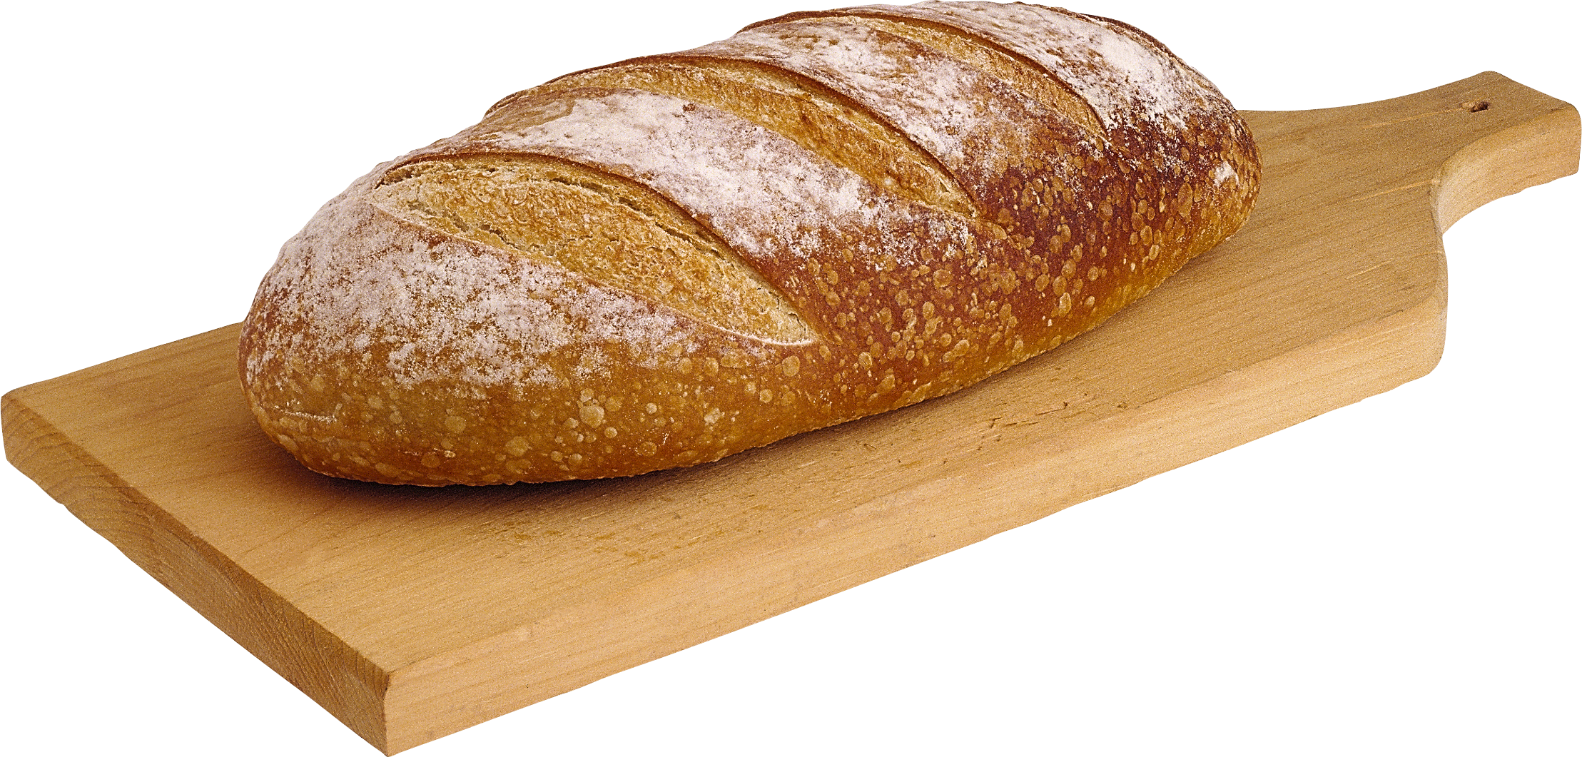
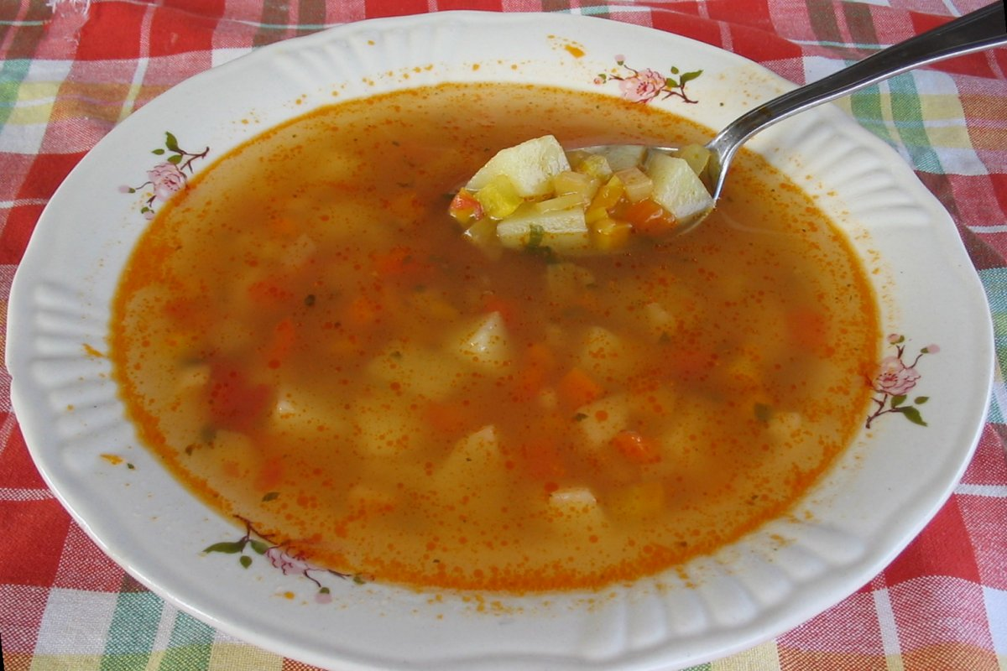
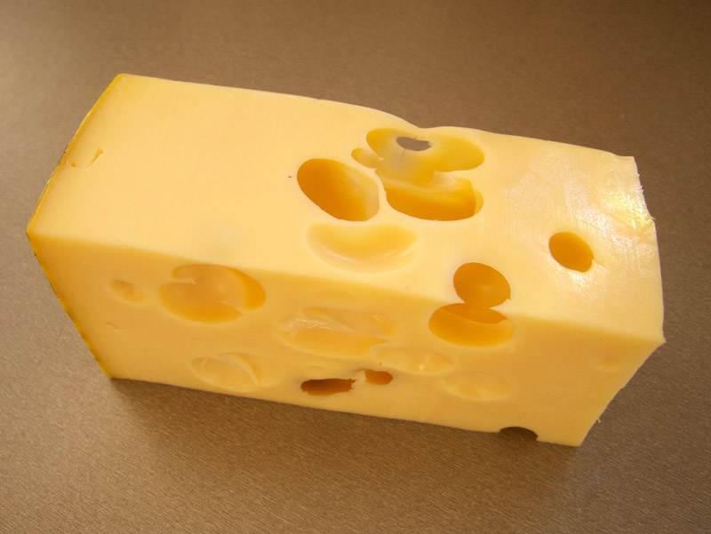
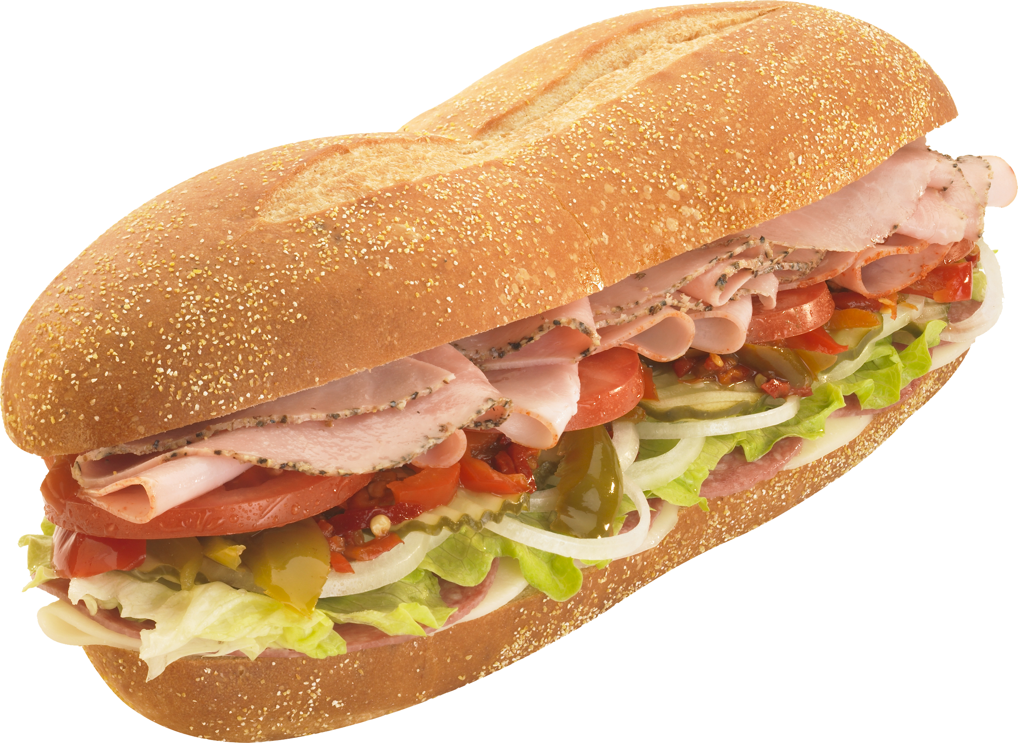
APPLE BANANA JUICE MILK BUTTER
BREAD SOUP SALAD CHEESE SANDWICH

Slide 3


I LIKE MILK.
I DON‘T LIKE CHEESE.

Slide 4
I LIKE APPLES.
I DON‘T LIKE SOUP.

Slide 5
I LIKE SANDWICH AND BANANA AND JUICE.
I DON‘T LIKE SALAD.

Slide 6
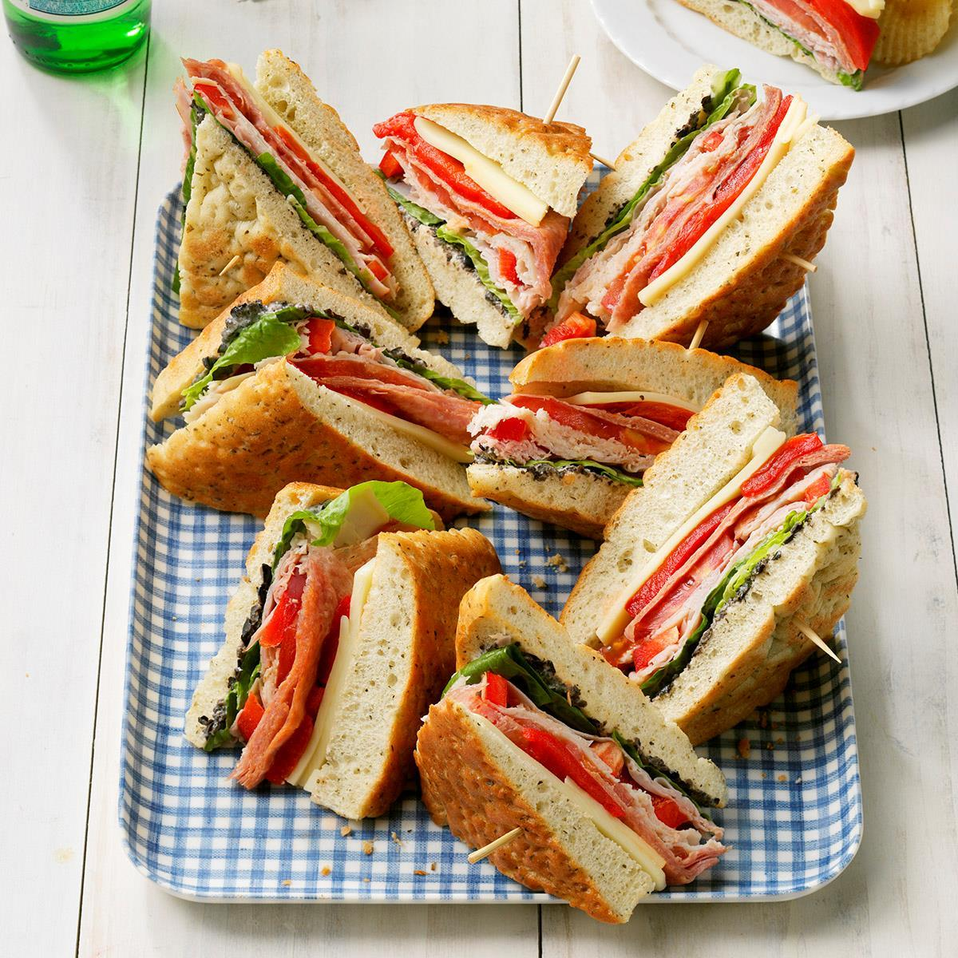
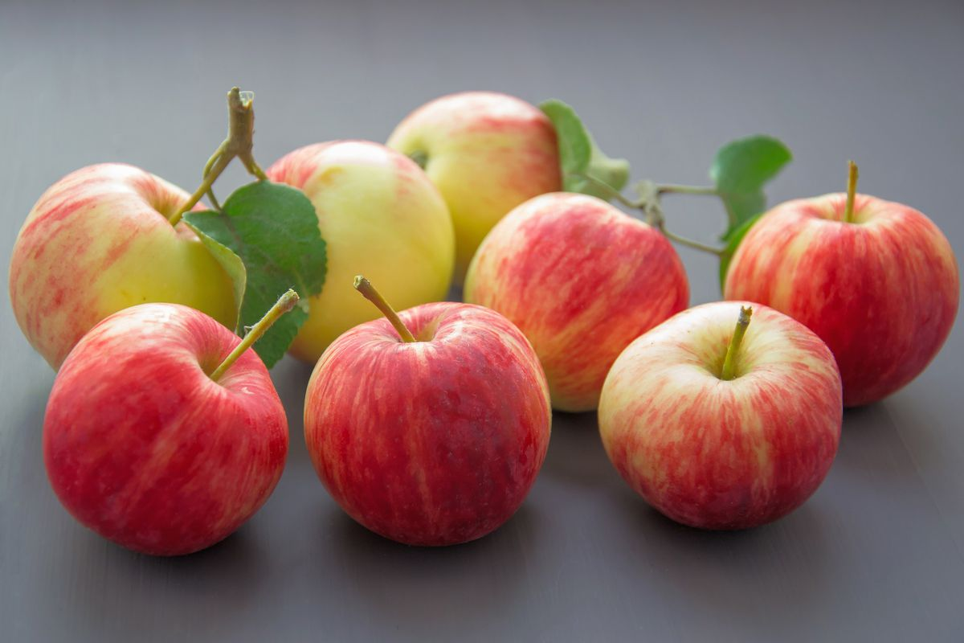
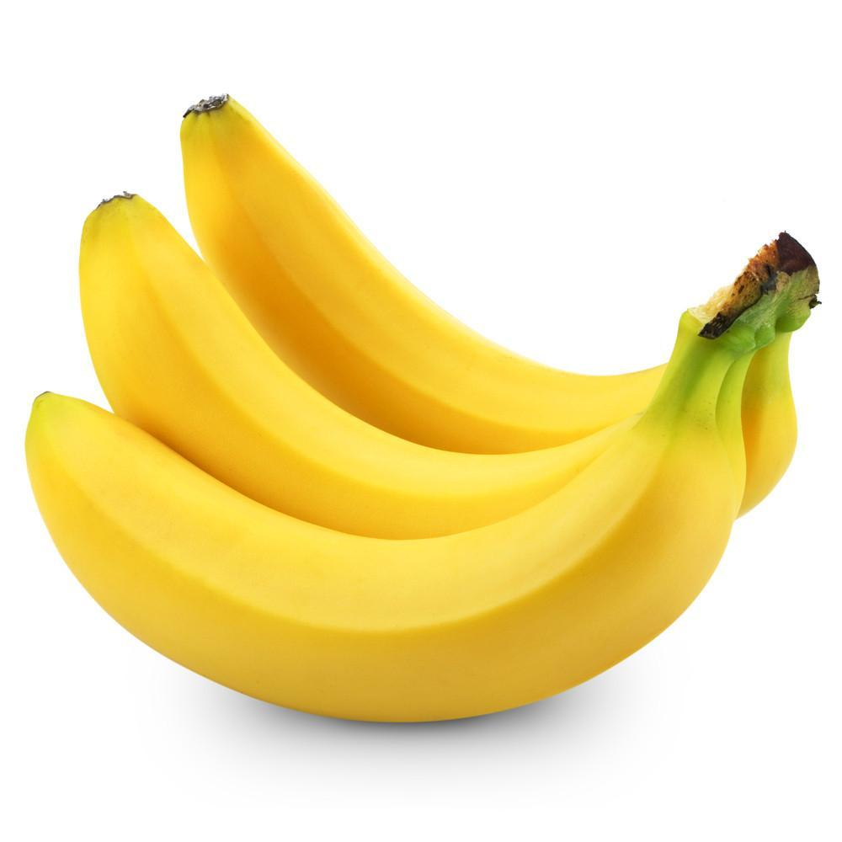
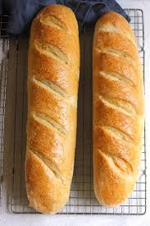
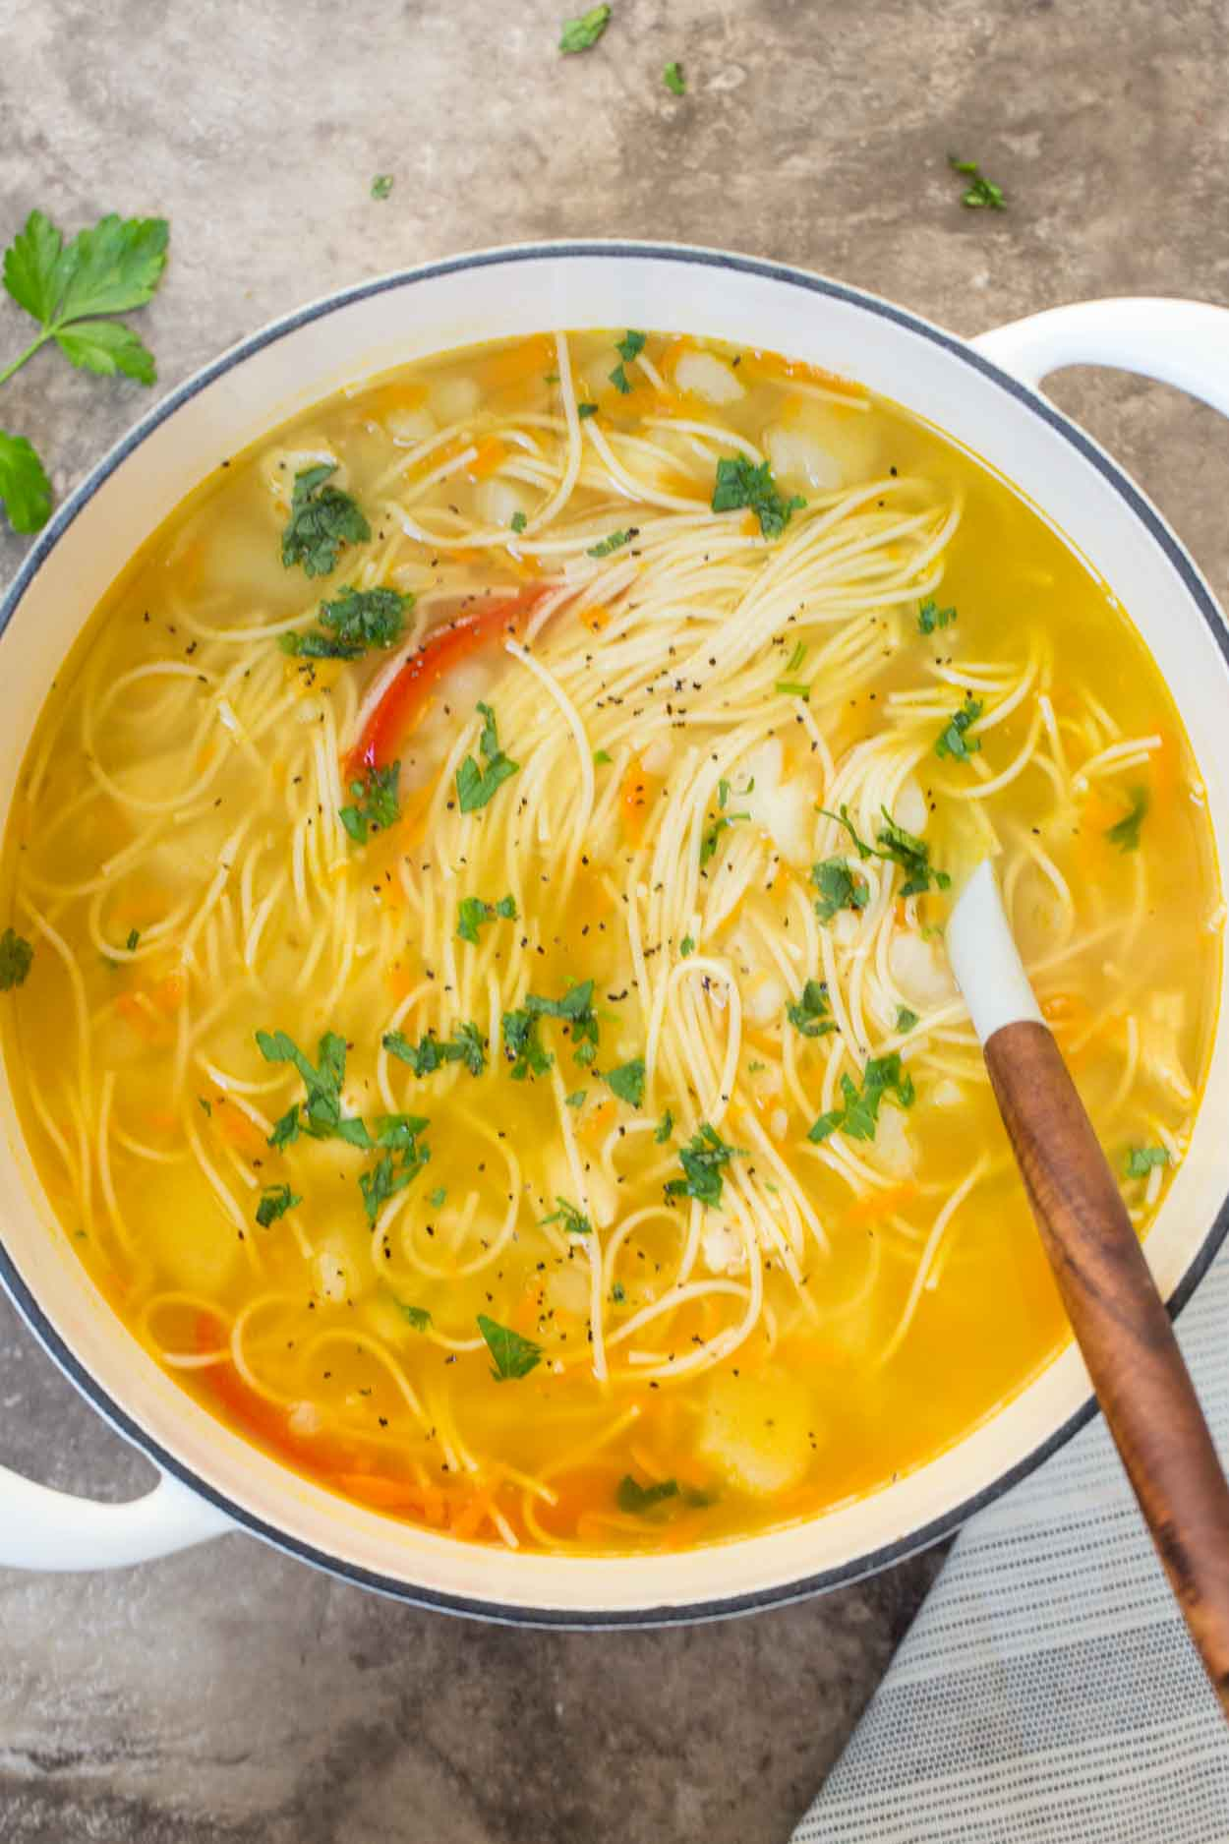
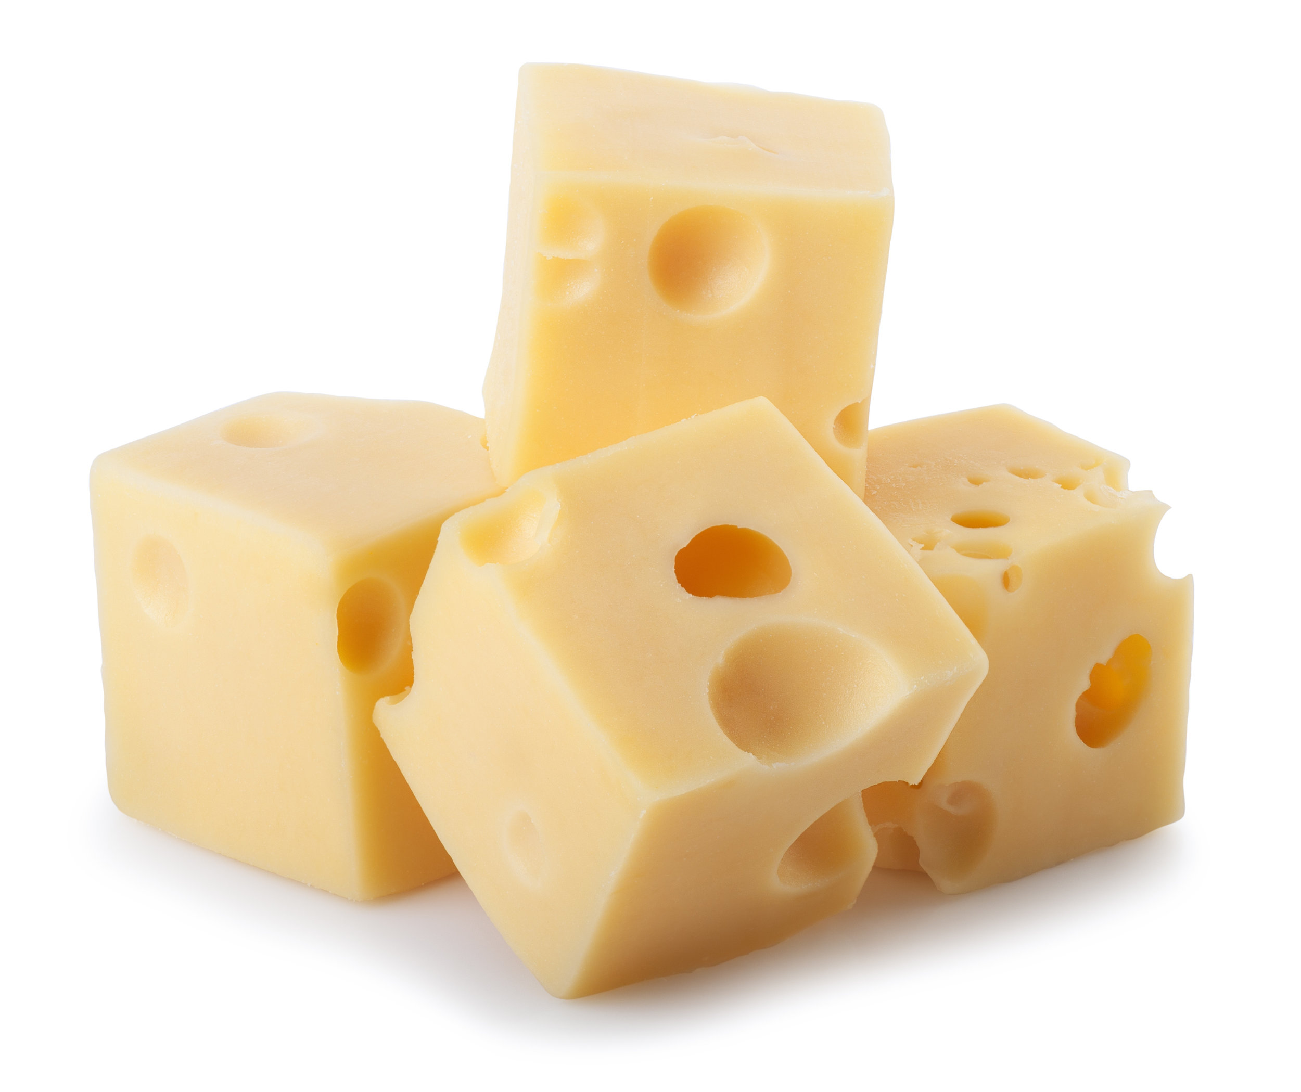
HOW MANY ?

Slide 7

GOOD JOB!!!

