Slide 1


ZLAGANJE OBLAČIL
Jesenice

Slide 2
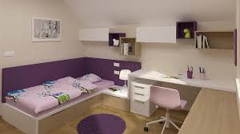
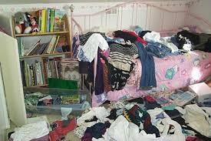

Slide 3
https://www.youtube.com/watch?v=5CW_FIsj29Y

