Slide 1
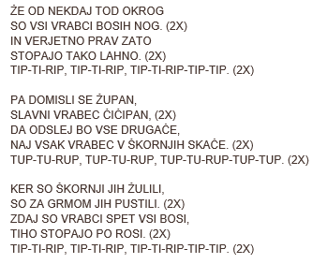
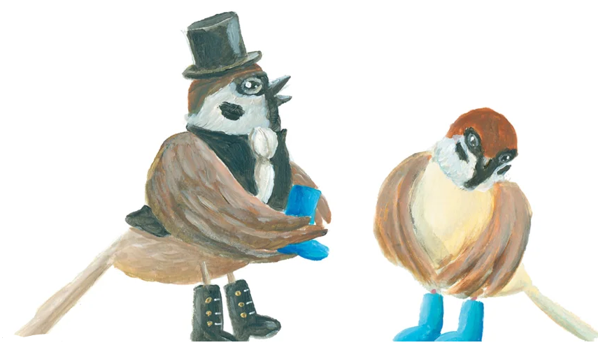
BOSI IN OBUTI VRABCI
MIRA VOGLAR

