Slide 1
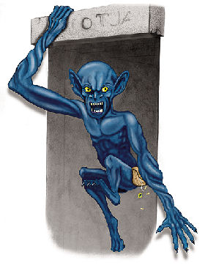


Slide 2
ghost
bat
Haunted house
spider

Slide 3
vampire
werewolf
coffin
zombie
witch

Slide 4
skull
pirate
skull &
crossbones
mummy
skeleton

Slide 5
goblin
ghoul
tomb
Bandaged finger

Slide 6
Monster | Actions
Ghost | appears and disappears.
Vampire | drinks blood, sleeps in coffins.
Witch | flies on a broom.
Werewolf | transforms at full moon.
Mummy | wears bandages.
Pirate | attacks and steals from ships.
Zombie | comes back from the dead.

Slide 7
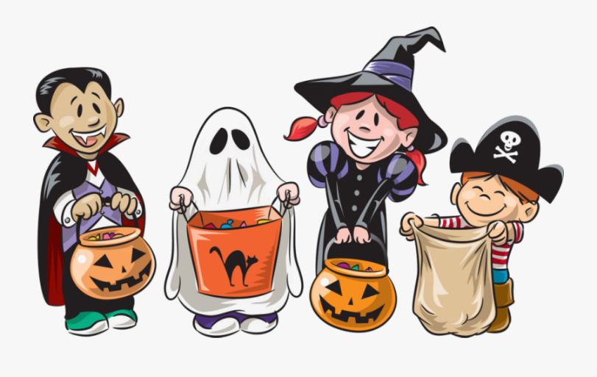
What do kids do?
They trick and treat.
They wear costumes.
They watch scary movies.

