Slide 1

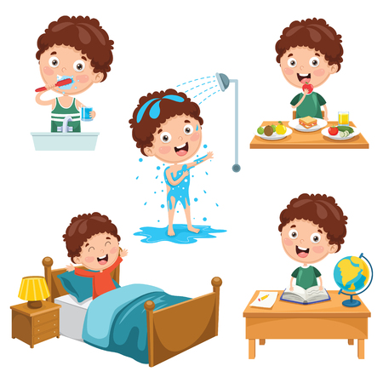


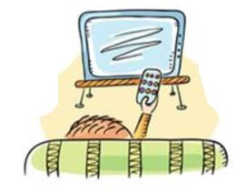

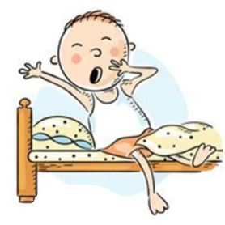
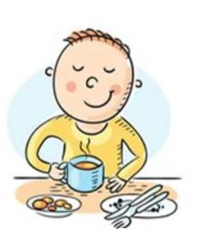

Slide 2
Get up
I get up.

Slide 3
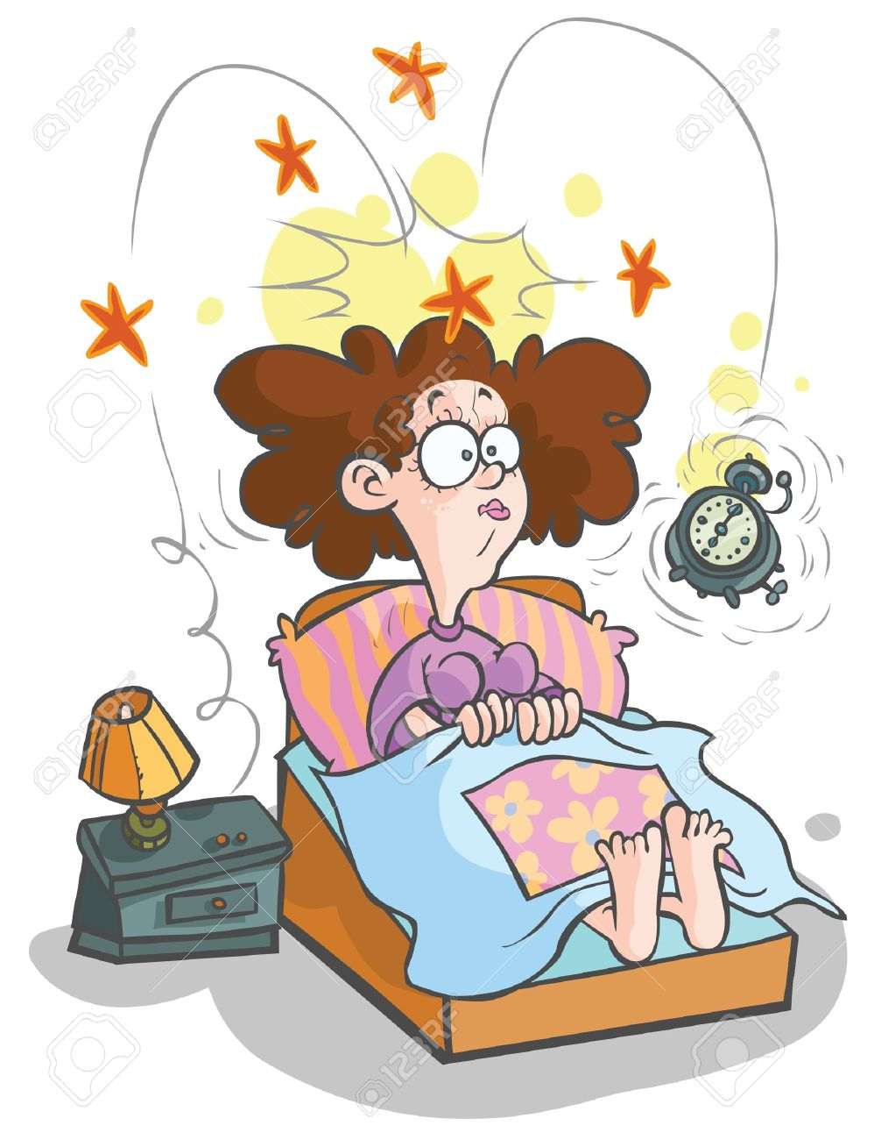
Wake up
I wake up.

Slide 4
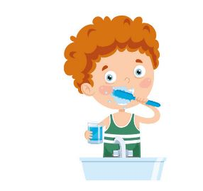
Brush /clean teeth
I brush/ clean my teeth.

Slide 5
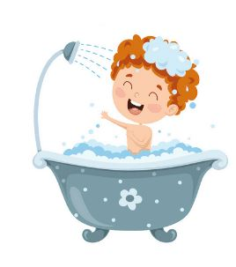
Have a shower
I have a shower.

Slide 6
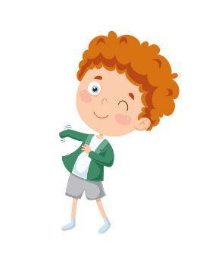
Get dressed
I get dressed.

Slide 7
Go to school
I go to school.

Slide 8

Study
I study.

Slide 9
Have breakfast
I have breakfast.

Slide 10
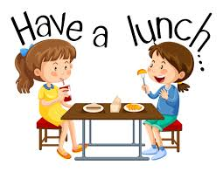
Have lunch
I have lunch.

Slide 11

Have dinner
I have dinner.

Slide 12

Do homework
I do my homework.

Slide 13
Watch Tv
I watch Tv.

Slide 14
Read a book
I read a book.

Slide 15
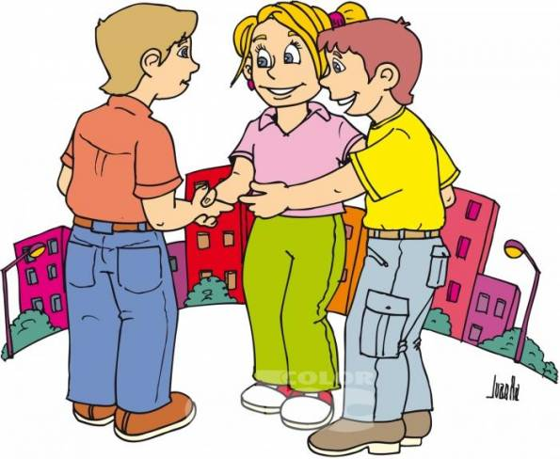
I play with friends
I play with friends.

Slide 16
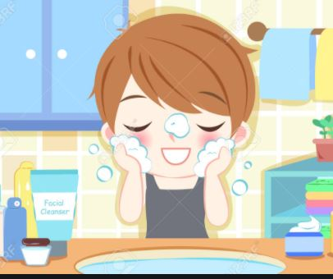
Wash face
I wash my face.

Slide 17
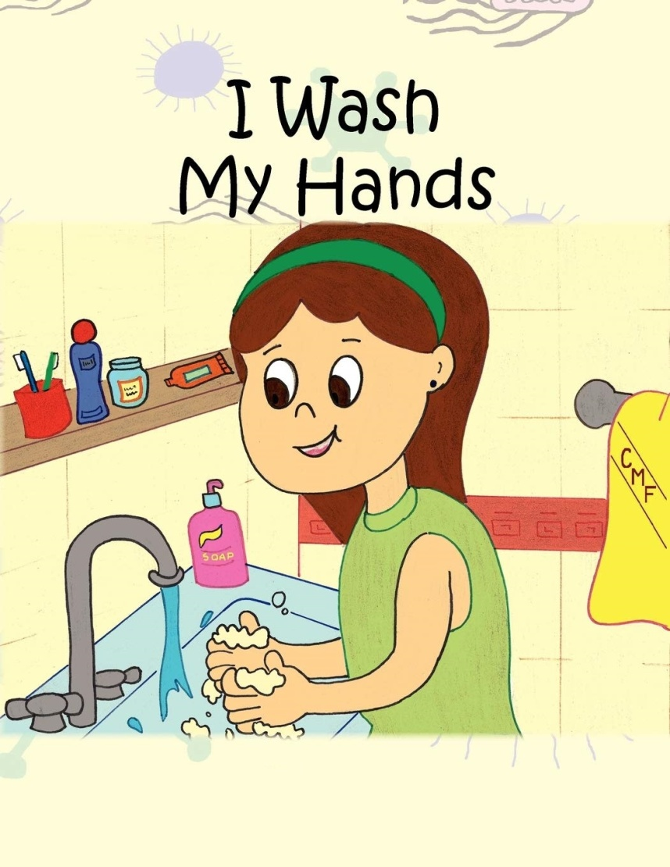
Wash hands
I wash my hands.

Slide 18
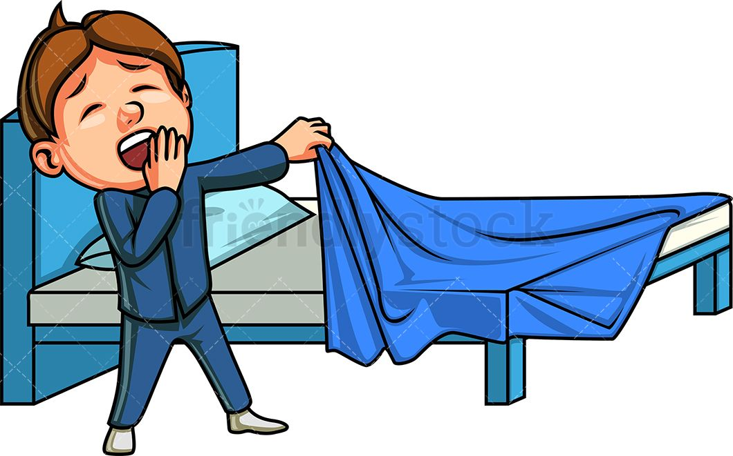
Go to bed
I go to bed.

Slide 19
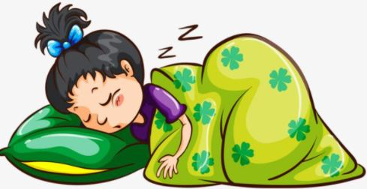
Sleep
I sleep.

Slide 20



