Slide 1
ROSIE‘S TEDDY BEAR
Angleška bralna značka

Slide 2
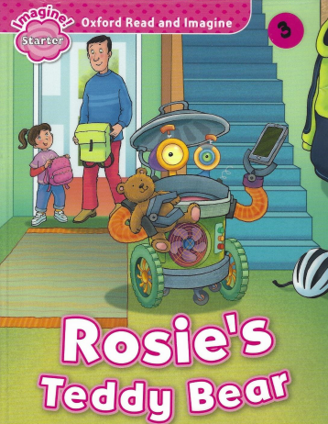
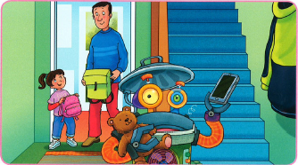
Look at the picture. What can you see?

Slide 3
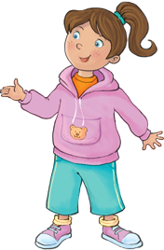

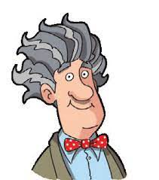
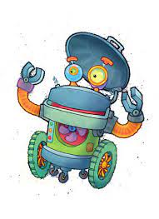
Who is this?
ROSIE
BEN
ROBOT CLUNK
GRANDPA

Slide 4
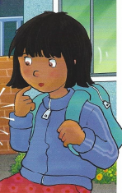

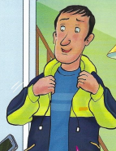
Who is this?
TEDDY
BEAR
BILLY
ROSIE‘S FRIEND
DAD

Slide 5


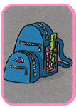

What‘s this?
Colour green
A chair
A bag
A book

Slide 6

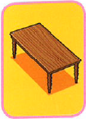


What‘s this?
A table
School
Colour red
A bike

Slide 7
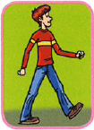
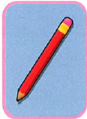
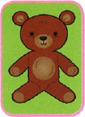
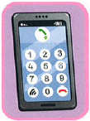
What‘s this?
To walk
A pencil
A teddy bear
A phone

Slide 8



Match the words with the pictures
Teddy bear
Chair
Bag

Slide 9
Say YES or NO.
Rosie has a teddy bear.
The teddy bear is Billy.
The phone is on the table.
Ben is on the bike.
Dad is on the bike.
Clunk is on the bike.
YES
YES
YES
NO
YES
NO

Slide 10
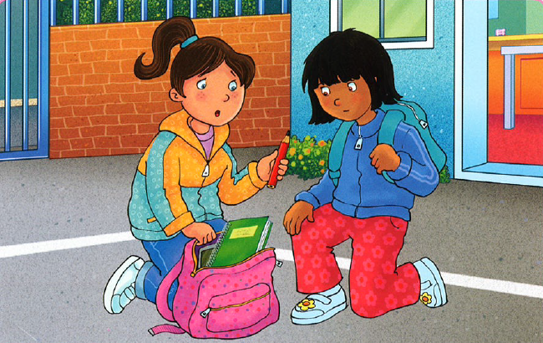
Say TRUE or FALSE.
I can see Rosie.
The bag is red.
The book is green.
The pencil is red.
I can see Billy.
TRUE
FALSE
TRUE
TRUE
FALSE

Slide 11
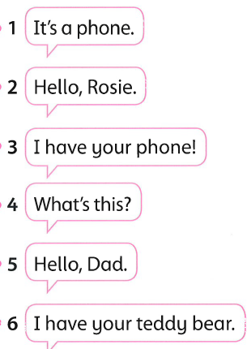
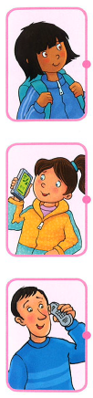
Who says this? Match.

Slide 12
Complete the chart.
COLOURS | SCHOOL
BAG
GREEN
CHAIR
PENCIL
RED
BOOK

Slide 13
Which one is it?
A table
A bike

Slide 14


Which one is it?
School
Walk

