Slide 1
Passive voice
2018/19
LK

Slide 2
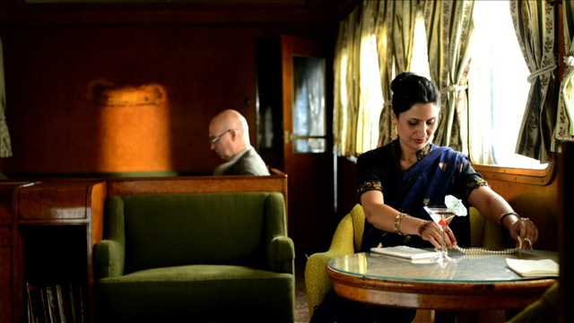
Stolen on the Outback Express
What examples of the passive voice can you find in the story?
Why is it used?
Please click on the photo above to go to the Stolen on the Outback Express video
Notes:
Play the start of the video story using excerpt/chapter 2, The Passives Story, as a warm-up for the class. (N.B. If you are using the complete video, rather than the video chapters, start at 1:15 after the passives song.) Stop part way through the story, at the point where Professor Grahamarian says “Dear dear. I think we should get Ms Parrot to come and help”. (This is at 2:34 in the chapter 2 video, or 3:49 in the complete video.)
Click on the photo to start, or paste this link into your browser:
https://www.youtube.com/watch?v=j8eIWG3Bf-w&feature=youtu.be&list=PLrj2iJKdUdbzmSkwVoc03-UBGwuIZUj7g

Slide 3
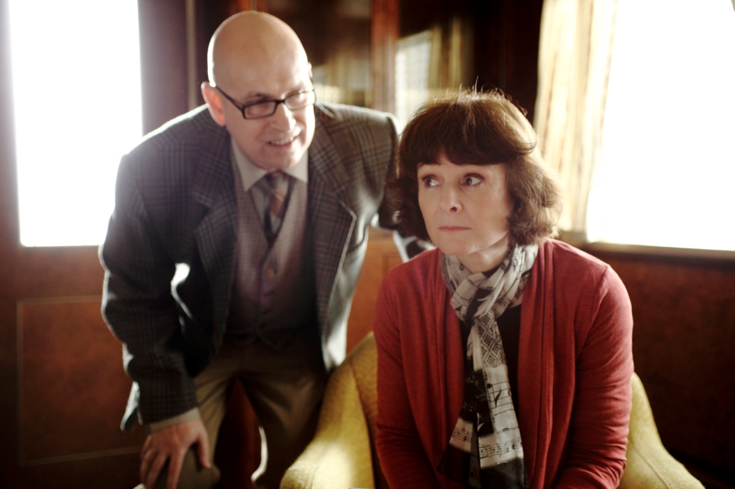
What examples of the passive voice can you find in the story?
Please click on the photo above to go to the Stolen on the Outback Express video
Notes:
Look for passive voice examples in the rest of the story. Play the story through to the end and stop at the teaching section.
Click on the photo to start, or use this link:
http://www.youtube.com/watch?v=j8eIWG3Bf-w&t=2m34s

Slide 4
Structure of Passive Verbs
  Syntactic Structure
  ACTIVE ----------------------- PASSIVE
  e.g. eats ----------------------- is eaten
  i.e. verb ----------------------- be + p.p.
  Note: “be” is changed according to
  the tense of the sentence
  the number (singular/plural) of the subject of the sentence.

Slide 5
Passive Verbs in Tenses
Present Tenses
Tenses Active Passive
Present - Simple -eats is eaten
- Continuous -is eating is being eaten
- Perfect -has eaten has been eaten

Slide 6
Past Tenses
Now, try to complete the following table:
Tenses Active Passive
Past - Simple -ate
- Continuous -was eating
- Perfect -had eaten

Slide 7
ANSWERS
Tenses Active Passive
Past - Simple -ate -was eaten
- Continuous -was eating -was being eaten
- Perfect -had eaten -had been eaten

Slide 8
Future Tenses
Tense Active Passive
Future - Simple -will eat
- Continuous - will be eating
Going to Future - is going to be eaten

Slide 9
ANSWERS
Tense Active Passive
Future - Simple -will eat will be eaten
will be eaten
is going to be eaten

Slide 10
MODALS
Present___________Active_________Passive
You should brush your teeth - should be brushed
Past______________Active__________Passive
You should have delivered it. - should have been delivered
!!! must have been
Not had have been;

Slide 11
The impersonal passive
Is used to express opinion in a formal style
It is said/ thought/ considered that……………………….
He/She is said/claimed to be …………………………….
It is estimated that………………………………………………

Slide 12
The causative: to have/get something done
Have sth. done is more formal than get sth. done
Also possible:
Get the chef to prepare you a vegetarian meal

Slide 13
Transitive
SUBJECT VERB OBJECT
started
What did Robin start?
Answer: the group project
The verb ‘start’ can take an object, so it is transitive.
Robin
the group project

Slide 14
Intransitive
SUBJECT VERB OBJECT
laughed.
What did Robin laugh?
Answer: Nothing. You cannot laugh something.
The verb ‘laugh’ cannot take an object, so is intransitive.
Robin

Slide 15
Some verbs are transitive and intransitive
I ran the race (transitive)
I ran quickly (intransitive)

Slide 16
The object of the active sentence becomes the subject of the passive sentence.
SUBJECT VERB OBJECT
started
SUBJECT VERB was started
Robin
the group project.
The group project
by Robin.

