Slide 1
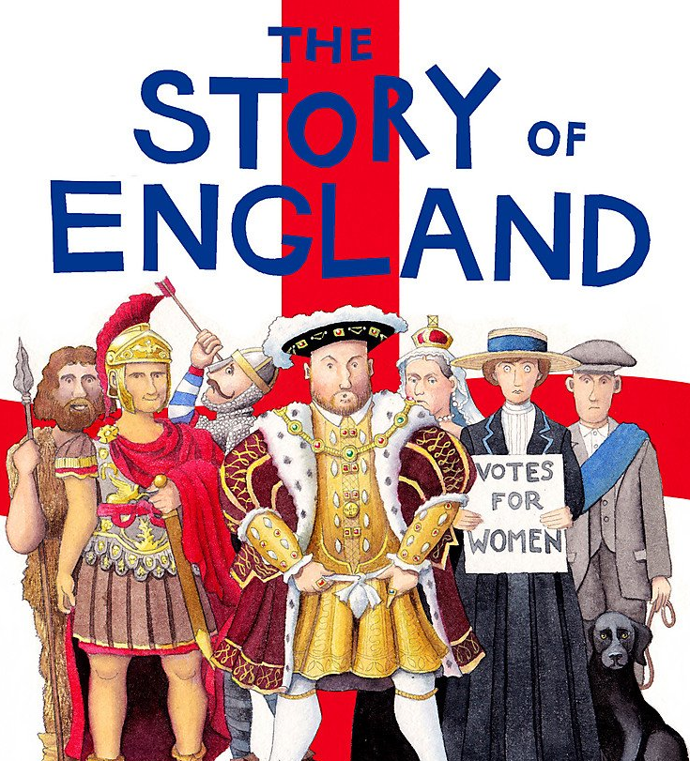

Slide 2
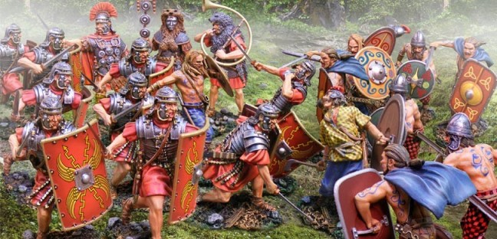
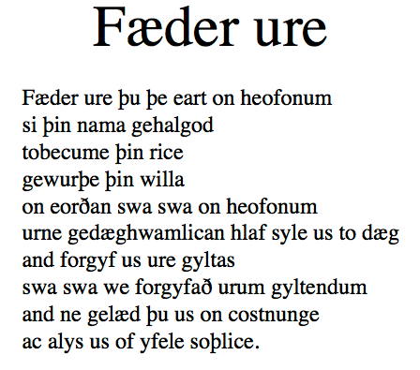
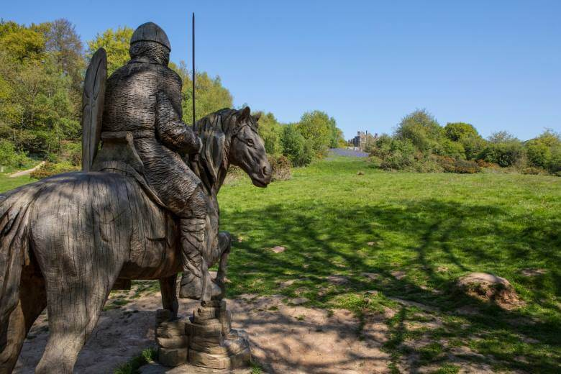
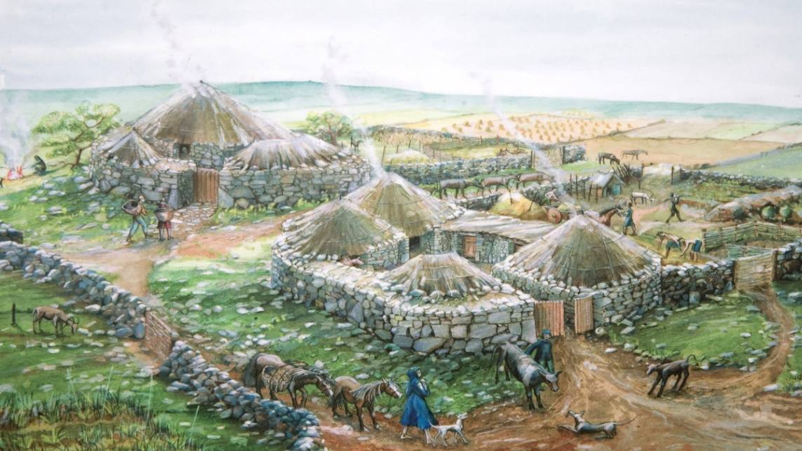
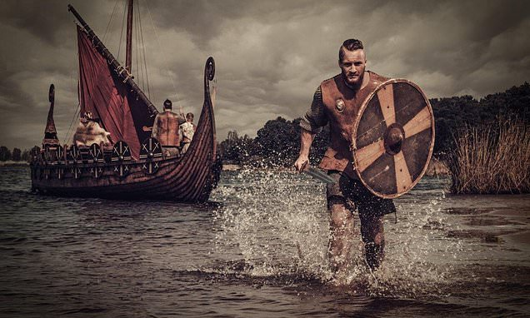

Slide 3
vocabulary
a mixture of (n) → to mix (v)
a dictionary (n) SLOVAR
law (n) → a new law lawyer!
ODVETNIK
to explain (v) → explanation (n) POJASNITI
PRAVO/ZAKON
a parliament (n)
spelling (n) → to spell a word ČRKOVANJE
an inhabitant (n) → !ancestor PREDNIK !descendant POTOMEC
the pronunciation (n) → to pronounce (v) IZGOVORJAVA
a settler (n) → to settle (v) NASELJENEC
strange (adj), confusing (adj) ČUDEN/ZAPLETEN
to arrive (v) → arrival (n) PRISPETI
alphabet (n), numerals (n)
to invade a country (v) → invaders (n) → invasion (n)
NAPASTI
God/GODDESS (n)
to defeat (v) → a defeat (n)=poraz
BOGINJA
PREMAGATI
to rule (v)
to make an agreement = to agree WITH sth DOGOVORITI SE
VLADATI
to replace (v) → a replacement (n)
the royal court
ZAMENJAVA
KRALJEVI DVOR
to appear (v) → appearance (n)
POJAVITI SE
to publish (v)
OBJAVITI
an accent (n)
NAGLAS
a conversation (n) → to converse (v)
POGOVOR

