Slide 1




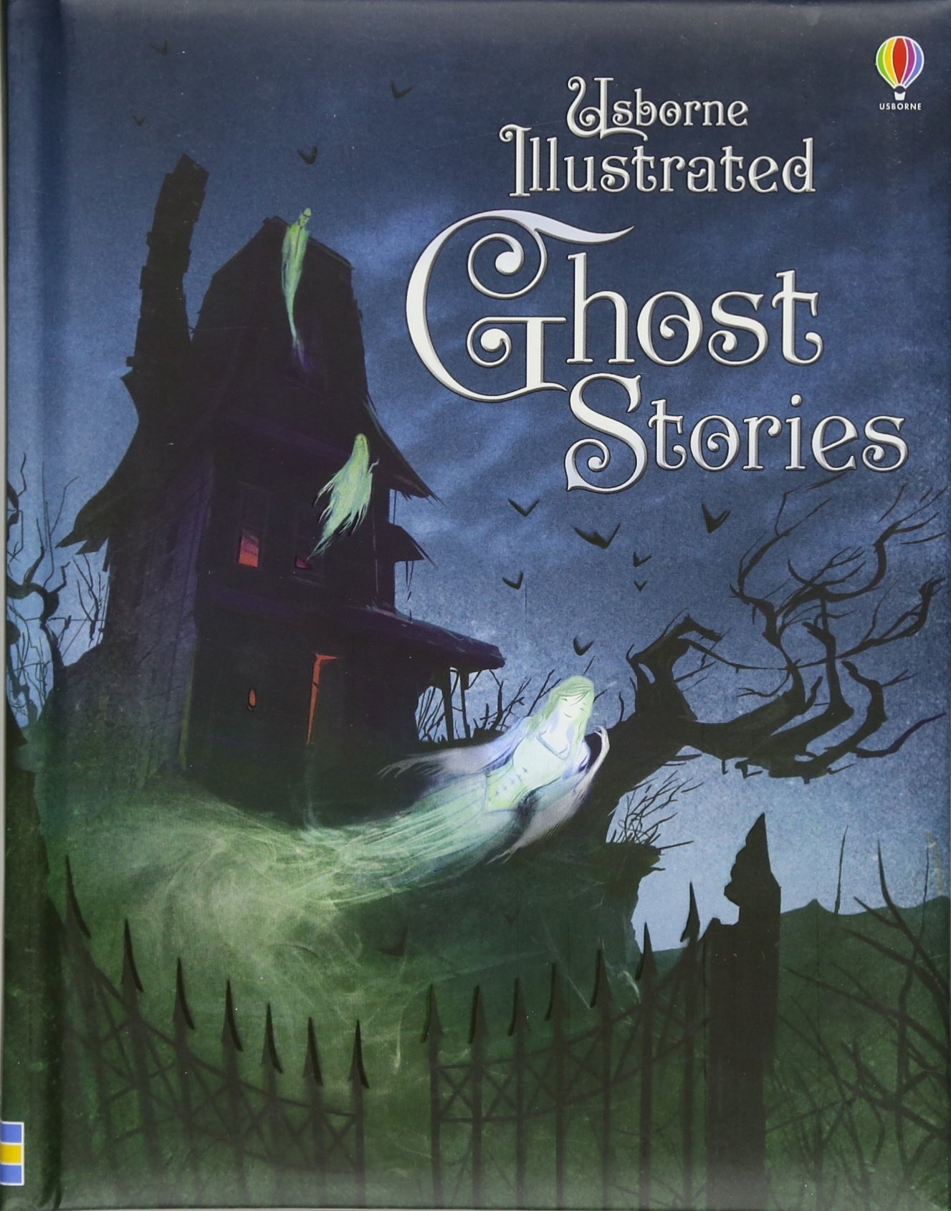



What kind of stories do you like to read?

Slide 2

Open your book, p. 18. Press the button and listen to the story

Slide 3
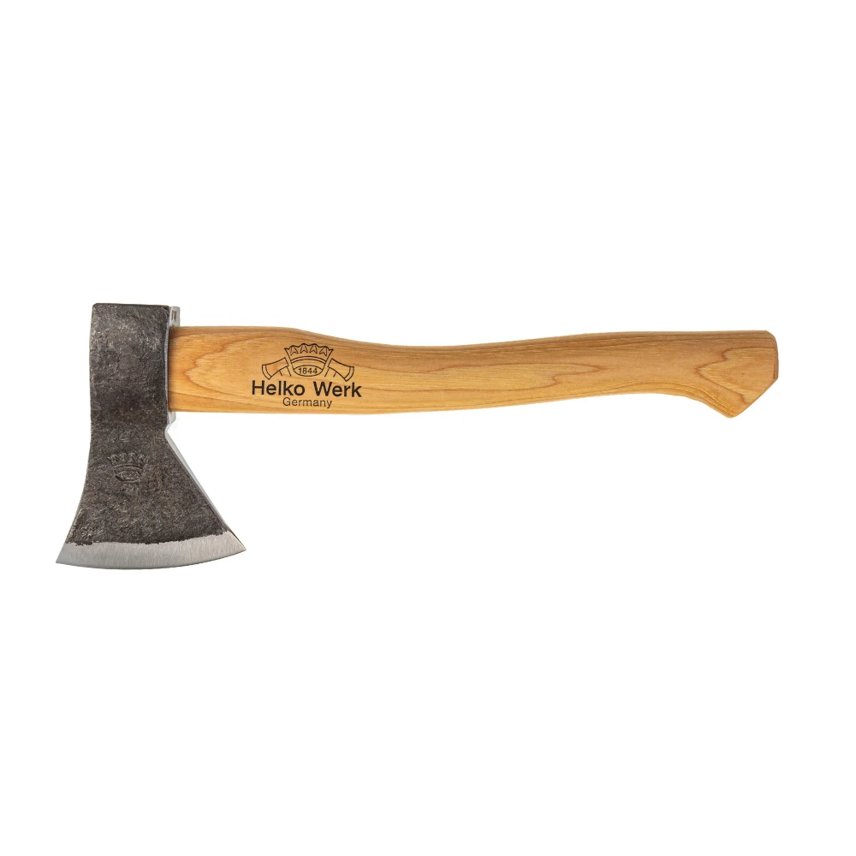
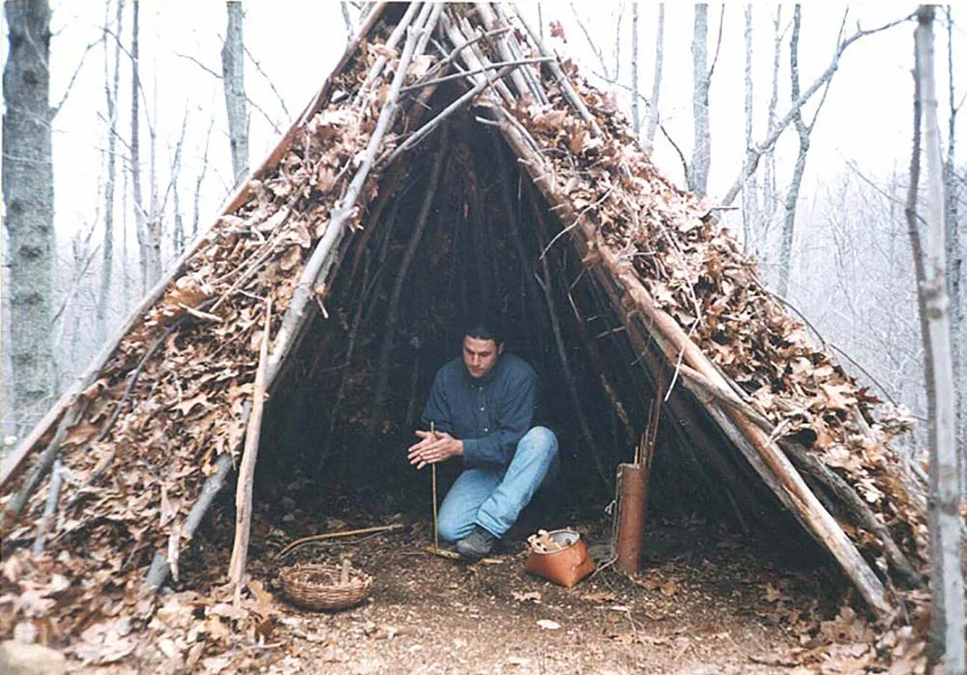
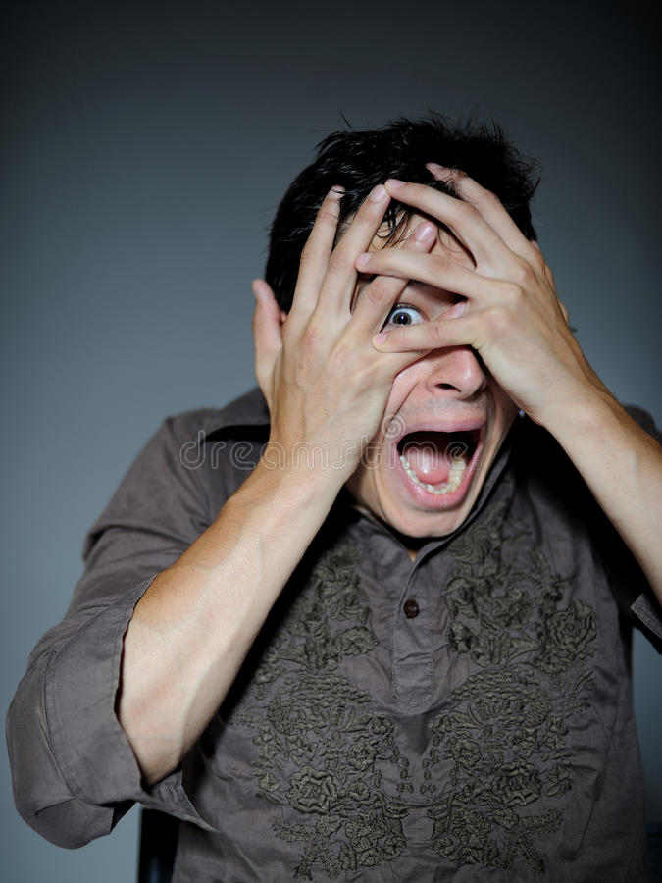
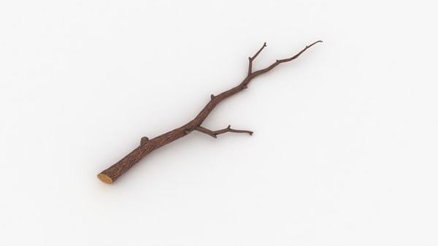
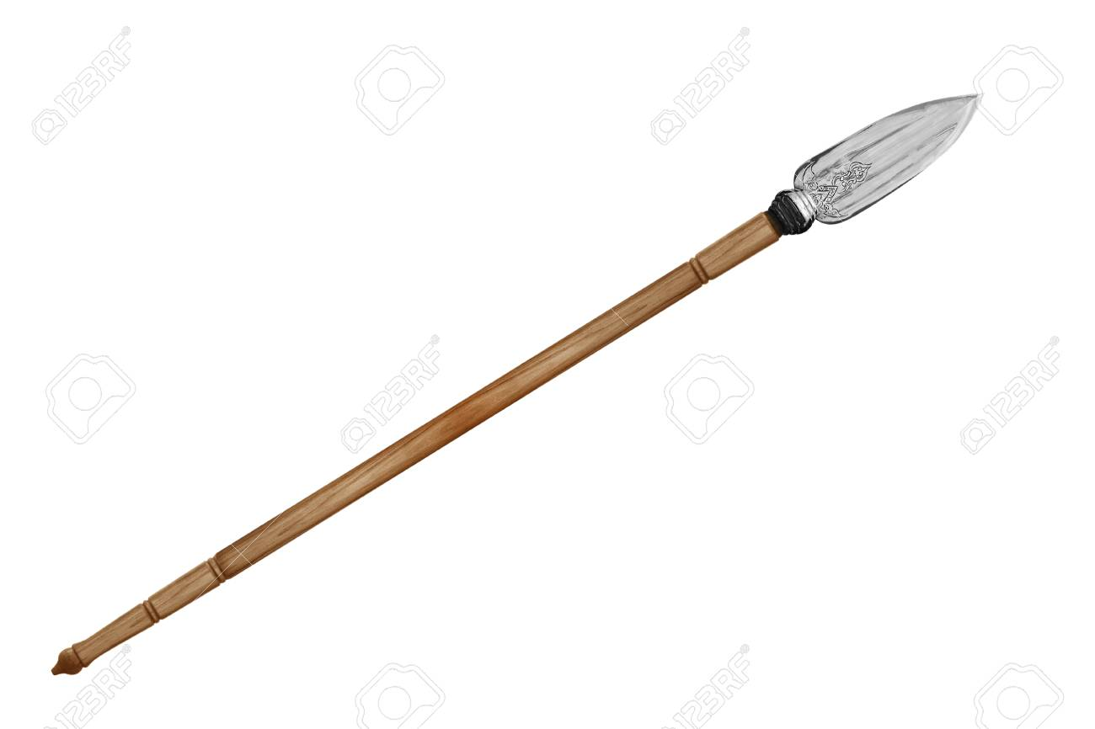
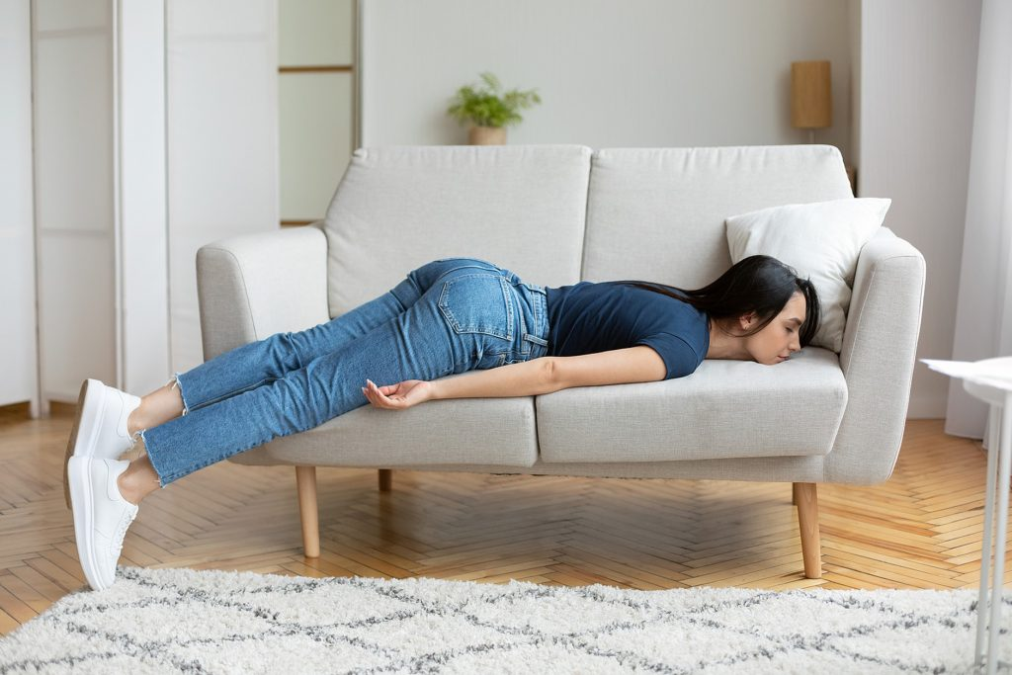
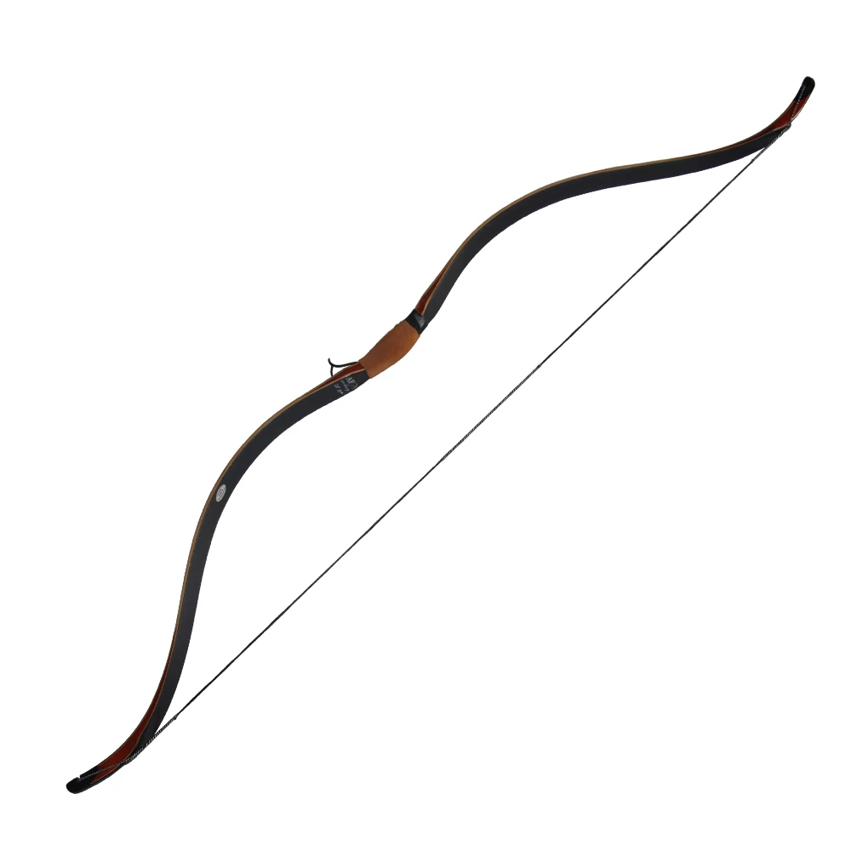
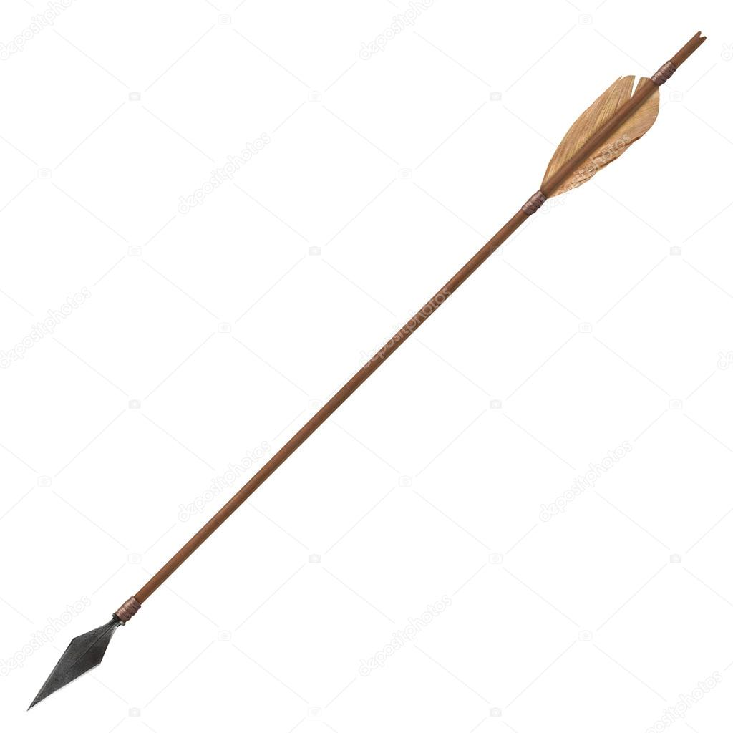
SURVIVAL (zelene besede so minimalni standard, rdeče obarvane razlage so za višji nivo).
PESSENGER (n)
TO HAVE A HEART ATTACK
FIERCE (adj)
Strong with lots of energy
SURFACE (n)
TERRIFIED (adj)
very frightened
Press the button ☺
the top layer
EXHAUSTED (adj)
extremely tired
TO CALL FOR HELP
A HATCHET (n)
TO HEAR A NOISE
a small axe
IN THE WILD
ADVENTURE (n) → adventurous (adj)
= an exciting experience
land not used by people for farming, building
TO SURVIVE (v)→ SURVIVAL (n)
to continue to live after an accident, war, or illness
TO MAKE A SHELTER
a place to live
A BRANCH
a part of a tree that grows out from the trunk (deblo)
TO CUT WOOD
TO START A FIRE
TO MAKE A SPEAR
a pole with a sharp blade
TO MAKE A BOW AND ARROW
a weapon used for shooting arrows

Slide 4
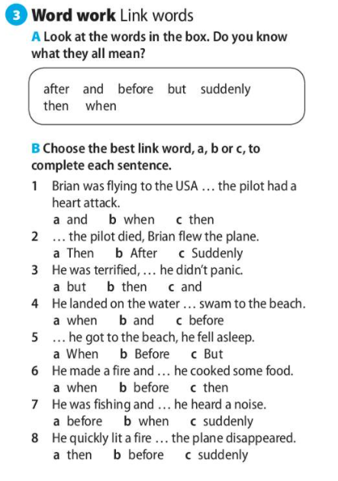
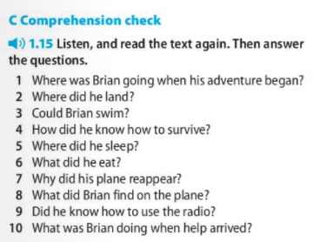
Odgovore tvori v celoti in jih zapiši v zvezek.
Npr: Brian was travelling from the USA to Canada to see his father when his adventure began.
Odgovore s pravilno vstavljenim veznikom zapiši v zvezek.

