Slide 1


Slide 2

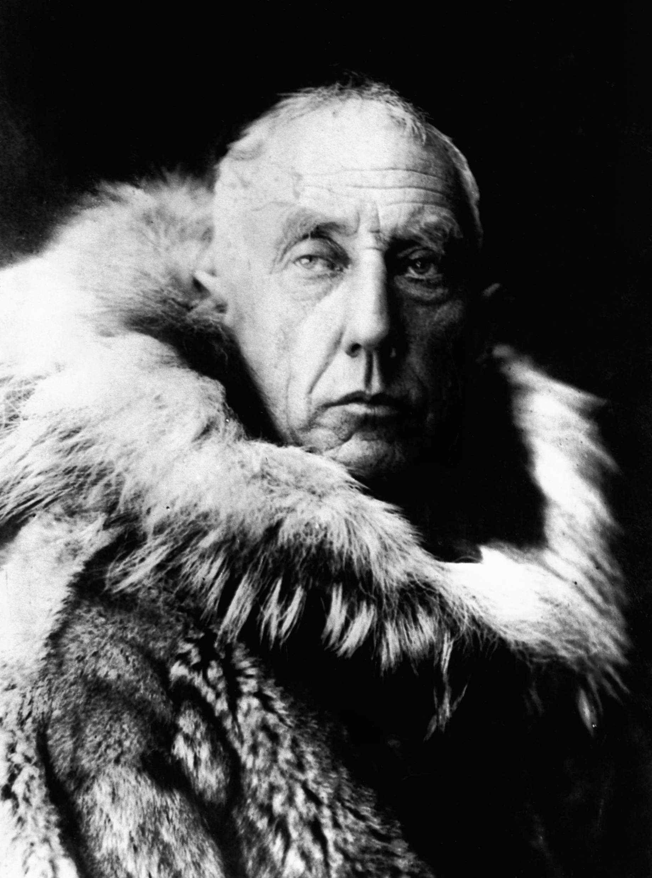

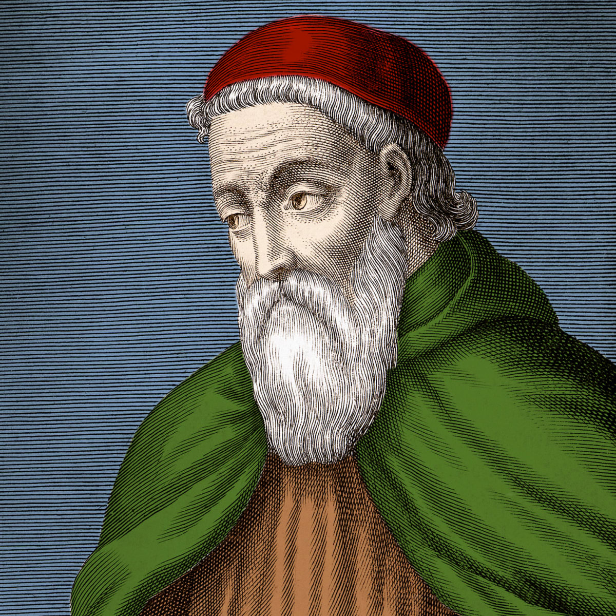
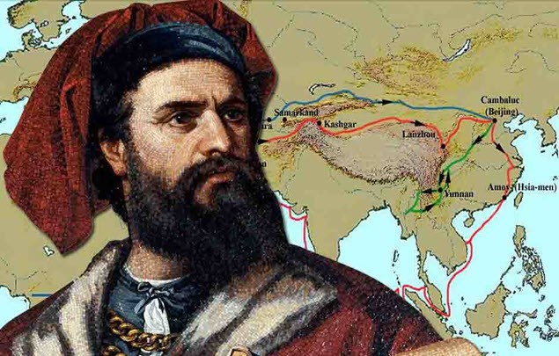

Slide 3


Prepiši novo besedišče; minimalni standardi so obarvani zeleno in svetlo modro. Za višje ocene in za učence, ki zmorejo več, dodajte še razlage v črni barvi.
JOURNEY (n) - an occasion when you travel from one place to another, especially over a long distance POTOVANJE
EXPEDITION (n) - a long and carefully organized journey ODPRAVA
EXPLORER(n) → EXPLORATION (n) = someone who travels through an unknown area RAZISKOVALEC
CORNER (n) - the point at which two lines or edges meet KOT
TO DISCOVER (v) → DISCOVERY (n) → DISCOVERER = to find someone or something ODKRITI
TRADE ROUTE (n) TRGOVINSKA POT
TREASURE (n) valuable things such as gold, silver, jewels ZAKLAD
TO GAIN (v) achieve something you want PRIDOBOTI
COMPASS (n)- an instrument that shows directions and has a needle that always points north
NAVIGATE (v) - to find which way you need to go KRMARITI
RESEARCHER (n) - someone who studies a subject in detail in order to discover new facts or test new ideas RAZISKOVALEC
THE SILK ROAD (n) - an ancient route along which silk was carried from China. SVILENA POT Silk → SVILA
SPICES (n) - a type of powder or seed that you put into food you are cooking to give it a special taste ZAČIMBE
SET OUT (v) - to start a journey KRENITI, ODPRAVITI SE
VOYAGE (n) – POTOVANJE

Slide 4
BATTLE (n) – a fight BITKA
PASSAGE (n) – a long narrow area KORIDOR, tudi hodnik STRAIT OF MAGELLAN-Magellanov preliv
TO HOLD THE GUINESS WORLD RECORD (n) DRŽATI/IMETI V LASTI GUINNESOV REKORD
DISTANCE (n) → DISTANT (adj) - space between two places or things RAZDALJA

