Slide 1
HALLOWEEN

Slide 2
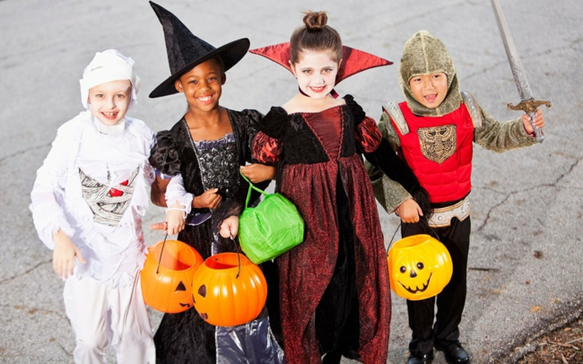
costumes

Slide 3
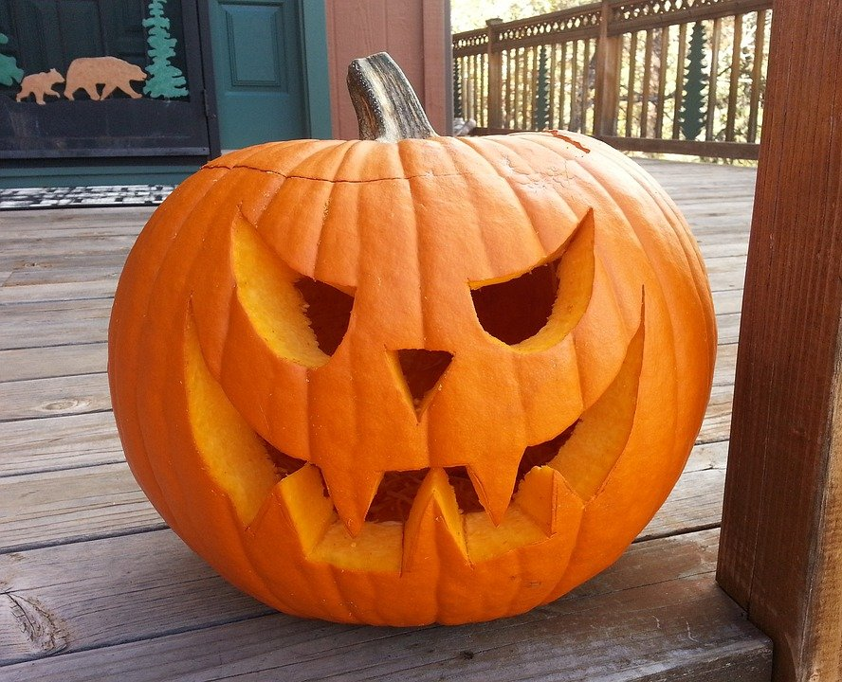
pumpkins

Slide 4
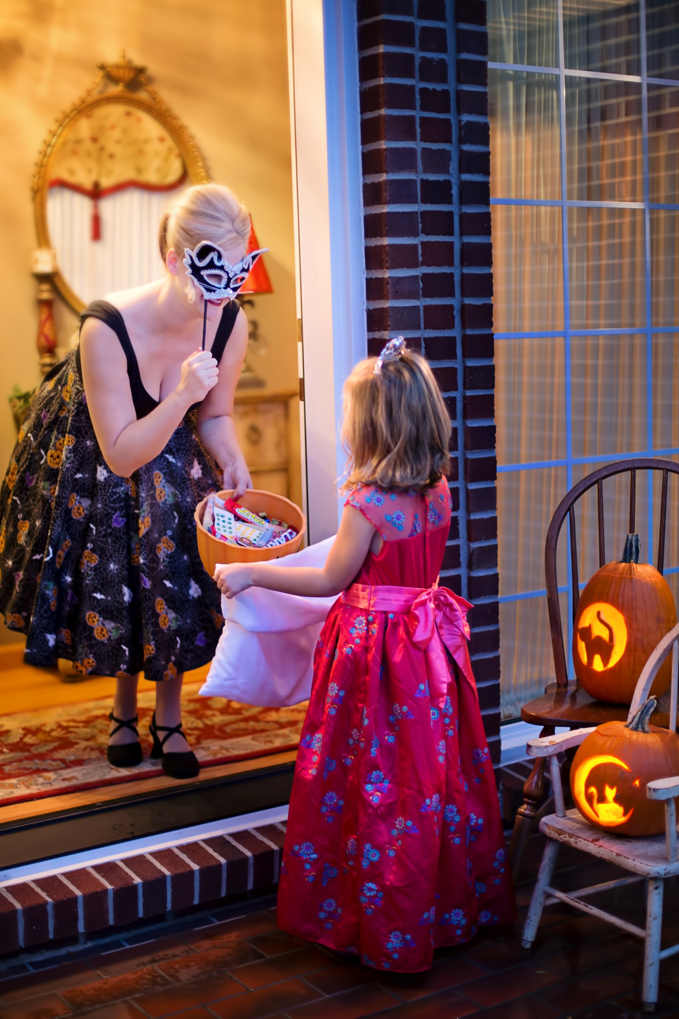
trick or treat

Slide 5
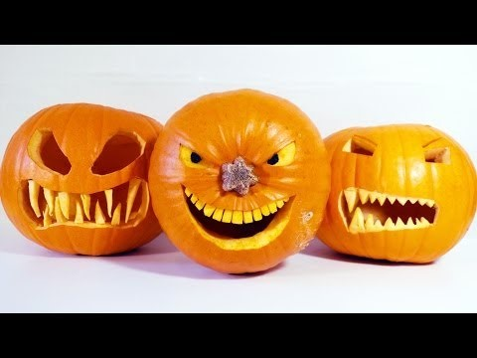
How to carve out pumpkins?
POGLEJ SI
POSNETEK KAKO
IZREZATI BUČO!

Slide 6
ZAPOJ LANSKO PESMICO
https://www.youtube.com/watch?v=4jxcWlq3CBg

Slide 7
POGLEJ SI ZGODBO
https://learnenglishkids.britishcouncil.org/short-stories/the-haunted-house

Slide 8
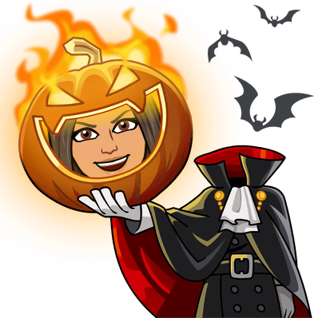
HAPPY HALLOWEEN!!!!

