Slide 1
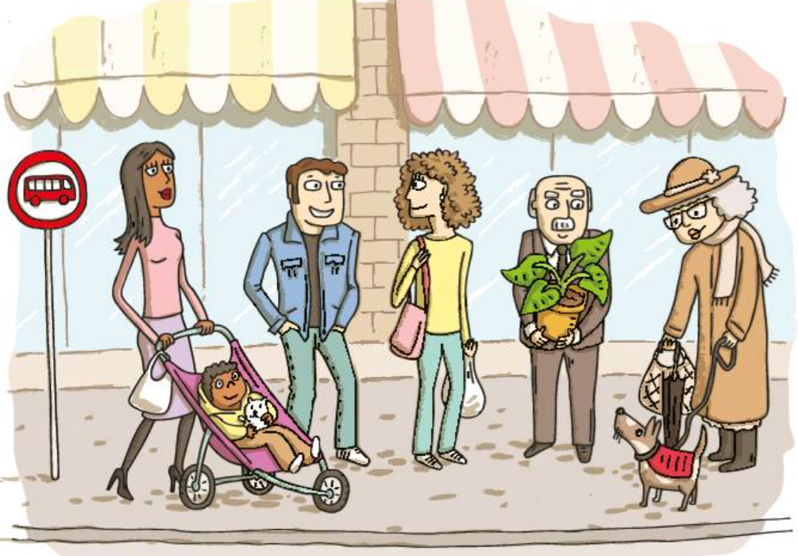
Describe the people at the bus stop. Use the following words:
*straight
*curly
*dark
*light
*bold
*attractive
*handsome
*short-sighted

Slide 2
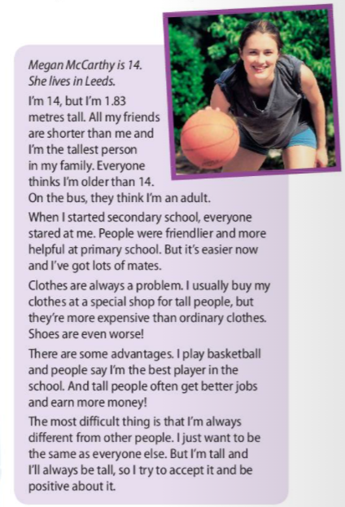
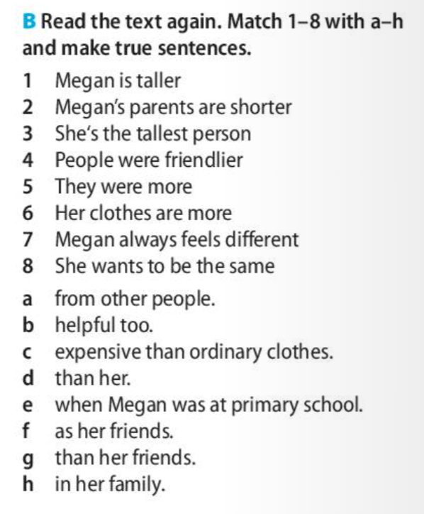
Write sentences in your notebook.

Slide 3

Comparatives and superlatives
a) ENOZLOŽNI PRIDEVNIKI
OSNOVNIK | PRIMERNIK | PRESEŽNIK
TALL | TALLER | THE TALLEST
FAST | FASTER | THE FASTEST
b) ENOZLOŽNI PRIDEVNIKI na -E
OSNOVNIK | PRIMERNIK | PRESEŽNIK
WISE | WISER | THE WISEST
LARGE | LARGER | THE LARGEST

Slide 4

c) DVOZLOŽNI PRIDEVNIKI NA -Y
OSNOVNIK | PRIMERNIK | PRESEŽNIK
BUSY | BUSIER | THE BUSIEST
EASY | EASIER | THE EASIEST
d) DVO IN VEČZLOŽNI PRIDEVNIKI
OSNOVNIK | PRIMERNIK | PRESEŽNIK
HELPFUL | MORE HELPFUL | THE MOST HELPFUL
EXPENSIVE | MORE EXPENSIVE | THE MOST EXPENSIVE
INTERESTING | LESS INTERESTING | THE LEAST INTERESTING
BORING | LESS BORING | THE LEAST BORING
CLEVER NARROW (ozek) QUIET SHALLOW (plitki) SIMPLE
PRI TEH PRIDEVNIKIH JE MOŽNO STOPNJEVANJE NA DVA NAČINA
It is too noisy here. Let‘s go somewhere quieter/more quiet.

Slide 5
e) PODVAJANJE ČRK
OSNOVNIK | PRIMERNIK | PRESEŽNIK
THIN | THINNER | THE THINNEST
BIG | BIGGER | THE BIGGEST
RED | REDDER | THE REDDEST
WET | WETTER | THE WETTEST
FAT | FATTER | THE FATTEST
→ ko se kratek pridevnik konča na samoglasnik in soglasnik

Slide 6

f) NEPRAVILNO STOPNJEVANJE
OSNOVNIK | PRIMERNIK | PRESEŽNIK
GOOD | BETTER | THE BEST
BAD | WORSE | THE WORST
FAR (daleč) | FURTHER | THE FURTHEST
LITTLE | LESS | THE LEAST
MUCH/MANY | MORE | THE MOST

Slide 7
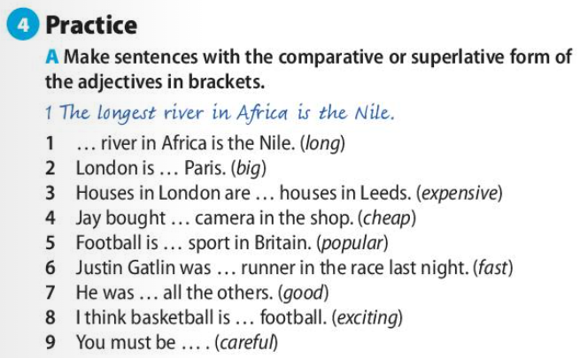
THAN NI ENAKO KOT THEN
I am taller than my brother.
= KOT
Then we went home. = POTEM
Bodi pozoren, kaj zahteva določen stavek.
London is ________________ Paris (big) → DRUGA STOPNJA: London je večji kot Paris
→ London is BIGGER THAN Paris

Slide 8

KEY
London is BIGGER THAN Paris.
Houses in London are MORE EXPENSIVE THAN houses in Leeds.
Jay bought THE CHEAPEST camera in the shop.
Football is THE MOST POPULAR sport in Britain.
Justin Gatlin was THE FASTEST runner in the race last night.
He was BETTER THAN all the others.
I think basketball is MORE EXCITING THAN football.
You must be MORE CAREFUL.
Wb, p. 18 and 19

Slide 9
