Slide 1
REVISION

Slide 2
Read
SB 22/2
SB 26, 27
SB 28

Slide 3
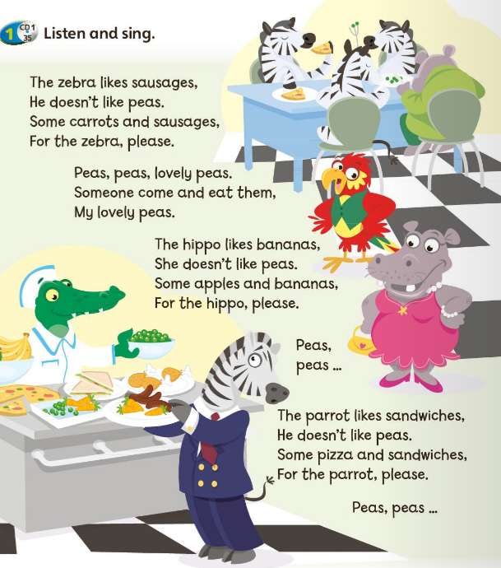
SB 24: A song
 | LIKES | DOESN‘T LIKE
ZEBRA
HIPPO
PARROT

Slide 4
SB 24: A song
 | LIKES | DOESN‘T LIKE
ZEBRA | sausages carrots | peas
HIPPO | bananas apples | peas
PARROT | sandwiches pizza | peas

Slide 5
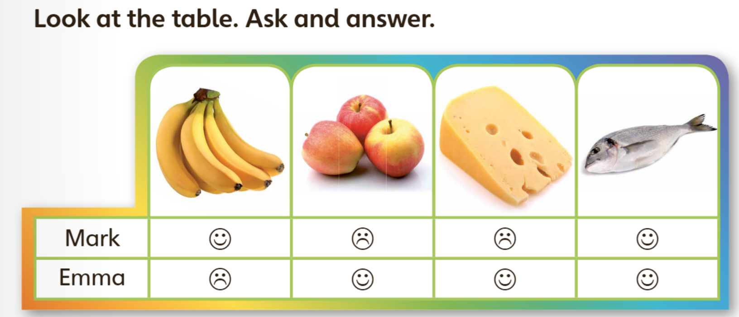
Uporabi podatke in pripoveduj.

Slide 6



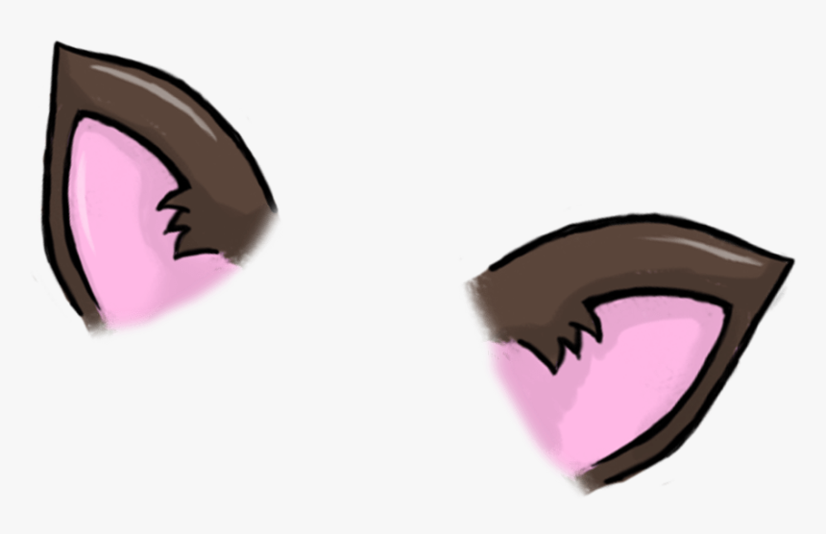





ANIMAL BODY PARTS

Slide 7
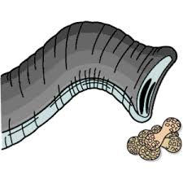

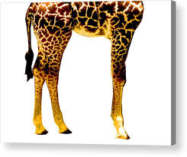
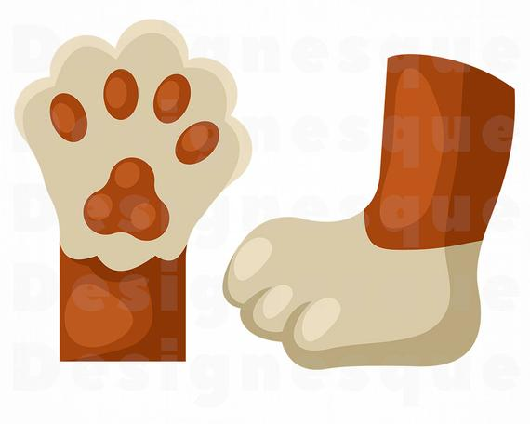
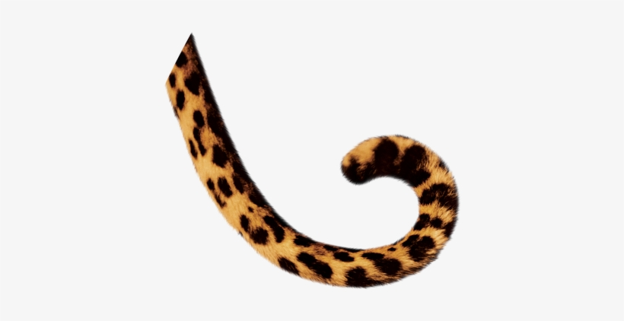


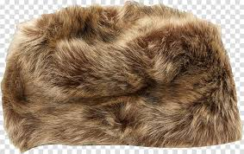


ANIMAL BODY PARTS

Slide 8
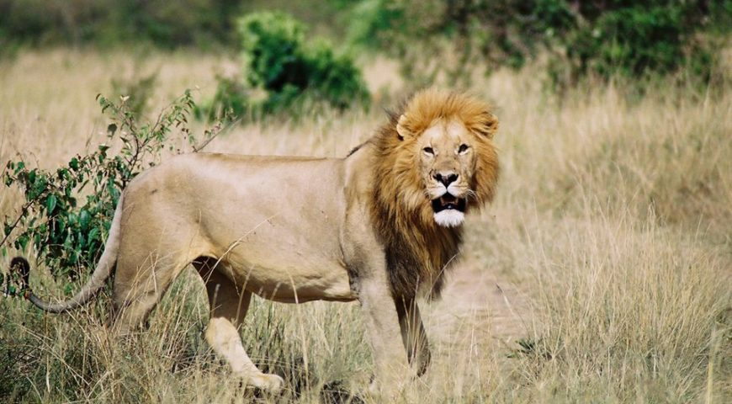
LET‘S DESCRIBE A LION
ANIMAL
COLOUR
BIG / SMALL
FAST / SLOW
LEGS /PAWS
TAIL
TEETH
FUR
EATS
LIVES
This is a lion.
It is brown.
It is big.
It is fast.
It has got four legs and four paws.
It has got a long tail.
It has got sharp teeth.
It has got fur.
It eats meat.
It lives in Africa.
PRIPOVEDUJ.
PREPIŠI POVEDI V ZVEZEK.

Slide 9
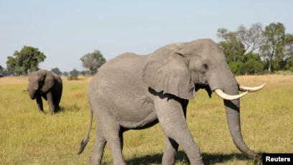
LET‘S DESCRIBE AN ELEPHANT
ANIMAL
COLOUR
BIG / SMALL
FAST / SLOW
LEGS
TAIL
TRUNK
TUSKS (okli)
EATS
LIVES
NAPIŠI STAVKE V ZVEZEK.

Slide 10
HOMEWORK
1. IZBERI DIVJO ŽIVAL IN JO OPIŠI, TAKO KOT V VZORCU.
2. ILUSTRIRAJ.

