Slide 1
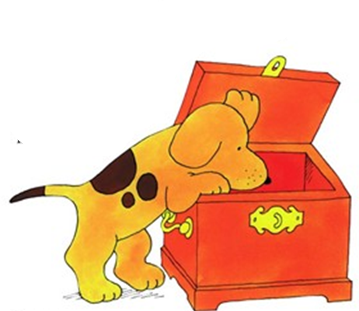

Where’s Spot?
Kje je piki?

Slide 2
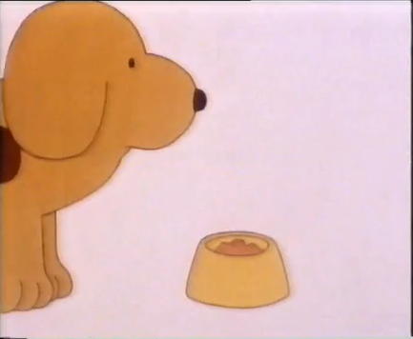
It’s dinner time, and where can Spot be? He’s in the house somewhere.

Slide 3
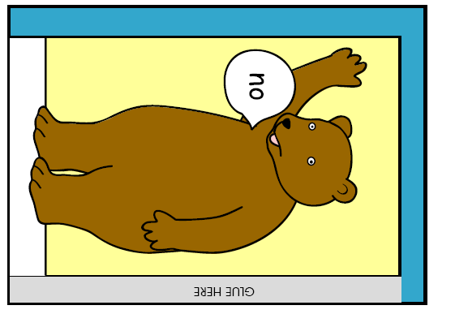
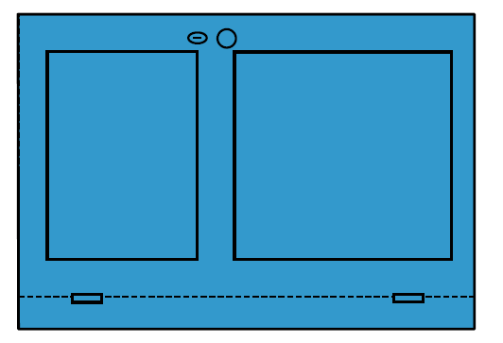
Is he behind the door?

Slide 4


Is he inside the clock?

Slide 5
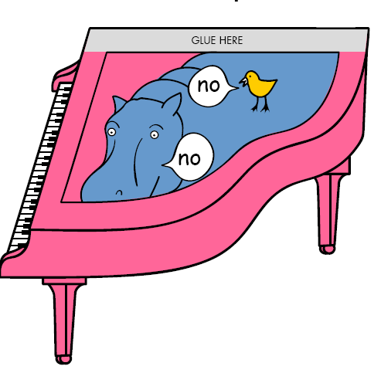
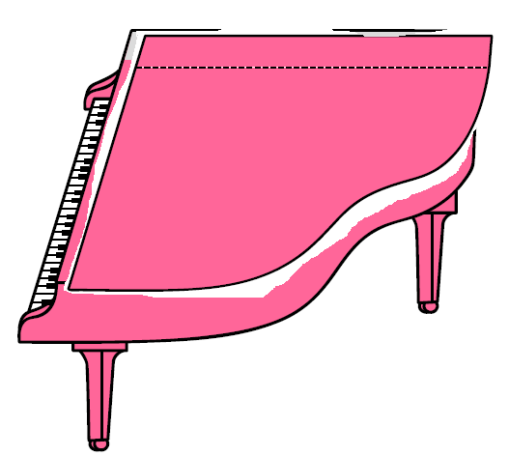
Is he in the Piano?

Slide 6
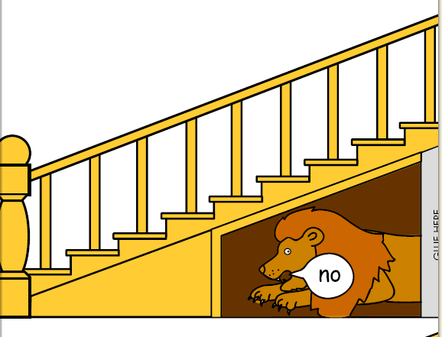
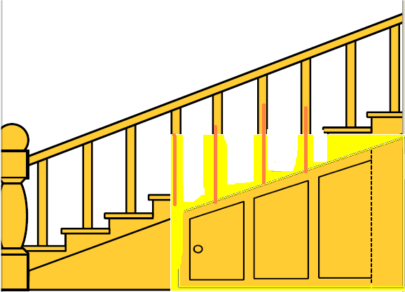
Is he under the stairs?

Slide 7
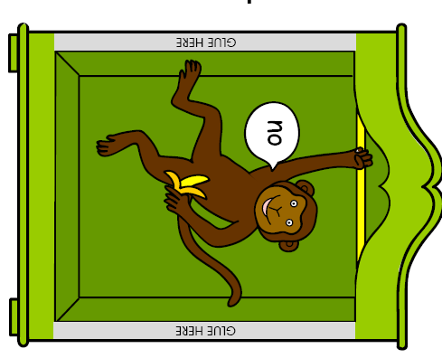
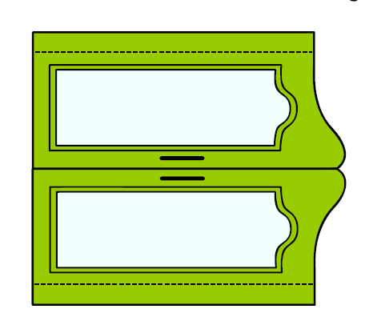
Is he inside the wardrobe?

Slide 8
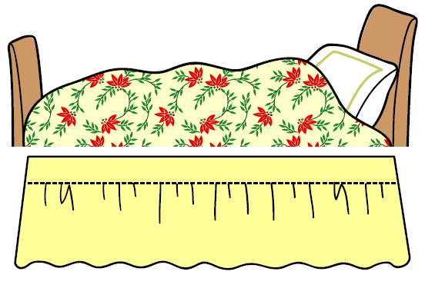
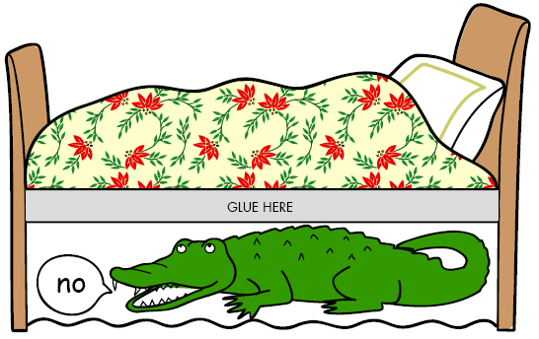
Is he under the bed?

Slide 9
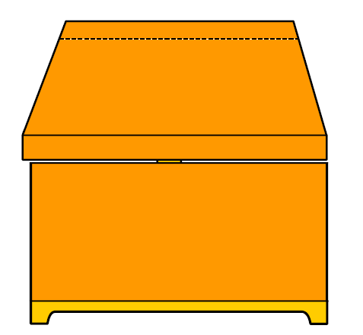
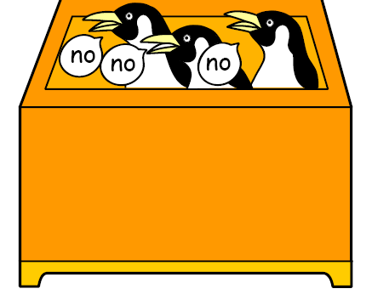
Is he in the box?

Slide 10
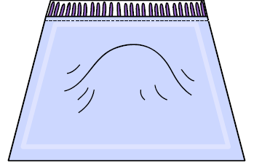
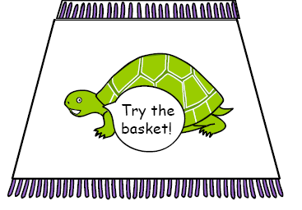
Is he under the rug?

Slide 11


Is he in the basket?

Slide 12
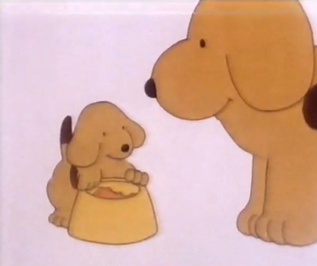
There you are spot. Good boy, now go and eat your dinner.

Slide 13
Notes:
Si dobro poslušal zgodbico? Sedaj si Piki ti.

Slide 14
Notes:
Si dobro poslušal zgodbico? Sedaj si Piki ti.

