Slide 1
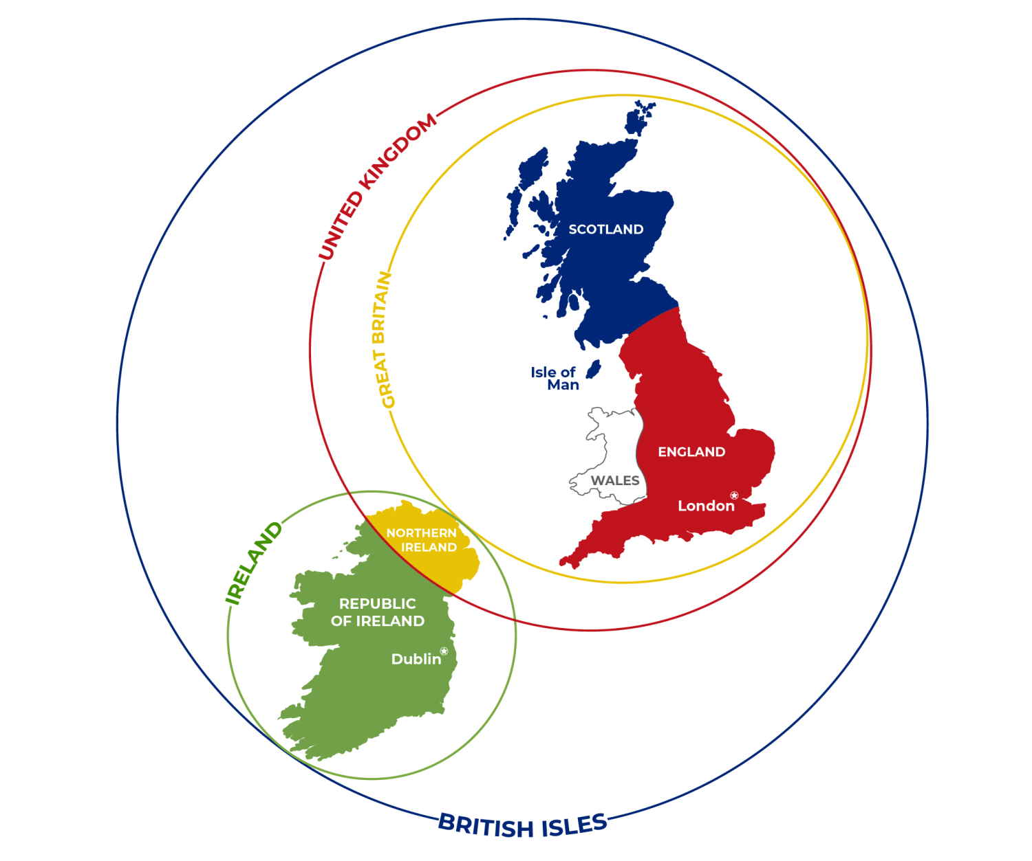
THE BRITISH
Reading comprehension, book, p. 35
naslov zapišeš v zvezek

Slide 2

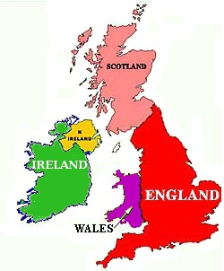




I come from Ireland
I am Irish.
I come from England.
I am English.
I come from Wales
I am Welsh.
I come from Scotland
I am Scottish.
We are from the United Kingdom. We are British.

Slide 3
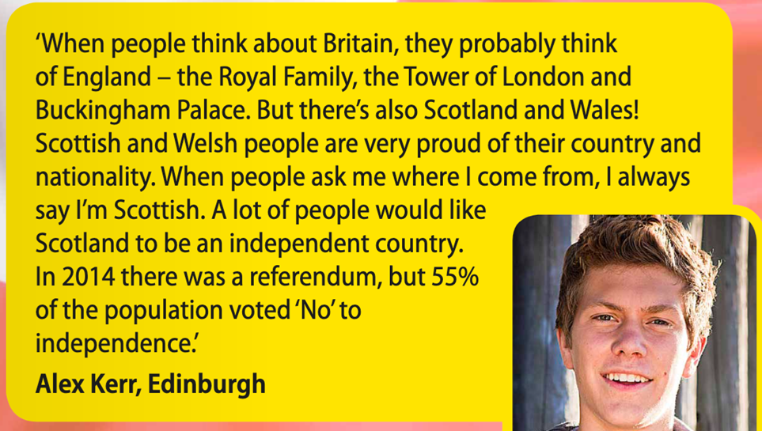
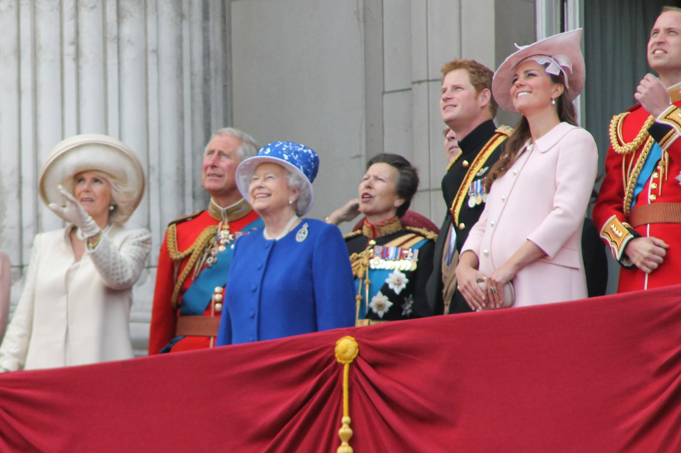
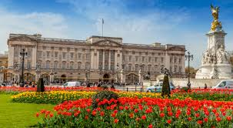
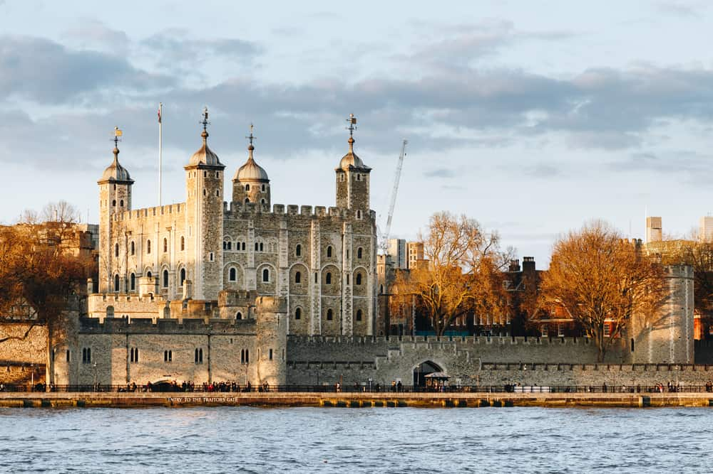
proud of = feeling pleasure and satisfaction because you have done something good = ponosen
royal (adj)= connected to a king or queen = kraljevi
independent (adj) = not influenced or controlled = neodvisen (tudi pri opisovanju osebnosti!)
independence (n) = neodvisnost
a referendum (n) = when all the people in a country are asked to give their opinion about or decide an important
political question. = referendum
to vote (v)→ voliti → elections (n) = volitve

Slide 4
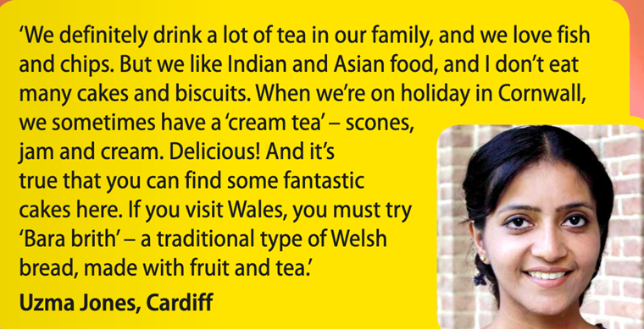
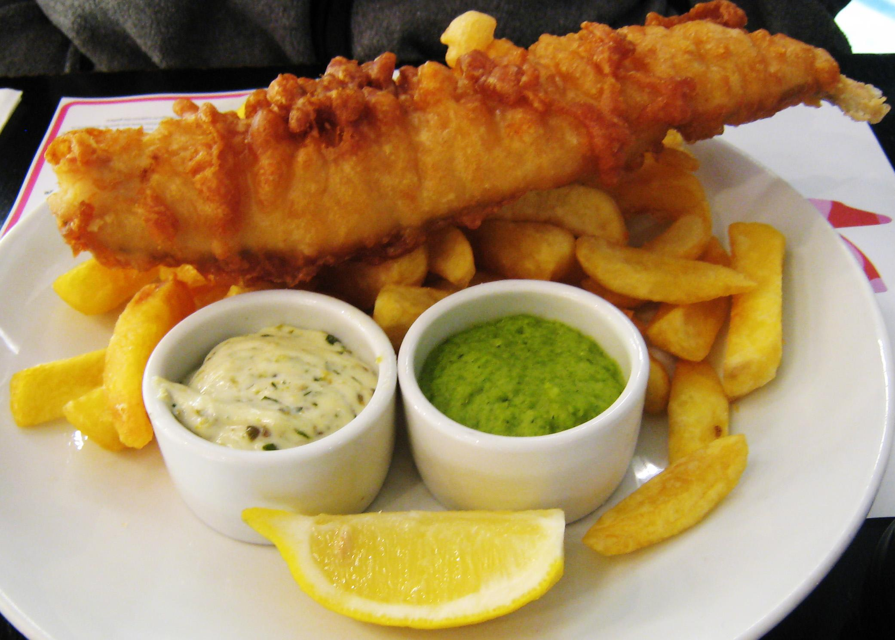
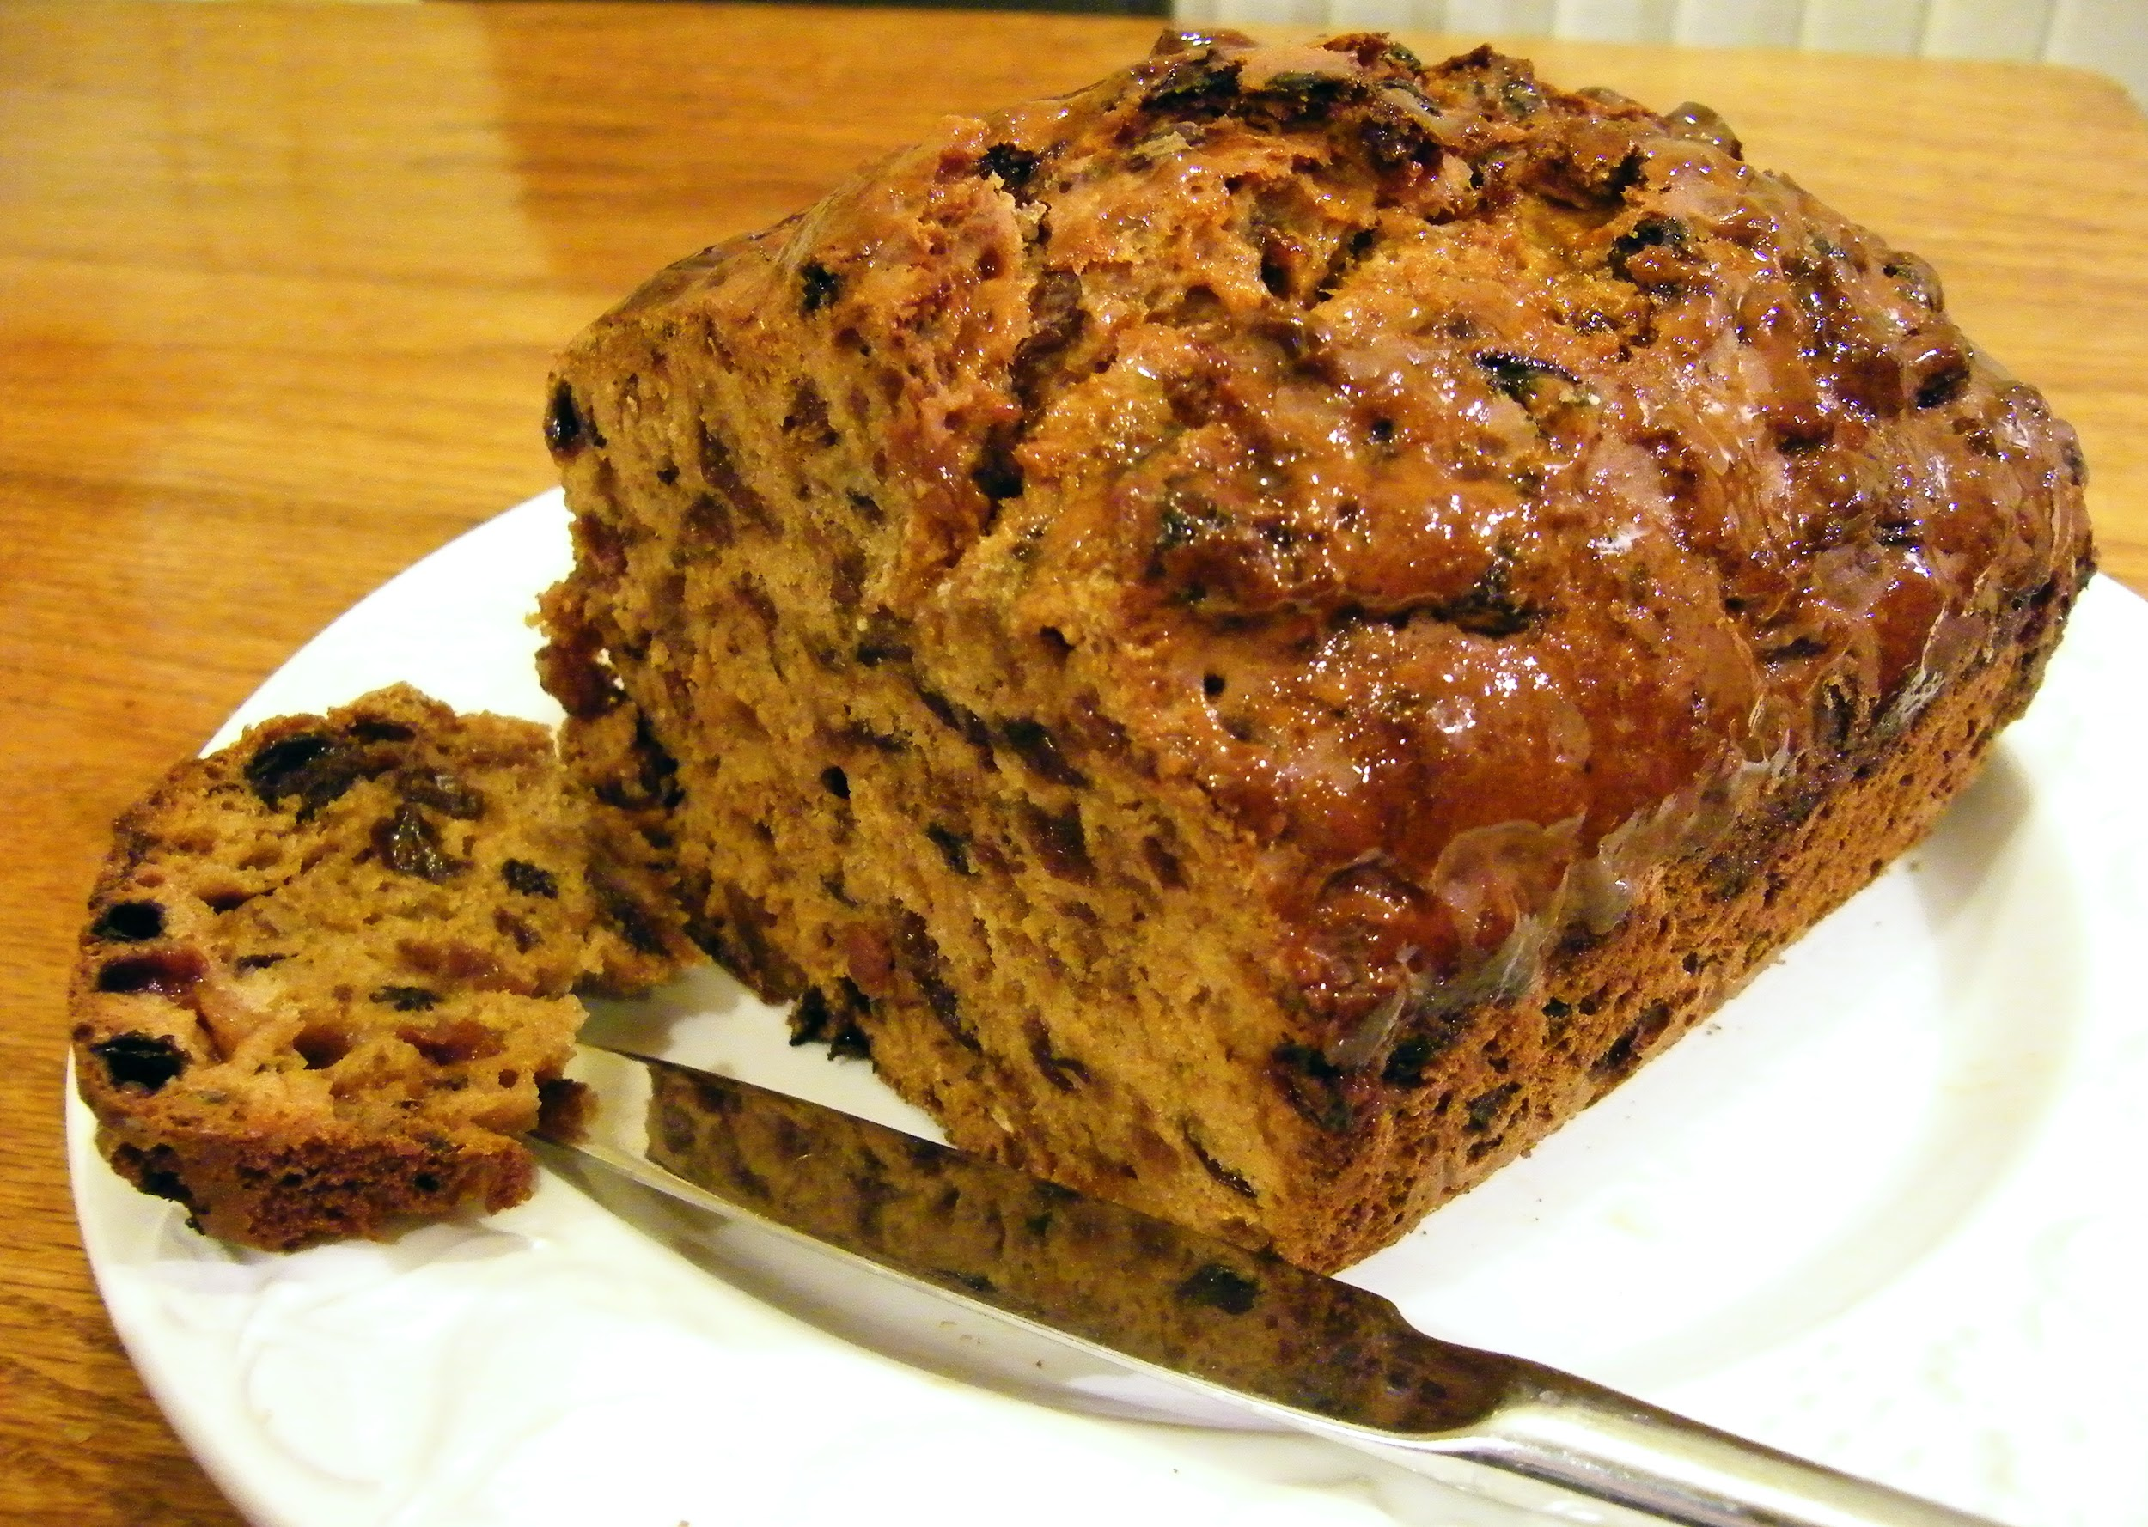
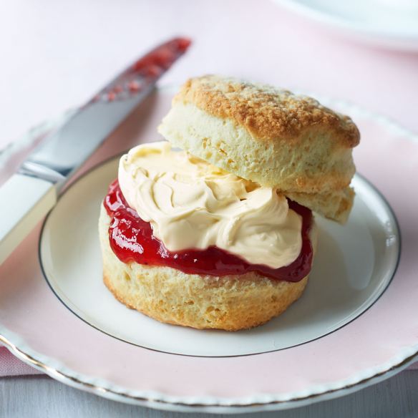
a scone: a small, round cake that is like bread usually served with butter and jam. kolaček

Slide 5
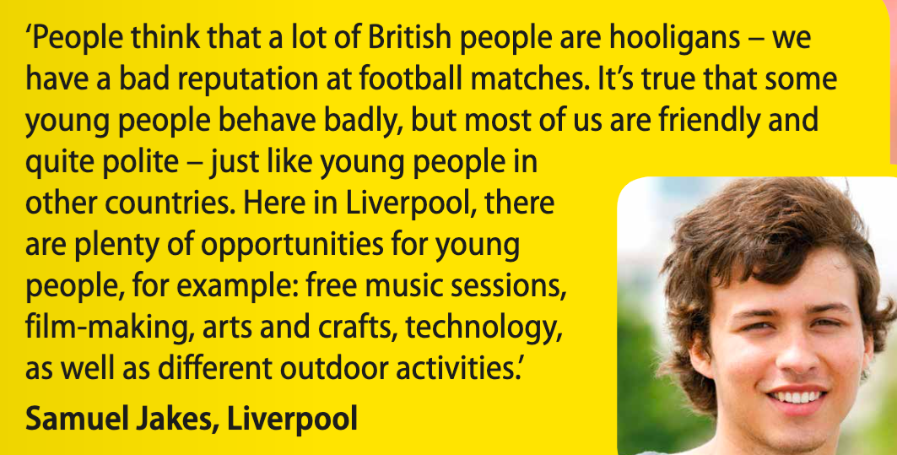
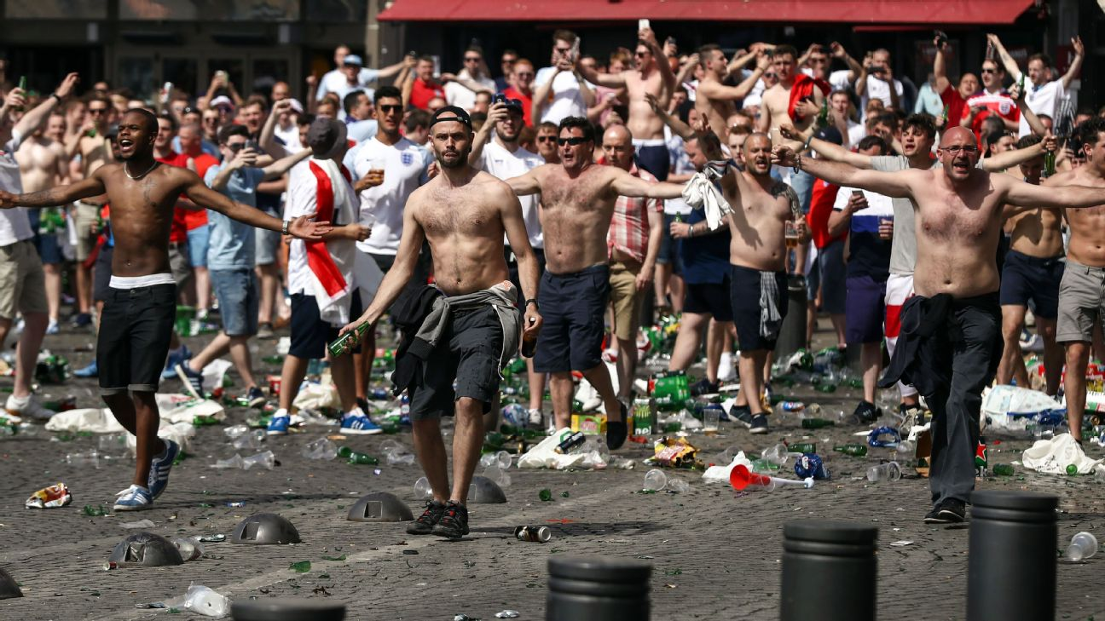
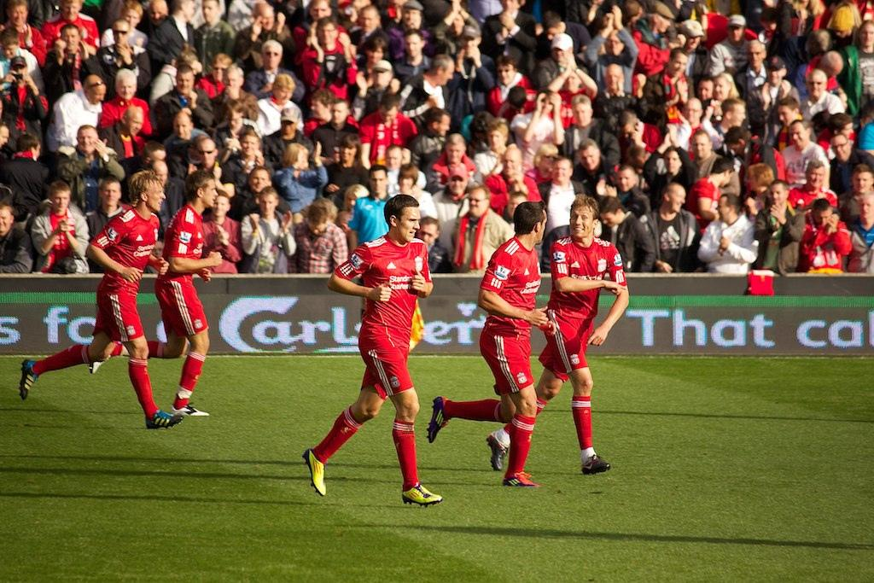
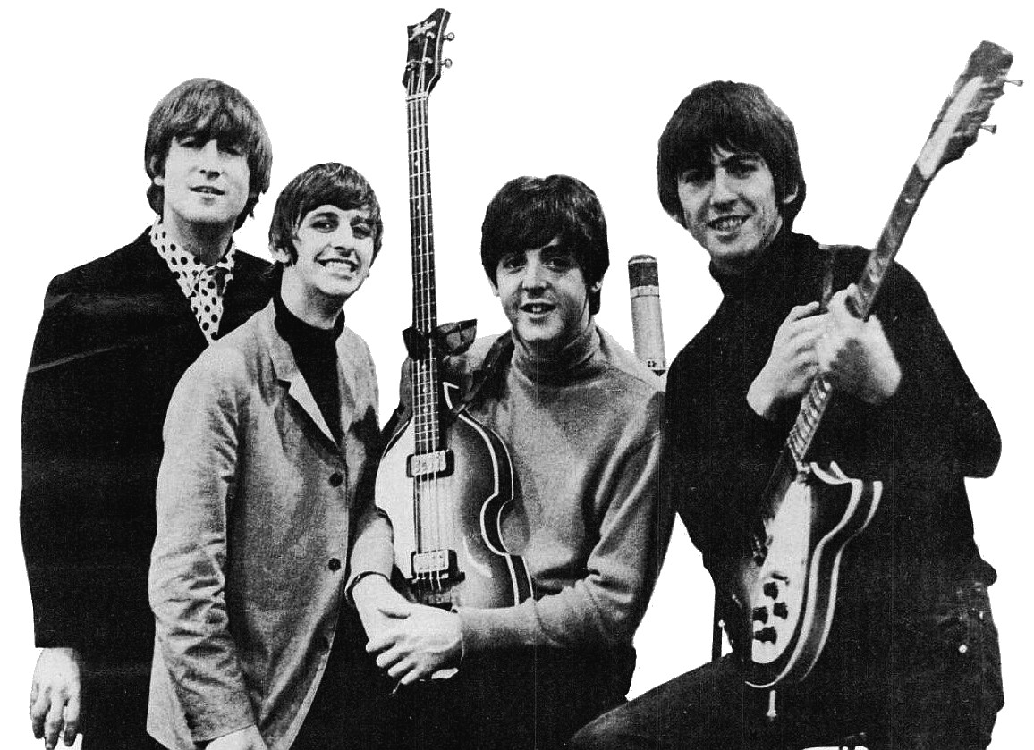
a hooligan (n) = a violent person who fights or causes damage in public places. huligan
to have a good/bad reputation = how much respect or admiration someone receive. ugled, sloves
to behave (v) → behaviour (n) = obnašati se/obnašanje

Slide 6
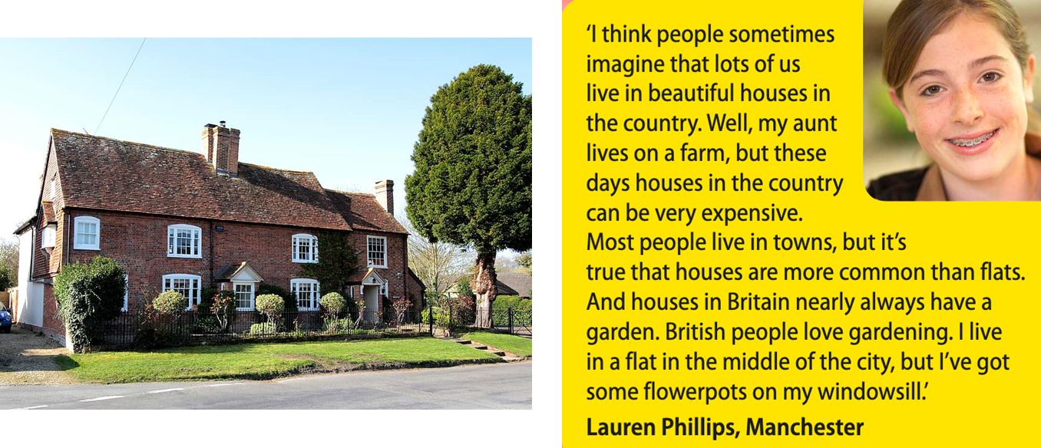

imagine (v) → imagination (n) = domišljija
flat (n) (US apartment) = rooms for living in that are part of a larger building = stanovanje
windowsill (n) = a shelf below a window. okenska polica

Slide 7
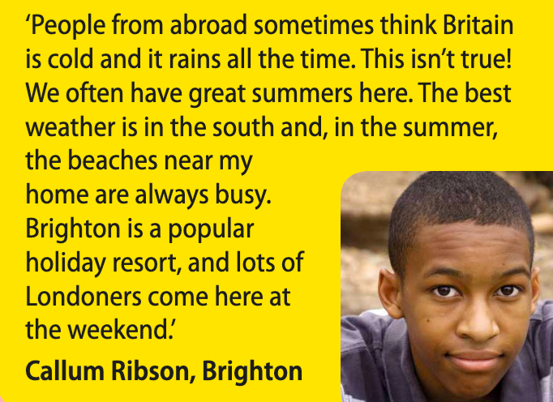
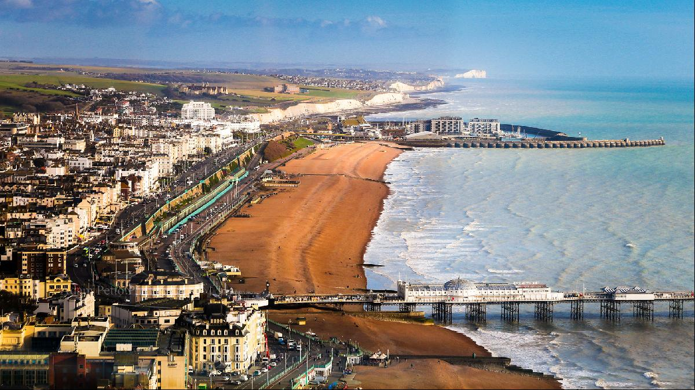
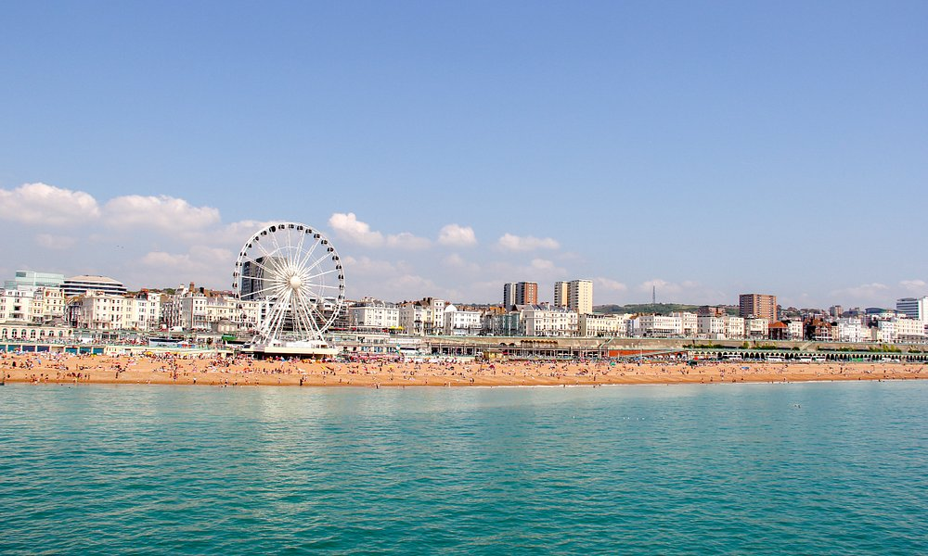
abroad (adv) → to go abroad/from abroad = to/from a foreign country = v tujini/na tujem/iz tujine
a holiday resort (n) = a place where many people go for rest, sport (a beach resort, a ski resort...) = letovišče

Slide 8
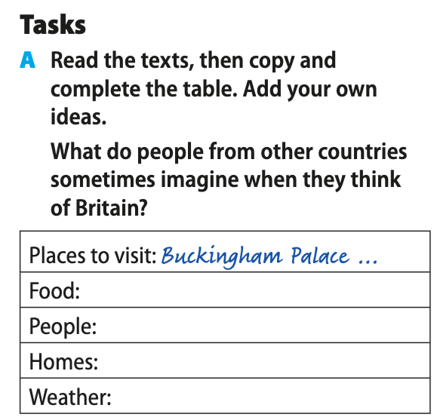
A: DOPOLNI RAZPREDELNICO S PODATKI IZ BESEDILA in JO PREPIŠI V ZVEZEK
B: REŠI PRVO IN DRUGO NALOGO V DELOVNEM ZVEZKU NA STRANI 23.
REŠITVE PREGLEDAMO V PETEK.
C: ODPRI SPLETNO STRAN NA POVEZAVI: https://www.liveworksheets.com/worksheets/en/English_as_a_Second_Language_(ESL)/British_culture/Listening*_British_Culture_jl115095zr
1.) Oglej si video in reši naloge. Ko končaš, klikni na FINISH in pojavi se ti spodnja slika
Klikneš na desno ikono in izpolniš s svojim imenom in mojim elektronskim naslovom: sabina.kramer@osziri.si
Oddane naloge, kot vedno, beležim.

Slide 9
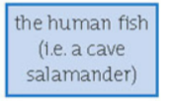







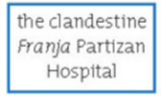



DOMAČA NALOGA DO PETKA: na list papirja preriši enako razpredelnico, kot je v učbeniku na strani 35 in jo dopolni s podatki za Slovenijo. Pri nekaterih kategorijah si lahko pomagaš z danimi pojmi in besedami. Dodaj lastne ideje!
buckwheat porridge
ajdovi žganci
Carniolan sausage
Kranjska klobasa
wallnut roll
potica
Trojane doughnuts (krofi)
mountains
Prekmurje cake
Prekmurska gibanica
Postojna cave
The Lipica horse
The Lipizzaner
the countryside
vineyards
the capital city Ljubljana
+ interesting things to see:
floating mills on the Mura river
Idrija lace

