Slide 1
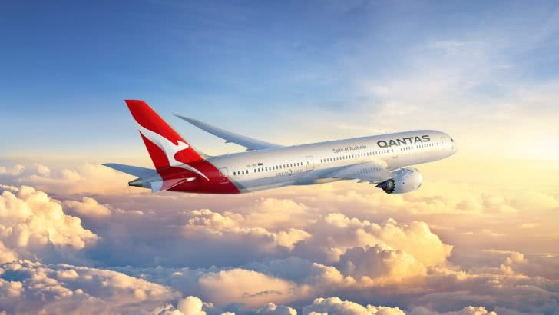
This is a slide title
Here you have a list of items
And some text
But remember not to overload your slides with content
Your audience will listen to you or read the content, but won’t do both.

Slide 2
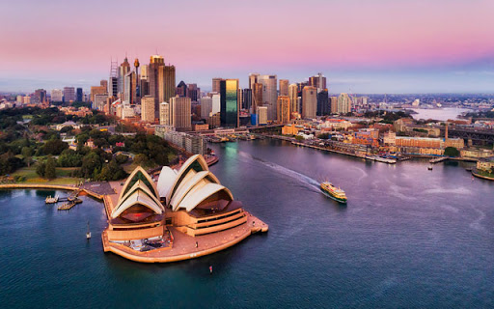
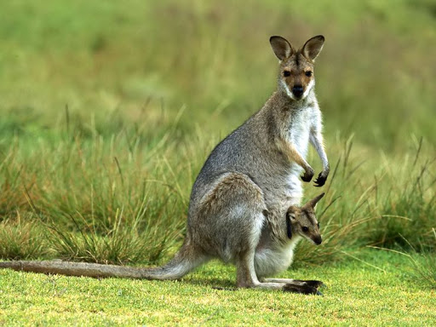
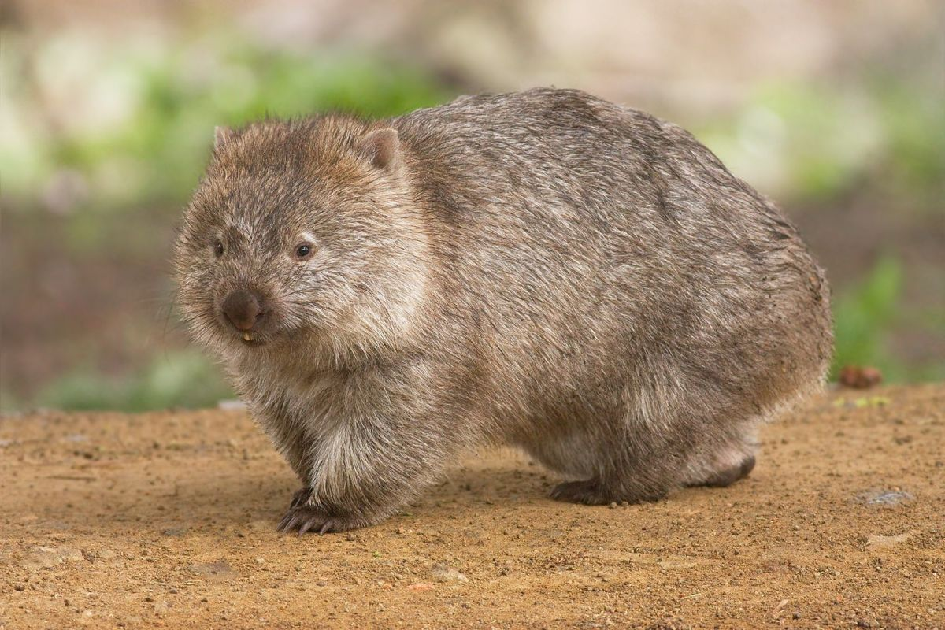
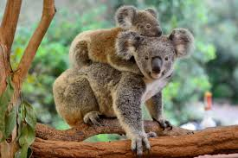
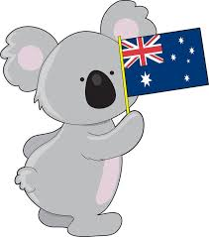
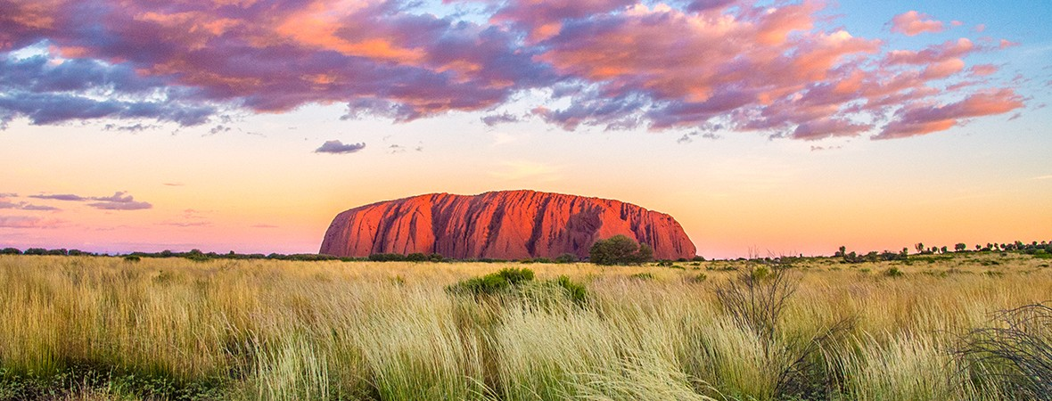
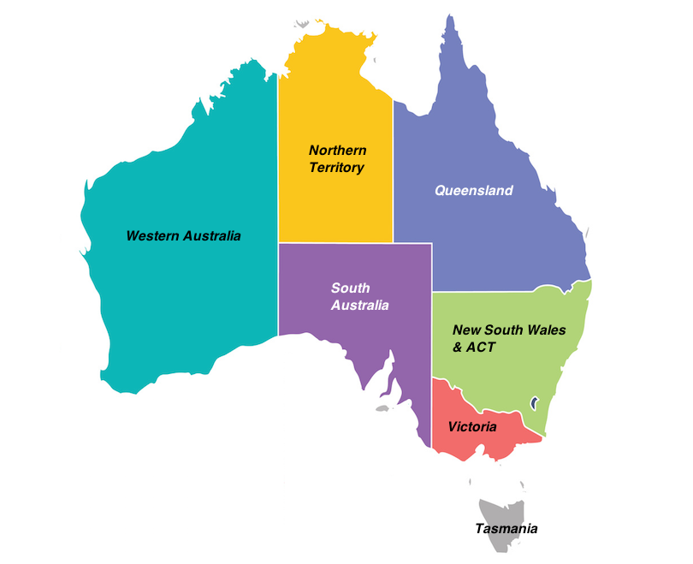

Slide 3
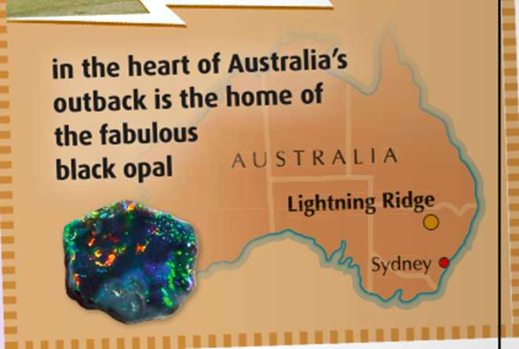
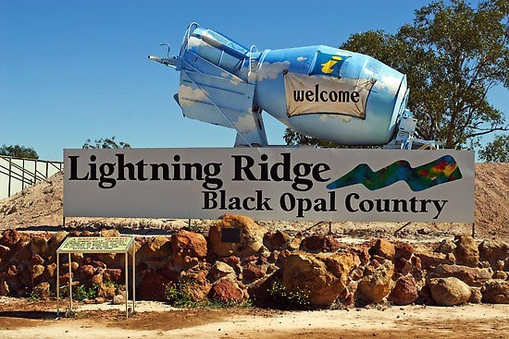
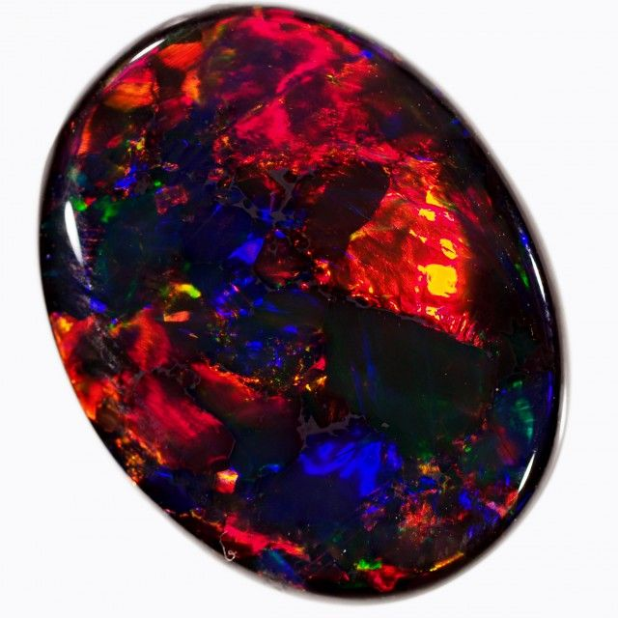
Our destination:
V zvezek napiši naslov: LIGHTNING RIDGE - TOO MANY TOURISTS!
Let‘s talk:
Where is Lightning Ridge? (=country)
What is Australia’s outback?
What is it famous for?
Do you think black opal is expensive?

Slide 4
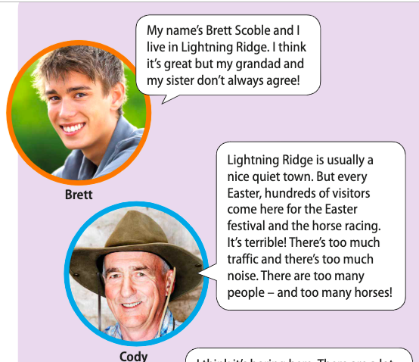
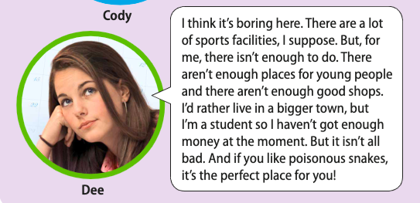
Poslušaj in beri besedilo, nato v zvezek zapiši besede s prevodi.
agree = strinjati se → disagree
a visitor = obiskovalec
a horse race = konjska dirka
traffic = promet
noise = hrup
a sport facility = športni obrat (stavba)
enough = dovolj
I’d rather = raje bi
a student = študent, študentka
poisonous = strupen
Yellow
Is the color of gold, butter and ripe lemons. In the spectrum of visible light, yellow is found between green and orange.

Slide 5
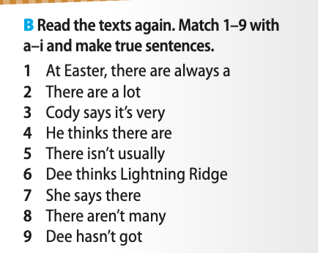
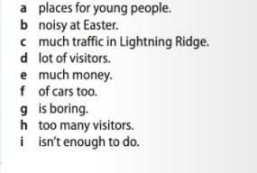
Exercise B, book, p. 38
Bodi pozoren na besede, ki označujejo količino nečesa.

Slide 6
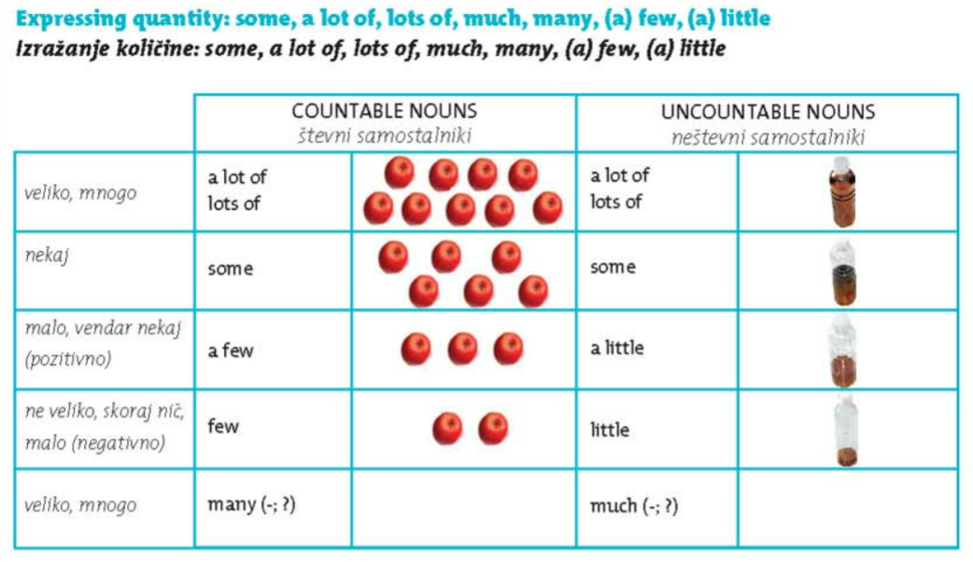

Slide 7
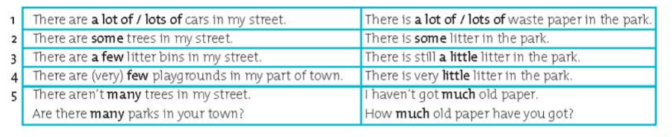

Slide 8
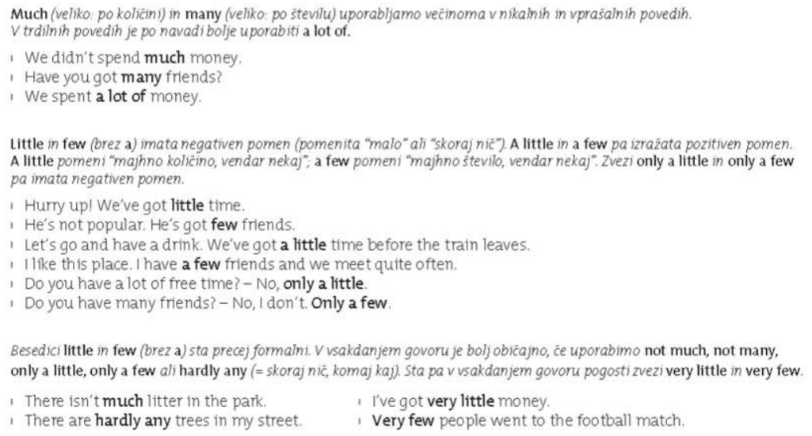

Slide 9
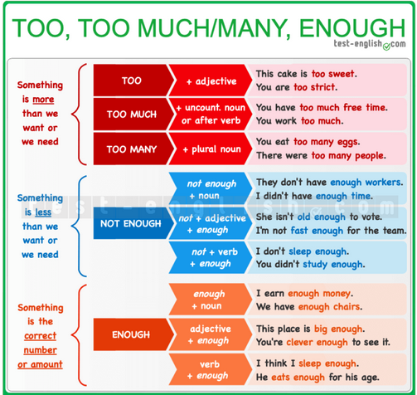
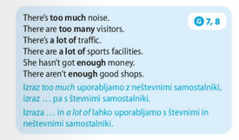

Slide 10
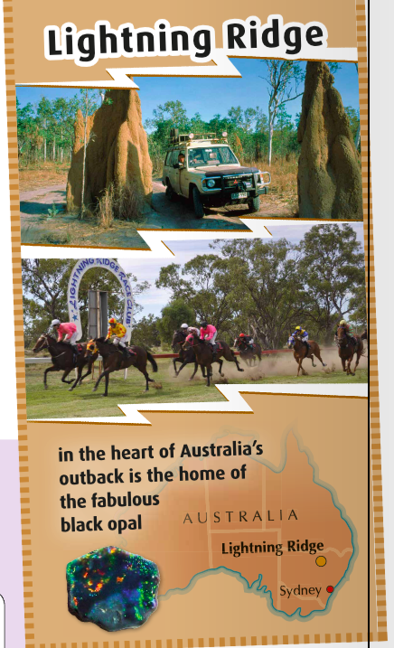
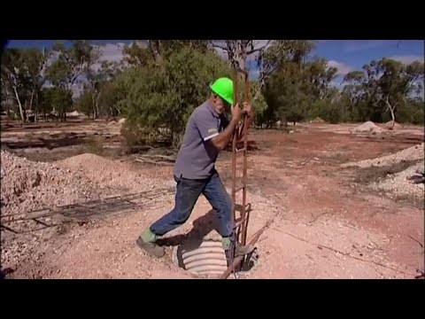
More about Lightning Ridge
https://www.youtube.com/watch?v=yiZCjLahx8I

Slide 11
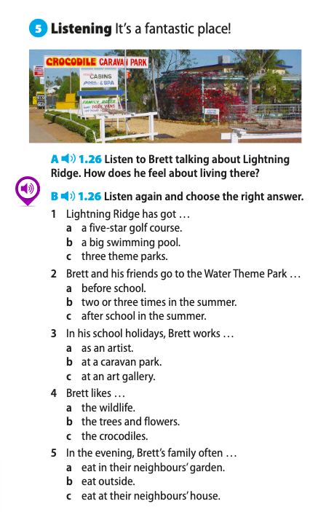

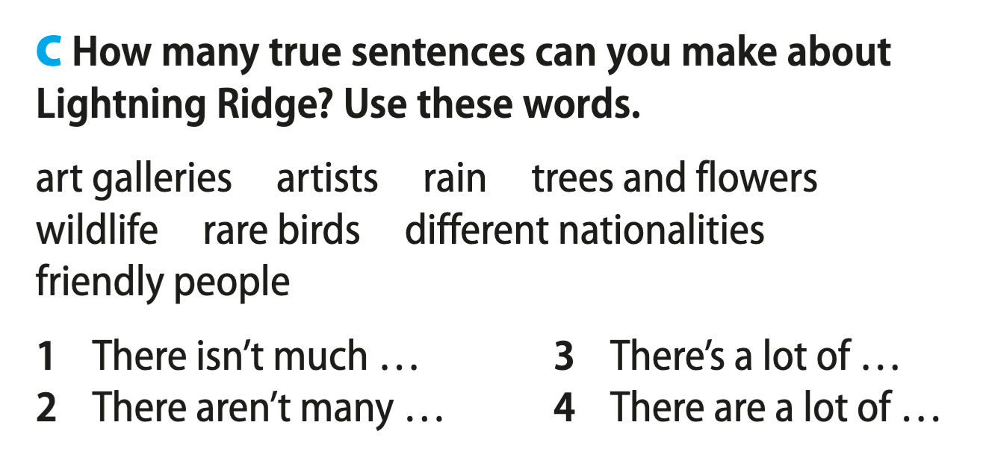
Let’s

Slide 12
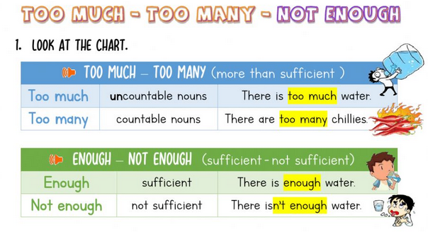

Slide 13
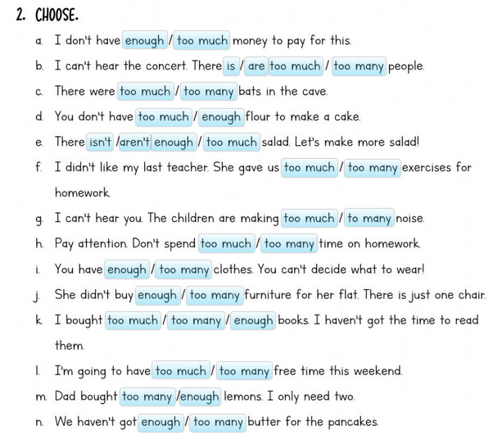

Slide 14

Exercises:
workbook, page 32.

