Slide 1

BODY PARTS
OD 13. 12. DO 17. 12. 2021
2. RAZRED

Slide 2

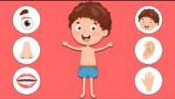

Slide 3
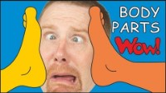
BODY PARTS

Slide 4
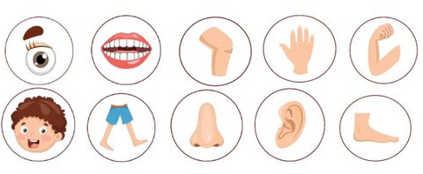

Slide 5
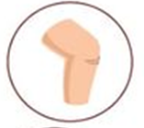





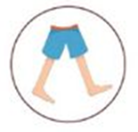
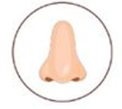
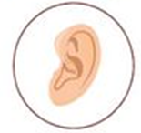
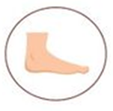
MISSING BODY PART

Slide 6
HEAD!

Slide 8
LEGS!
LEGS!

Slide 10
EYE!

Slide 12
ARM!

Slide 14
NOSE!

Slide 15


Slide 16


Slide 17


