Slide 1
WINTER AND
ZIMA
IN
CHRISTMAS
BOŽIČ

Slide 2
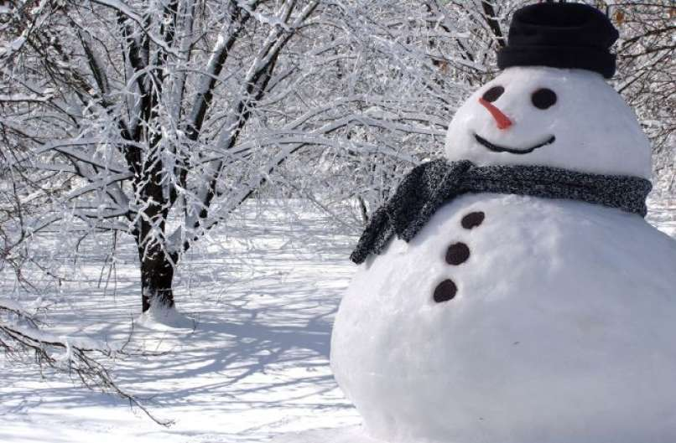
SNOWMAN
THIS IS A BIG SNOWMAN.

Slide 3
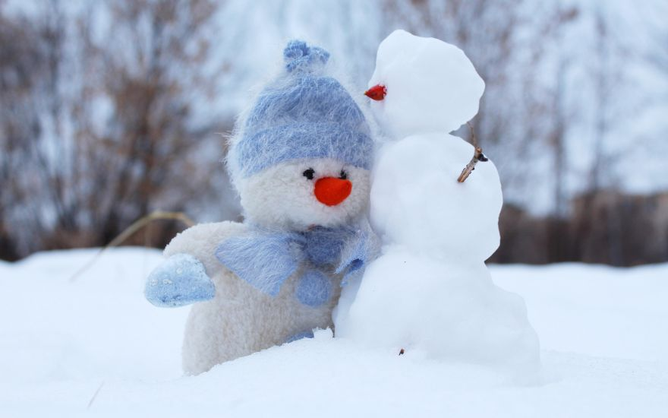
THIS SNOWMAN IS VERY SMALL.

Slide 4
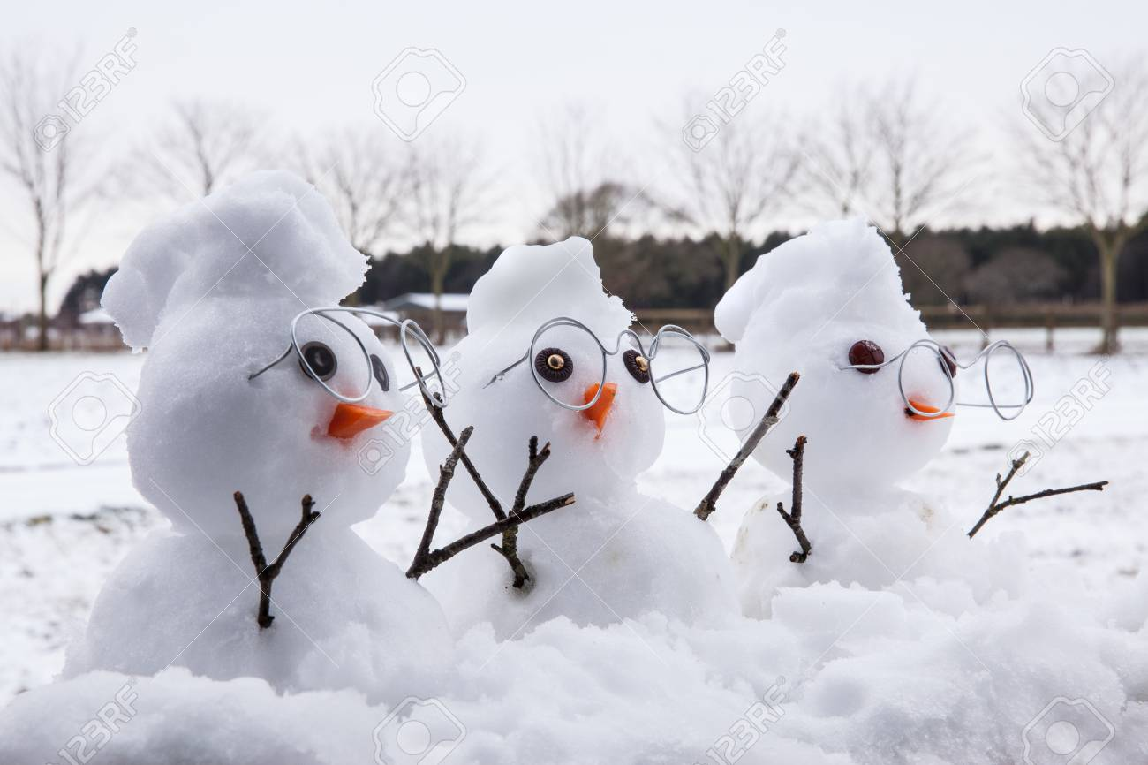
HOW MANY SNOWMEN ARE THERE?
KOLIKO SNEŽAKOV JE TUKAJ? LET‘S COUNT!
THREE!
THERE ARE
THREE
SNOWMEN.
3
2
1

Slide 5

CLOTHES FOR SNOW ARE
HAT
SCARF
JACKET
MITTENS
BOOTS

Slide 6
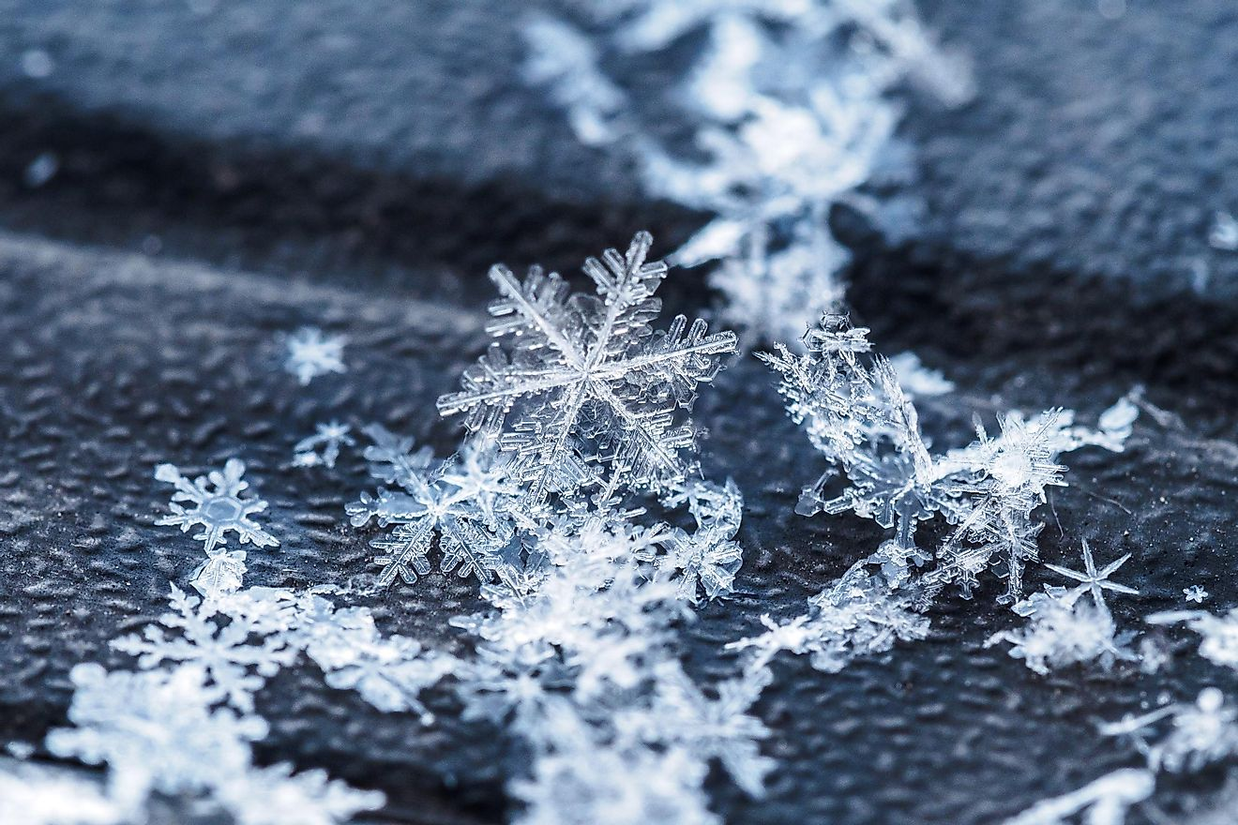
SNOWFLAKES

Slide 7
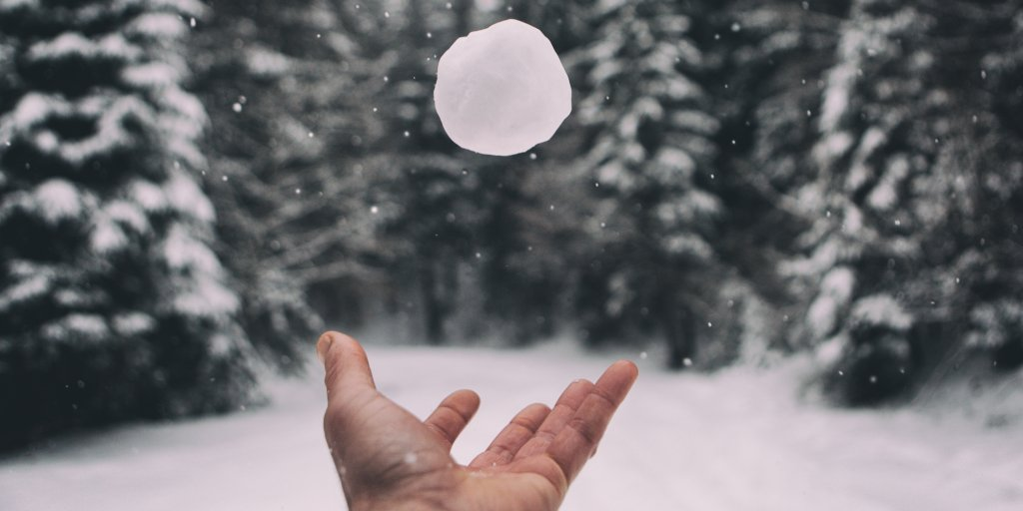
SNOWBALL

Slide 8
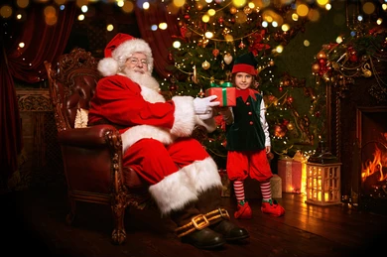
SANTA CLAUS
ELF

Slide 9
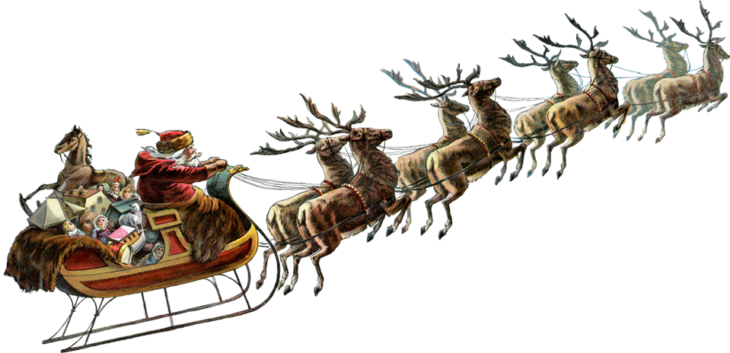
SANTA CLAUS AND HIS REINDEER

Slide 10

VESEL BOŽIČ!

