Slide 1
ENGLISH
3RD GRADERS
(HE, SHE, IT, CAN, CAN‘T, FEELINGS, CAN YOU)

Slide 2
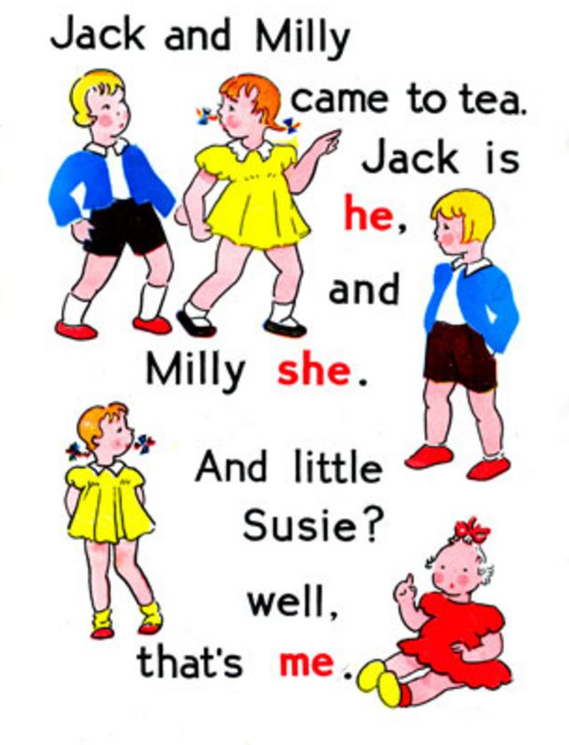
HE , SHE , IT

Slide 3

ON– Tony, my dad, brother, Mr. Bean...
ONA– Lucy, my mum, sister, Miss Smith...
ONO – živali, predmeti, stvari
A penguin, a rubber, a computer, a car, an apple, an owl, a potato...

Slide 4


Slide 5
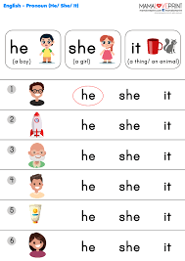

Slide 6
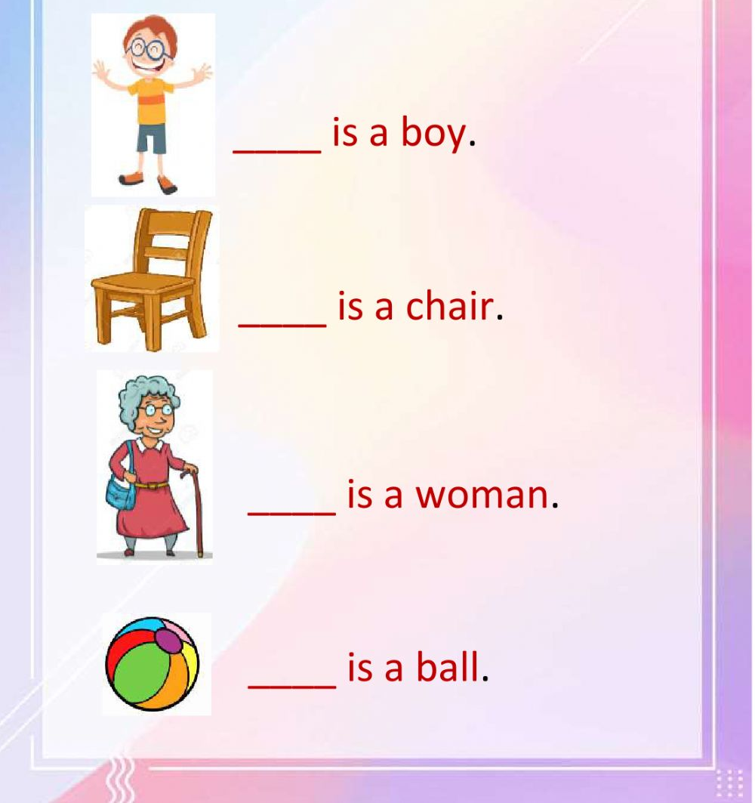

Slide 7
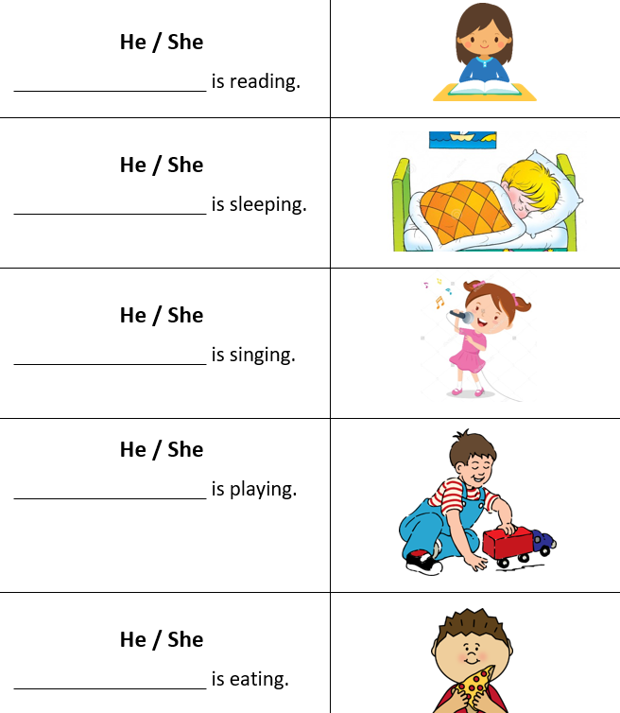

Slide 8
FEELINGS

Slide 9
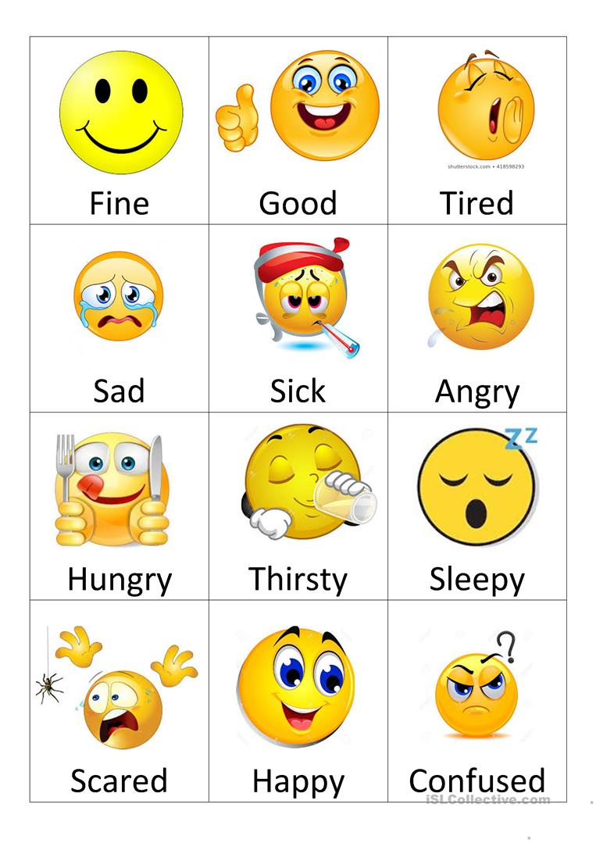
How are you?
I‘m tired.
How is she?
She‘s sleepy.
How is he?
- He‘s thirsty.

Slide 10
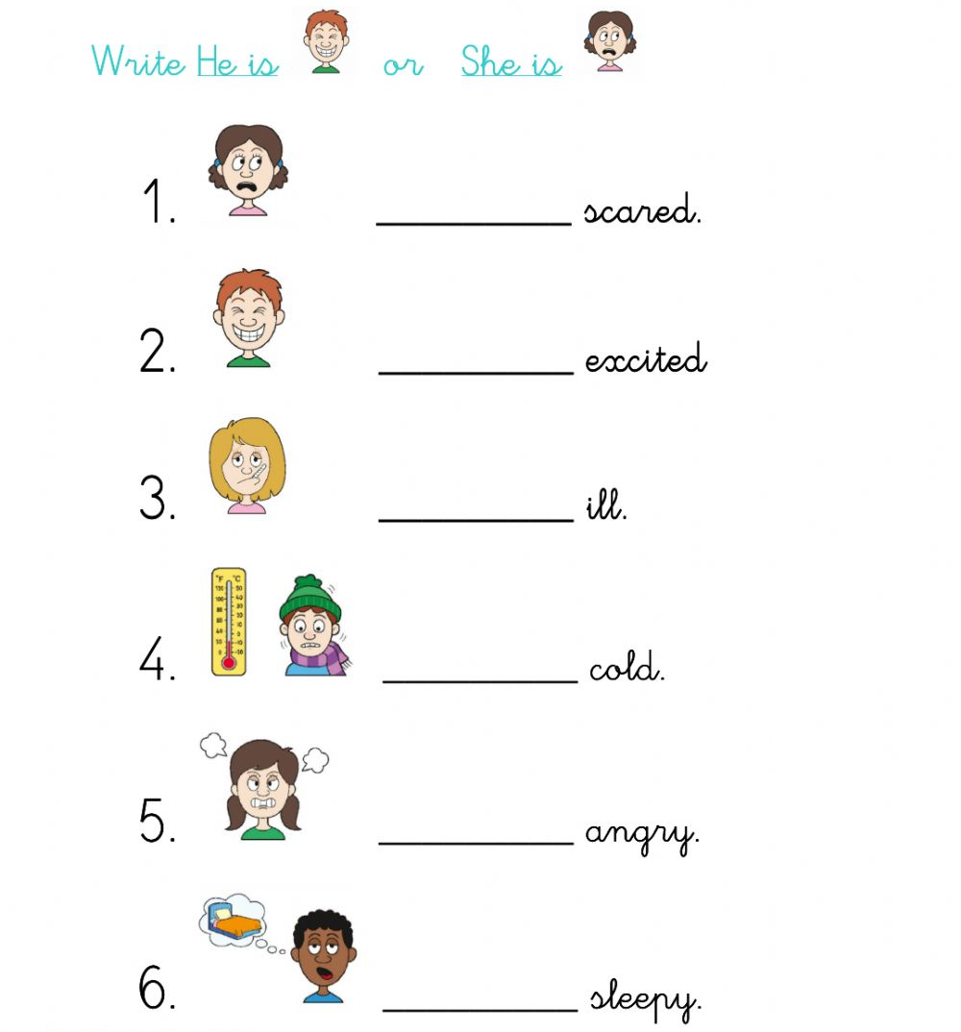

Slide 11
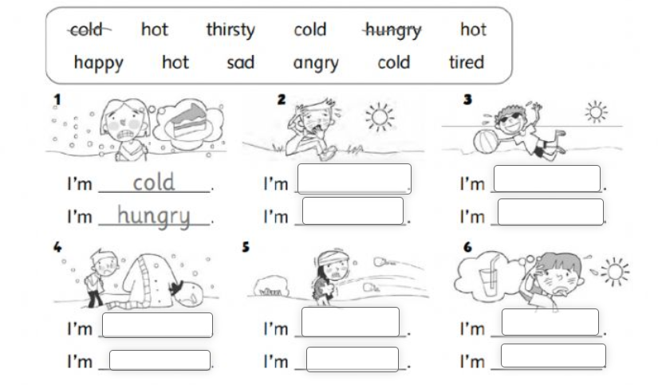

Slide 12
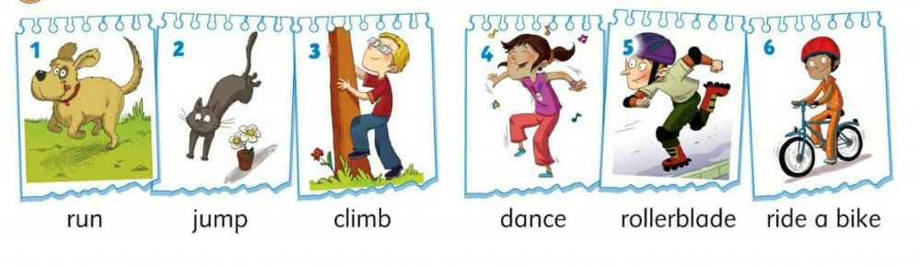
Actions

Slide 13
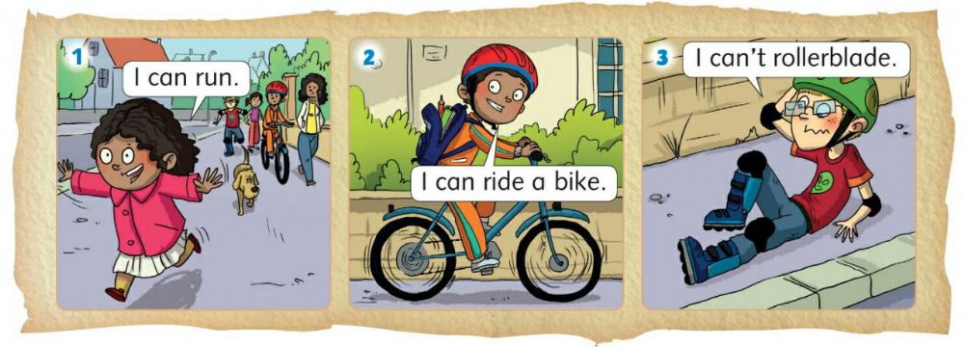

Slide 14
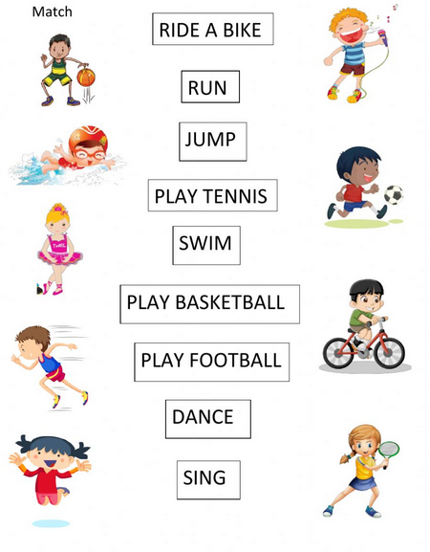

Slide 15
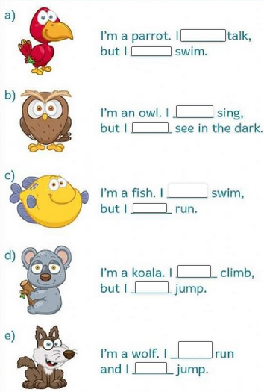
and – in
but - toda
https://www.liveworksheets.com/worksheets/en/English_as_a_Second_Language_(ESL)/Can_or_can't/Can_or_Can't_(Questions)_bg1415861dj

Slide 16
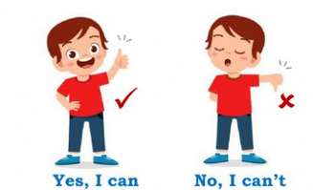
CAN YOU ______?
https://www.liveworksheets.com/worksheets/en/English_as_a_Second_Language_(ESL)/Can_or_can%27t/Can_you...$_qo1262962qj

Slide 17
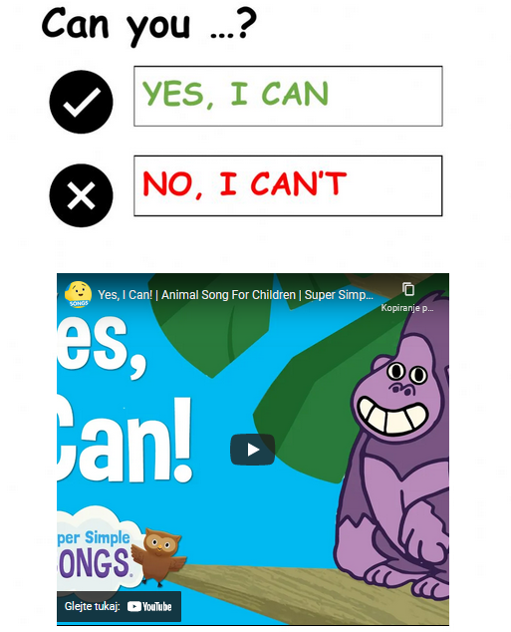

Slide 18
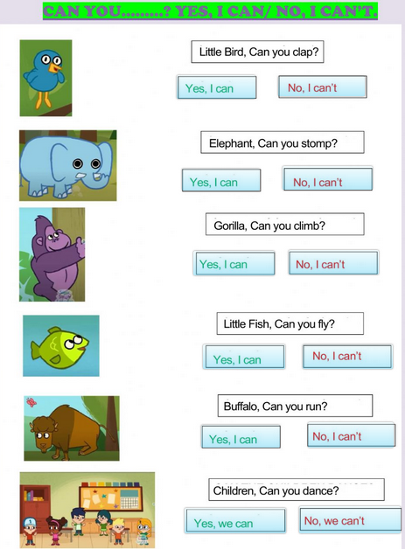

Slide 19
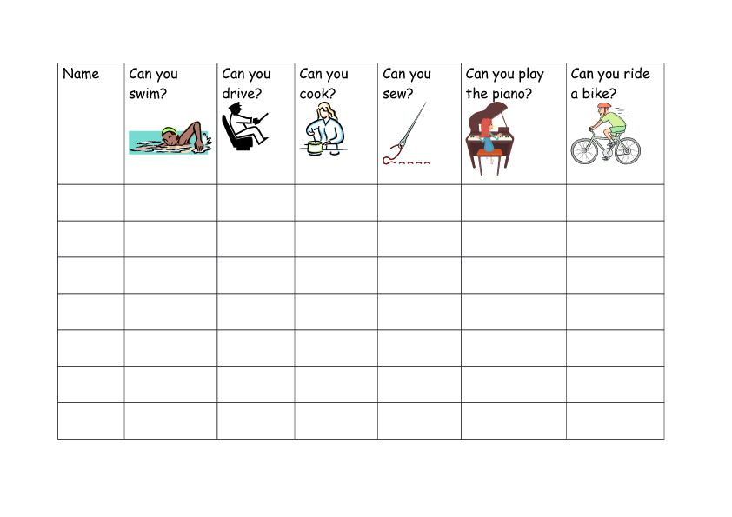

Slide 20
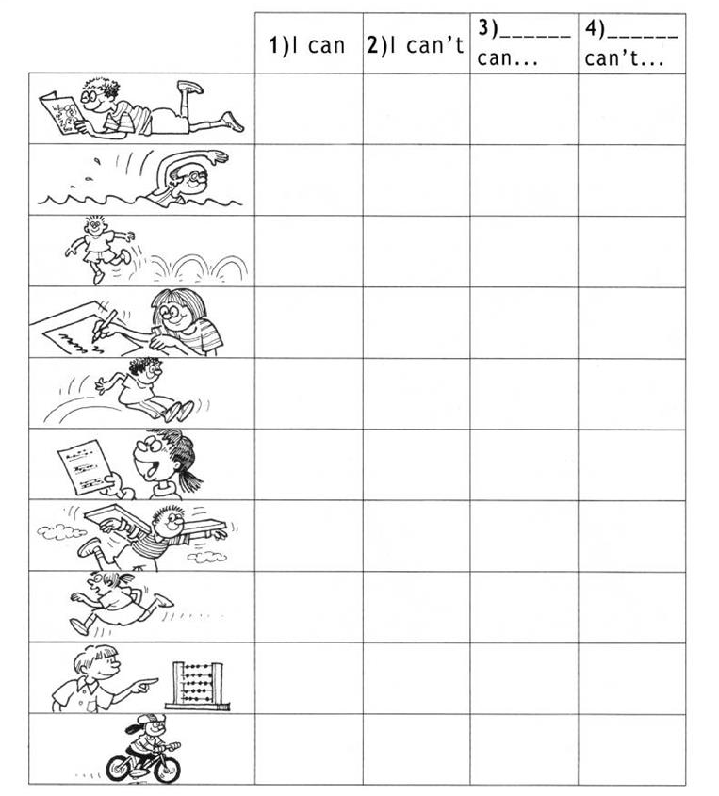

Slide 21
Exercises
https://www.liveworksheets.com/worksheets/en/English_as_a_Second_Language_(ESL)/Can_or_can%27t/Abilities-means_of_transport_en1969782hc
https://www.liveworksheets.com/ib559036tm

