Slide 1
CLOTHES
Spoznajmo oblačila

Slide 2

HAT

Slide 3
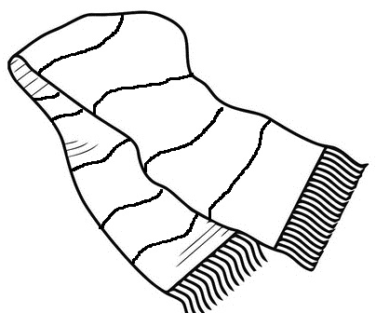
SCARF

Slide 4
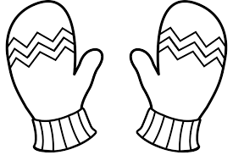
MITTENS

Slide 5
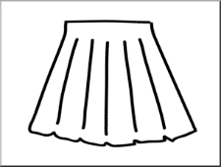
SKIRT

Slide 6
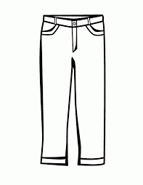
TROUSERS

Slide 7
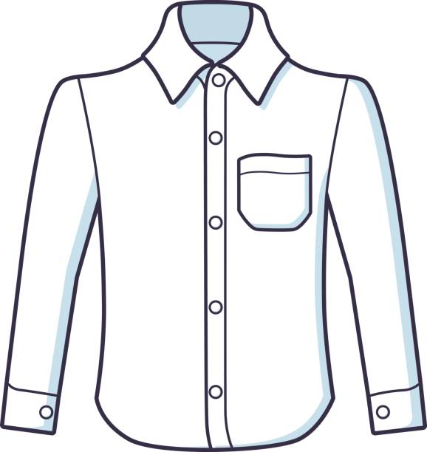
SHIRT

Slide 8
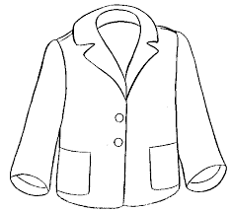
JACKET

Slide 9

COAT

Slide 10
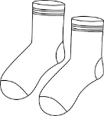
SOCKS

Slide 11

SLIPPERS

Slide 12
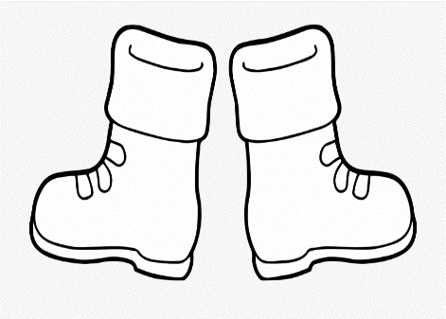
BOOTS

