Slide 1
VEHICLES (vozila)
3.razred

Slide 2
Listen and sing along ☺
(poslušaj in zapoj)
https://www.youtube.com/watch?v=Kpoze1QKOCY

Slide 3
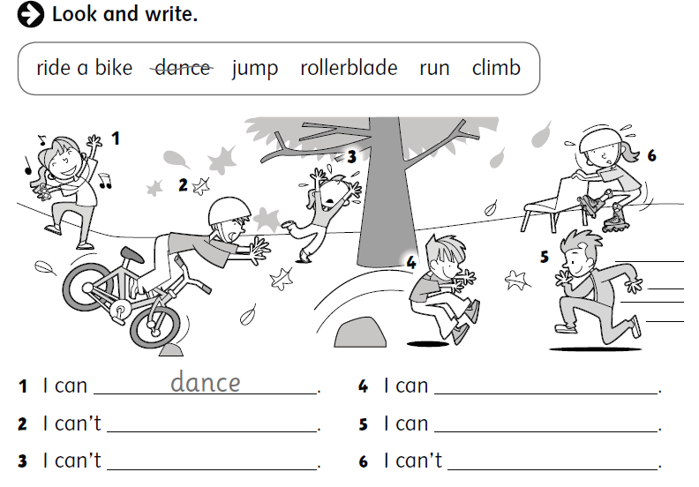
PONOVITEV: Prepiši stavke in vsavi CAN/CAN‘T.

Slide 4
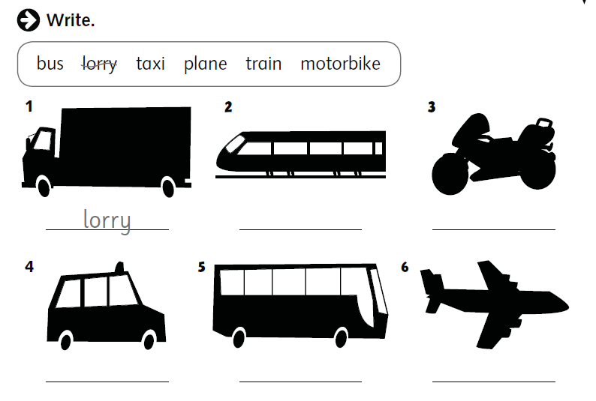
VEHICLES (vozila)
Preriši sličice in pod nje zapiši pravilno besedo. Potem klikni in preveri rešitve.
A train
A motorbike
A taxi
A bus
A plane

Slide 5
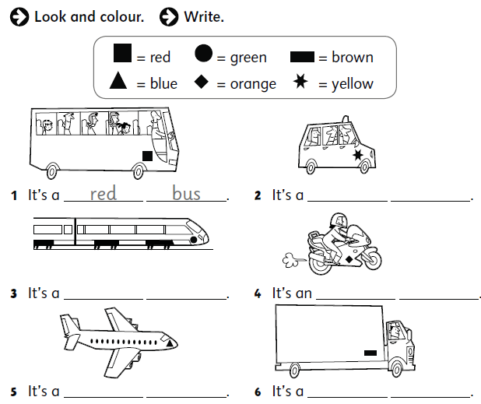
Natančno si oglej risbe in v zvezek zapiši cele stavke.

Slide 6
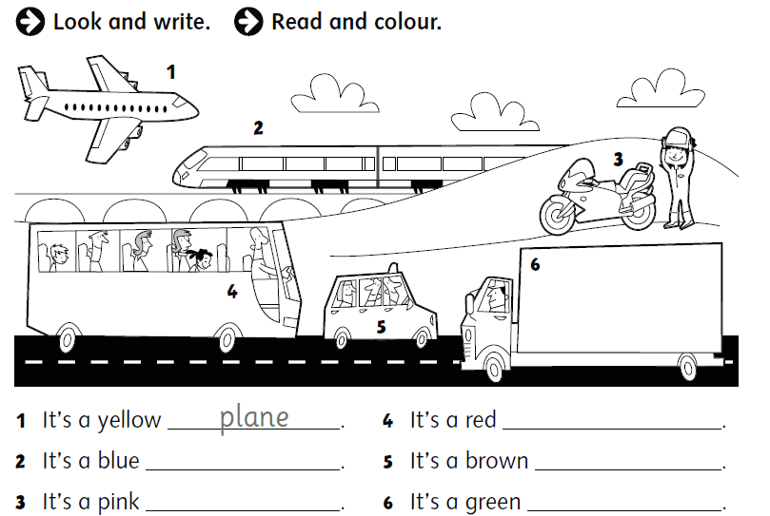

Slide 7
Prepiši in spodaj dopolni stavek, ki velja zate.
HOW DO YOU GO TO SCHOOL?
I go to school:
- by bus.
- by bike (kolo).
- by car (my mum and dad drive me to school).
- on foot (peš).
I go to school ___ ______________.
**Spodaj nariši sebe na poti do šole.

