Slide 1




Slide 2

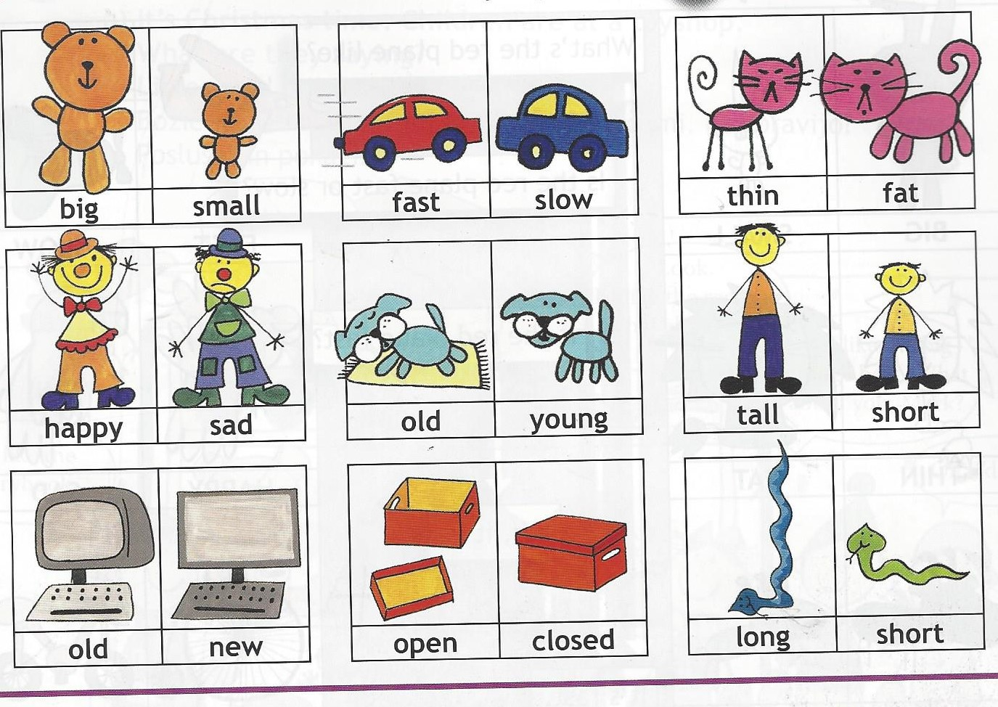
WHAT DO YOU SEE?

Slide 3


Slide 5

Small
Big
Long
Short
Short
Tall
Young
Old
Fast
Slow
Sad
Happy
Thin
Fat
New
Old
Closed
Open

