Slide 1
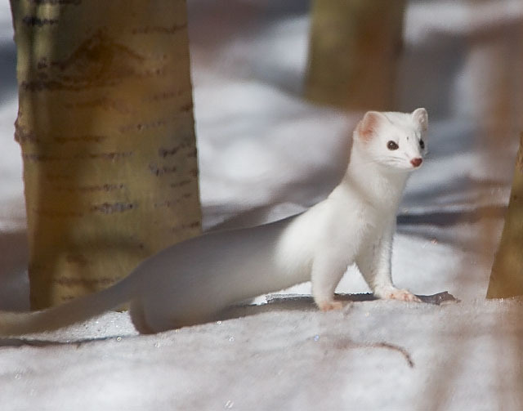
STOAT

Slide 2
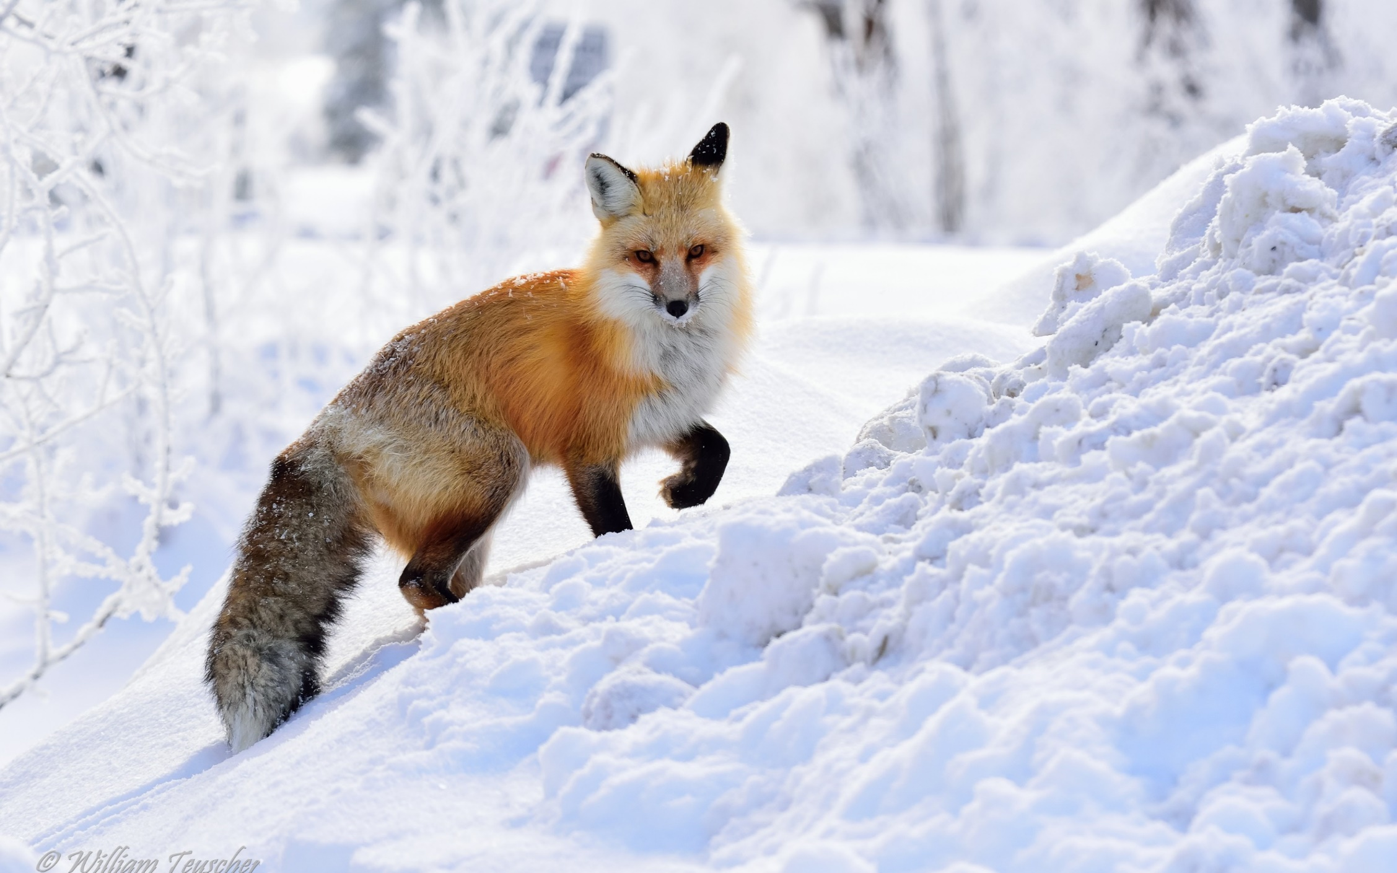
FOX

Slide 3
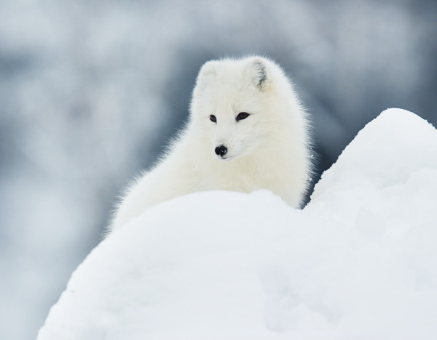
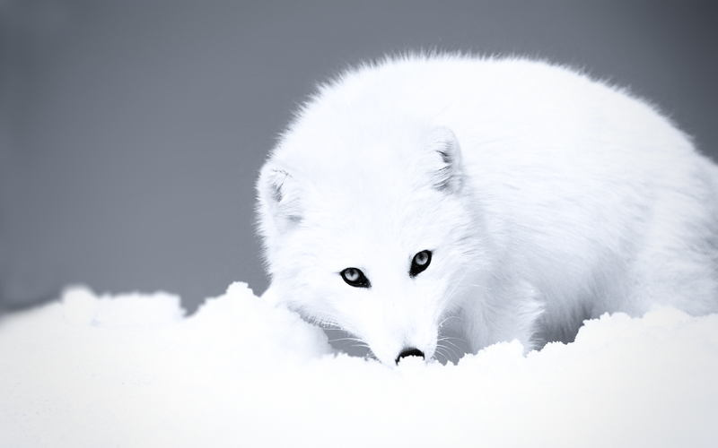
ARCTIC FOX

Slide 4
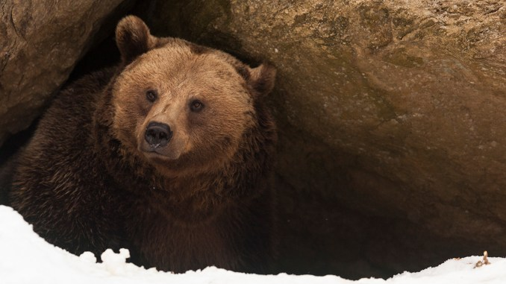
BEAR

Slide 5
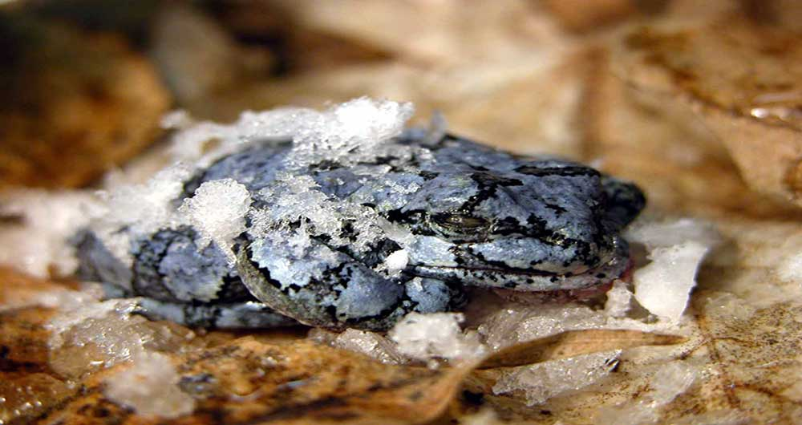
FROG

Slide 6
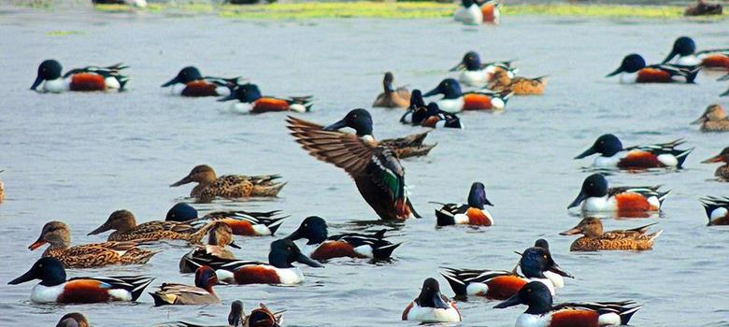
BIRDS - - DUCKS (FLY)

Slide 7
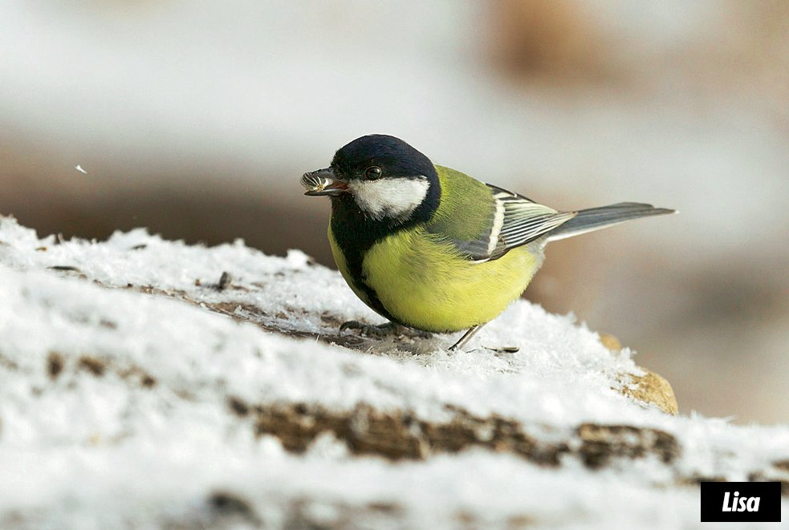
TIT

Slide 8
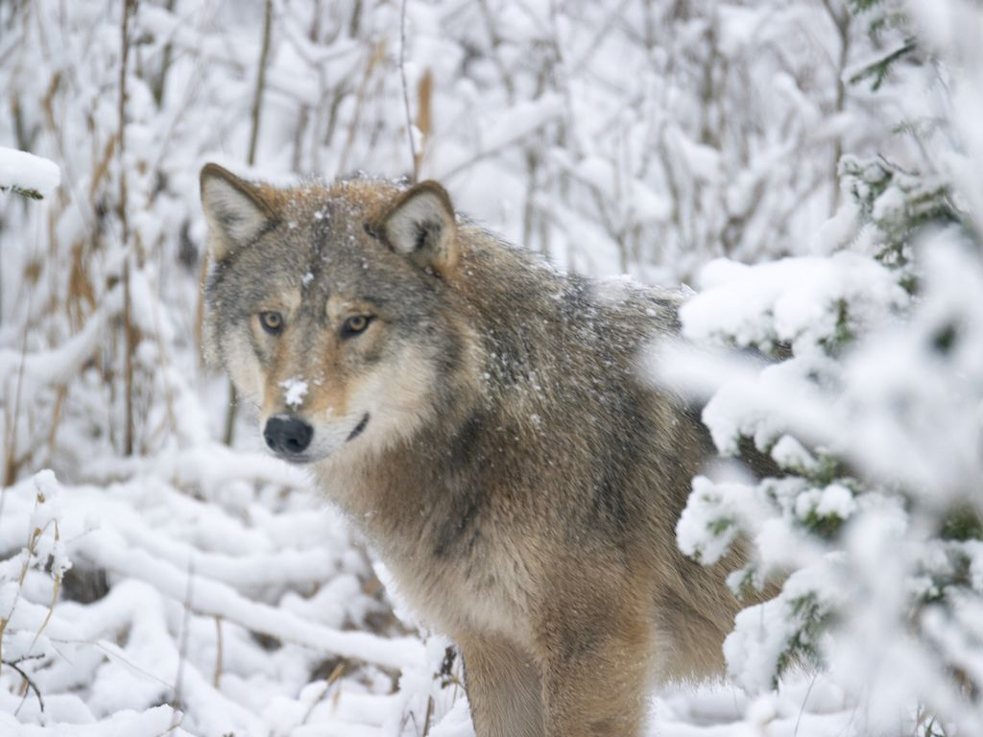
WOLF

Slide 9
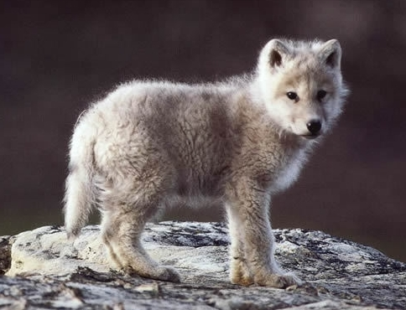
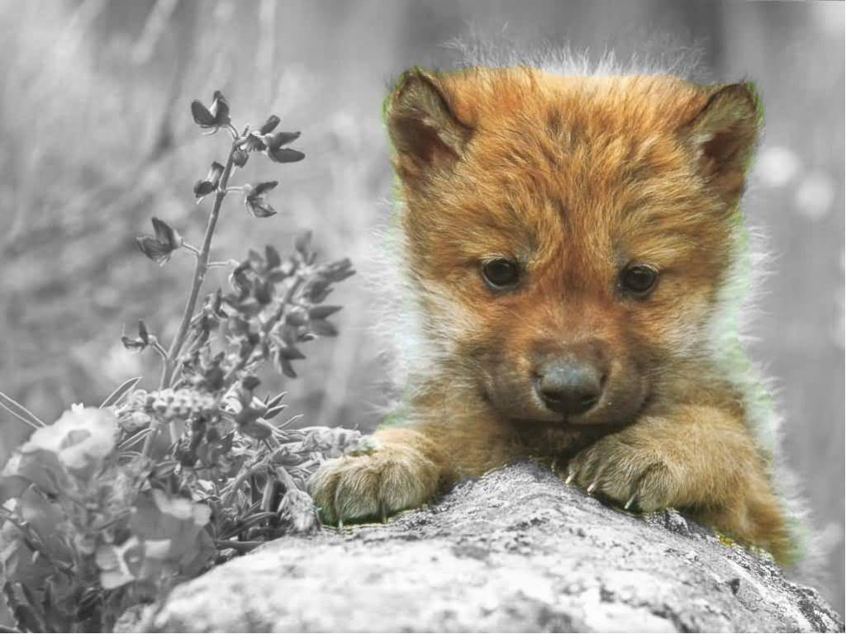
BABY WOLVES IN THE WINTER

Slide 10
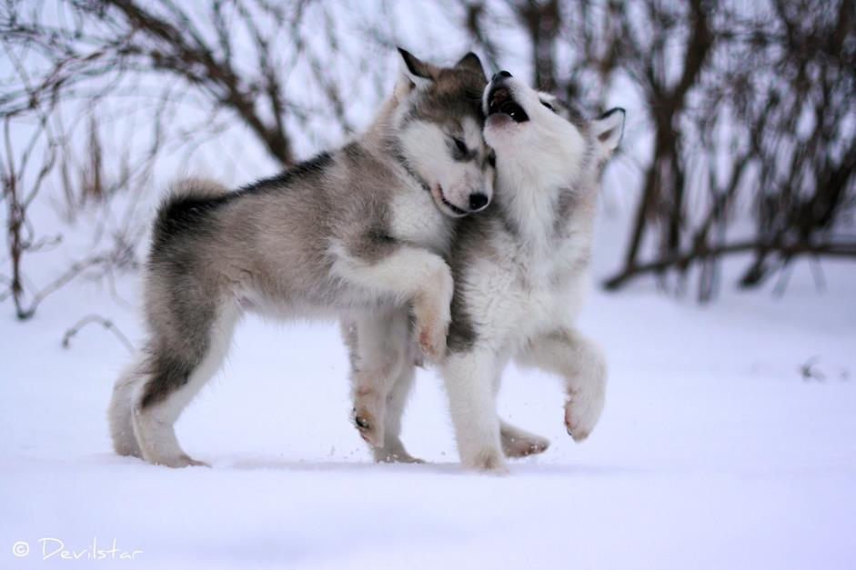
BABY WOLVES ARE PLAYING

Slide 11
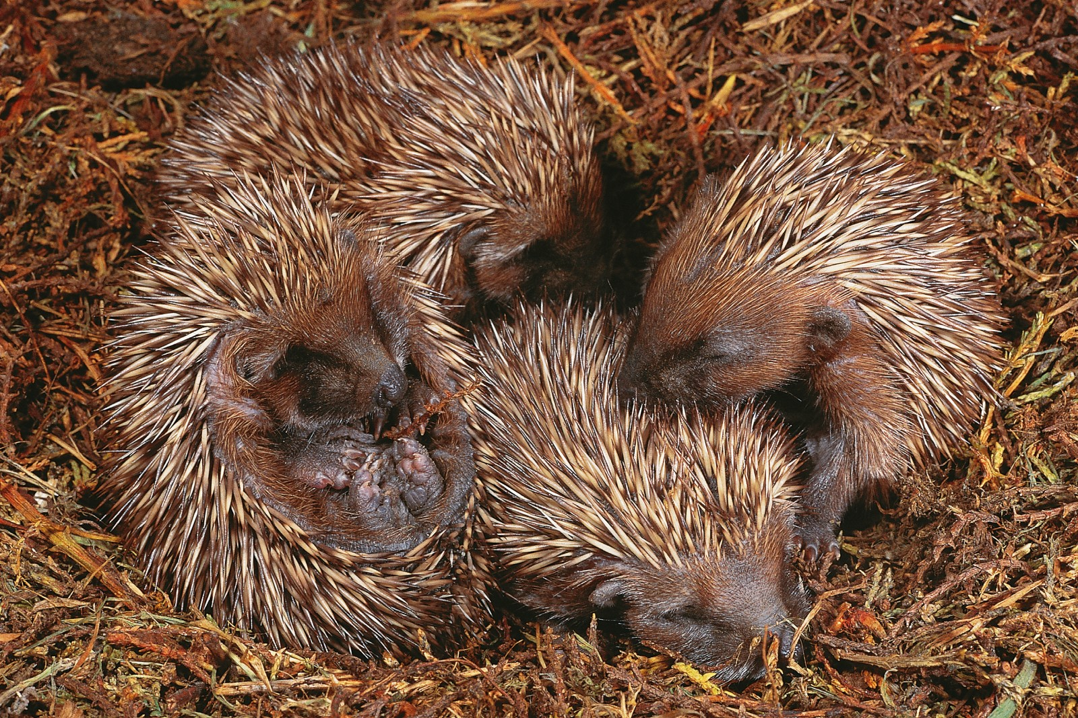
HEDGEHOGS SLEEP

Slide 12
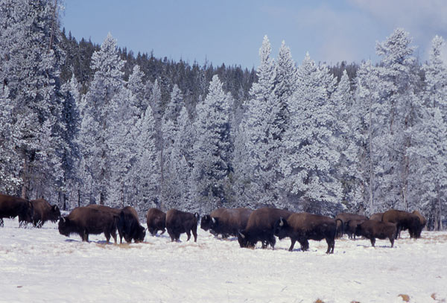
BISONS

Slide 13
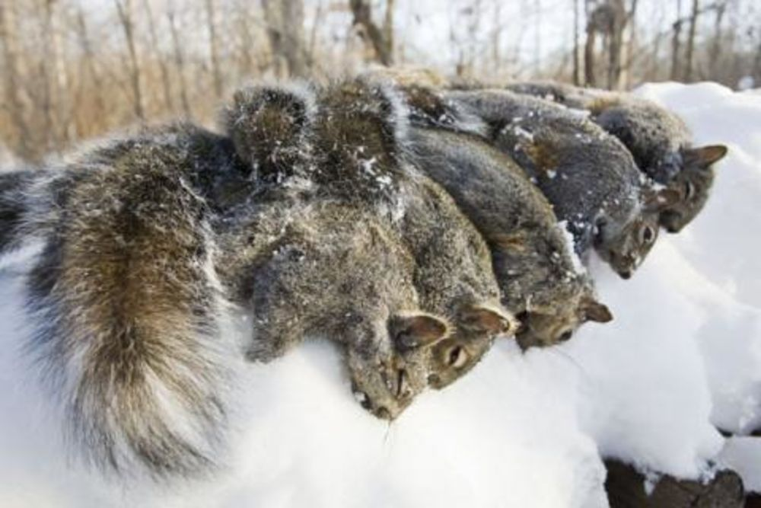
SQUIRRELS

Slide 14
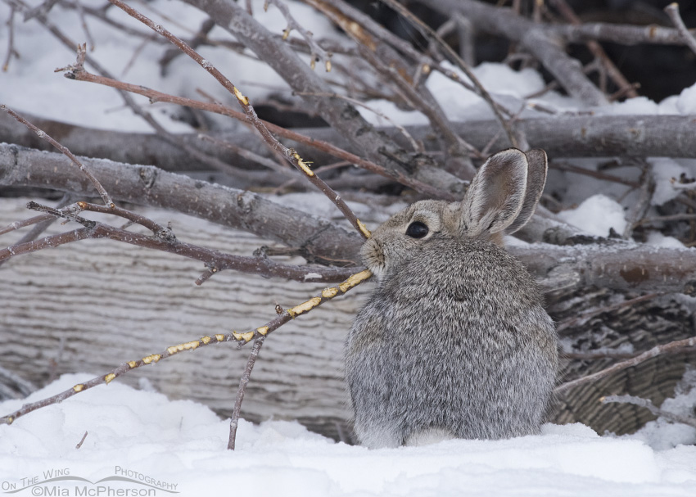
RABBIT EATS BARK

Slide 15
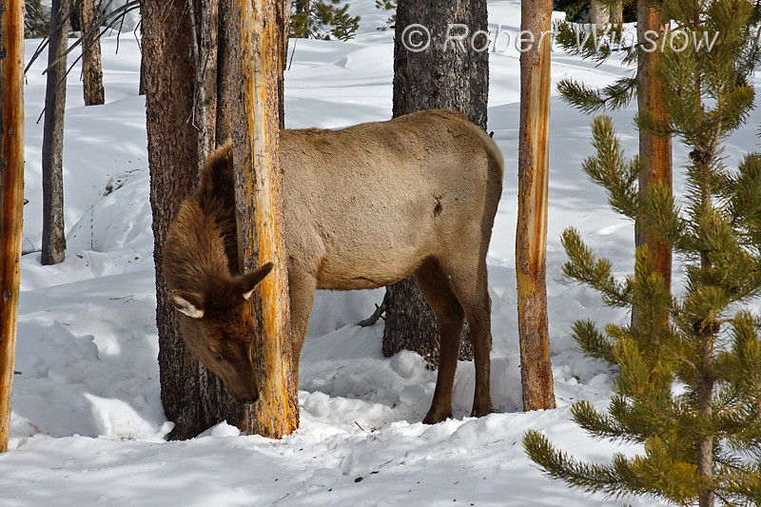
DEER

Slide 16
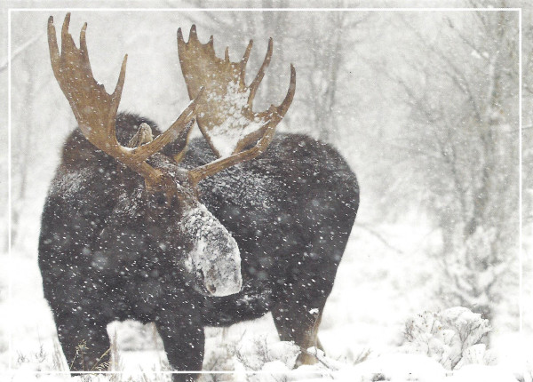
MOOSE

Slide 17
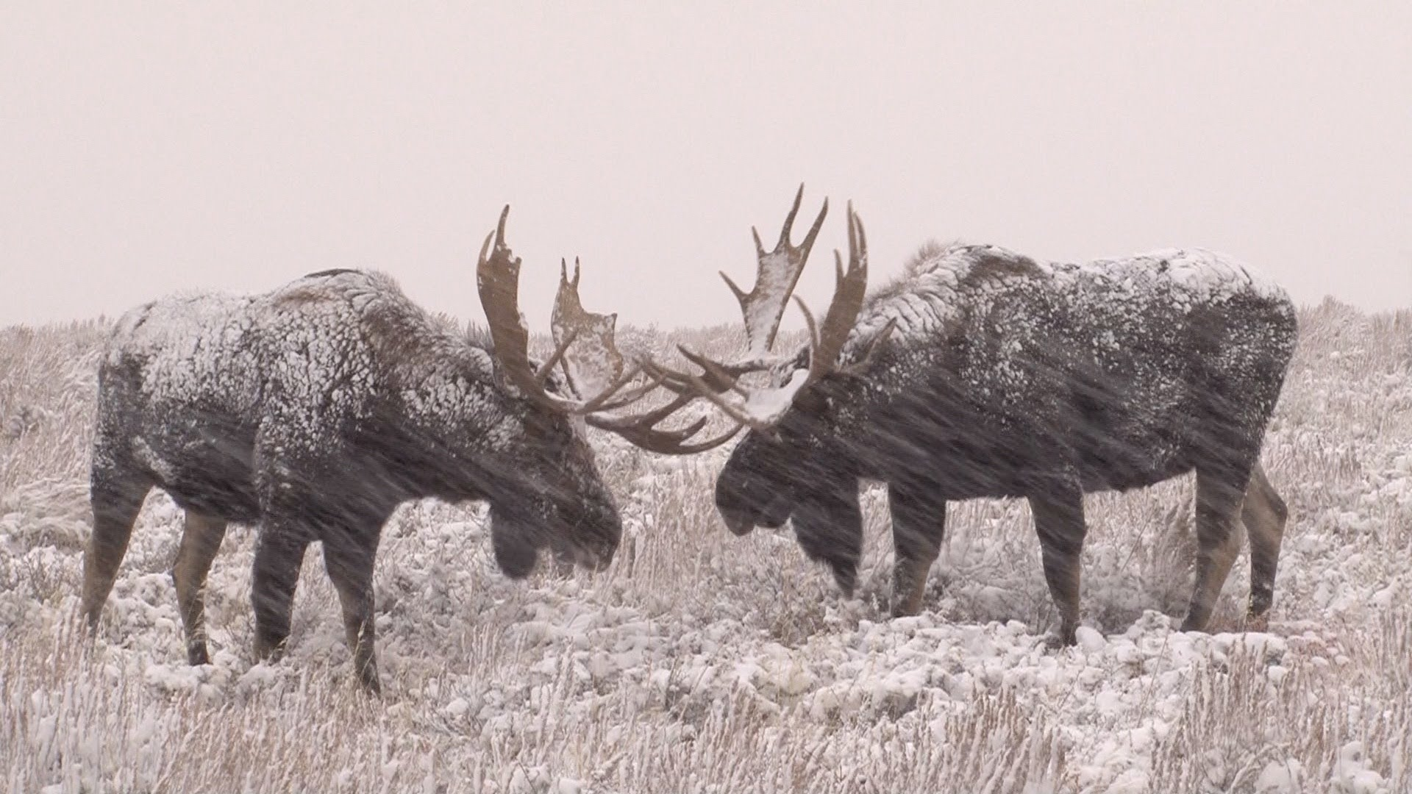
THE MOOSE ARE FIGHTING

Slide 18
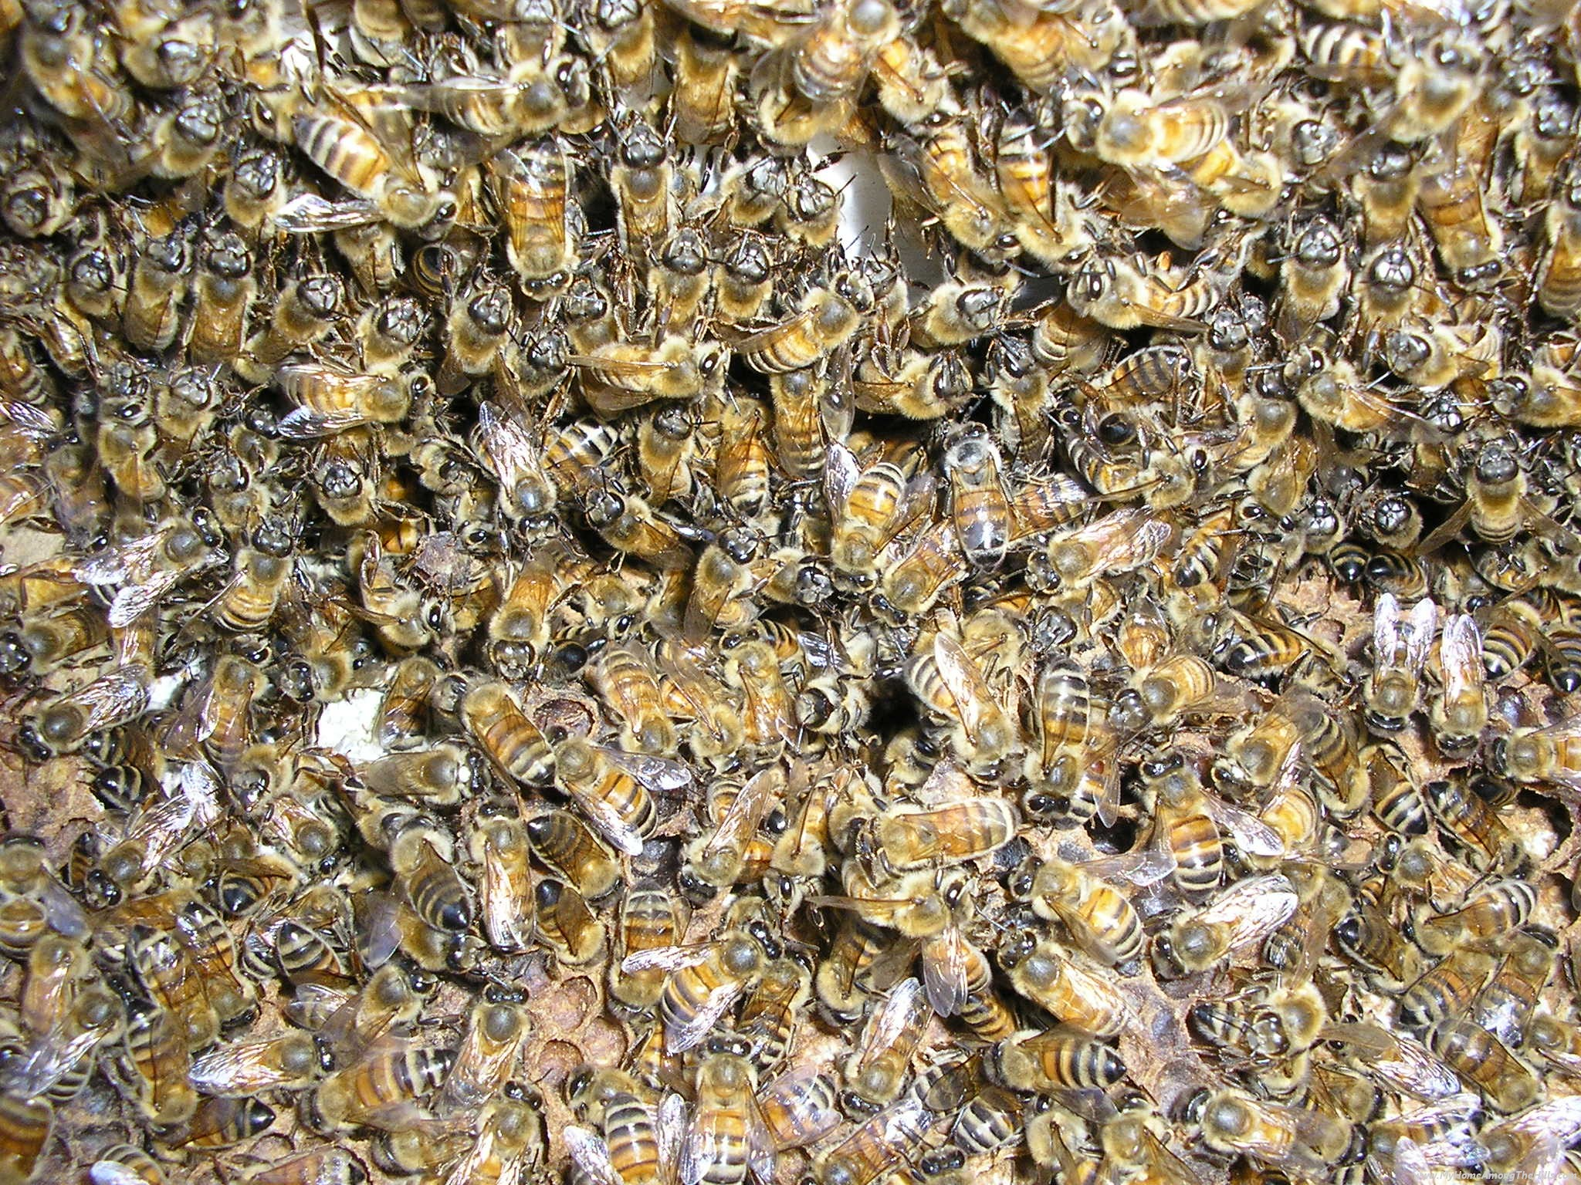
BEES STICK CLOSE TOGETHER

Slide 19
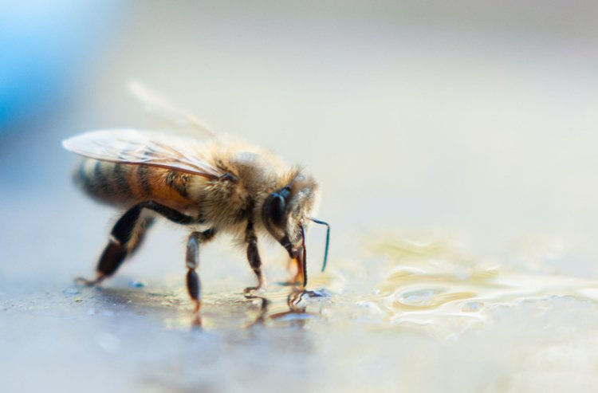
THEY EAT HONEY

Slide 20
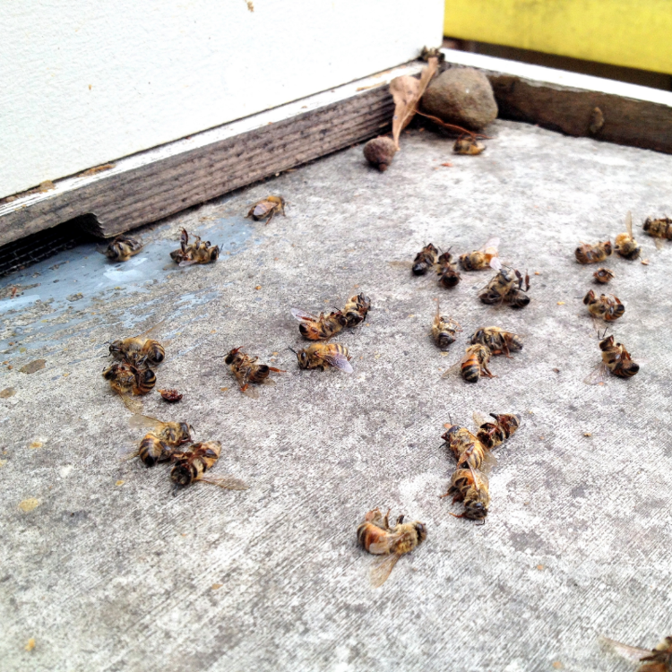
THEY HUNKER DOWN

Slide 21
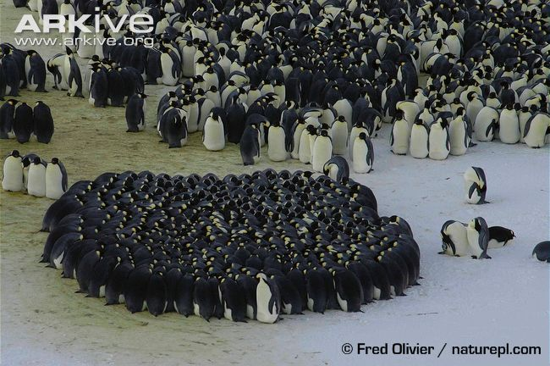
PENGUINS STICK TIGHT TOGETHER

