Slide 1


Slide 2

Think of 5 objects that define you. Write them down or draw them.
Describe them to your neighbour.

Slide 3
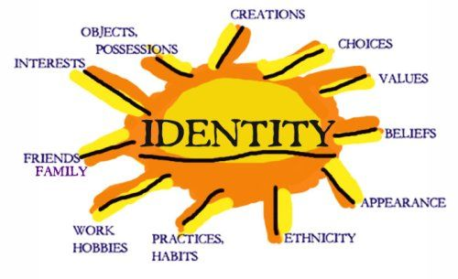

Slide 4

What‘s in a name?
Discuss in small groups:
Does your name have any meaning?
Do you know where your name comes from? Do you think this is important? Does it say something about you?
Who gave you the name? Were you named after someone?
Does your name show which country you come from?
What would you be called if you were the other sex?
Do people pronounce your name in different ways?
Is your name easily translatable into German, French or English?
If so, what would it be in other languages?
Are there any well-known people with this name?
Have you got a nickname? Who gave it to you? Does it say anything about you?
Does the way your name is constructed say anything about your cultural or social background?
Reflection
Would you do this activity with children? Why yes/no?

Slide 5
You as a child
Think back at the time you were five or six. Think about relationships with others around you, the kinds of things you believed in and the way you behaved.
What traditions and rituals brought you joy and which did you avoid?
How did you feel connected to your cultural identity?
Which different groups did you belong to?
Now think about yourself now. How different are you to the person you once were?

Slide 6
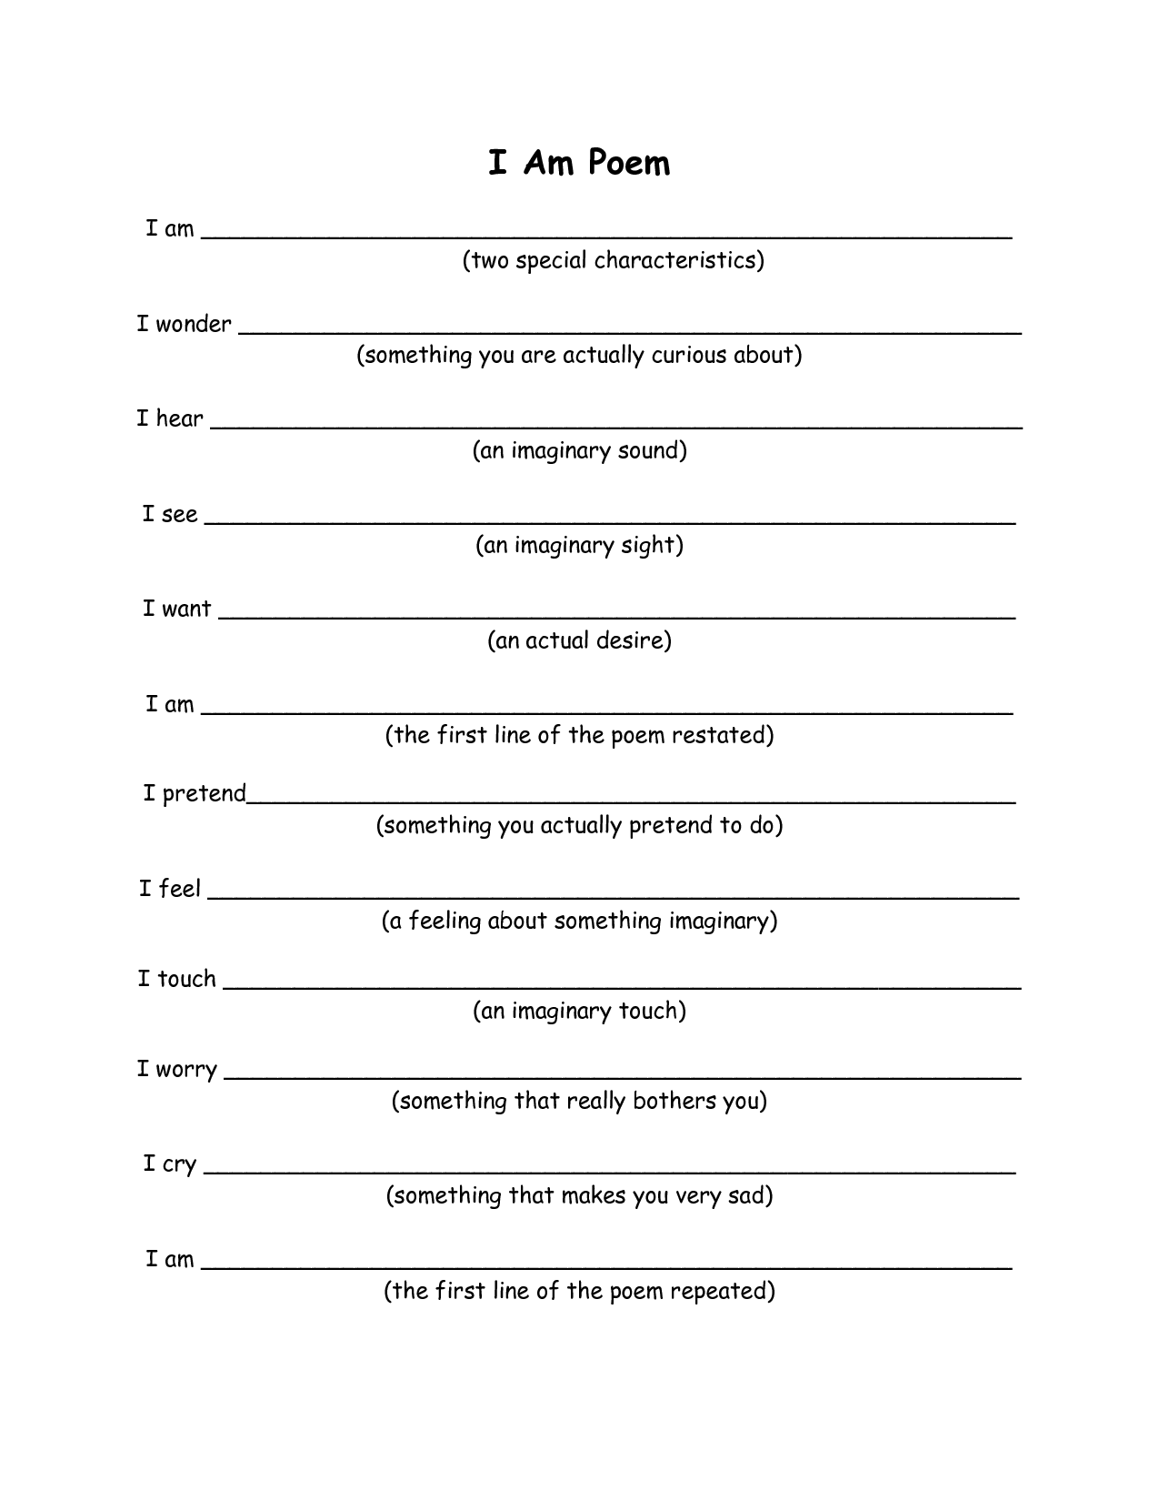

Slide 7
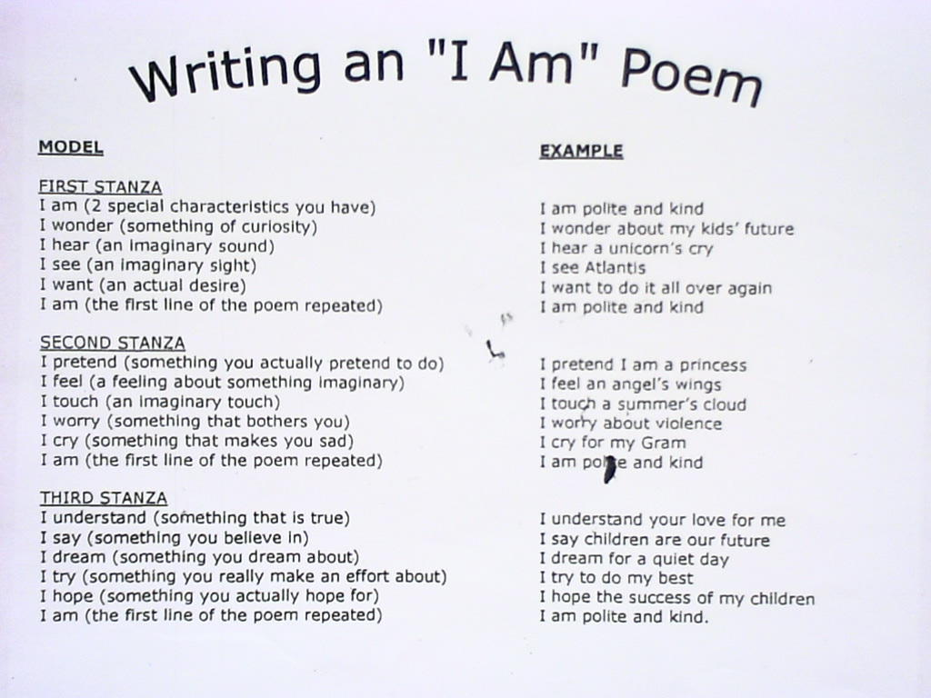

Slide 8
I am… (a sport)
I am… (types of food)
I am… (culture, colour)
I am… (games you like)
I am… (things you believe in)
I am… (education, experience)
I am… (personal characteristics)
I am… (cartoons)
I am… (family)
I am… ((types of) films)
I am… (TV channels)
I am… (things you like doing)
….
-

Slide 9
Sample - My Personal "I Am From" Poem
I am basketball on a snowy driveway.
I am fishsticks, crinkle-cut frozen french fries and frozen mixed vegetables.
I am primarily white, upper-middle class neighborhoods and racially diverse schools.
I am Donkey Kong, Ms. Pac Man, Atari 2600 and sports video games.
I am football on Thanksgiving and New Year's Day.
I am "unity in diversity" and "speaking from your own experience."
I am triple-Wahoos, earning three degrees from the University of Virginia.
I am diversity, multicultural education, identity, introspection, self-reflection, and social action.
I am Daffy Duck, Mr. Magoo, Hong Kong Phooey, Foghorn Leghorn, and other cartoons.
I am Tae Kwon Do, basketball, the batting cages, a soccer family, and the gym.
I am a wonderful family, close and loving and incredibly supportive.
I am films based on true stories and documentaries
I am the History Channel, CNN, ESPN, BRAVO, and Home Team Sports.
I am a passion for educating and facilitating, personal development and making connections.

Slide 10

Write your own ‘I am’ poem.

