Slide 1
Culture in coursebooks

Slide 2
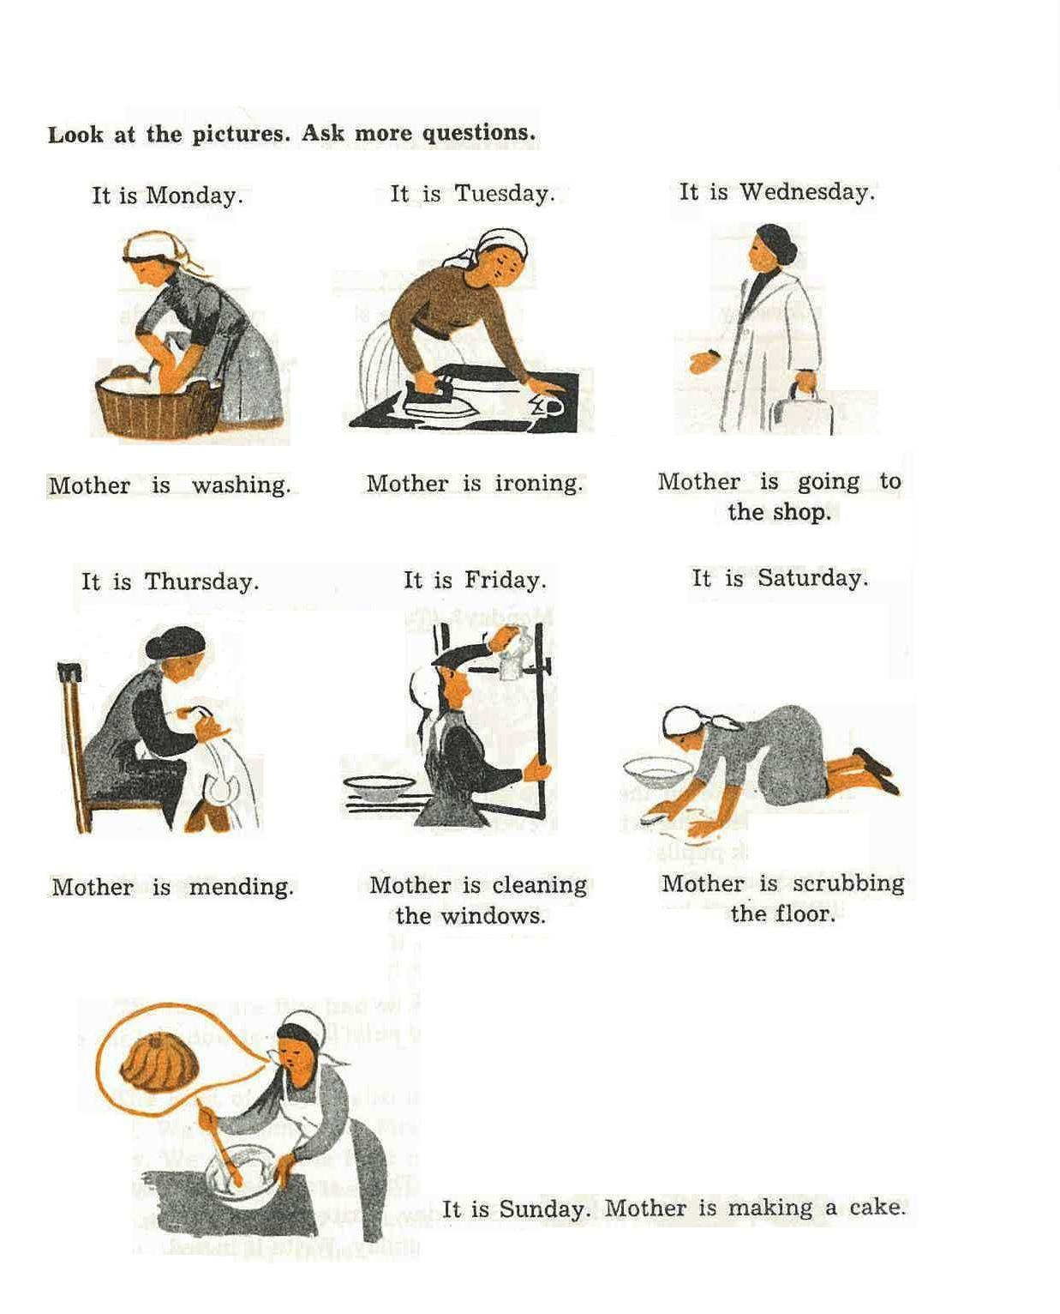
1960s

Slide 3
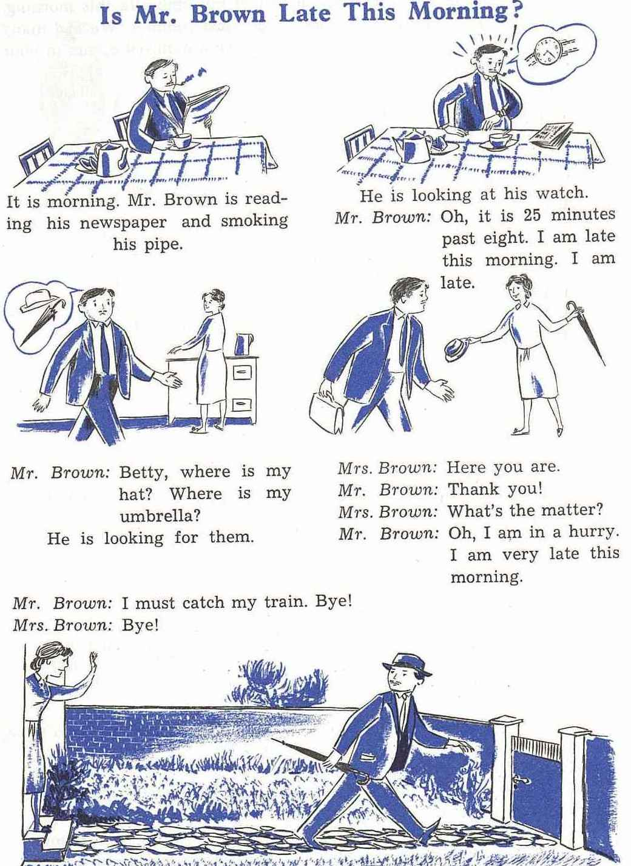
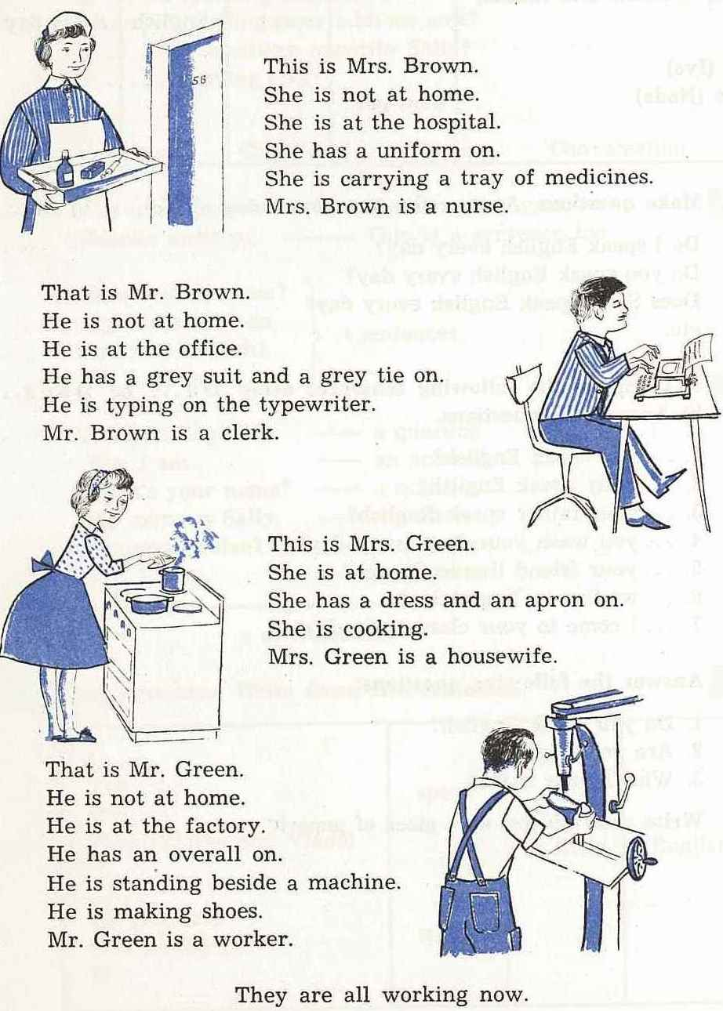

Slide 4
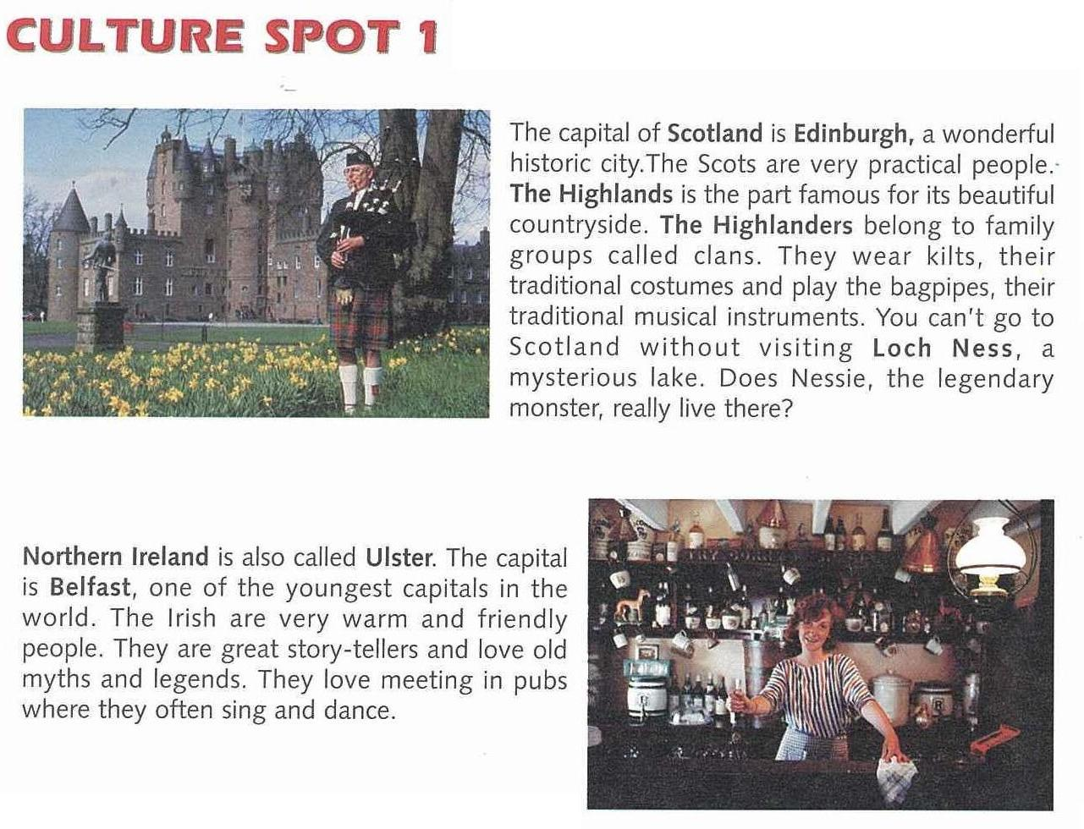
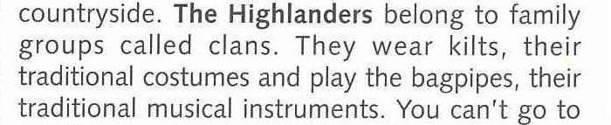
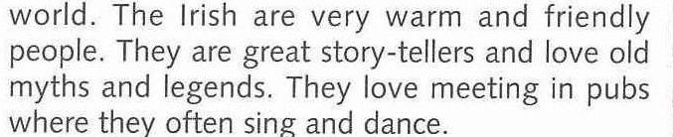

Slide 5
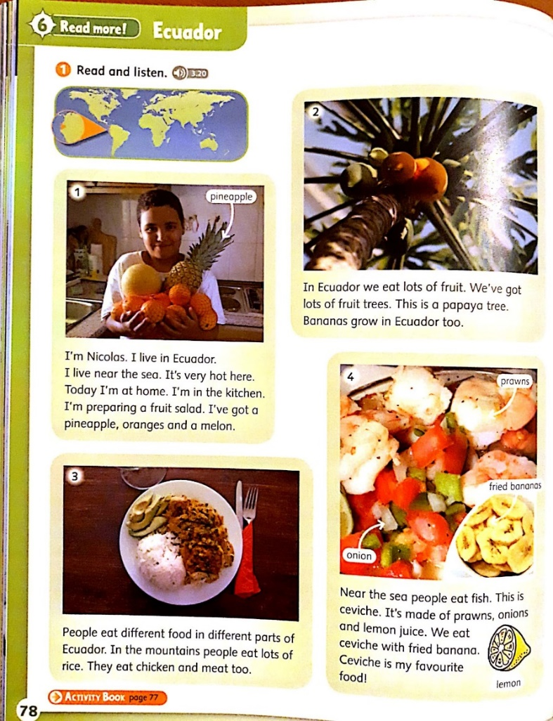
Young Explorers 1, OUP

Slide 6
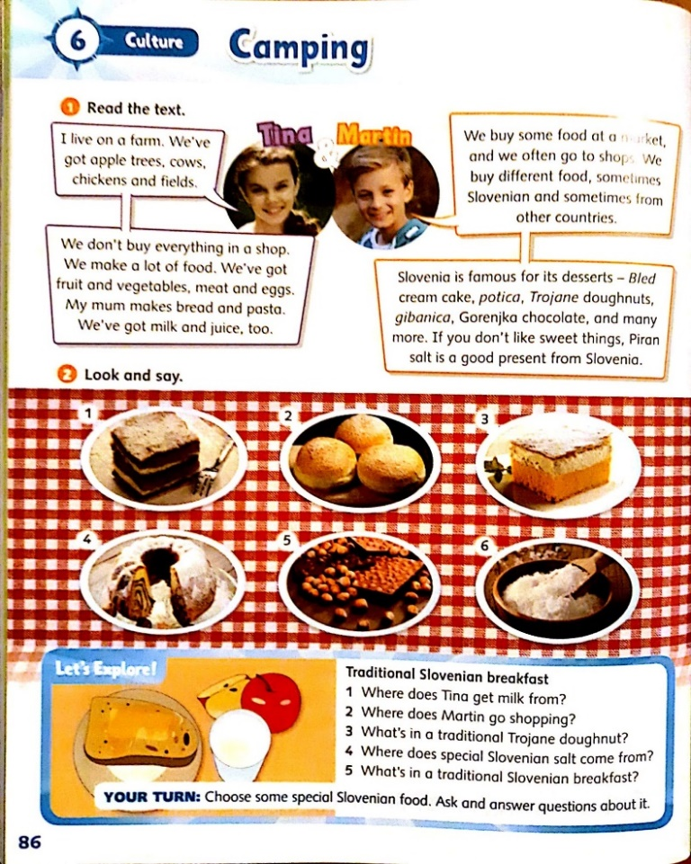
Young Explorers 1, OUP

Slide 7
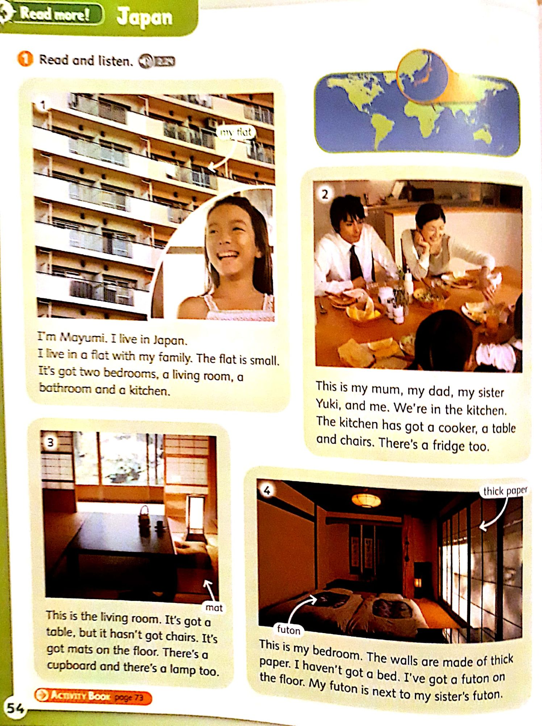
Young Explorers 1, OUP

Slide 8
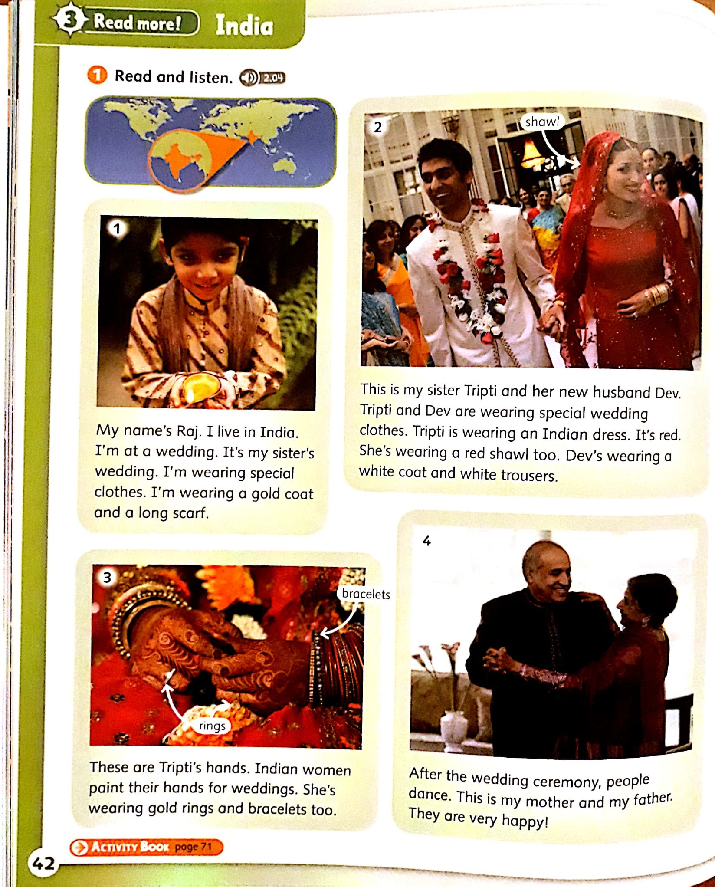
Young Explorers 1, OUP

Slide 9
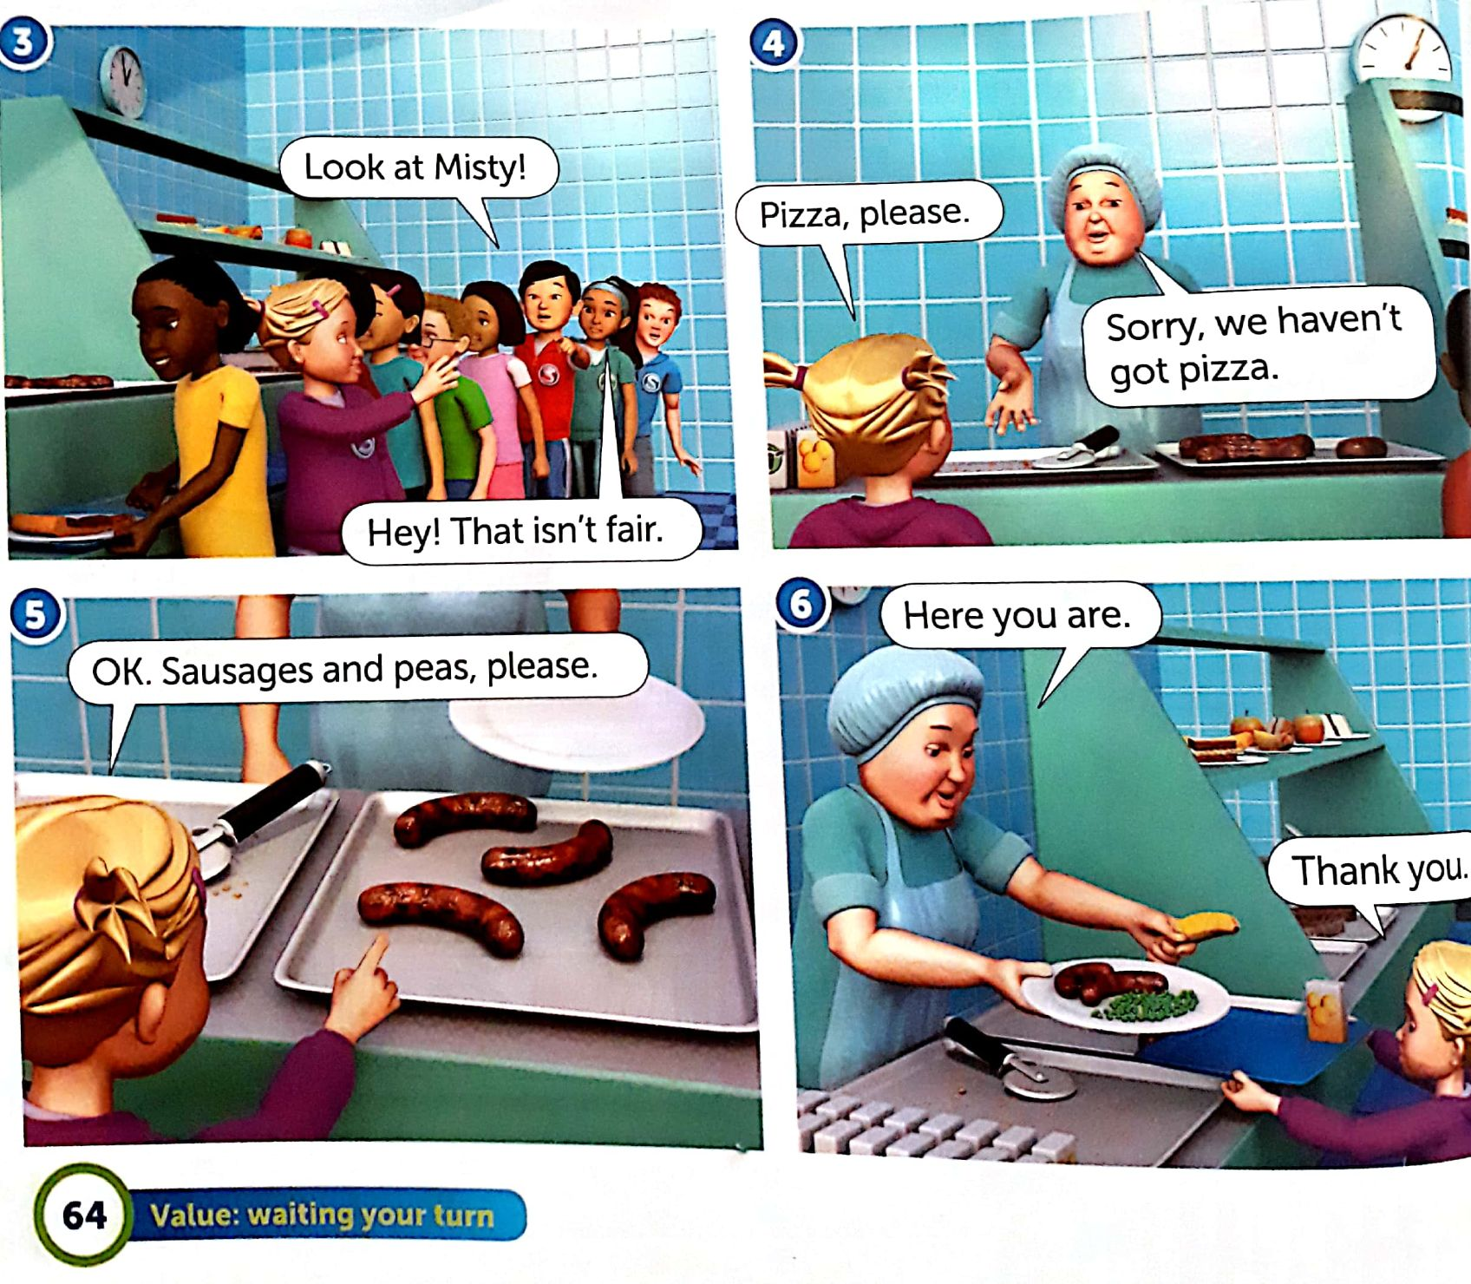
Super minds 1, teaching values

Slide 10
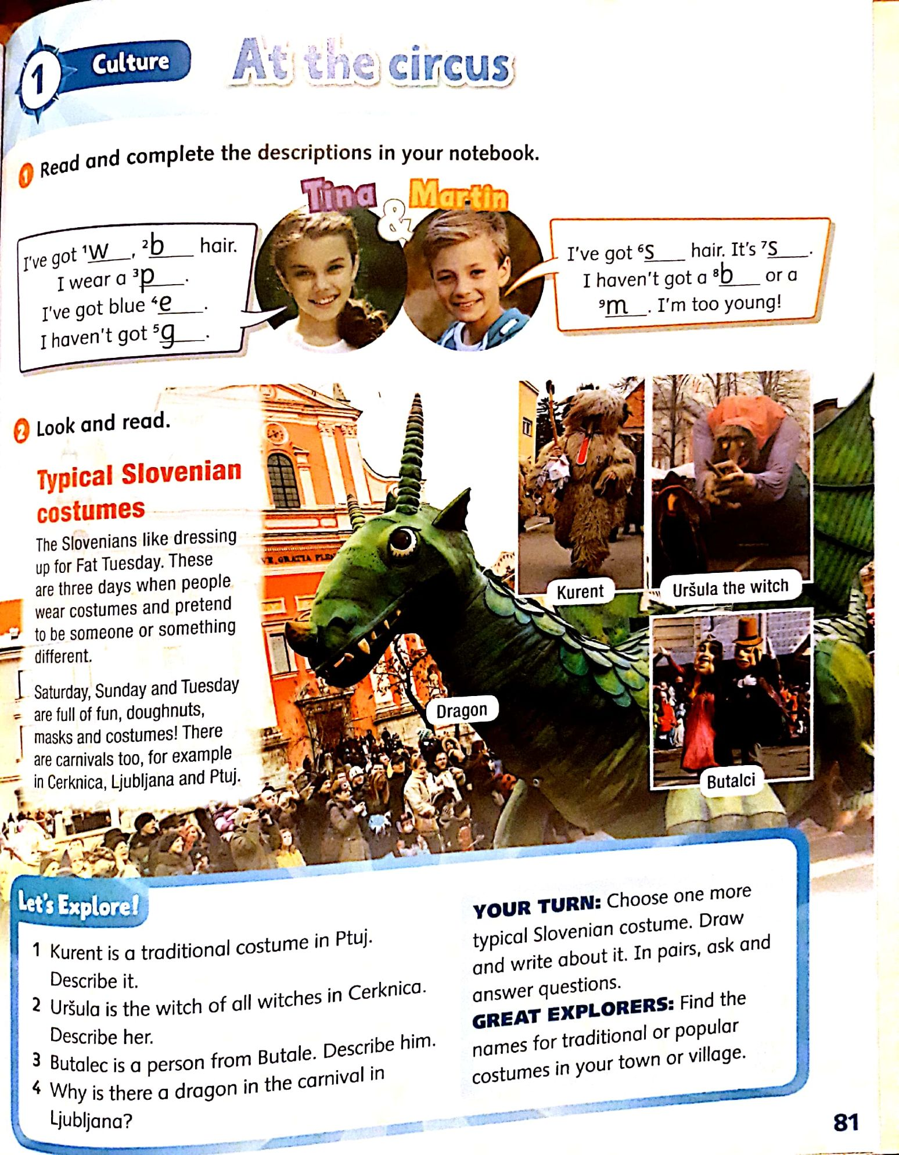
Young Explorers 2, OUP

Slide 11
Teaching culture
Four frequent approaches to teaching culture:
The Frankenstein Approach – bits and pieces
The 4-F Approach (Folk dances, festivals, fairs, and food)
The Tour Guide Approach – monuments, rivers, cities, etc.
The 'By-The-Way' Approach – sporadic lectures or bits of behavior selected indiscriminately

Slide 12
Coursebook evaluation
How are cultural issues presented in the coursebooks for teaching English to children?
Which cultures are presented?
How many activities for raising cultural awareness are there?
Are they appropriate?
Do they present cultures in a stereotypical way?
Is there any presentation of people of different skin colour, disabled people…?
How are the roles of women and men presented?
Which cultural topics do they introduce to children? (geography, food…)
Would you add/adapt any?

