Slide 1
Linguistic landscapes
Mateja Dagarin Fojkar

Slide 2
Linguistic landscape is the "visibility and salience of languages on public and commercial signs in a given territory or region" (Landry and Bourhis 1997:23)
For example – some public signs may be in the native language, English, German, Croatian…
The study field has only been developed recently, looking at the influence of languages on the certain region, country…
The study of linguistic landscape also examines such patterns as which languages are used for which types of institutions (e.g. country club, hospital, ethnic grocery store), which languages are used for more expensive/cheaper items (new cars or used cars), or which languages are used for more expensive/cheaper services (e.g. pool cleaning or washing machine repair). Also, linguistic landscape can be studied across an area, to see which neighborhoods have signs in which languages.

Slide 3
Discussion points
What languages can you see (or hear) when you are at home?
What languages do you come across on your way to school?
How does it make you feel to see that language in that place?
Have you ever been somewhere where you don’t understand any of the languages you see?
What places can you think of where you can see many different languages?

Slide 4
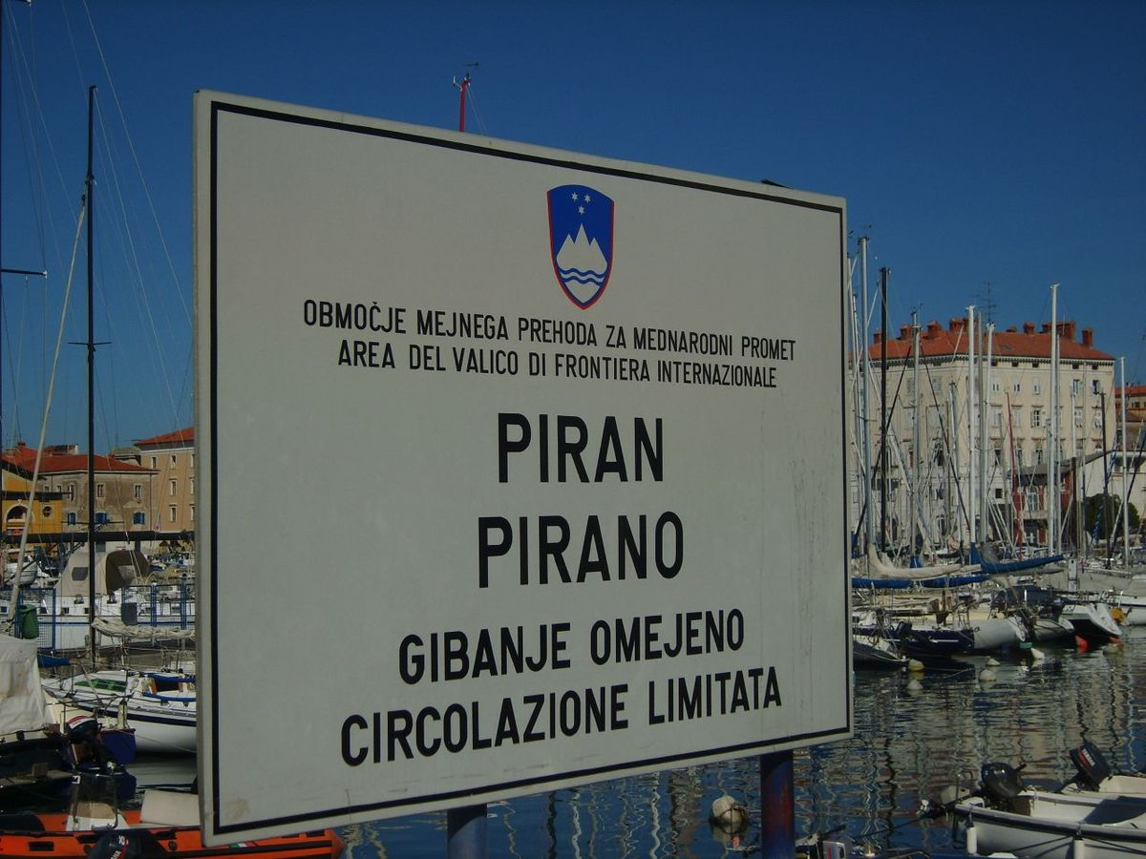
Bilingual signs in border areas

Slide 5
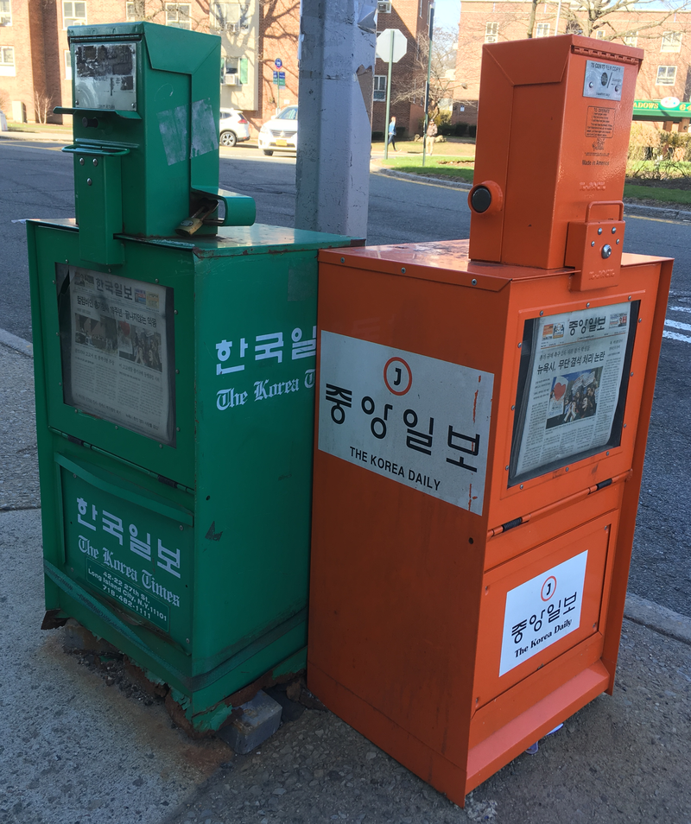
Newspaper stand in 2 languages

Slide 6

advertising

Slide 7
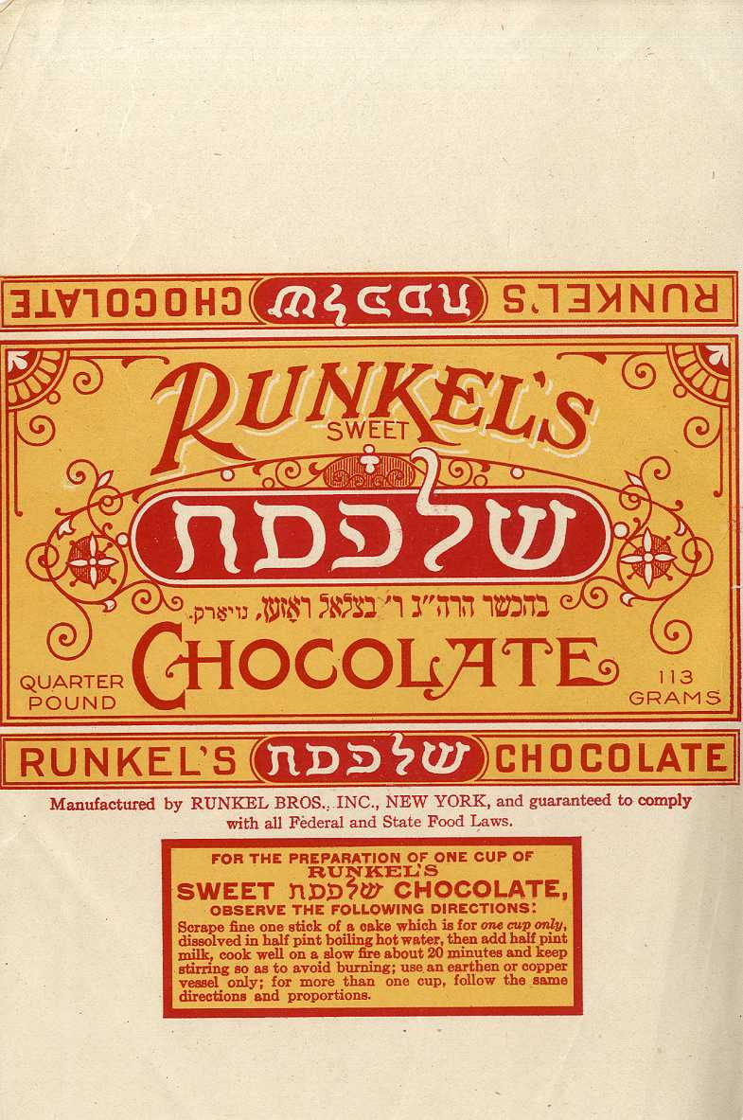

Slide 8
task
Work in pairs. Go around the faculty building and take pictures of advertisements, signs in more than one language.
What do you think is the reason for using another language?
Do you think using another language is effective/appropriate?
How might people feel when they see that language?
How would someone who does not understand the language feel?
In the course of the following days observe other places and try to see other examples of linguistic landscapes.

