Slide 1
THE UNITED STATES OF AMERICA

Slide 2
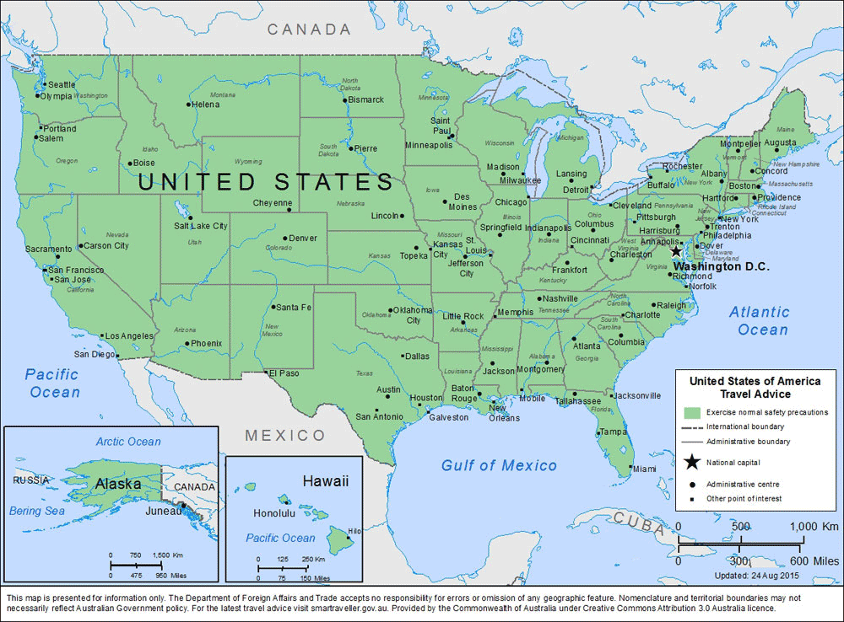
GENERAL INFORMATION

Slide 3
GENERAL INFORMATION
AREA: 9,826,630 sq m
POPULATION TOTAL: 332 million
URBAN POPULATION: 81 %
ADMINISTRATIVE DIVISIONS: 50 states and the District of Columbia. Two states, Alaska and Hawaii, are separate from mainland USA.
FORM OF GOVERNMENT: federal constitutional republic; President: Joe Biden

Slide 4
GENERAL INFORMATION
CAPITAL CITY: Washington, DC
LONGEST RIVER: the Mississippi, 3900 km
HIGHEST MOUNTAIN: Mount McKinley, 6,198 m
LARGEST LAKE: Lake Superior, 83,300 sq m
CLIMATE: mostly temperate, but tropical in Hawaii and Florida, arctic in Alaska, semiarid in the great plains west of the Mississippi River, and arid in the Great Basin of the southwest

Slide 5
GENERAL INFORMATION
FIRST LANGUAGE: English; SECOND LANGUAGE: Spanish
CURRENCY: US Dollar (USD)
HDI (HUMAN DEVELOPMENT INDEX) IN 2021: 0,921
  HDI is a composite statistic of life expectancy, education, and per capita income indicators, which are used to rank countries into four tiers of human development.
51 Facts about America
101 Facts about America

Slide 6
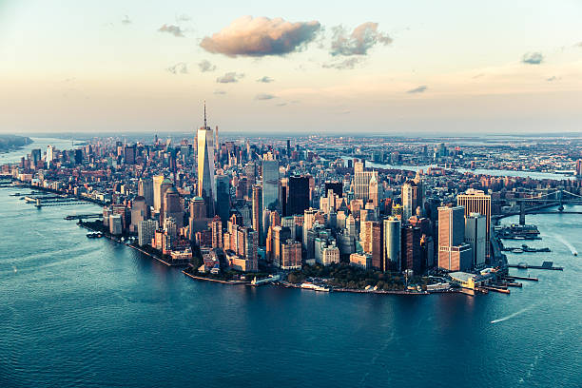
NEW YORK
https://docs.google.com/presentation/d/1imwA1q2vKdwAcTsXJkjcRoC_XgAKEfUrNz4QQqjIG1c/edit?usp=sharing

Slide 7
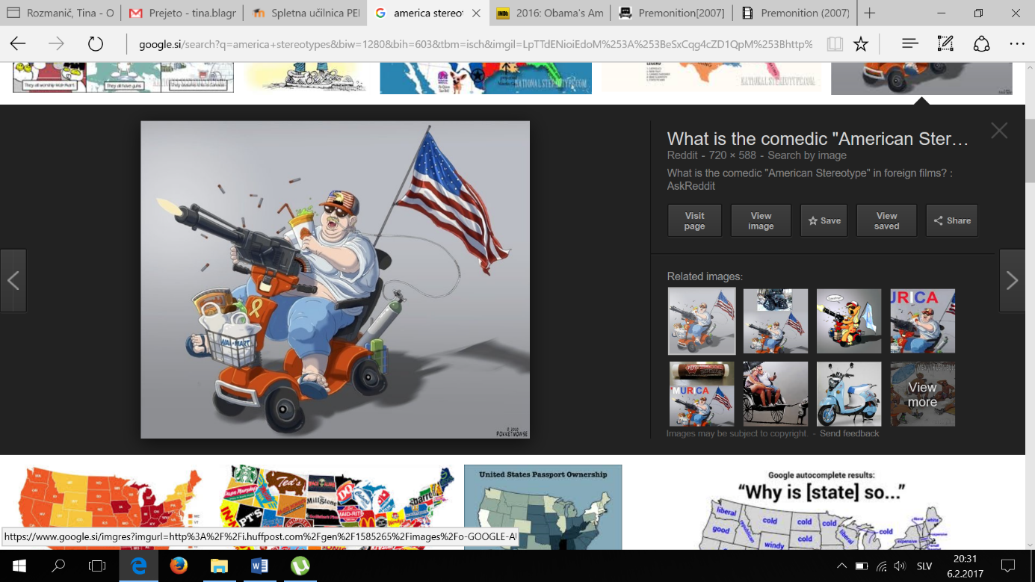
AMERICAN STEREOTYPES
Stereotypes

Slide 8

AMERICAN STEREOTYPES - POSITIVE
Generosity
Optimism
Hardworking

Slide 9
AMERICAN STEREOTYPES - NEGATIVE
"Obesity"
"Gun-loving" culture of violence
Materialism, over-consumption and extreme capitalism
Lack of intelligence and cultural awareness
Racism and racialism

Slide 10
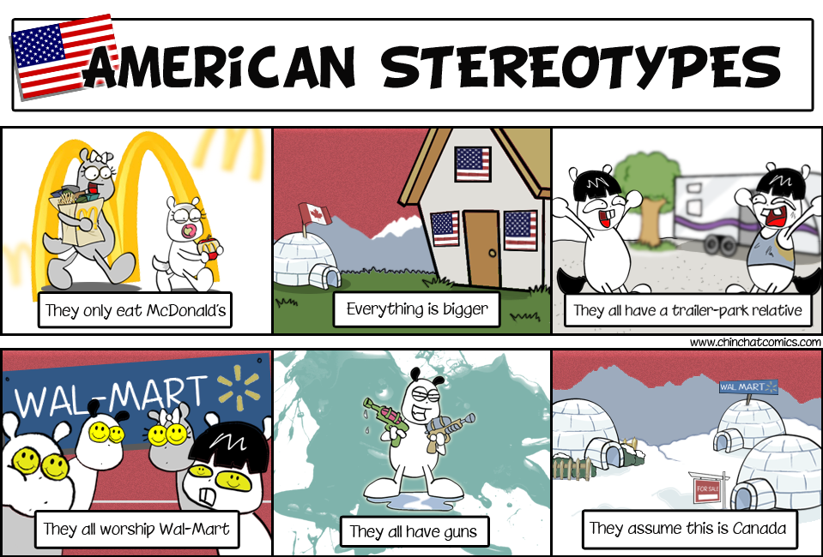
AMERICAN STEREOTYPES - NEGATIVE
Environmental ignorance
Arrogance and boastfulness
Military zeal
Overly hard-working

Slide 11
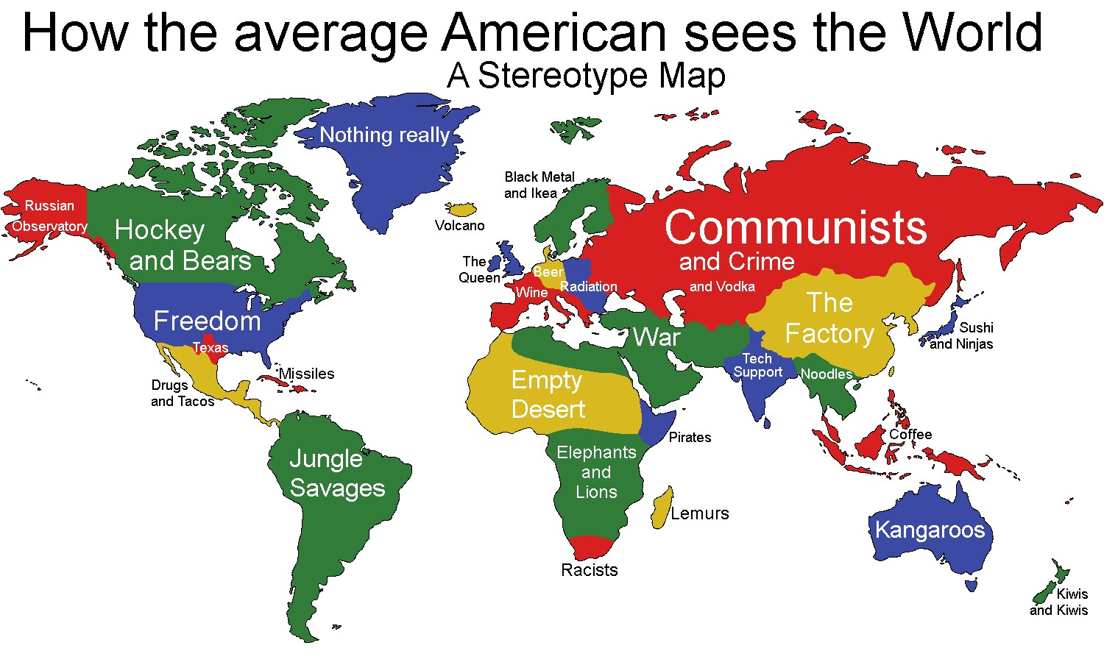

Slide 12
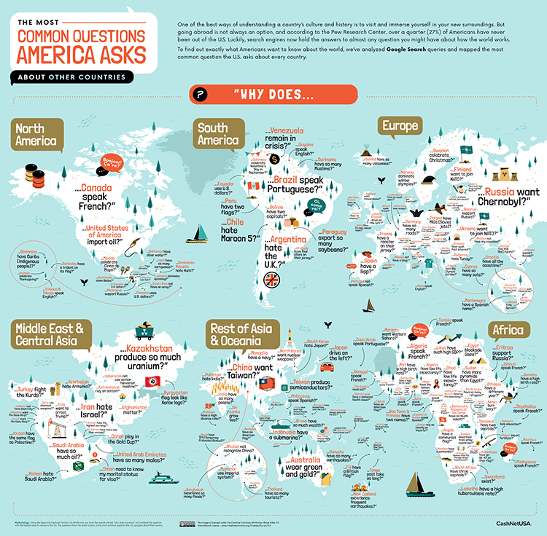

Slide 13

EDUCATION IN THE USA
Education in the USA is provided by:
public (87 %),
private (10 %),
and home schools (3 %).
Logan's story

Slide 14
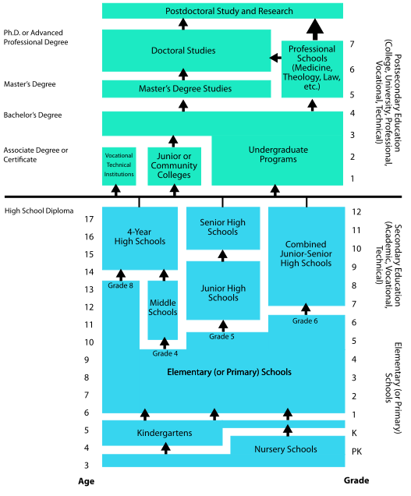

Slide 15

A PRESIDENTIAL SYSTEM: THE USA
The United States is a federal republic in which the president, Congress, and federal courts share powers reserved to the national government according to its Constitution.

Slide 16
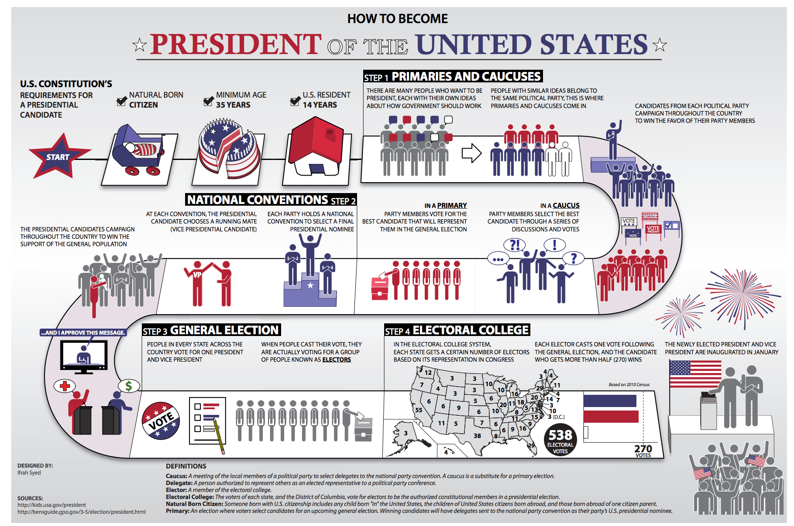
How to become president of the USA

Slide 17

STUMP SPEECHES

Slide 18
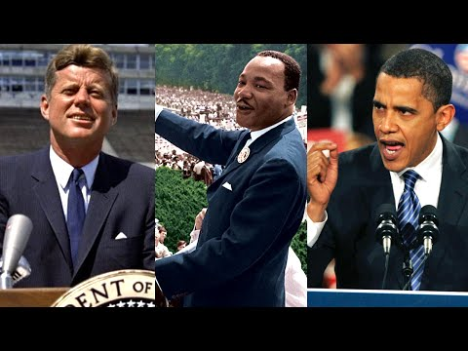
STUMP SPEECHES
In groups write a 1-minute speech about how you’ll improve the US
Think about the negative / positive stereotypes we talked about
Perform your speech–who will you vote for? We’ll vote the American way ;) https://www.270towin.com/

Slide 19
WRITE A CAPTION
Your group will receive one image from U.S. history
Guess what it's about
Write a caption (about 2 sentences long)
See how close you were to the "real" caption!

Slide 20
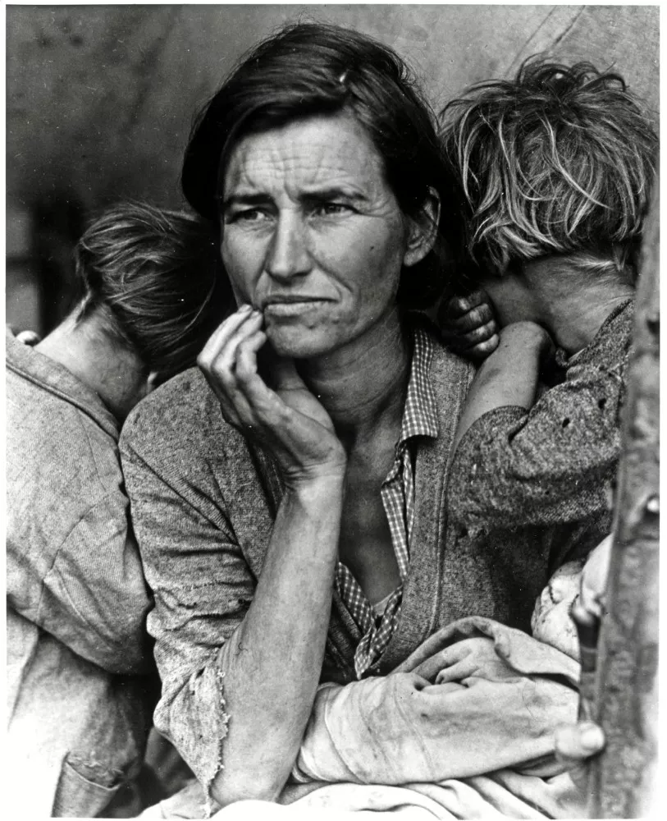
This woman was one of many migrant workers picking peas in California in the 1930s to make just enough money to survive. It was taken by photographer Dorothea Lange as she traveled to document the hardships of the Great Depression.
(https://www.thoughtco.com/great-depression-pictures-1779916)

Slide 21
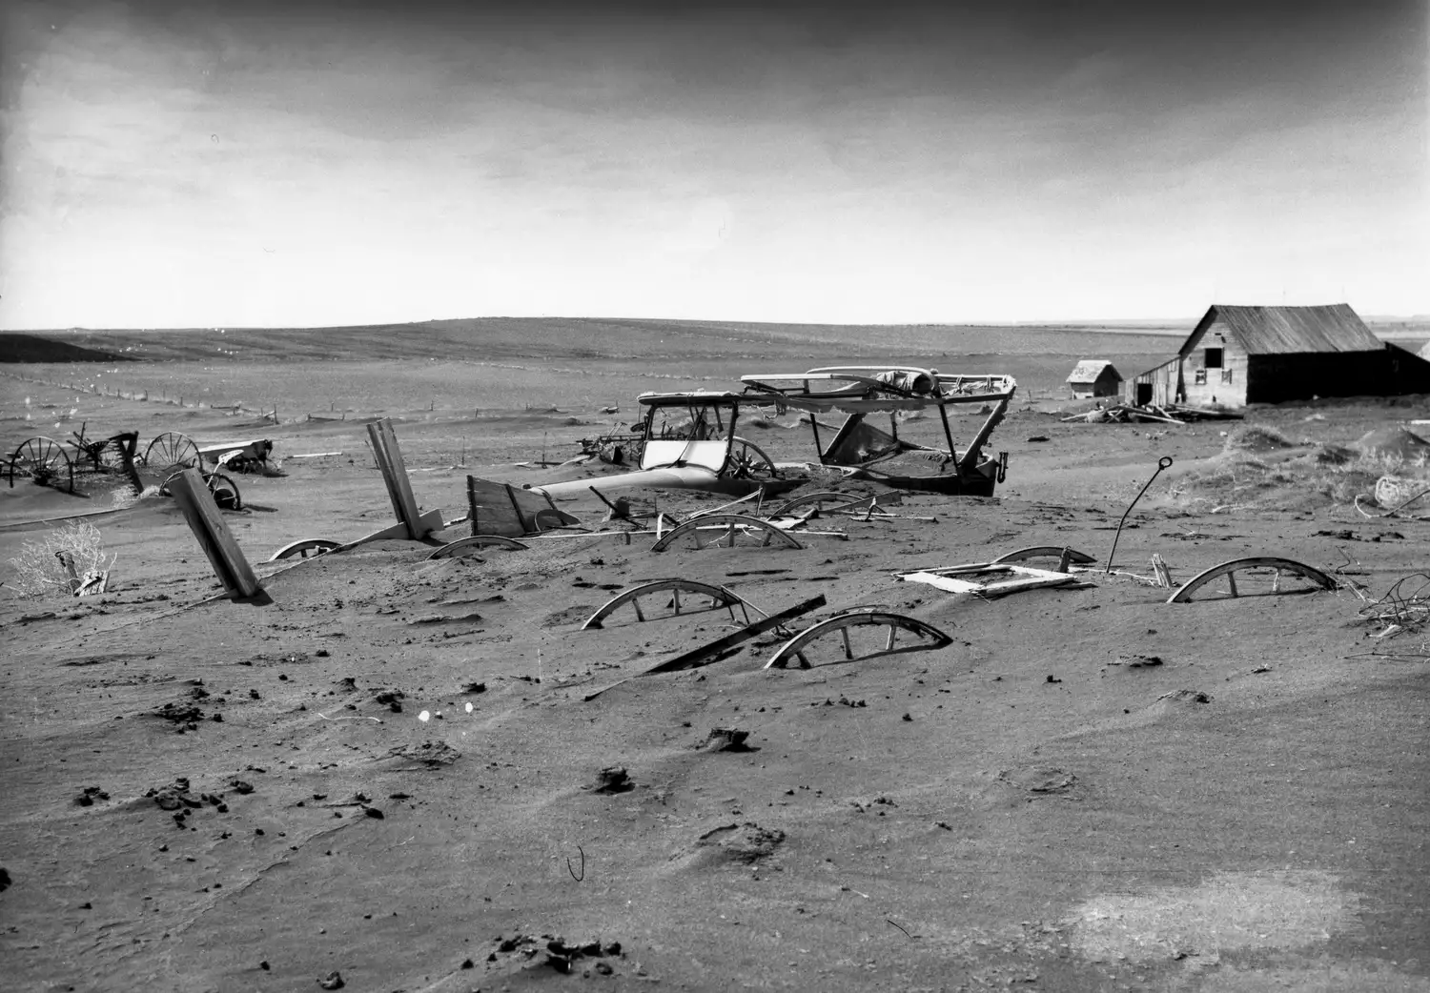
In previous depressions, farmers were usually safe from the severe effects of the depression because they could at least feed themselves. Unfortunately, during the Great Depression, the Great Plains were hit hard with both a drought and horrendous dust storms, creating what became known as the Dust Bowl.
https://www.thoughtco.com/the-great-depression-1779289

Slide 22
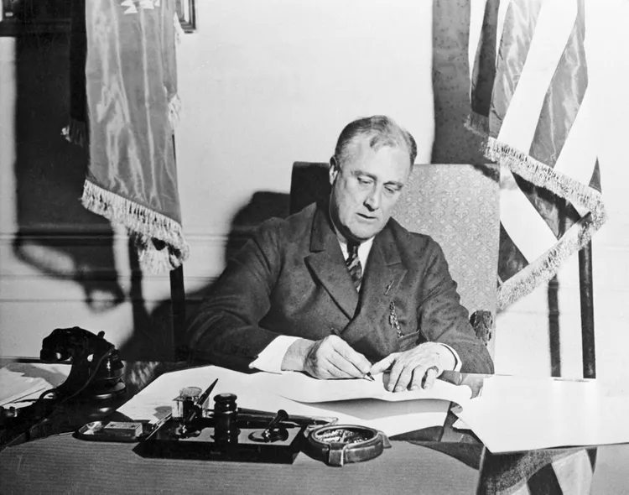
The New Deal is an economic policy launched by Franklin D. Roosevelt to end the Great Depression.
FDR proposed the New Deal to reverse the downward economic spiral. The goals were relief, recovery, and reform for those who were hardest hit.
https://www.thebalancemoney.com/fdr-and-the-new-deal-programs-timeline-did-it-work-3305598

Slide 23
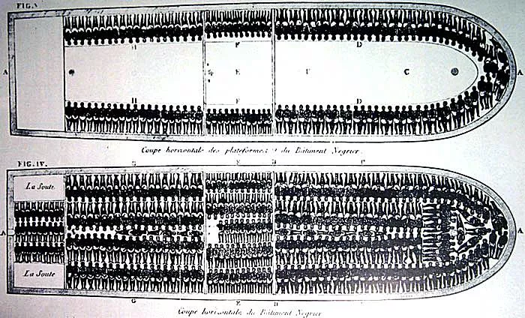
This drawing of the slave ship Brookes shows the plan for packing 482 captive people onto the decks. This detailed cross-sectional drawing was distributed by the Abolitionist Society in England as part of their campaign against the slave trade, and dates from 1789.
https://www.thoughtco.com/images-african-slavery-and-slave-trade-4122913

Slide 24
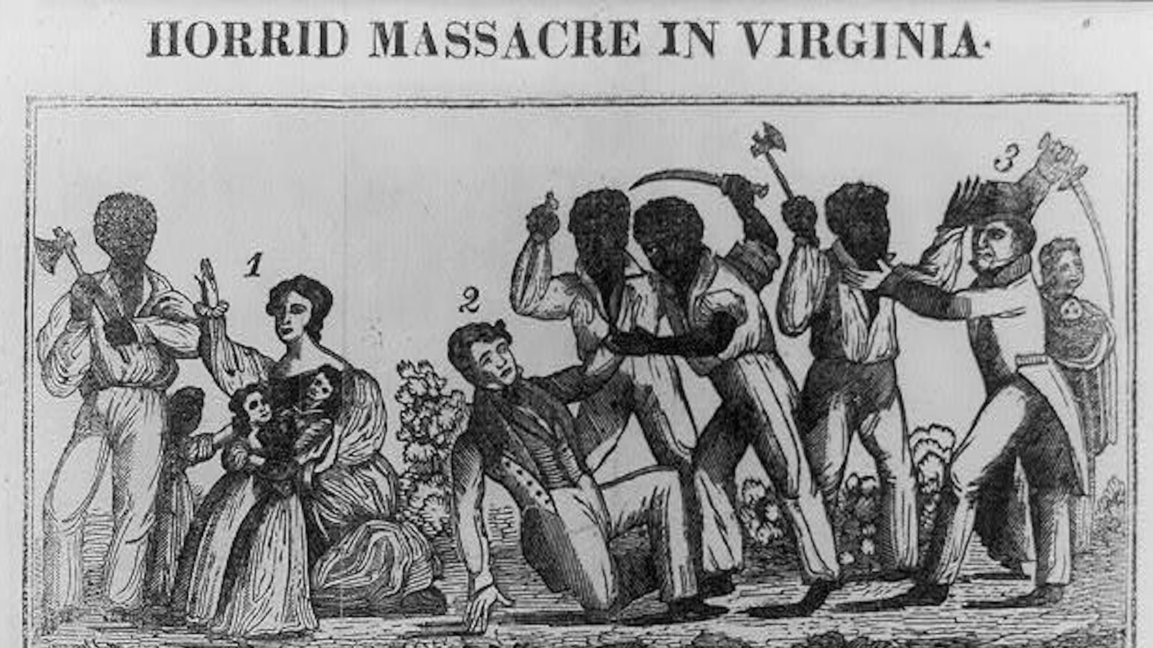
On August 21, 1831, Nat Turner began what would turn out to be the deadliest slave rebellion in American history. Over the course of 48 hours, Turner and a group of rebel slaves killed more than 50 whites in Southhampton, Virginia.
https://www.theatlantic.com/national/archive/2013/08/on-this-day-in-1831-a-bloody-uprising-in-the-virginia-countryside/278905/

Slide 25
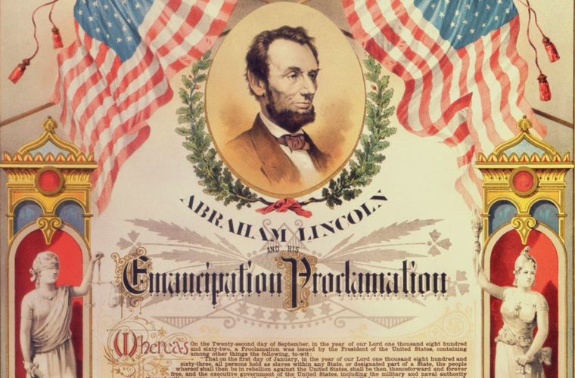
On September 22, soon after the Union victory at Antietam, Abraham Lincoln issued a preliminary Emancipation Proclamation, declaring that as of January 1, 1863, all slaves in the rebellious states “shall be then, thenceforward, and forever free.”
https://samepassage.org/emancipation-proclamation/

Slide 26
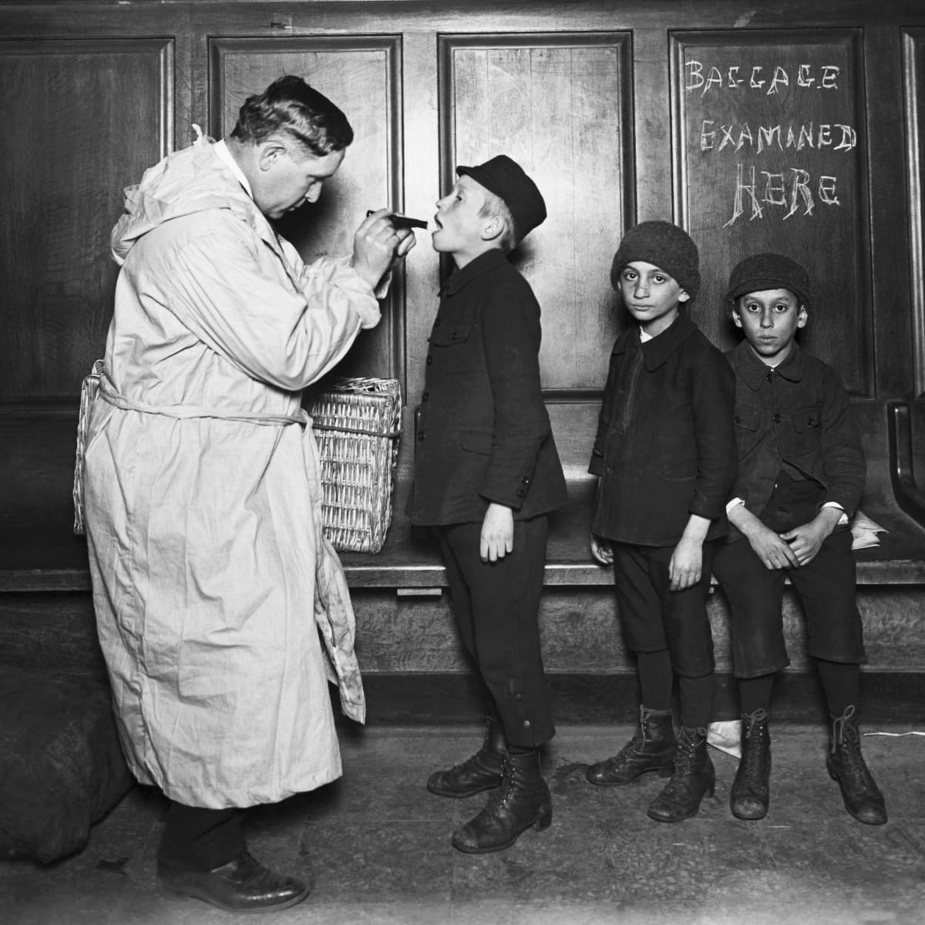
After opening in 1892, Ellis Island became known as the gateway to America and a symbol of a chance at the American dream. In the 62 years it was open, the island facility processed more than 12 million immigrants. It has been estimated that close to 40 percent of current U.S. citizens can trace at least one ancestor to Ellis island.
https://www.history.com/news/immigration-ellis-island-photos

Slide 27
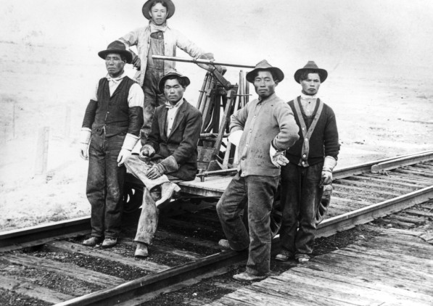
The Chinese workers on the Central Pacific Railway were paid less than the others. They had to sleep outside in tents, while other workers usually slept in rail cars. In a competition with workers building the eastern line, the Chinese outpaced them, laying 16 km of track in one day.
https://www.workers.org/2021/03/55287/

Slide 28
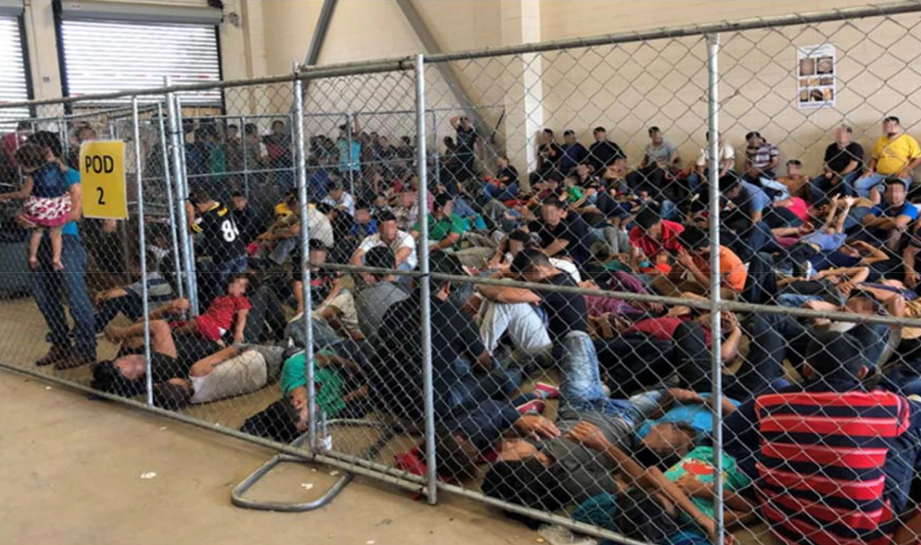
Overcrowding of families observed by the Department of Homeland Security Office of Inspector General on June 10, 2019. The exposure of cramped and filthy facilities where migrants are being held have sparked either outrage at President Donald Trump or accusations that the bad conditions all started with former President Barack Obama.
https://www.nbcnews.com/news/latino/bad-sheer-inhumanity-detention-conditions-migrants-worse-under-trump-advocates-n1025961

Slide 29
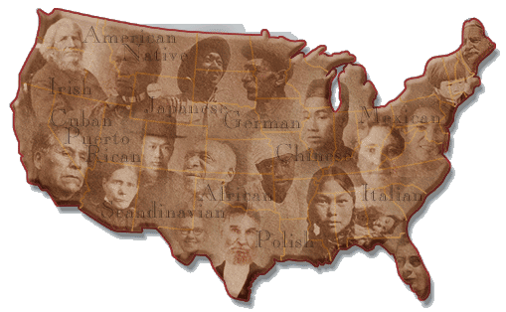
AMERICA, A NATION OF IMMIGRANTS
Immigration

Slide 30
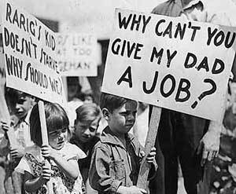
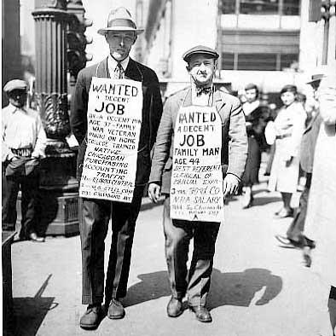
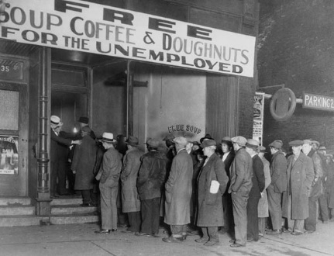
THE GREAT DEPRESSION
The Great Depression

Slide 31
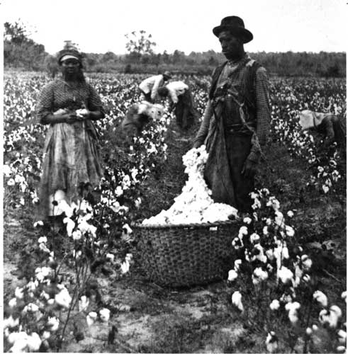
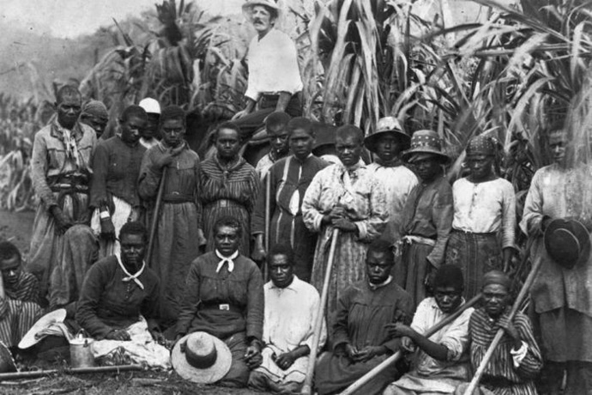
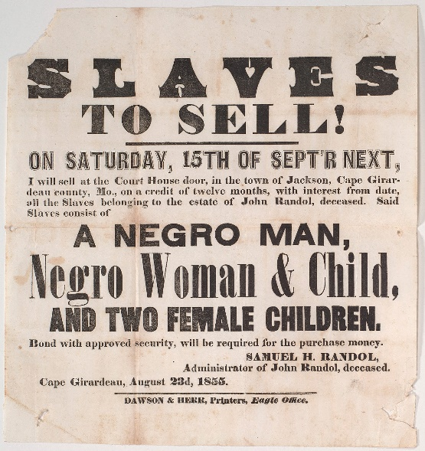
SLAVERY
12 years a slave

Slide 32
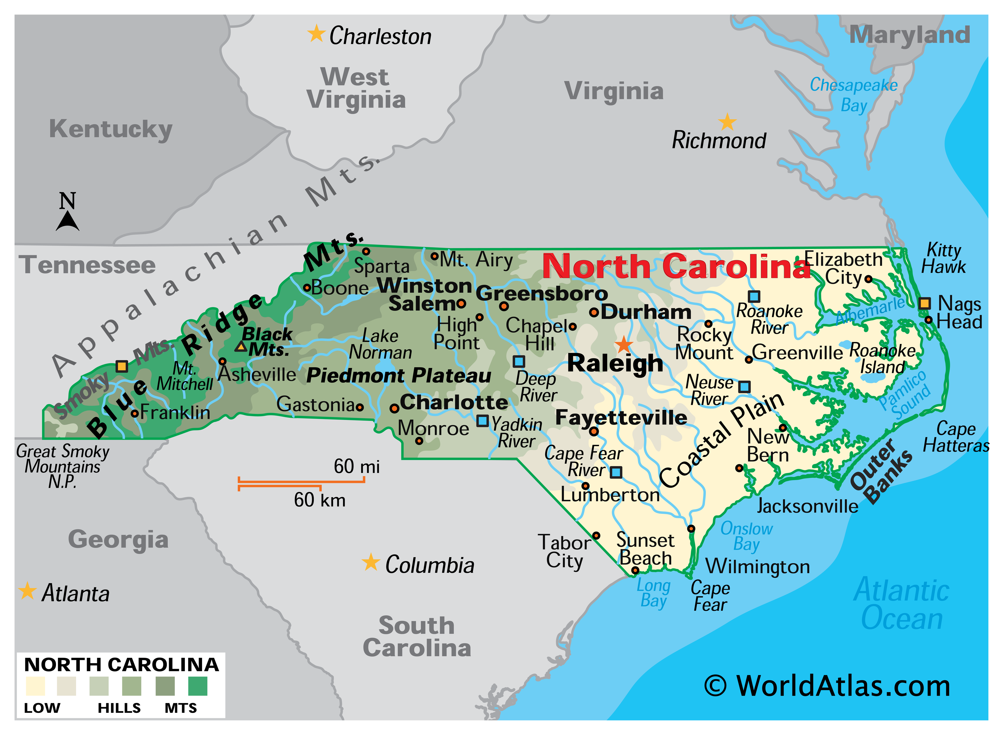
NORTH CAROLINA
NORTH CAROLINA PRESENTATION

Slide 33

What did you learn today?
Or…
https://tinyurl.com/2s3u7ta9

