Slide 1
AUSTRALIA

Slide 2
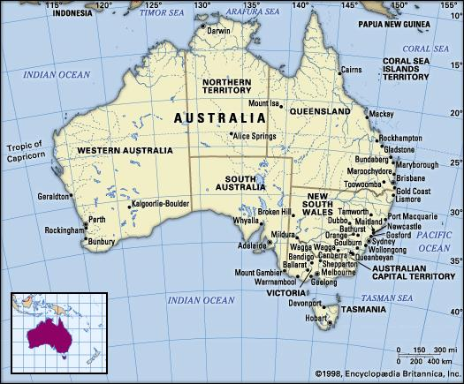

Slide 3
GENERAL INFORMATION
AREA: 7,686,850 sq m
POPULATION TOTAL: 25.69 million (2021)
URBAN POPULATION: 89 %
FORM OF GOVERNMENT: federal parliamentary democracy
ADMINISTRATIVE DIVISION: six states and two territories

Slide 4
GENERAL INFORMATION
CAPITAL CITY: Canberra
LONGEST RIVER: Murray-Darling, 3,490 km
HIGHEST MOUNTAIN: Mount Kosciuszko, 2,229 m
LARGEST LAKE: Lake Mackay, 3,494 sq km
CLIMATE: generally arid to semi arid; temperate in south and east; tropical in north

Slide 5
GENERAL INFORMATION
OFFICIAL LANGUAGE: English
CURRENCY: Australian Dollar (AUD)
HDI (HUMAN DEVELOPMENT INDEX) IN 2023: 0,951
  HDI is a composite statistic of life expectancy, education, and per capita income indicators, which are used to rank countries into four tiers of human development.

Slide 6
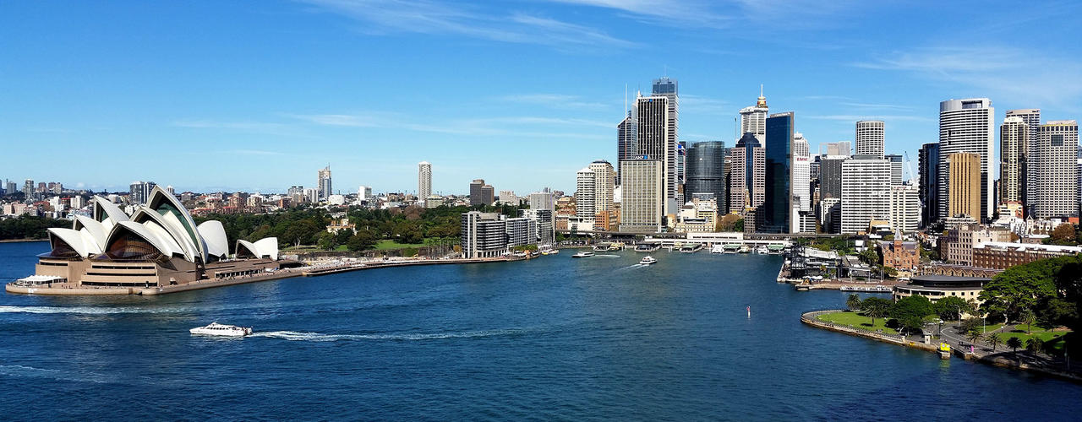
101 Facts About Australia - YouTube

Slide 7
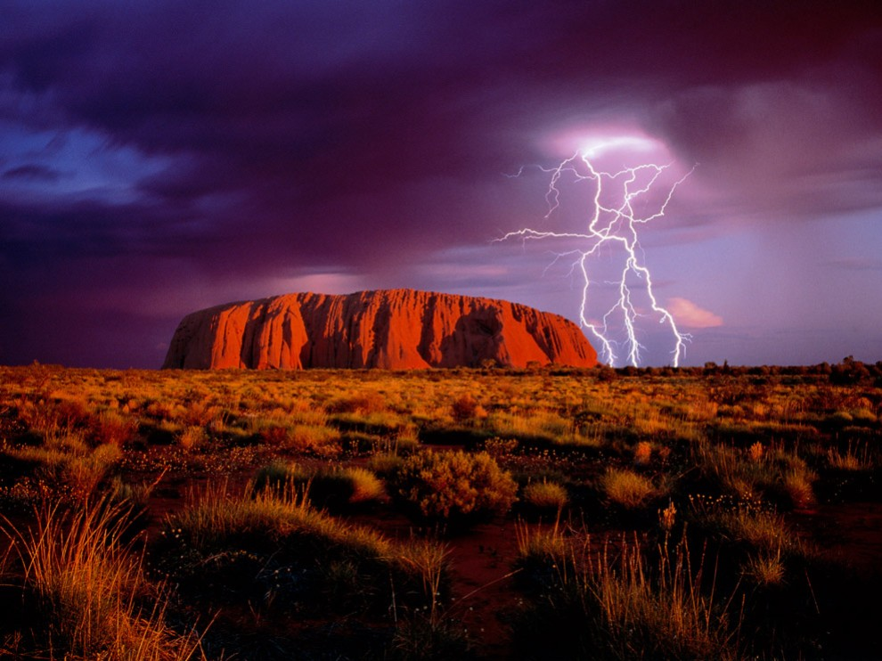
10 Best Places to Visit in Australia - Travel Video - YouTube
10 Weird Things That Are Common in Australia

Slide 8
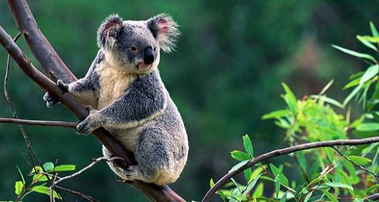
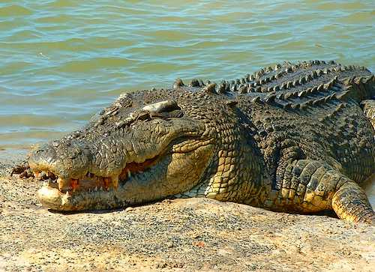
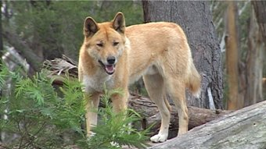
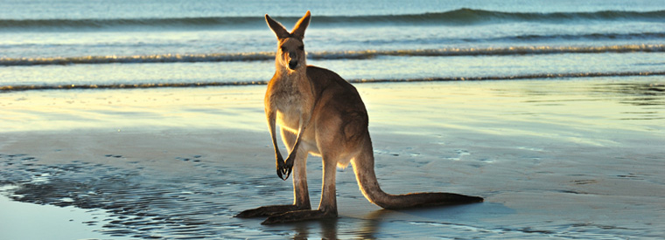
10 Most Dangerous Animals In Australia

Slide 9
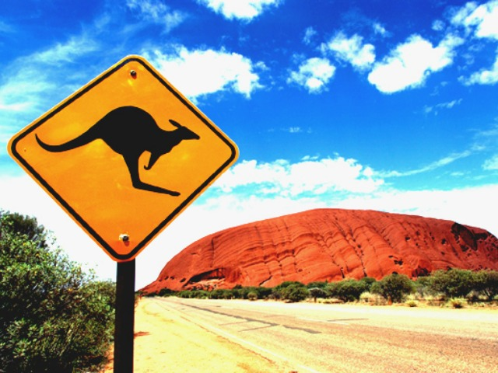

Slide 10
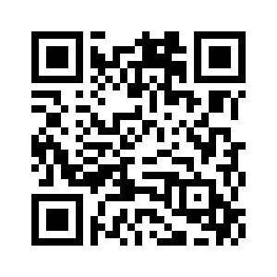
What did you learn today?

