Slide 1
Angleški jezik I – strategije za učenje tujega jezika
MATEJA DAGARIN FOJKAR in TINA ROZMANIČ

Slide 2


We would like you
to have fun
and
learn as much as possible

Slide 3
Teachers
Lectures: Mateja Dagarin Fojkar (30 lessons)
Practical classes: Tina Rozmanič (30 lessons)
Lectures: Wednesdays from 14.40 to 16.10
Practical classes: Wednesday from 13.00 to 14.30

Slide 4
What?
Songs and games
Internet Use
Vocabulary
Stories
Reading interesting topics
Speaking in groups
Writing

Slide 5

E-classroom
Angleški jezik I: strategije za učenje tujega jezika
Password: iloveenglish

Slide 6
Course goals
To communicate actively in English
To learn new phrases and collocations
To practice study skills
To talk about language learning strategies and how you learn languages
To learn how to teach English in pre-school education

Slide 7
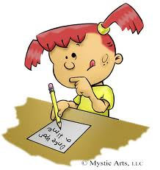


Language skills – practical classes
Listening
Reading
Writing
Speaking
Vocabulary
Grammar

Slide 8
Language strategies and teaching skills – lectures
TEACHING SKILLS
Storytelling
Using posters
Using flashcards
Games
Songs, rhymes
Art and craft in ELL
MI
Puppets in ELL
LANGUAGE STRATEGIES
LL experiences
Ways of LL
Learning styles
How children learn languages

Slide 9
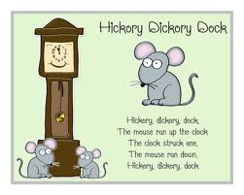
Nursery Rhymes
Hickory Dickory Dock,
The mouse ran up the clock.
The clock struck one,
The mouse ran down!
Hickory Dickory Dock.

Slide 10

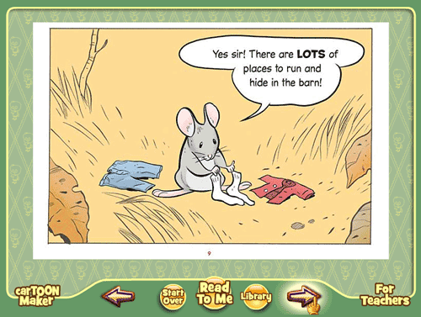
Picture books

Slide 11
Guess the stories
''When the Princess is fifteen years old, she shall prick her finger on a spindle and fall down dead.'‘
''I too shall die and float as foam upon the sea, not hear the music of the waves or see the lovely flowers, and the red sun. Isn't there anything at all I can do to win an immortal soul?'‘
''Those are pretty children the mother has. They are all pretty except that one; he didn't turn out right. I do wish she could make him over again.'‘
''Nibble, nibble, gnaw, who is nibbling at my little house?'‘
''…., …., Let down your hair.'‘
''Oh, just miserably! I've hardly closed my eyes all night! Heaven knows what was in my bed! I've been lying on something so hard that I'm black and blue all over! It's simply dreadful!''

Slide 12
EXAMINATION
1. Written examination (50%)
Reading, listening, vocabulary and grammar tasks
(connected to the work done at practical classes), writing tasks – (connected to the lectures)
2. An oral presentation (30%)
Be a kindergarten English teacher (in groups)
(during the lectures)
3. Project work file (20%)
In groups choose a topic and collect vocabulary, pictures, activities, songs, games, movement activities, stories and webpages on the topic and put the file in the e-classroom – deadline: 10. 1. 2023

Slide 13
An oral presentation (30%)
In groups of 3 choose a topic and present it to us as if we were children (through a children’s book, games, a nursery rhyme or a song etc.). Erasmus students can teach us their language.
The presentation should be app. 25 minutes long and should first include a 5 minute presentation of the project work.
You will be assessed according to the assessment scale which you find in the e-classroom under Course requirements.
After the presentation you need to upload a self-reflection sheet (each person in the group their own one).

Slide 14
Project work file (20 %)
Should contain:
A selection of vocabulary, pictures, activities, songs, games, movement activities, stories and webpages on the topic (group work)
Self-reflection sheet (individual)

Slide 15

To have another language is to possess a second soul.
Charles the Great

