Slide 1
METHODS AND APPROACHES IN
TEACHING ENGLISH TO YOUNG LEARNERS
Mateja Dagarin Fojkar

Slide 2
Total Physical Response
TPR:
GAMES
STORIES
SONGS/CHANTS
Notes:
A methods based on intensive listening and showing meaning with gestures.
It’s most common in teacher giving commands and students performing them.
CHILDREN LEARN MOST BY DOING THINGS and with TPR you take into account their silent period as well.

Slide 3
TPR in classroom
https://www.youtube.com/watch?v=1Mk6RRf4kKs
While watching write down the TPR steps.

Slide 4
TPR GAMES
Simon says, flashcard games, commands, miming games, clap and stamp
Everybody listen
And look at me
Touch something red
When I count to three
One – two – three!
Notes:
Flashcard games: flashcards around classroom: fly to the butterfly, jump to the frog,hop to the rabbit, crawl to the spider….
Which topics can be most explored?
Body parts
Colours
Numbers
Classroom objects
Commands:
Stand up, sit down
Lift/raise Point to
Touch Take
Jump Turn around
Clap Open / close
Draw Put Write…

Slide 5
TPR activity
Think of 10 TPR commands you can give to pupils to practise classroom language (you can play it as Simon says).

Slide 6
TPR
Most common topics:
Body parts
Colours
Numbers
Classroom objects
Notes:
A methods based on intensive listening and showing meaning with gestures. E.g. Toby the tiger in Join In has lots of TPR commands.
1st brainstorming topics together
2nd: pair work – for each topic brainstorm a few commands
Stand up, sit down
Lift/raise
Point to
Touch
Take
Jump
Turn around
Clap
Open / close
Draw
Write…

Slide 7
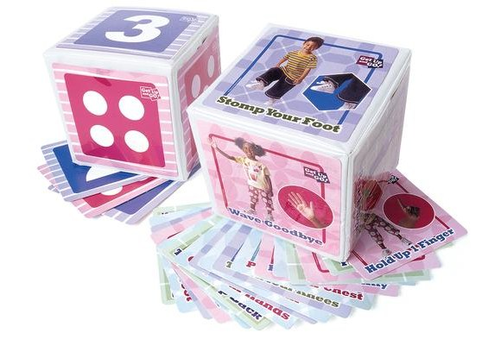
TPR
ENORMOUS DICE ACTIVITIES

Slide 8
My name is Berry Mary
Children sit in a circle. One of the children goes out. The other children decide who will be Berry Mary. The child, who was out, comes back and asks each child: What’s your name? They answer. When the child answers My name is Berry Mary, both of them need to run around the circle and take the same place.

Slide 9
HUMAN VENN DIAGRAM
SUMMER CLOTHES
BOTH
WINTER CLOTHES

Slide 10
TPR CHANT
You’re a tree, grow tall.
You’re a very bouncy ball.
You’re a lady, in the rain.
You’re a bird, you’re a plane.
You’re a lion, you’re a frog.
You’re a monkey, you’re a log.
(Woods & Bowler, Jet)

Slide 11
TPR chants – Let‘s move
Stand up and stretch!
Stand up and jump!
Hop, jump, hop, jump!
Stop!
Up, down, up, down
Turn around!
(Puchta & Elliot, 2017)

Slide 12
I can jump
I can jump,
I can hop,
I can clap,
And I can stop.
I can jump,
I can hop,
I can run,
And I can stop.
I can jump,
I can hop,
I can dance,
And I can stop.
I can jump,
I can hop,
I can sit,
And I can stop. (Puchta & Elliot, 2017)

Slide 13
Chants created by teachers
Walk with me, walk with me, walk with me. Run with me, run with me, run with me. Jump with me, jump with me, jump with me. Swim with me, swim with me, swim with me.
Oh, wait! Oh, no! There’s a shark!
We must go!
(repeat backwards: swim with me…, jump with me…, run with me…, walk with me)
Yupee! Saved at last!

Slide 14
The Listen chant
Hands on heads,
Hands on knees,
Cross your arms,
And listen, please.
One, two, three,
Hands up!
And look at me! (Puchta & Elliot, 2017)

Slide 15
The classroom chant
Point to the window,
Point to the door,
Point to the board,
Point to the floor.
Point to a table,
Point to a pen
Point to a chair,
And start again! (And that‘s the end!)
(Puchta & Elliot, 2017)

Slide 16
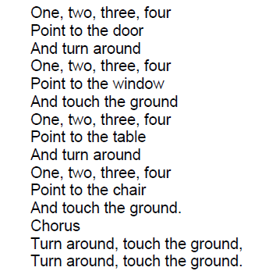
TPR chants

Slide 17
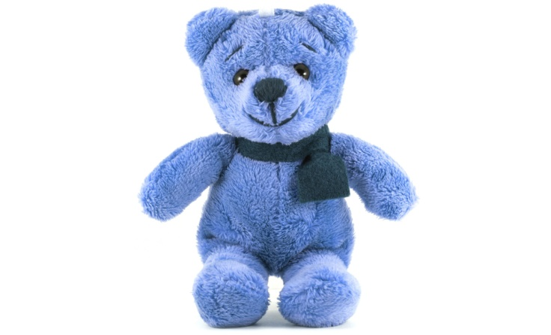
Teddy bear
Teddy bear, teddy bear, turn around.
Teddy bear, teddy bear, touch the ground.
Teddy bear, teddy bear, tie your shoe.
Teddy bear, teddy bear, that will do.
Teddy bear, teddy bear, go upstairs.
Teddy bear, teddy bear, say your prayers.
Teddy bear, teddy bear, turn off the light.
Teddy bear, teddy bear, say goodnight!

Slide 18
TPR SONGS
Head, shoulders, knees and toes
Itsy bitsy spider
Wheels on the Bus
If you’re happy and you know it (simple version: https://www.youtube.com/watch?v=l4WNrvVjiTw )
Hickory dickory dock
Hockey Pockey
Here we go round the mulberry bush
Five little monkeys …

Slide 20
The wheels on the bus
The wheels on the bus go round and round,
Round and round,
Round and round.
The wheels on the bus go round and round,
All through the town.
The wipers on the bus go swish, swish, swish,
Swish, swish, swish.
Swish, swish, swish.
The wipers on the bus go swish, swish, swish,
All through the town.
The driver on the bus goes "Move on back!",
"Move on back!",
"Move on back!".
The driver on the bus goes "Move on back!",
All through the town.
The people on the bus go up and down,
Up and down,
Up and down.
The people on the bus go up and down,
All through the town.
The horn on the bus goes beep, beep, beep,
Beep, beep, beep.
Beep, beep, beep.
The horn on the bus goes beep, beep, beep,
All through the town.
The baby on the bus goes "Wah, wah, wah",
"Wah, wah, wah",
"Wah, wah, wah".
The baby on the bus goes "Wah, wah, wah".
All through the town.
The parents on the bus go "Shh, shh, shh",
"Shh, shh, shh",
"Shh, shh, shh".
The parents on the bus go "Shh, shh, shh".
All through the town.
http://learnenglishkids.britishcouncil.org/en/songs/the-wheels-the-bus

Slide 21
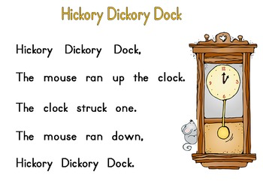
two – woo,
three – wee,
four – no more

Slide 22


Slide 23
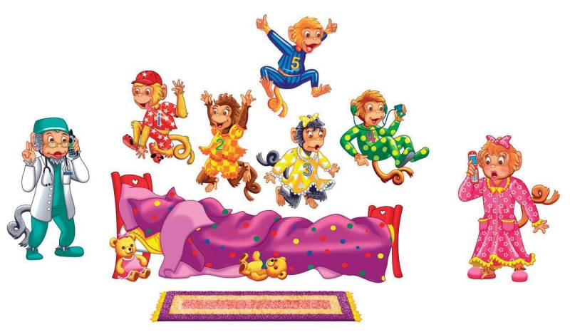
Five little monkeys
Five little monkeys jumping on the bed
One fell off and bumped his head
Mama called the doctor,
And the doctor said
No more monkeys jumping on the bed
http://supersimplelearning.com/songs/original-series/one/five-little-monkeys/

Slide 24
Elephants have wrinkles
Elephants have wrinkles, wrinkles, wrinkles.
Elephants have wrinkles. Wrinkles everywhere!
On their toes. On their toes.
No one knows, No one knows
Why -y- y- y.
Repeat with knees, hips, ears, trunks, teeth.
https://www.youtube.com/watch?v=cRvMB9zJvsg

Slide 25
https://www.youtube.com/watch?v=GoSq-yZcJ-4

Slide 26
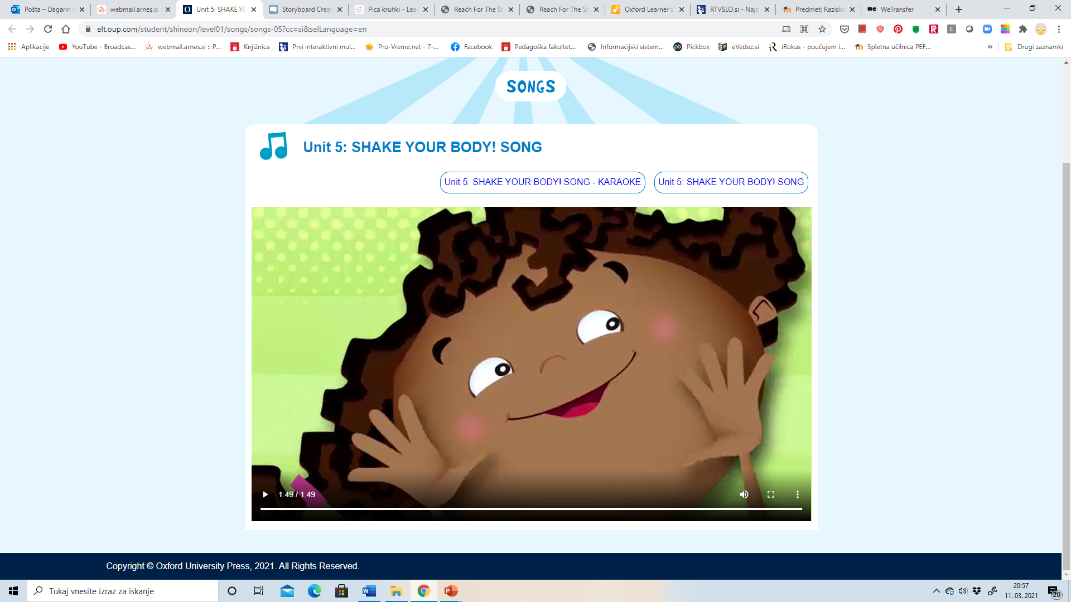
Shake your body song
https://elt.oup.com/student/shineon/level01/songs/songs-05?cc=si&selLanguage=en

Slide 27
TPRS
Developed by a Spanish teacher, Blaine Ray in 1990
3 steps to TPRS:
Show meaning of new words with gestures, pictures
Practise new vocabulary
Tell the story with gestures
https://www.youtube.com/watch?v=bkMQXFOqyQA

Slide 28
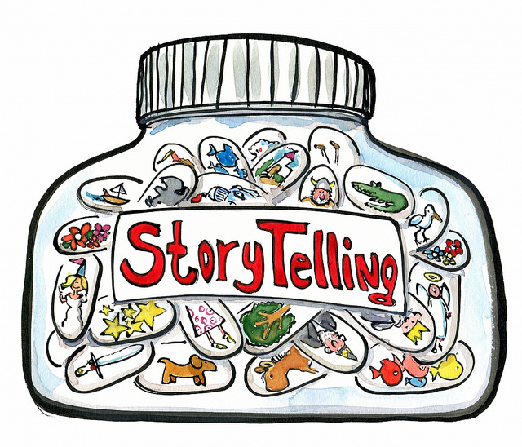
TPR STORYTELLING
In pairs/groups choose a well known story or create a new one and tell it with the gestures
Put your story with into the e-classroom.

Slide 29
TPR STORY
THE ENORMOUS ELEPHANT
This is the story of Enormous Elephant, Magic Monkey, and Crazy Crocodile.
One day Enormous Elephant was bored, very bored. Then he had an idea.
'I know,’ he said, 'I'll go to New York.'
So he started to walk, and he walked, and he walked, and he walked. On the way he met Magic Monkey.
'Hello, Magic Monkey,’ he said.
'Hello,’ said Magic Monkey.
'What's the matter?’ said Enormous Elephant.
'I'm bored,’ said Magic Monkey, ‘very, very bored’.
'I've got an idea,’ said Enormous Elephant, 'why don't you come to New York with me?'
'OK,' said Magic Monkey.
So they started to walk, and they walked, and they walked, and they walked, and they walked.
On the way they met Crazy Crocodile.
'Hello, Crazy Crocodile,’ they said.
'Hello,’ said Crazy Crocodile.
'What's the matter?’ said Enormous Elephant.
'I'm bored,’ said Crazy Crocodile, ‘very, very bored’.
'I've got an idea,’ said Enormous Elephant, 'why don't you come to New York with us?'
'OK,’ said Crazy Crocodile.
So they started to walk, and they walked, and they walked, and they walked, and they walked.
And they walked, and they walked, and they walked.
And they walked, and they walked, and they walked.
‘Oh, I’m tired,’ said Enormous Elephant.
‘Oh, I’m tired,’ said Magic Monkey.
‘Oh, I’m tired,’ said Crazy Crocodile.
So they all went to sleep.
(Phillips, S. 2000. Drama with Children. Oxford: OUP.)

